Slide 1



What’s on a Food Label?
Image source: USDA/SNAP-Ed
Notes:
Food labels help consumers make purchasing decisions at the grocery store and provide information about what is inside the container. An attractive label initially helps sell the product to the consumer and gives the consumer information about the product identity, quality, nutrition, and relevant health and safety information.

Slide 2
Julie Albrecht, PhD, RD
Carol Schwarz, MS, RD
Alice Henneman, MS, RDN
University of Nebraska–Lincoln Extension
food.unl.edu
For more information, email
carol.schwarz@unl.edu
Updated October 6, 2020

Slide 3

Confused about food labels?
Here’s what you need to know …
Image source: Pixabay.com
Notes:
Read the slide.

Slide 4
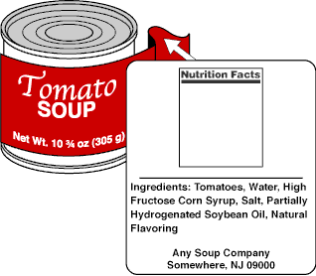
Required Information on All Food Labels
A statement of identity
A net weight or contents statement
An ingredient statement
A statement that gives the name and place of business of the product’s manufacturer, packer, or distributor
The Nutrition Facts label
A
E
b
C
D
Image source: FDA
Notes:
Five pieces of information are required on all food labels:
a statement of identity
a net weight or contents statement
an ingredient statement
a statement that gives the name and place of business of the product’s manufacturer, packer, or distributor.
the Nutrition Facts label
https://www.fda.gov/downloads/Food/GuidanceRegulation/GuidanceDocumentsRegulatoryInformation/UCM265446.pdf

Slide 5
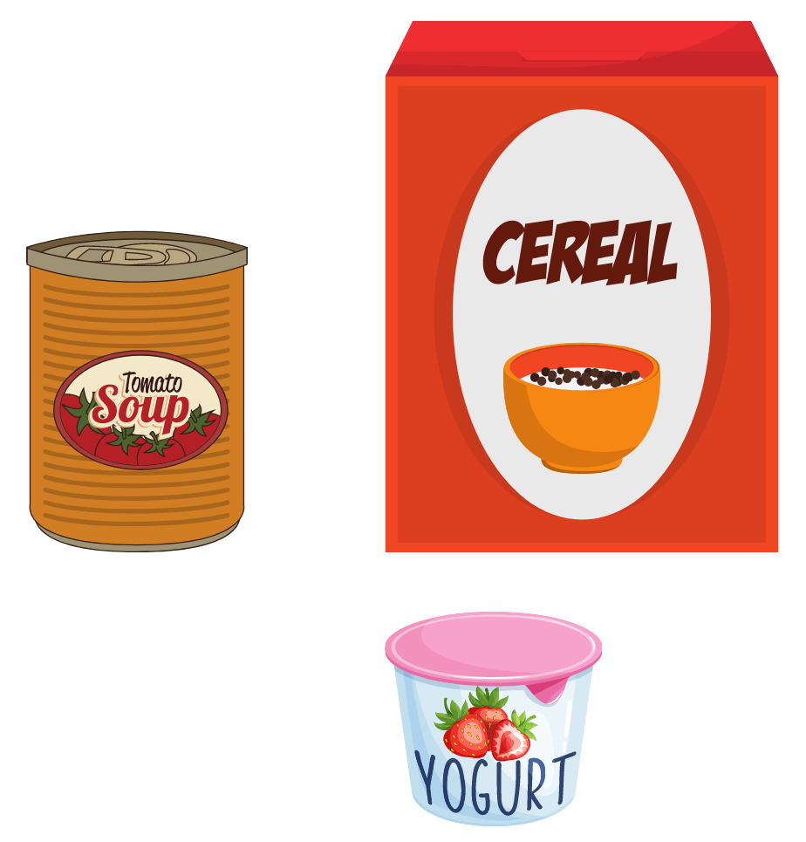
Statement of Identity
Describes the product
Common name of the food
Notes:
The statement of identity describes the product and preferably the common name of the food. A unique or fanciful name may be used if no common name exists as long as the name describes the product for the consumer to understand what the product is.

Slide 6
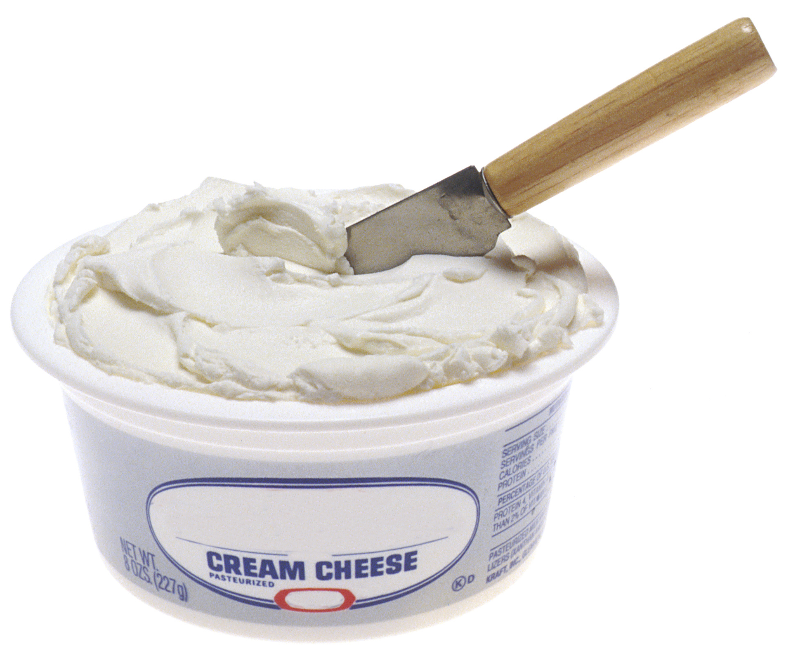
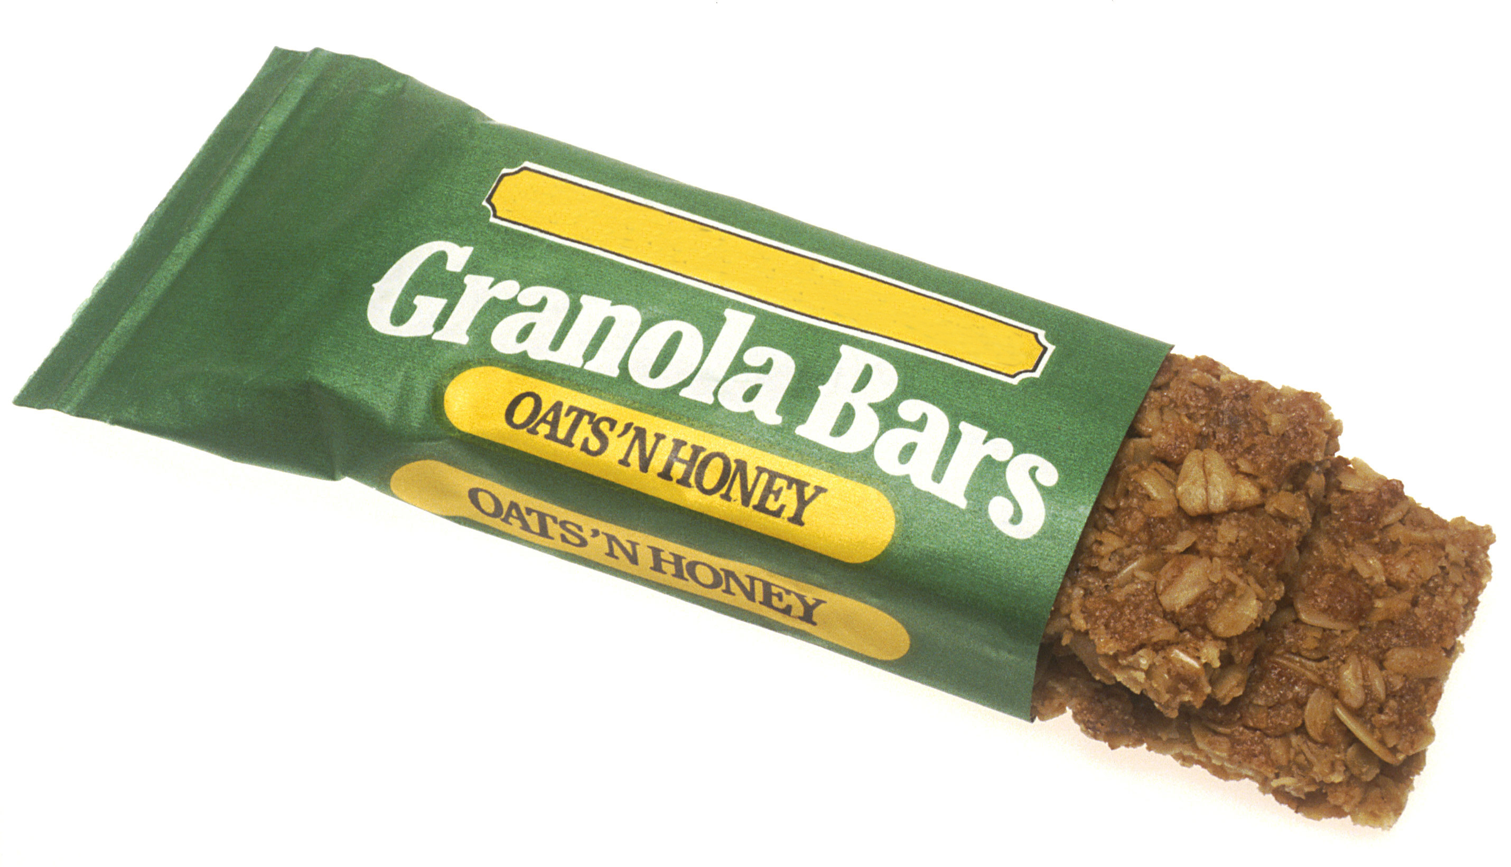
What is the statement of identity for these products?
Image source: National Cancer Institute / Renee Comet (Photographer)
Notes:
Read the slide.

Slide 7
What is the statement of identity for these products?
cream cheese
granola bars
Image source: National Cancer Institute / Renee Comet (Photographer)
Notes:
Read the slide.

Slide 8
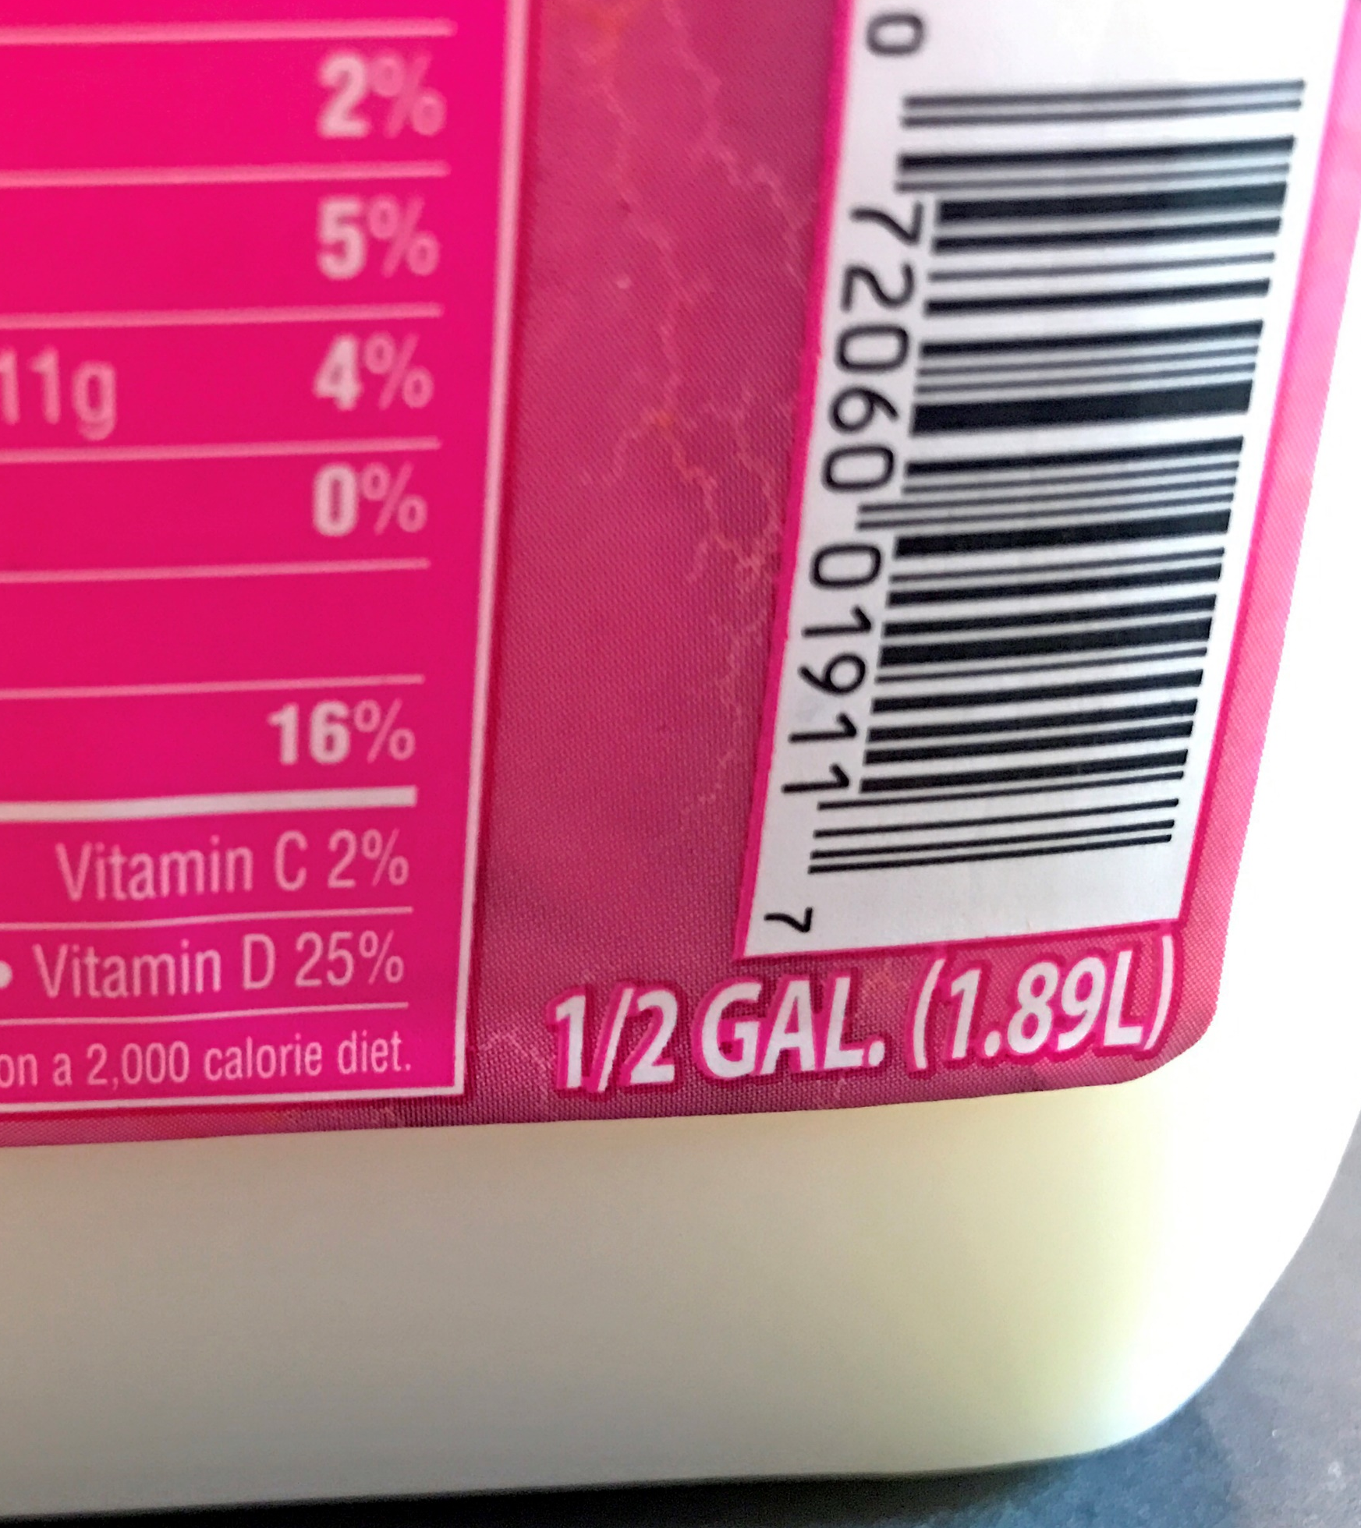
Net Weight or Contents Statement
The edible product is listed:
By weight, volume or numerical count
In English and metric units
Image source: Photo by Alice Henneman
Notes:
The edible product in the container is listed by weight, volume, or numerical count depending on the product. The weight and volume must be listed in both English and metric units.
The weight or contents statement must be located on the lower 30% of the container.

Slide 9
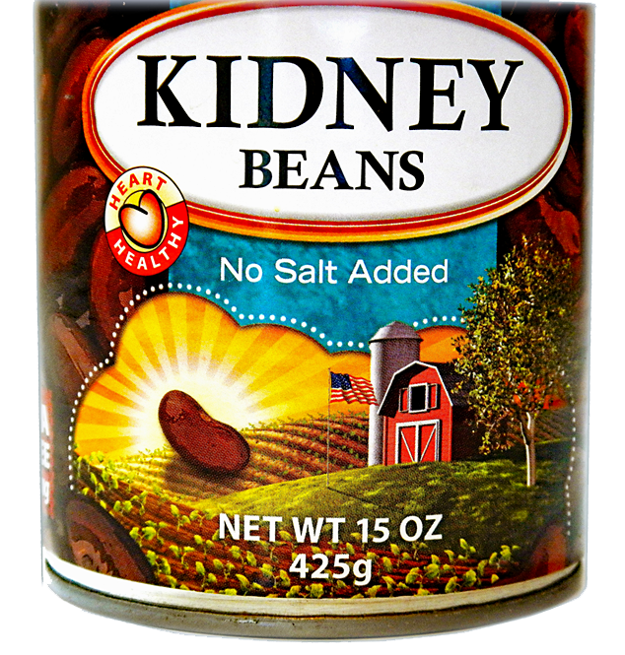
Find the Net Weight
Image source: Photo by Alice Henneman
Notes:
Read the slide.

Slide 10
Find the Net Weight
Image source: Photo by Alice Henneman
Notes:
The net weight is 15 ounces or 425 grams.

Slide 11
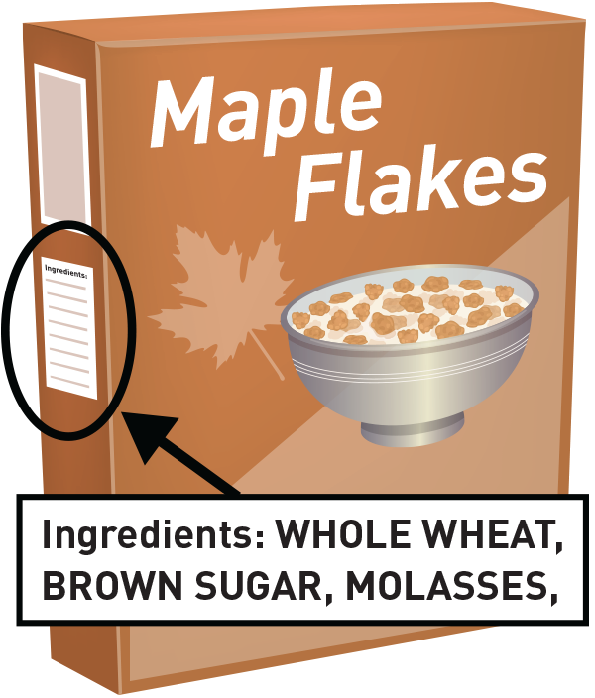
Ingredient Statement
Ingredients are listed:
Below the Nutrition Facts panel
By common name in descending order by weight
Image source: FDA
Notes:
The list of ingredients in the product is listed below the Nutrition Facts panel. The ingredients are listed by their common or usual name in descending order by weight. For example: If “whole wheat” is listed first, that ingredient is found in the largest amount in weight in the product. The ingredient listed last contributes the least amount by weight.
Food manufacturers may include the name of a food allergen in parenthesis following the common or usual name of the food source if the name isn’t listed elsewhere. For example, if the term “enriched flour” occurs in the list of ingredients, it might be followed in parenthesis by the word “wheat,” which can be a food allergen, plus other substances found in the flour, such as various B vitamins and iron.

Slide 12
Which of these ingredient statements lists sugar as its largest ingredient by weight?
Ingredients: wheat flour, whole oat flour, corn syrup, sugar, soybean and palm oil …
Ingredients: sugar, whole grain corn flour, wheat flour, whole oat flour, oat fiber, soluble corn fiber, vegetable oil …
Ingredients: water, vegetable oils, sugar, vinegar, modified starch, wheat starch, salt …
Notes:
Read the slide.

Slide 13
Which of these ingredient statements lists sugar as its largest ingredient by weight?
Ingredients: wheat flour, whole oat flour, corn syrup, sugar, soybean and palm oil …
Ingredients: sugar, whole grain corn flour, wheat flour, whole oat flour, oat fiber, soluble corn fiber, vegetable oil …
Ingredients: water, vegetable oils, sugar, vinegar, modified starch, wheat starch, salt …
Notes:
The second ingredient statement lists sugar as its largest ingredient by weight.

Slide 14
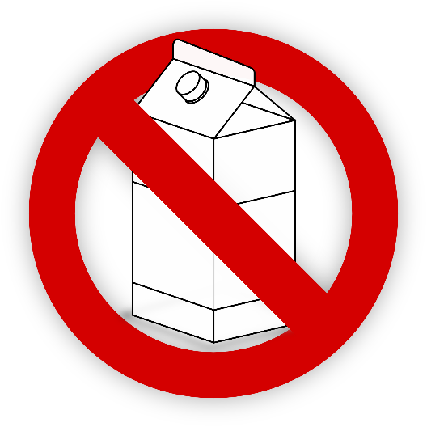



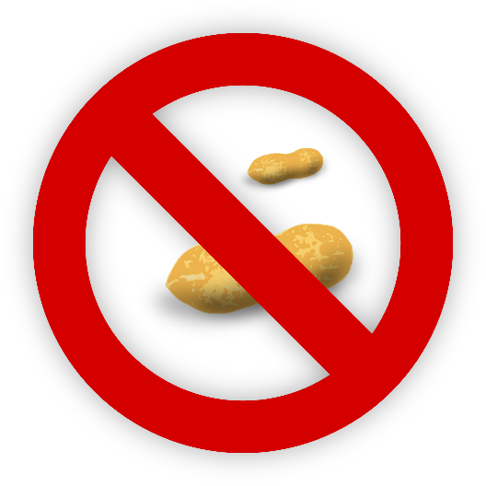



Ingredient Statement
& Allergen Labeling
Eight allergens must
be identified:
Eggs
Milk
Wheat
Soy
Peanuts
Type of Tree nuts
Type of Fish
Type of Shellfish
Image source: Pixabay.com
Notes:
Allergen labeling is required if a food product contains one of the eight allergens: eggs, milk, wheat, soy, peanuts, tree nuts, fish, and crustacean shellfish.
The type of tree nut, the type of fish, and the type of shellfish must be listed.
While more than 160 foods have been identified as the cause of food allergies in sensitive individuals, these eight major food allergens account for over 90 percent of all documented food allergies. They also represent the foods most likely to cause severe or life-threatening reactions.

Slide 15
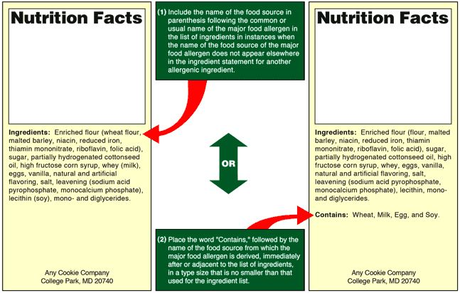
Two Ways of Labeling Allergens
1
1
2
2
Image source: FDA
Notes:
The allergens can be identified on the label in two ways:
In parentheses following the name of the ingredient. Example: Enriched flour (wheat flour …..)
Immediately after or adjacent to the list of ingredients in a “contains” statement. Example: “Contains: Wheat, Milk, Egg, and Soy”
https://www.fda.gov/food/resourcesforyou/consumers/ucm079311.htm

Slide 16
1
Within the ingredients list:
Ingredients: apples, pie crust [flour (wheat), shortening, liquid albumen (egg), salt], sugar, flour lemon juice, whole milk, cinnamon.
May contain pecans.
Find the Allergen
2
Using a contains statement:
Ingredients: apples, pie crust [flour, shortening, liquid albumen, salt], sugar, flour lemon juice, whole milk, cinnamon.
Contains: Wheat, Egg, Milk.
May contain pecans.
Source of example: Jennifer Miner, Canadian Food
Inspection Agency at FSIS Public Meeting on Allergens
Notes:
Show the slide.
Flip to the next slide to display the answers …

Slide 17
Within the ingredients list:
Ingredients: apples, pie crust [flour (wheat), shortening, liquid albumen (egg), salt], sugar, flour lemon juice, whole milk, cinnamon.
May contain pecans.
1
Find the Allergen
2
Using a contains statement:
Ingredients: apples, pie crust [flour, shortening, liquid albumen, salt], sugar, flour lemon juice, whole milk, cinnamon.
Contains: Wheat, Egg, Milk.
May contain pecans.
Source of example: Jennifer Miner, Canadian Food
Inspection Agency at FSIS Public Meeting on Allergens
Notes:
Both examples illustrate the presence of wheat, egg, and milk. They also alert the consumer that the product may contain pecans.

Slide 18
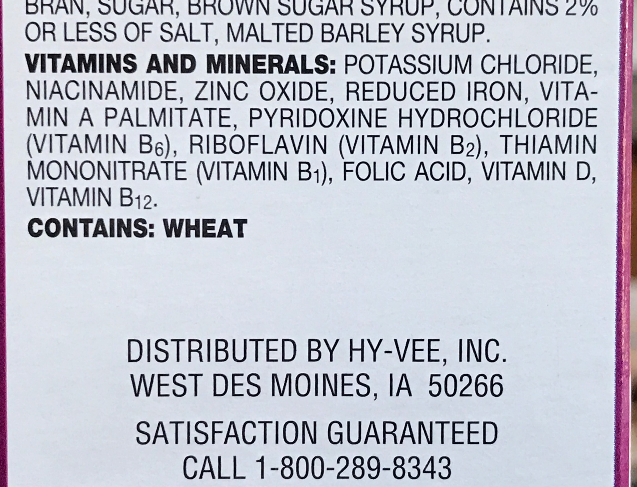
Statement
with Name and
Place of Business
The statement can be of the product’s:
Manufacturer
Packer or
Distributor
distributor:
HY-VEE
Image source: Photo by Alice Henneman
Notes:
This statement provides the food product’s manufacturer, packer, or distributor. It may consist of a business name, city, and zip code if the address can be found in a public directory under the business name. Otherwise the complete address must be given.

Slide 19
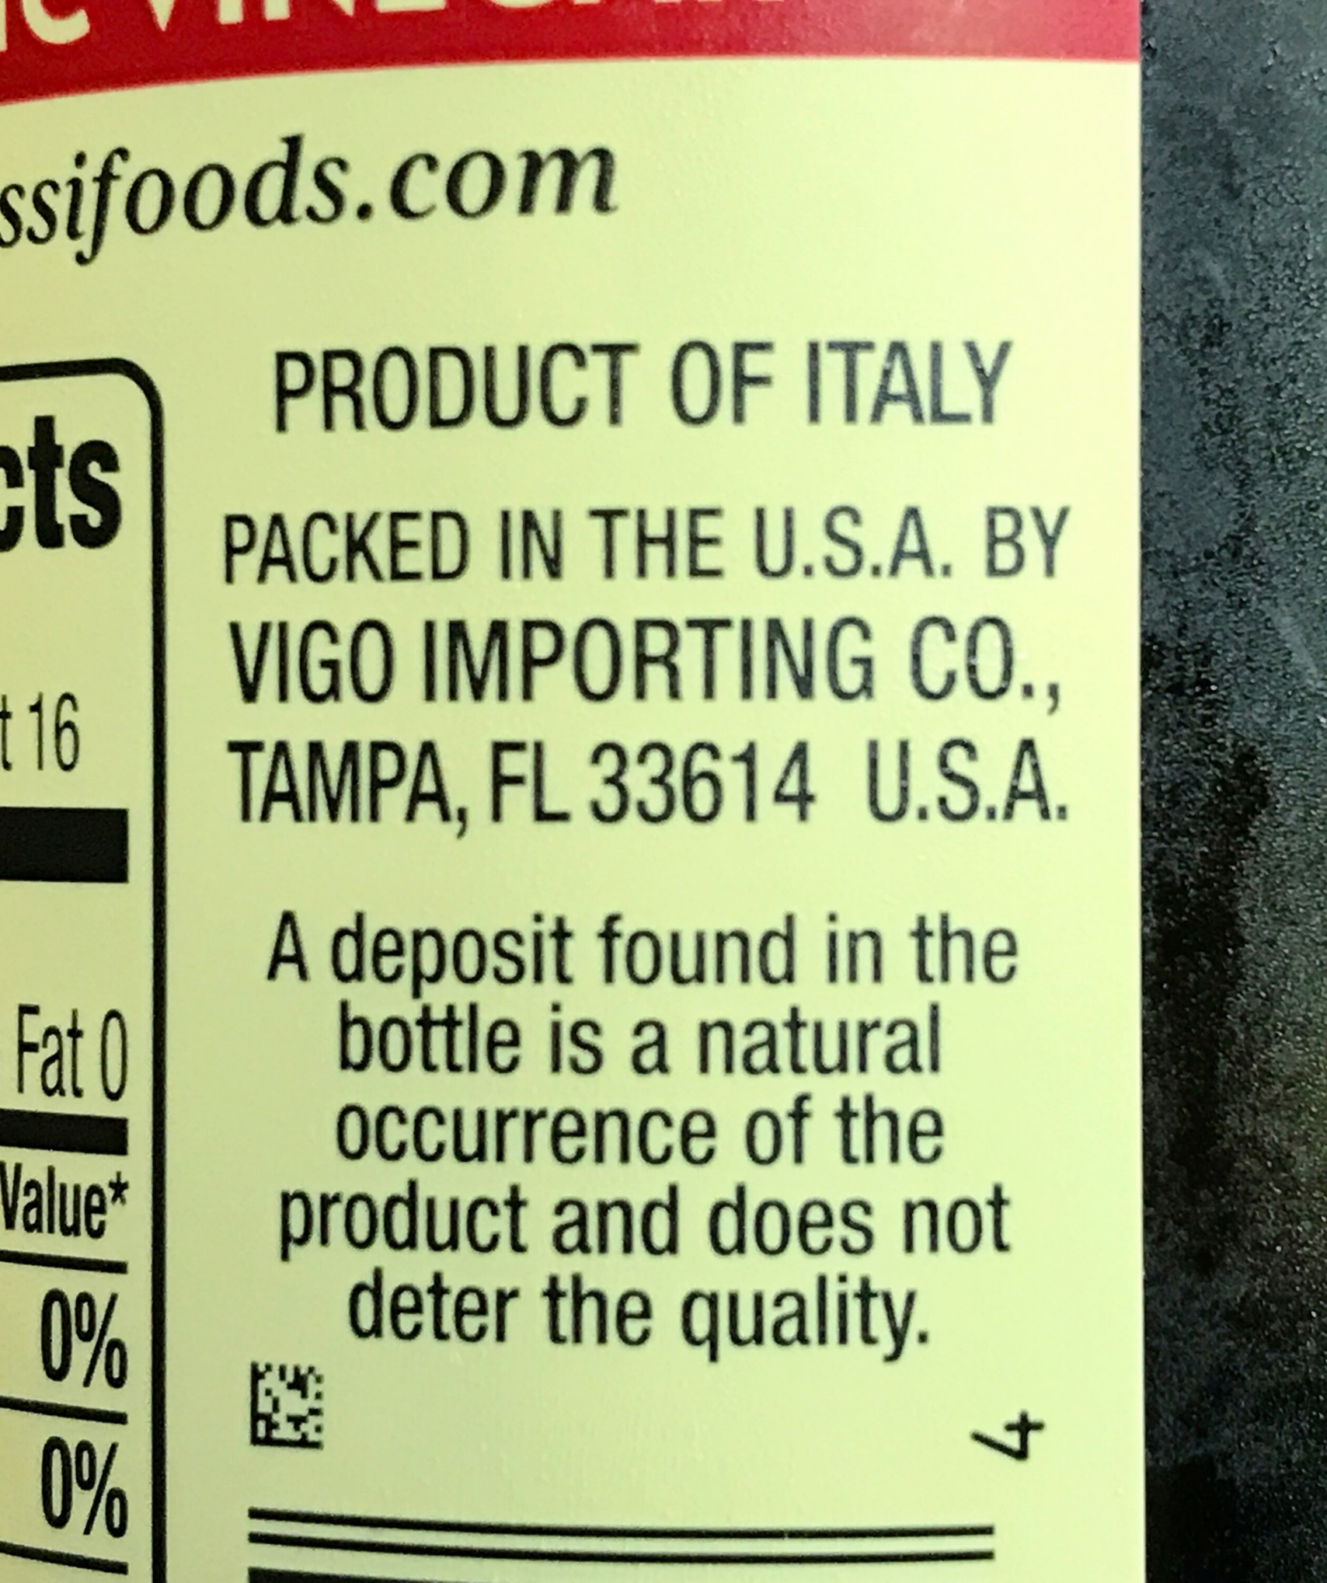
Country of Origin
Required by U.S. Customs and Border Protection for imported foods
Image source: Photo by Alice Henneman
Notes:
A statement of the country of origin on the labeling of imported foods is not required by the Federal Food, Drug, & Cosmetic Act; however, this is a requirement of the U.S. Customs and Border Protection.

Slide 20
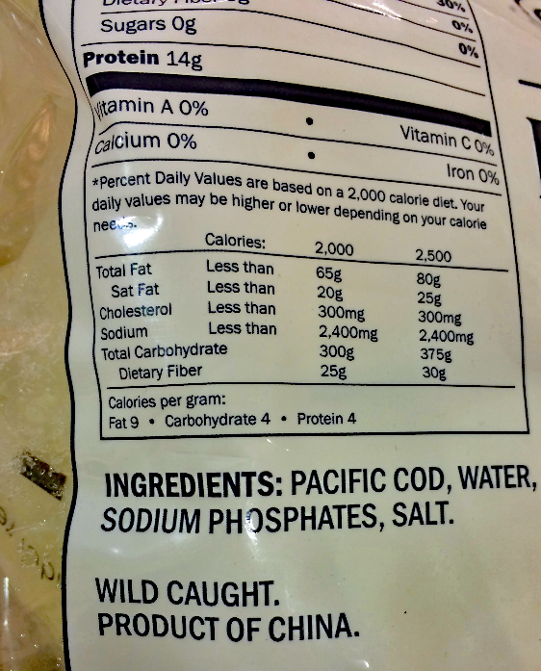
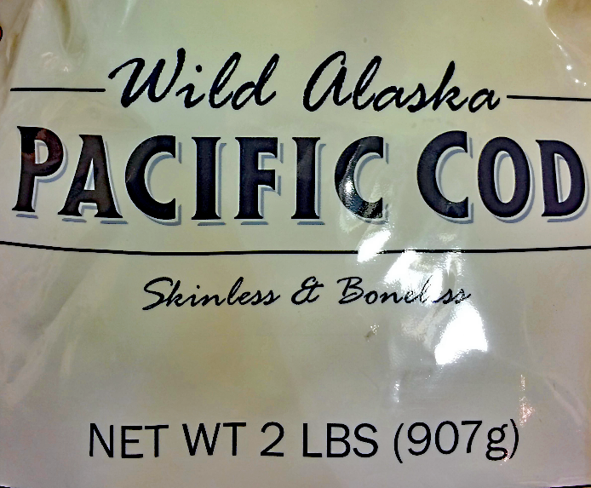
What is the country of origin on this label?
Image source: USDA, CC license CC BY 2.0
Notes:
Read the slide.

Slide 21
What is the country of origin on this label?
Image source: USDA, CC license CC BY 2.0
Notes:
The country of origin is China.

Slide 22
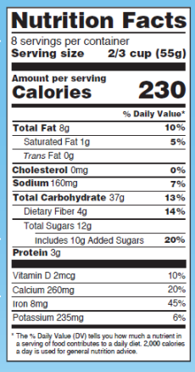
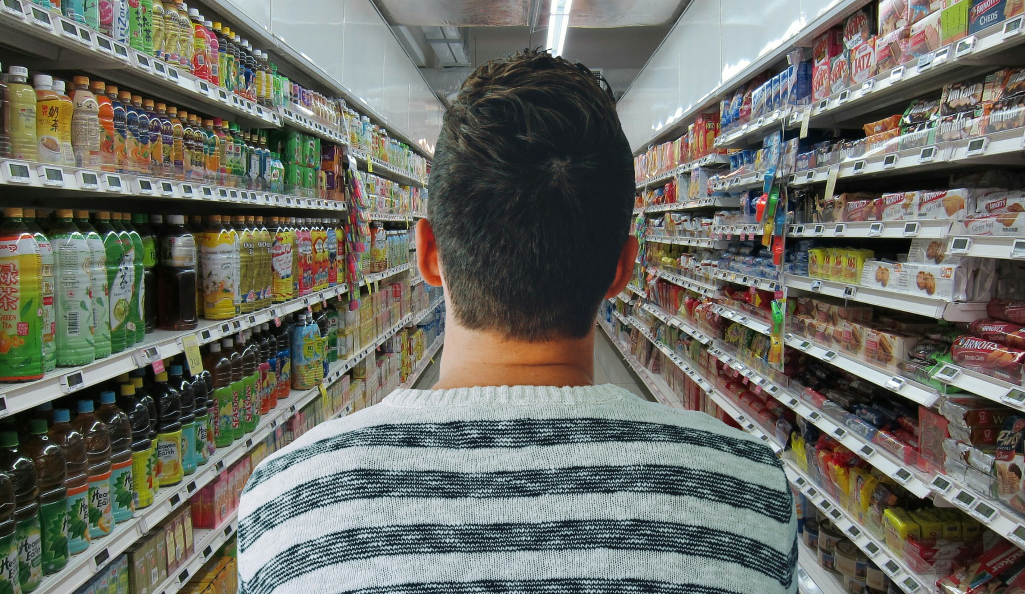
The Facts about the Nutrition Facts Label
Interpreting the Updated Labels
Image source: Label, FDA and grocery store, Pixabay.com
Notes:
Here’s how to interpret the updated Nutrition Facts label ….

Slide 23
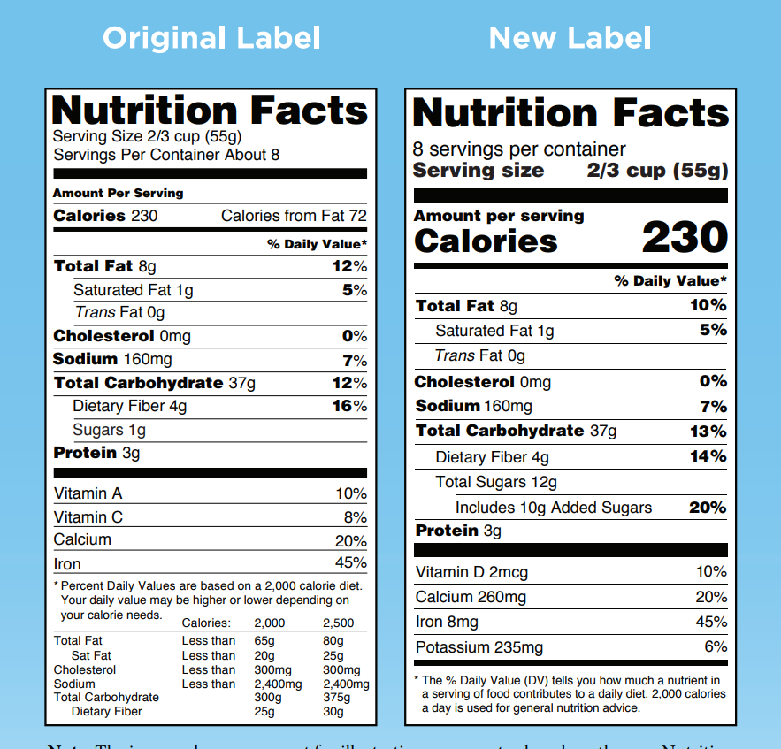
Nutrition Facts Label
1
2
3
4
6
5
Image source: FDA
Notes:
The Nutrition Facts label has been on packages since 1992. Manufacturers with $10 million or more in annual food sales have until 2020 before the new label is required, and manufacturers with less than $10 million in annual food sales will have until 2021. Some manufacturers have already started using the new label.
Major differences cited by FDA are: (https://www.fda.gov/ForConsumers/ConsumerUpdates/ucm620013.htm)
1. The new label makes it easier if you or a member of your family is counting calories by putting the calories, the number of servings, and the serving size in larger, bolder type. We thought it was important to better highlight these numbers because nearly 40 percent of American adults are obese, and obesity is associated with heart disease, stroke, certain cancers, and diabetes.
2. FDA is required to base serving sizes on what people actually eat and drink, so serving size requirements have been adjusted to reflect more recent consumption data. This way, the nutrition information provided for each serving is more realistic. For certain packages that contain more than one serving, you will see nutrition information per serving as well as per package. That means for a pint of ice cream, calories and nutrients are listed for one serving and the whole container.
3. The old label lists calories from fats, but the new label does not. The FDA made this change because research shows the type of fat consumed is more important than total fats. For example, monounsaturated and polyunsaturated fats, such as those found in most vegetable oils and nuts, can reduce the risk of developing heart disease when eaten in place of saturated and trans fat.
4. Added sugars are now listed to help you know how much you are consuming. The 2015-2020 Dietary Guidelines for Americans recommends you consume less than 10 percent of calories per day from added sugars. That is because it is difficult to get the nutrients you need for good health while staying within calorie limits if you consume more than 10 percent of your total daily calories from added sugar.
5. Good nutrition means that you are getting the right amount of nutrients for your body to function correctly and to fight chronic diseases like obesity, heart disease, certain cancers, and type II diabetes. The FDA has updated the list of nutrients required on the label to include Vitamin D and Potassium because Americans today do not always get the recommended amounts of these nutrients. Conversely, Vitamins A and C are no longer required, because deficiencies in these vitamins are rare today, but they can be listed by manufacturers voluntarily.
6. Daily values for nutrients like sodium, dietary fiber, and Vitamin D have been updated and are used to calculate the % Daily Value (DV) that you see on the label. The % DV helps you understand the nutrition information in the context of a daily diet. The footnote at the bottom of the label has changed to better explain the meaning of the % DV.

Slide 24
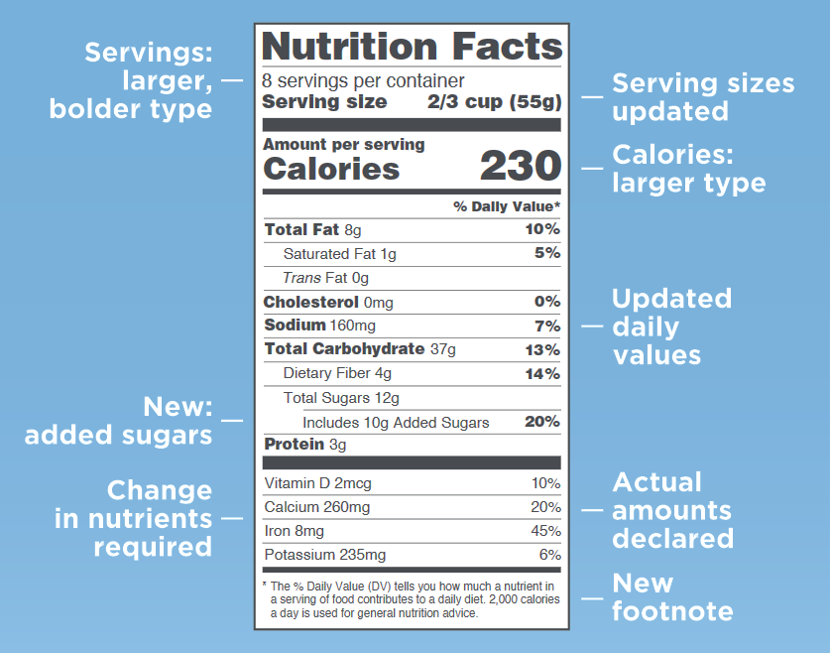
Nutrition Facts Label Changes
Nutrition Facts Label Changes
Image source: FDA
Notes:
Here’s a summary of the changes … read the slide.

Slide 25
WHY the changes?
  New science is available to help consumers make decisions about food
  Daily values updated to the 2015-2020 Dietary Guidelines
Serving size based on what people actually eat
Added sugars are listed – Americans are consuming too much sugar
Vitamin D and Potassium are added – many do not get enough
Notes:
New science is available to help consumers make decisions about food.
The % Daily Value helps consumers determine what nutrients are in the food product and if that nutrient is high, or low. If 20% or more of a nutrient, it is high; and 5% or less of a nutrient, it is low. The % Daily Value is based on a 2,000-calorie diet.
The daily values have been updated based on the 2015-2020 Dietary Guidelines.
Serving size is now based on what people actually eat. This has changed over time. It is not based on what they should eat.
Added sugars are now listed on the label to inform consumers how much sugar is added to the food product. This is different than the natural sugars that are already in the product or food.
Changes in nutrients required on the label were made because Vitamin D and potassium are nutrients that Americans do not get enough of in their diet. Vitamin D is important in bone health and potassium helps to lower blood pressure.
Serving sizes have changed since the original nutrition facts. Serving sizes will be more realistic to reflect how much people typically eat at one time. Serving sizes must be based on the amount of the food or beverage that people actually eat not what they should eat. Packaging affects how much people eat and drink. If you drink the entire bottle in one setting it will be considered one serving. The Nutrition Facts label information is based on the serving size given for the food.

Slide 26
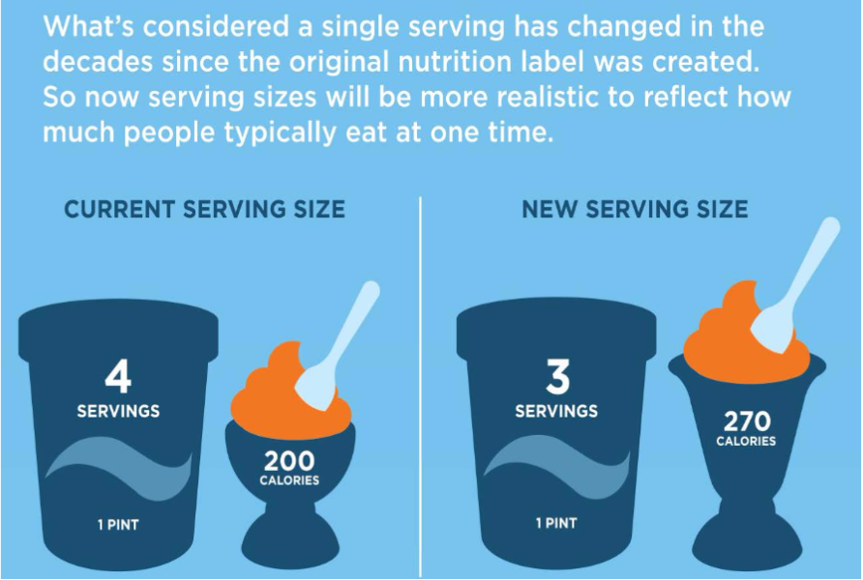
Serving Size Changes
Image source: FDA
Notes:
Serving sizes have changed since the original nutrition facts. Serving sizes will be more realistic to reflect how much people typically eat at one time.
“ For certain packages that contain more than one serving, you will see nutrition information per serving as well as per package. That means for a pint of ice cream, calories and nutrients are listed for one serving and the whole container.” https://www.fda.gov/ForConsumers/ConsumerUpdates/ucm620013.htm

Slide 27
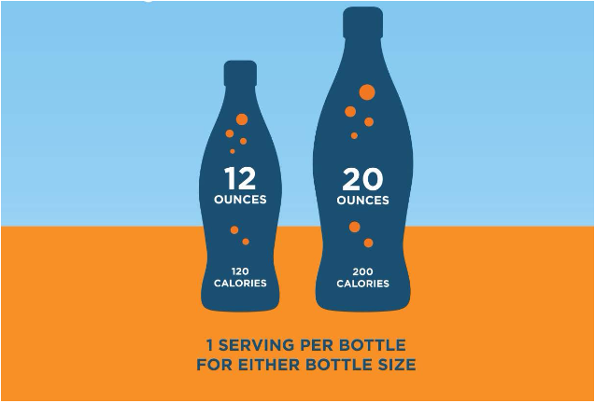
Labeling Single-Serving Packages
Image source: FDA
Notes:
Packaging affects how much people eat and drink. If you drink the entire bottle in one setting it will be considered one serving. The Nutrition Facts information is based on the serving size given for the food.

Slide 28
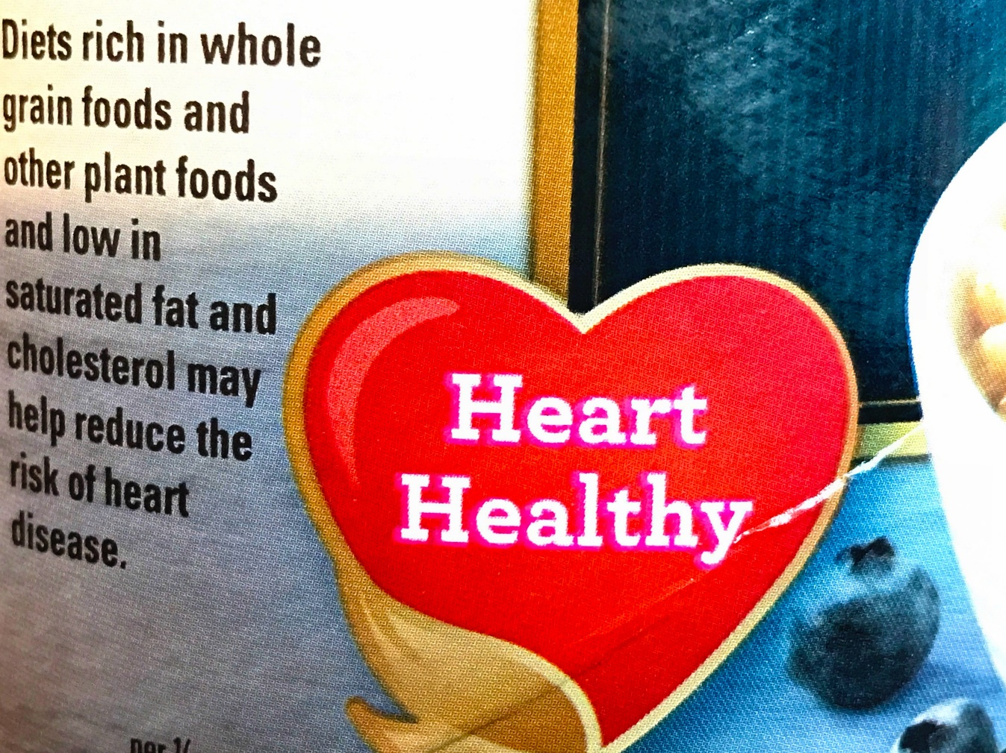
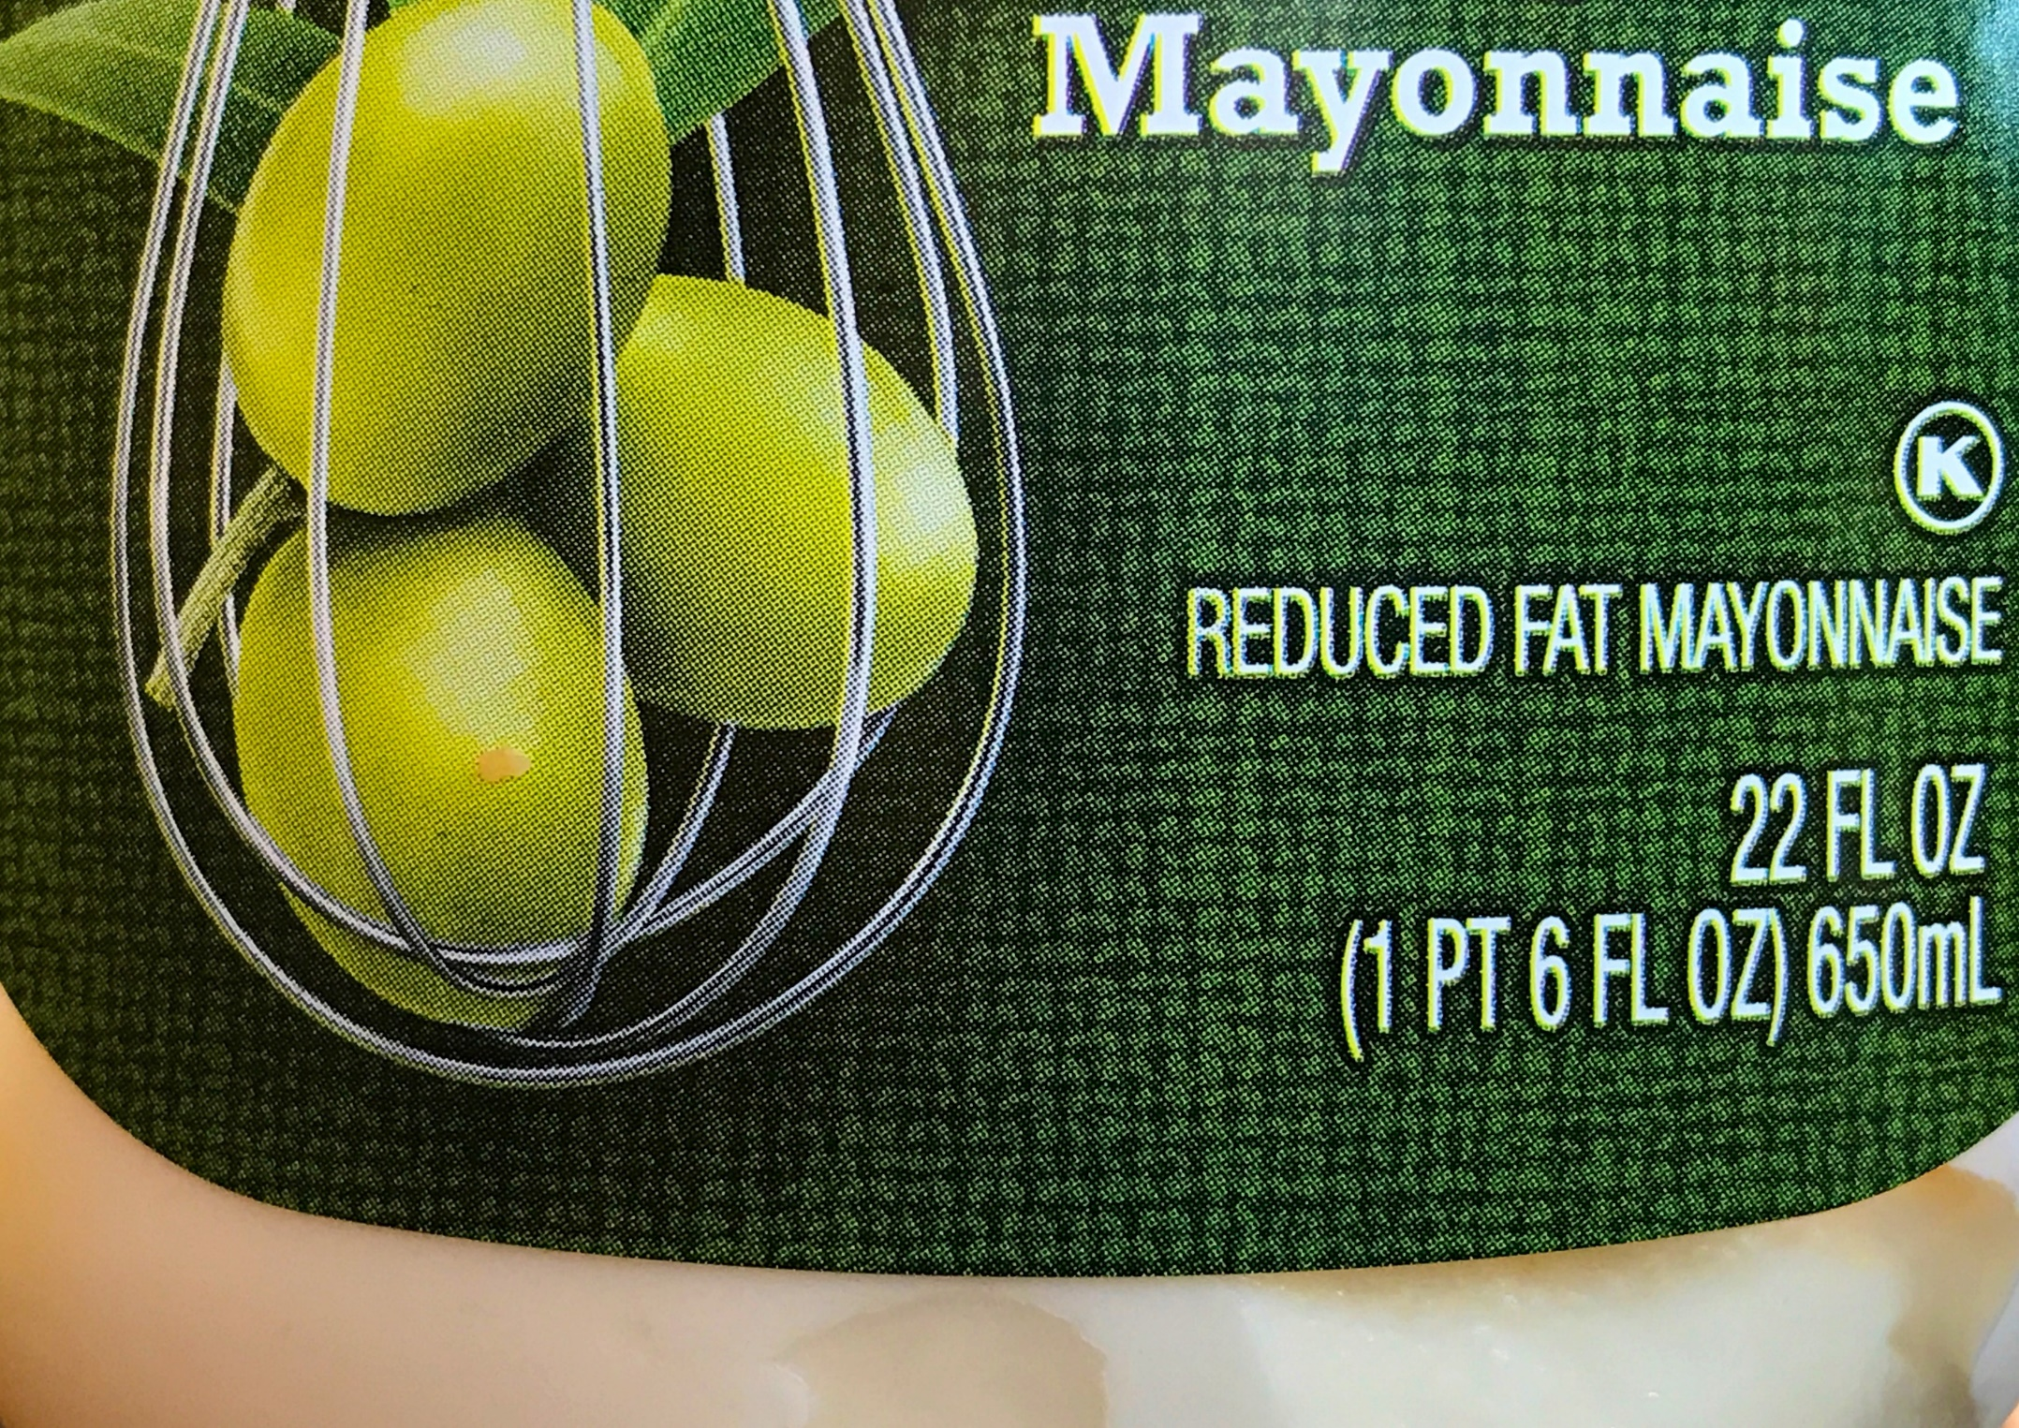
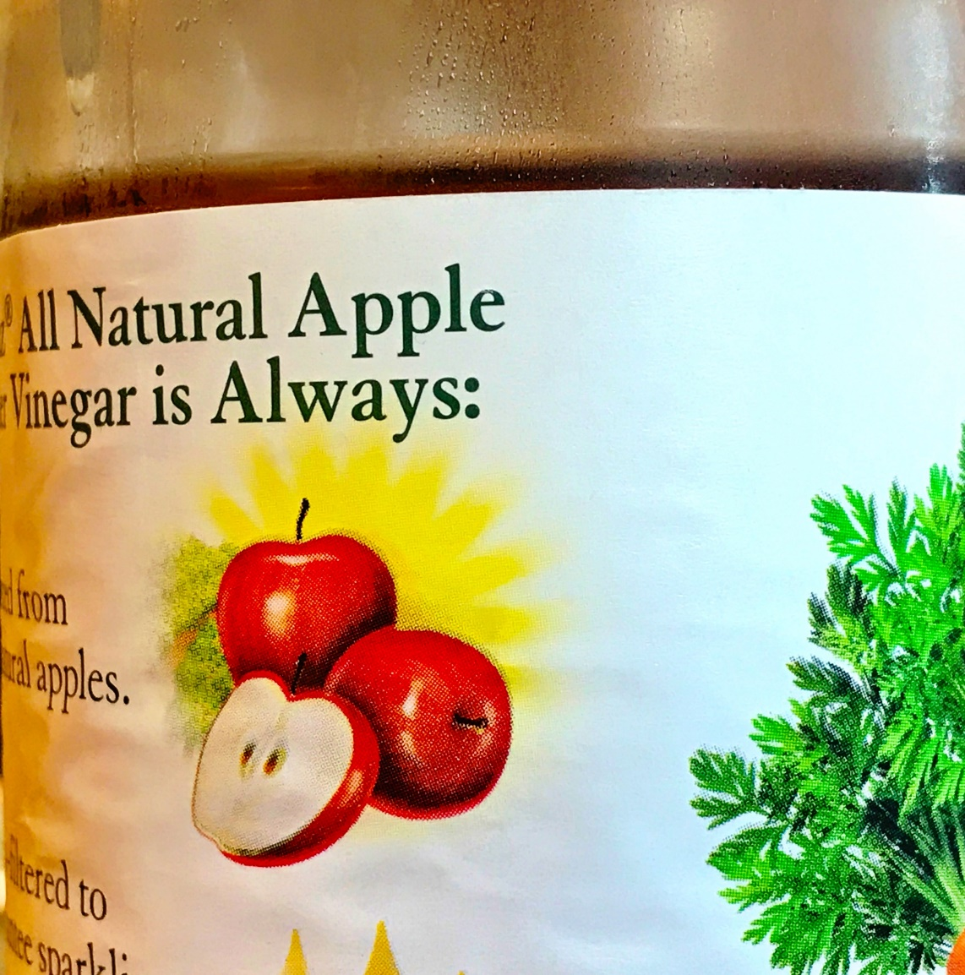
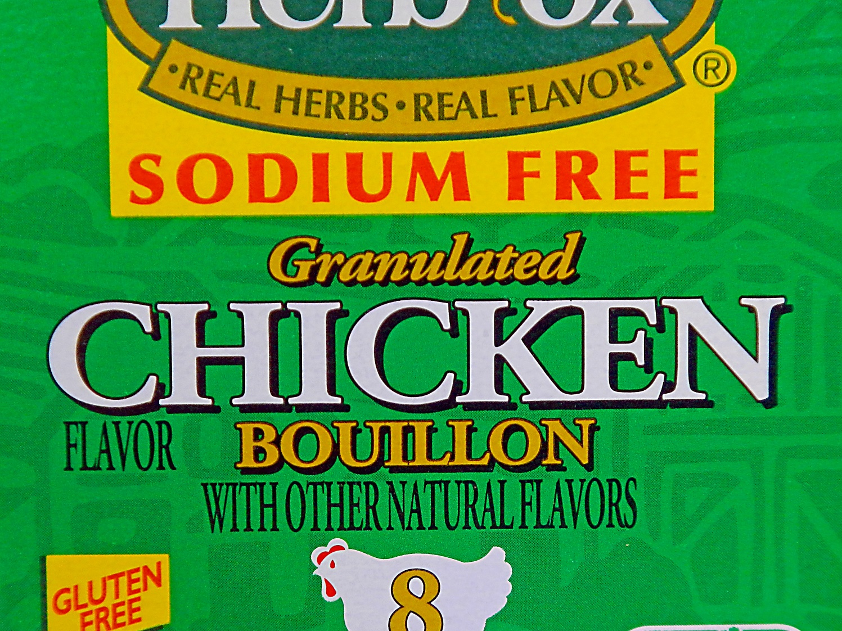
Sorting out “Nutrient Content Claims, “Health Claims” and Other Claims on Food Labels
Image source: Photo by Alice Henneman
Notes:
Moving on to other label claims …

Slide 29
Nutrient Content Claims
On labels, the terms used to describe nutrients in foods have approved definitions.
Image source: Photo by Alice Henneman
Notes:
Various terms have been used to describe nutrients in foods. When used on food labels, these terms have a consistent meaning.
For example, “Reduced fat” is an approved definition.

Slide 30
Sample Nutrient Content Claims
Calorie free | less than 5 calories per serving
Reduced calorie | at least 25% fewer calories than regular version
Low calorie | 40 calories or less per serving
Fat free | less than 0.5 grams fat per serving (trans or saturated)
Reduced fat | at least 25% less fat than regular version
Low fat | 3 grams or less of fat per serving
Notes:
Here are the approved definitions for terms associated with calories and fat.
If you had 2 food products; for example: one reduced calorie/fat and one regular calorie product, you could compare the labels.
https://www.fda.gov/downloads/Food/GuidanceRegulation/GuidanceDocumentsRegulatoryInformation/UCM265446.pdf

Slide 31
Sample Nutrient Content Claims
Sugar free | less than 5 calories per serving
Reduced sugar | at least 25% less sugar than regular version
No added sugar | no sugars added during processing or packing, including ingredients that contain sugar such as juice or dry fruit
Sodium free | less than 5 mg of sodium per serving
Reduced sodium | at least 25% less sodium than regular version
Low sodium | 140 mg or less sodium per serving
Light/Lite | 1/3 fewer calories or 50% less fat than regular version
Notes:
These are approved terms for sugar, sodium, and light/lite.
https://www.fda.gov/downloads/Food/GuidanceRegulation/GuidanceDocumentsRegulatoryInformation/UCM265446.pdf

Slide 32
Sample Nutrient Content Claims
High, rich in, excellent source of: | 20% or more of Daily Value
Good source of, contains, provides: | 10% to 19% of Daily Value
More, enriched, fortified, added: | 10% or more of Daily Value
Notes:
https://www.fda.gov/downloads/Food/GuidanceRegulation/GuidanceDocumentsRegulatoryInformation/UCM265446.pdf

Slide 33
Some Additional Nutrition-Related
Label Terms
Gluten Free, Without Gluten, Free of Gluten, or No Gluten: Foods cannot contain wheat, rye, barley or cross breeds of these grains (2014)
Healthy: Current guidance by FDA is that manufacturers can use the term on foods that meet one of these definitions): Food not low in total fat but has fat profile of mostly mono and polyunsaturated fats OR contains at least 10% of the Daily Value of potassium or Vitamin D per reference amount commonly consumed.
Natural: Currently no definition
Notes:
Gluten Free Labeling
In 2014, “gluten free” “without gluten”, “free of gluten” and “no gluten” were defined by FDA. Previously, before these terms were used, and the consumer could not be sure that the product did not contained gluten. Now foods labeled with these terms cannot contain an ingredient that is any type of wheat, rye, barley or crossbreeds of these grains or an ingredient derived from these grains without a processing step to remove gluten.
Healthy
In 2016, FDA has proposed that the term “Healthy” have a standard definition. Food manufacturers can use the term if their product is not low in total fat but has a fat profile made of mostly mono and polyunsaturated fats OR contains at least 10 % of the Daily Value of potassium or Vitamin D per reference amount commonly consumed.
https://www.fda.gov/regulatory-information/search-fda-guidance-documents/guidance-industry-use-term-healthy-labeling-human-food-products
Natural
Currently the term “Natural” does not have a definition but FDA is considering a standard definition for Natural.

Slide 34
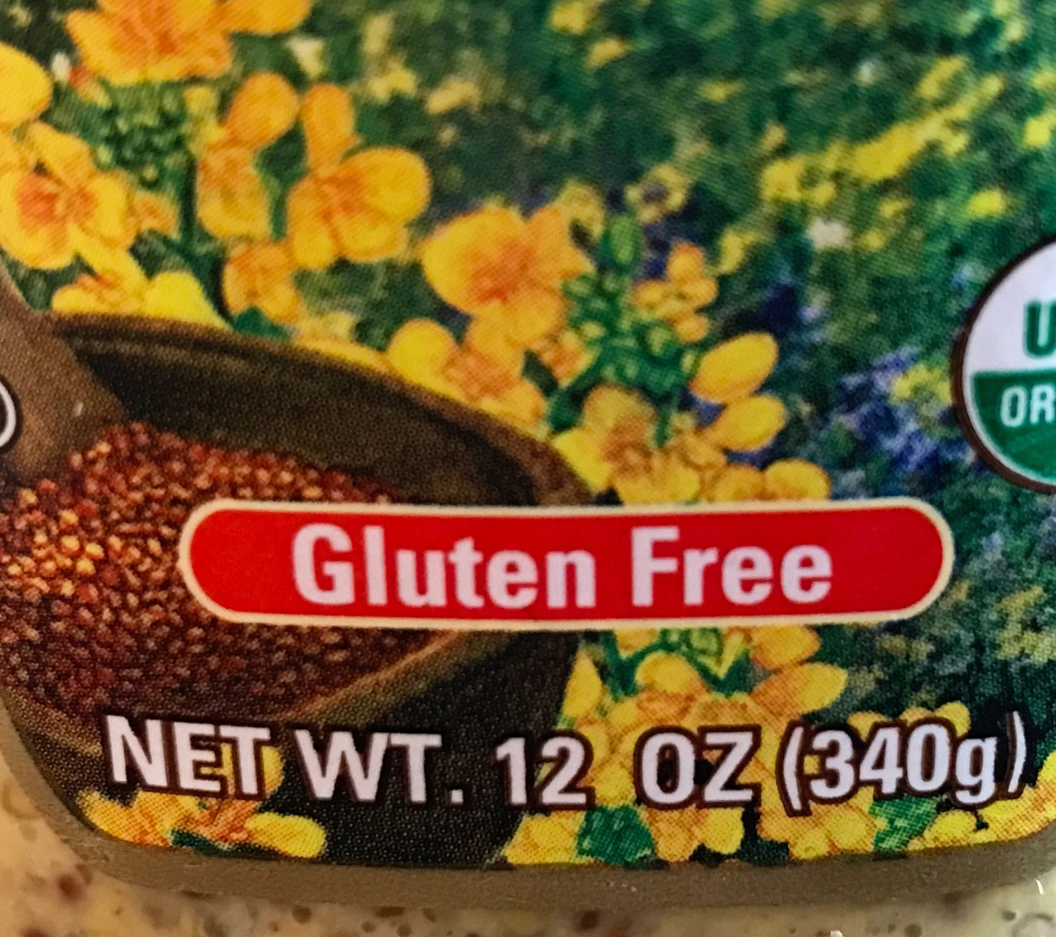
Label Examples: Natural, Healthy, Gluten Free
Image source: Photos by Alice Henneman
Notes:
Examples of foods with these terms used on the label.

Slide 35
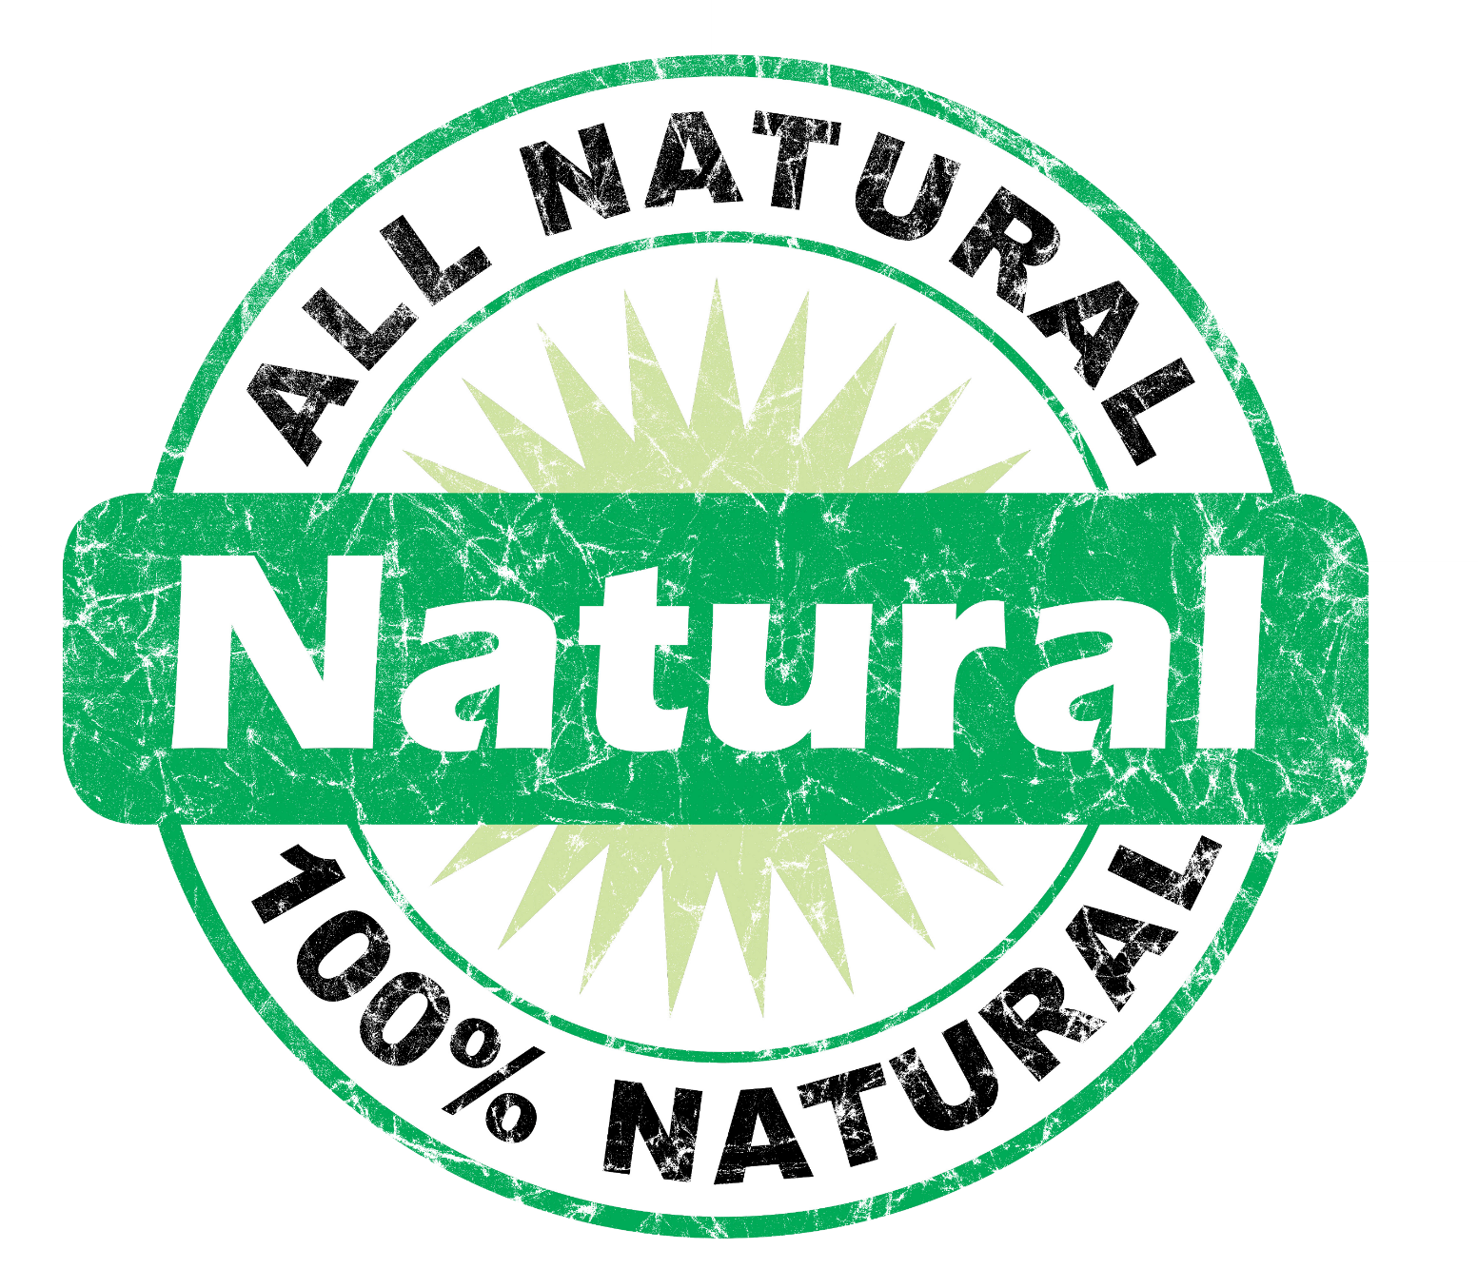
Which Label Does NOT Have a Government “Definition”?
Image source: Photo by Alice Henneman; illustration by Vicki Jedlicka
Notes:
Read the slide.

Slide 36
Which Label Does NOT Have a Government “Definition”?
X
Image source: Photo by Alice Henneman; illustration by Vicki Jedlicka
Notes:
Natural is not defined.

Slide 37
Health Claims
A Health Claim describes a relationship between a food, food component or dietary supplement AND a reduced risk for a specific disease or health condition.
1
Health Claims are based on extensive research.
2
Notes:
Read the slide.

Slide 38
“Authorized” Health Claims
There must be significant scientific agreement (SSA) among qualified experts that the claim is supported by the totality of publicly available scientific evidence for a substance/disease relationship.
The authorized health must contain the elements of a substance and a disease or health-related condition.
Notes:
To be approved by the FDA as an authorized health claim, there must be significant scientific agreement (SSA) among qualified experts that the claim is supported by the totality of publicly available scientific evidence for a substance/disease relationship. https://www.fda.gov/Food/LabelingNutrition/ucm2006876.htm

Slide 39
Examples of “Authorized” Health Claims
“Diets low in sodium may reduce the risk of high blood pressure, a disease associated with many factors.”
“Healthful diets with adequate folate may reduce a woman's risk of having a child with a brain or spinal cord birth defect.”
“Development of cancer depends on many factors. Eating a diet low in fat and high in fruits and vegetables, foods that are low in fat and may contain vitamin A, vitamin C, and dietary fiber, may reduce your risk of some cancers. Oranges, a food low in fat, are a good source of fiber and vitamin C.”
Notes:
Read slide: What are some of the claims that you see on food labels?
The authorized health must contain the elements of a substance and a disease or health-related condition.
Examples from:
Sodium: https://www.ecfr.gov/cgi-bin/retrieveECFR?gp=1&SID=7d28421c2c27bebbb318c37340189bf4&ty=HTML&h=L&mc=true&r=SECTION&n=se21.2.101_174
Folate: https://www.ecfr.gov/cgi-bin/retrieveECFR?gp=1&SID=7d28421c2c27bebbb318c37340189bf4&ty=HTML&h=L&mc=true&n=pt21.2.101&r=PART#se21.2.101_179
Cancer: https://www.ecfr.gov/cgi-bin/retrieveECFR?gp=1&SID=7d28421c2c27bebbb318c37340189bf4&ty=HTML&h=L&mc=true&r=SECTION&n=se21.2.101_178

Slide 40
“Qualified” Health Claims
Qualified health claims (QHCs) are supported by scientific evidence, but do not meet the more rigorous “significant scientific agreement” standard required for an authorized health claim.
They must be accompanied by a disclaimer or other qualifying language to accurately communicate to consumers the level of scientific evidence supporting the claim.
Notes:
Qualified health claims (QHCs) are supported by scientific evidence, but do not meet the more rigorous “significant scientific agreement” standard required for an authorized health claim. To ensure that these claims are not misleading, they must be accompanied by a disclaimer or other qualifying language to accurately communicate to consumers the level of scientific evidence supporting the claim. https://www.fda.gov/Food/LabelingNutrition/ucm2006877.htm

Slide 41
Examples of “Qualified” Health Claims
“Scientific evidence suggests, but does not prove, that whole grains (three servings or 48 grams per day), as part of a low saturated fat, low cholesterol diet, may reduce the risk of diabetes mellitus type 2.”
“Supportive but not conclusive scientific evidence suggests that daily consumption of about 1½ tablespoons (20 grams) of oils containing high levels of oleic acid, may reduce the risk of coronary heart disease. To achieve this possible benefit, oleic acid-containing oils should replace fats and oils higher in saturated fat and not increase the total number of calories you eat in a day. One serving of [x] oil provides [x] grams of oleic acid (which is [x] grams of monounsaturated fatty acid).”
Notes:
What are some of the claims that you see on food labels?
Examples from:
Whole grain: https://www.fda.gov/food/food-labeling-nutrition/questions-and-answers-health-claims-food-labeling
Oleic acid: https://www.fda.gov/food/cfsan-constituent-updates/fda-completes-review-qualified-health-claim-petition-oleic-acid-and-risk-coronary-heart-disease

Slide 42
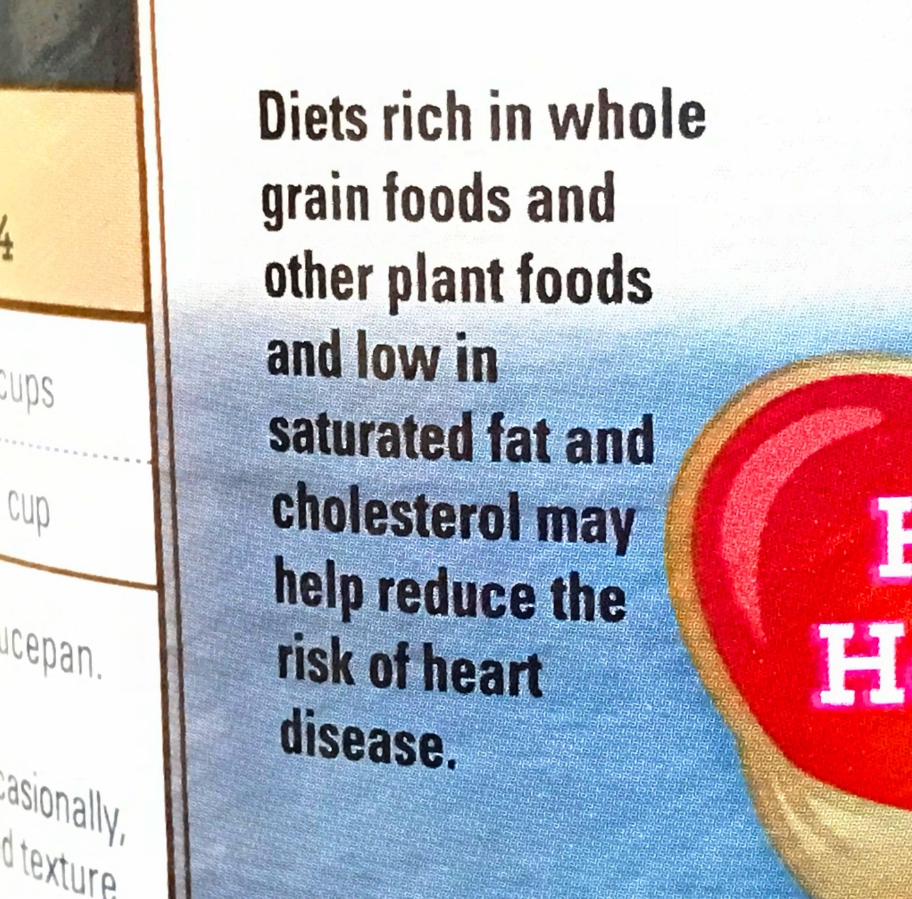
Is This an “Authorized” or a “Qualified’
Health Claim and Why?
Image source: Photo by Alice Henneman
Notes:
Read the slide. Then move to next slide to show the answer.

Slide 43
Is This an “Authorized” or a “Qualified’
Health Claim and Why?
Authorized health
claim
Image source: Photo by Alice Henneman
Notes:
Read the slide.
Note that it is not accompanied by a disclaimer or other qualifying language to communicate to consumers the level of scientific evidence supporting the claim as would be necessary in a “qualified” health claim.

Slide 44
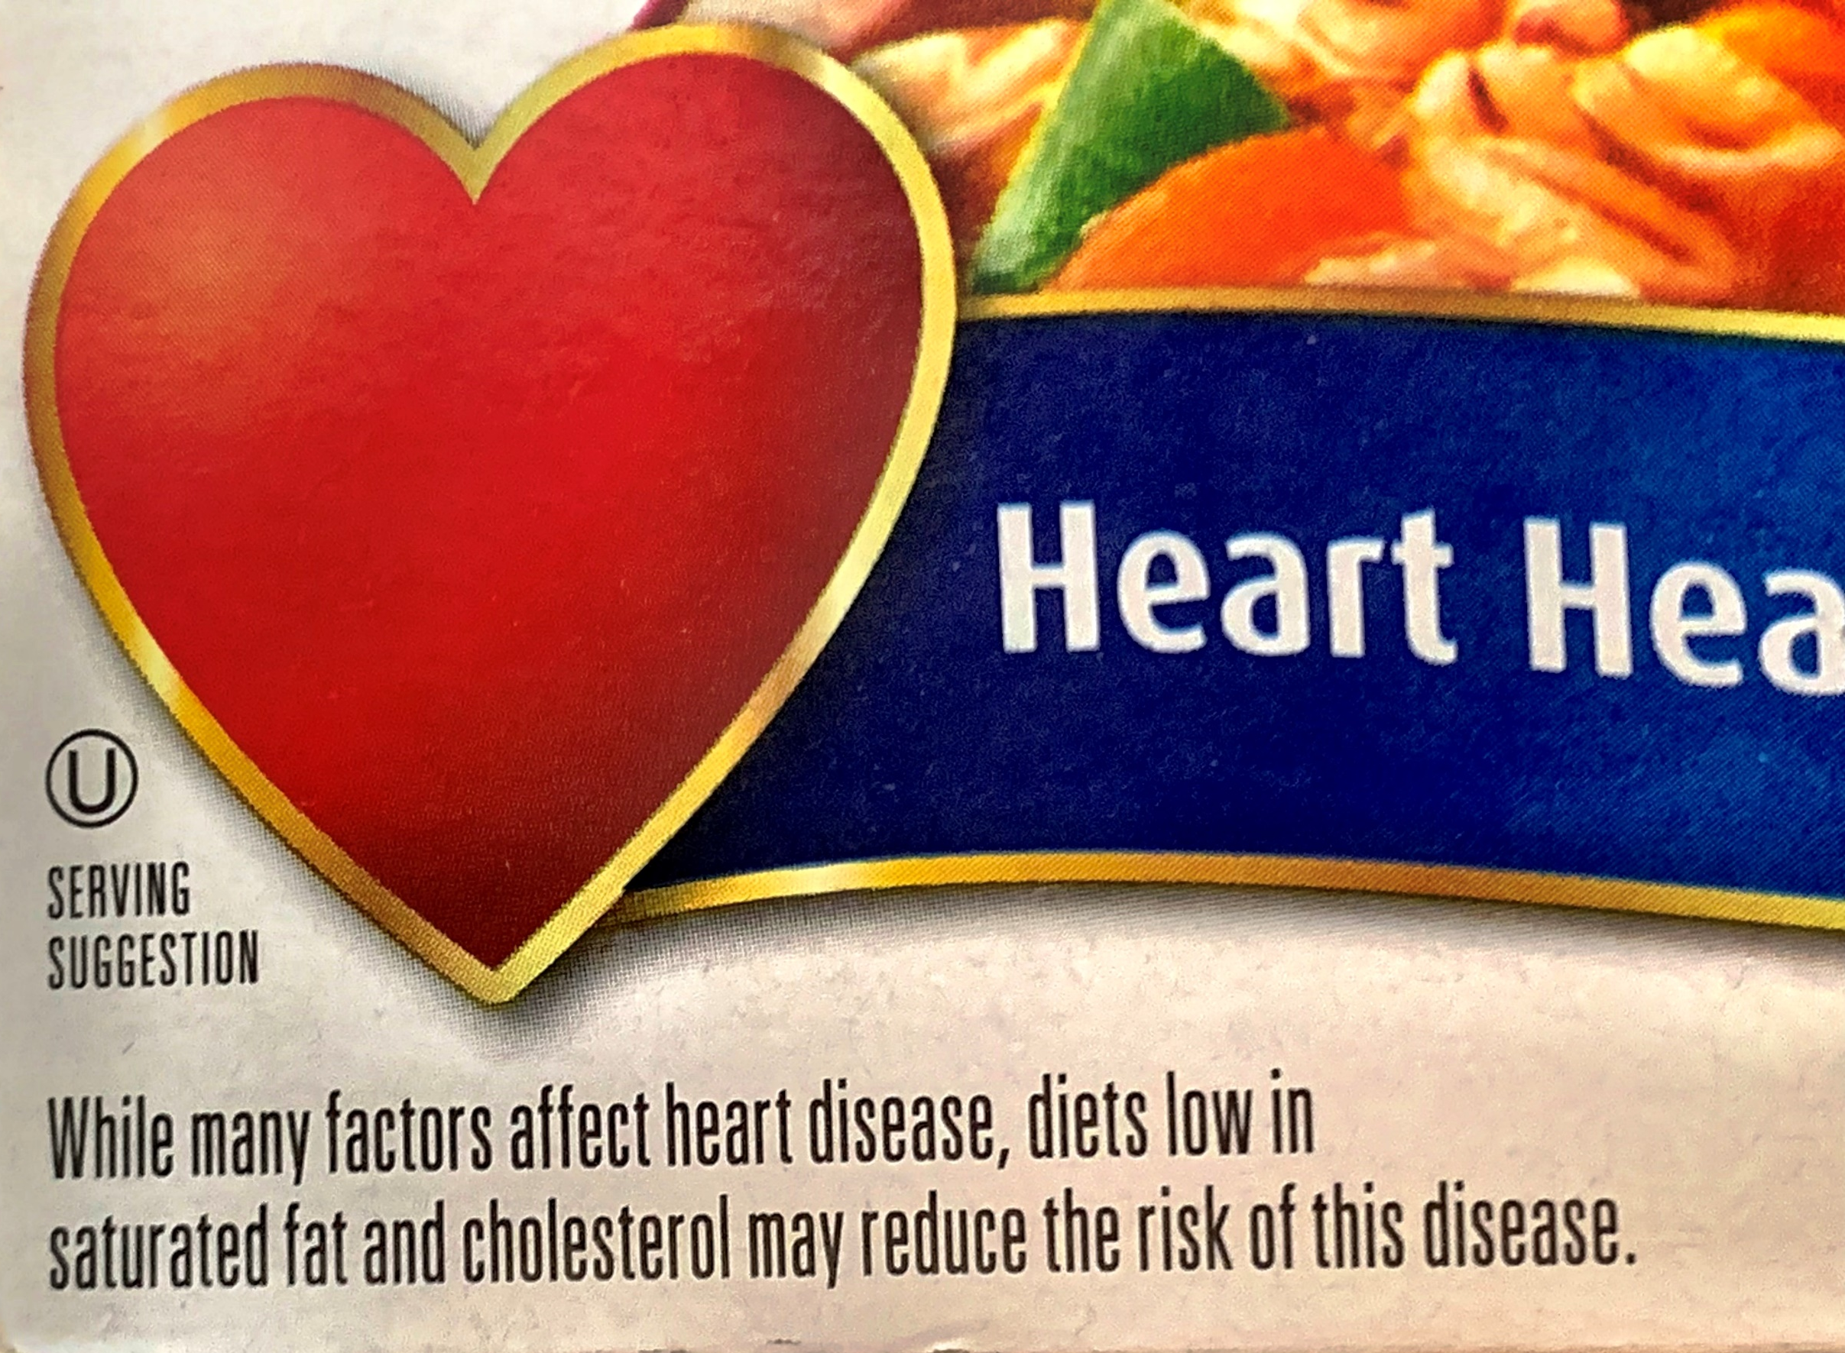
Is This an “Authorized” or a “Qualified’
Health Claim and Why?
Image source: Photo by Alice Henneman
Notes:
Read the claim on the slide. Then move to the next slide to show the answer.

Slide 45
Is This an “Authorized” or a “Qualified’
Health Claim and Why?
Authorized health claim
Image source: Photo by Alice Henneman
Notes:
Read the answer. It doesn’t have a disclaimer and would be an authorized health claim.

Slide 46
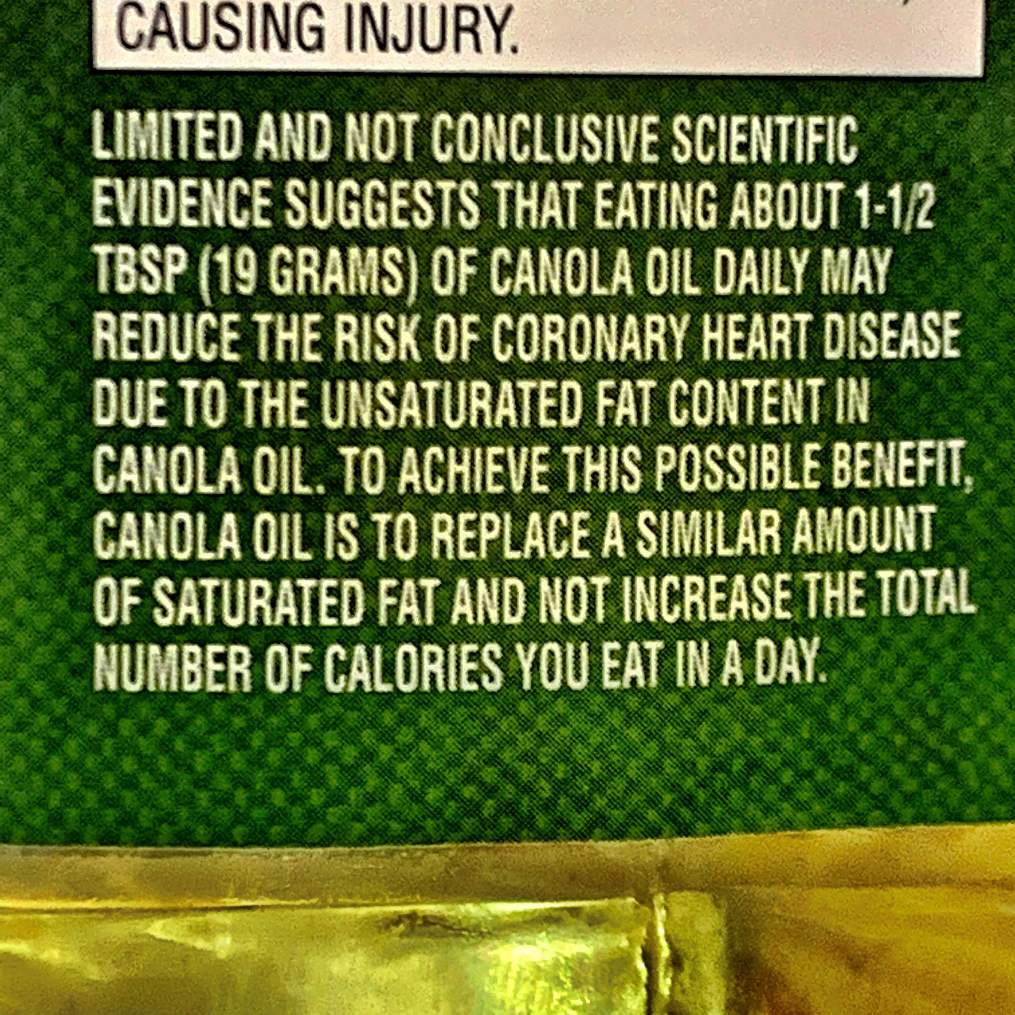
Is This an “Authorized” or a “Qualified’
Health Claim and Why?
Image source: Photo by Alice Henneman
Notes:
Read the claim on the slide. Then move to the next slide to show the answer.

Slide 47
Is This an “Authorized” or a “Qualified’
Health Claim and Why?
Qualified
Health
Claim
Image source: Photo by Alice Henneman
Notes:
Note how, as a “Qualified” claim, that it is accompanied by a disclaimer and qualifying language to communicate to consumers the level of scientific evidence supporting the claim.

Slide 48

Other Label Statements…
“No hormones added” or “raised without hormones”
“GMO Free”
Image source: USDA/SNAP-Ed
Notes:
Some other label statements include: “no hormones added” or “raised without hormones;” and “GMO Free.”

Slide 49
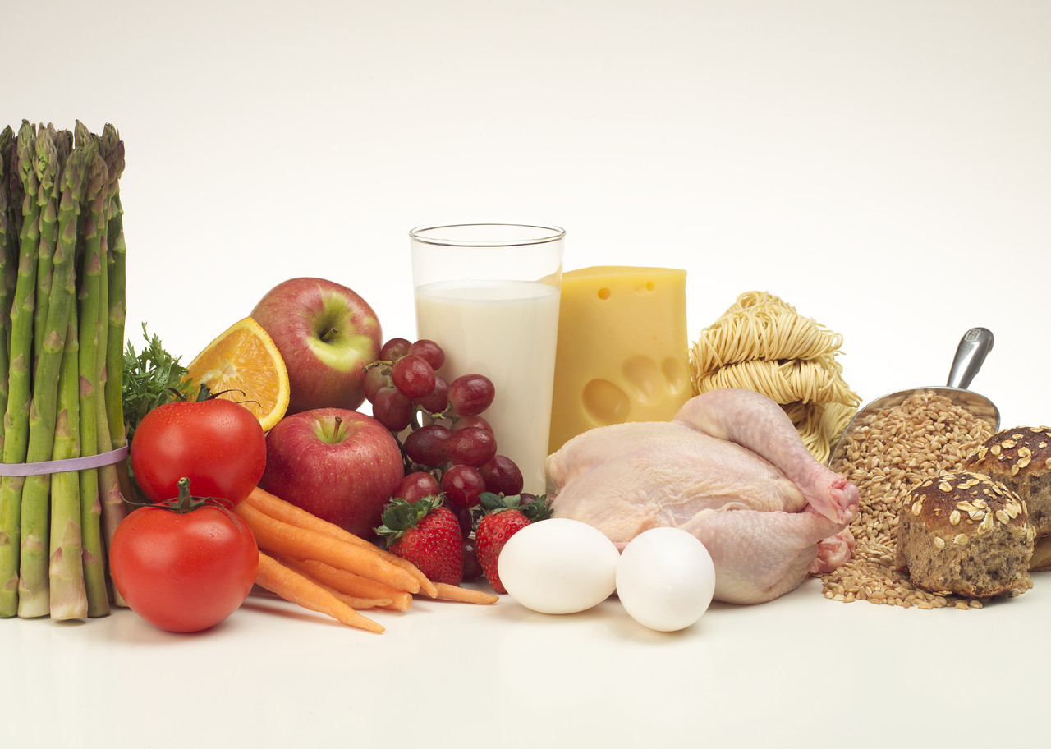
Hormone Free
“Free of hormones” or “hormone free” vs. “No hormones added” or “raised without hormones”
Anything that is or has been alive contains hormones, including plants!
Is there anything in this photo that is “hormone free”?
Notes:
Before discussing hormones in foods, it is important to make a distinction between “free of hormones” and “no hormones added” or “raised without hormones.” Anything that is or has been alive contains hormones, including plants. There is no such thing as “hormone free” meat or animal products.

Slide 50


Pork and Poultry
We have hormones but no “added” hormones
Added hormones aren’t allowed by USDA in pork and poultry.
A claim of “no hormones added” on pork or poultry must be followed by the statement, “Federal regulations prohibit the use of hormones.”
Notes:
Read slide and add: Be aware, the claim of “no hormones added” may be in much larger letters than the statement saying the use of hormones is prohibited.
Source: https://www.fsis.usda.gov/wps/portal/fsis/topics/food-safety-education/get-answers/food-safety-fact-sheets/food-labeling/meat-and-poultry-labeling-terms/meat-and-poultry-labeling-terms

Slide 51
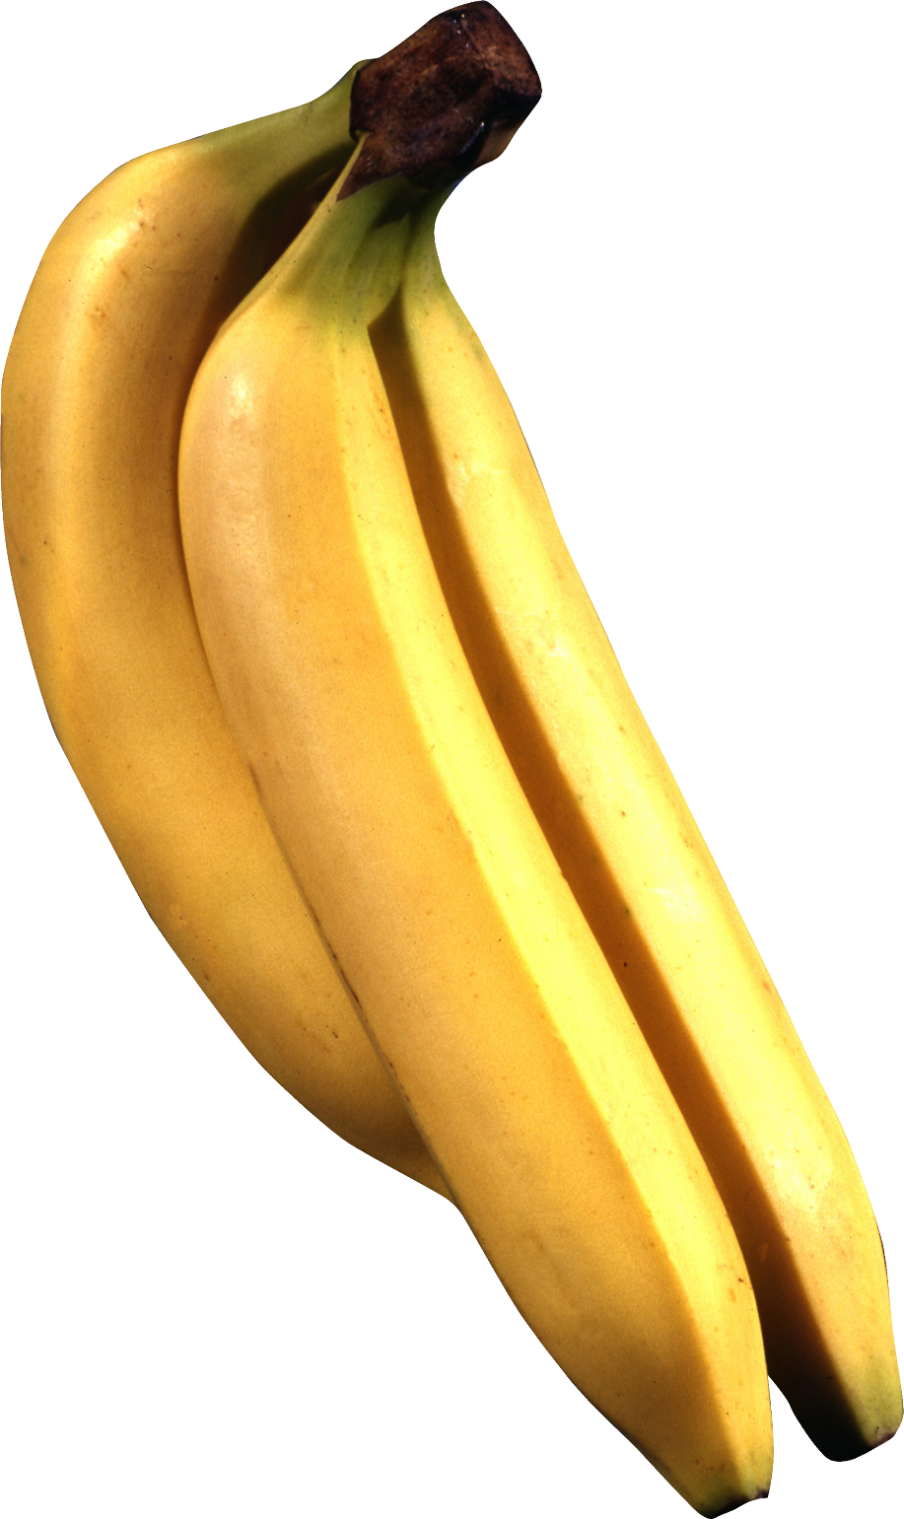
GMO-Free
Are you paying extra for a food when none of its ingredients contained GMOs in the first place?
Which banana is NOT a GMO food?
GMO-Free
labeling
No GMO
labeling
Image source: Pixabay.com
Notes:
In today’s marketplace, you may find foods promoted as “GMO free” or “contains no GMOs.” Before you pay extra for this food, be aware it may not be made with any ingredients that contain GMOs in the first place. In other words, the same type of food without that label may also be free of GMO ingredients.

Slide 52
Neither of them are GMO foods and never have been
GMO-Free
No GMO
labeling
Image source: Pixabay.com
Notes:
As to which banana is NOT a GMO food … neither of them are GMO foods and never have been!

Slide 53
GMO Foods in United States
More information …
Currently available …
Corn (field and sweet)
Soybeans
Cotton
Canola
Alfalfa
Sugar beets
Papaya (Hawaiian)
Squash
Artic Apples
Arctic Apples (first available in some areas by 2017 with market presence growing yearly)
NOTE: Not all versions of all these foods are genetically engineered.
Before being placed on the market, genetically modified foods must be approved by the Food and Drug Administration, the USDA and the Environmental Protection Agency
Notes:
Read the slide.

Slide 54
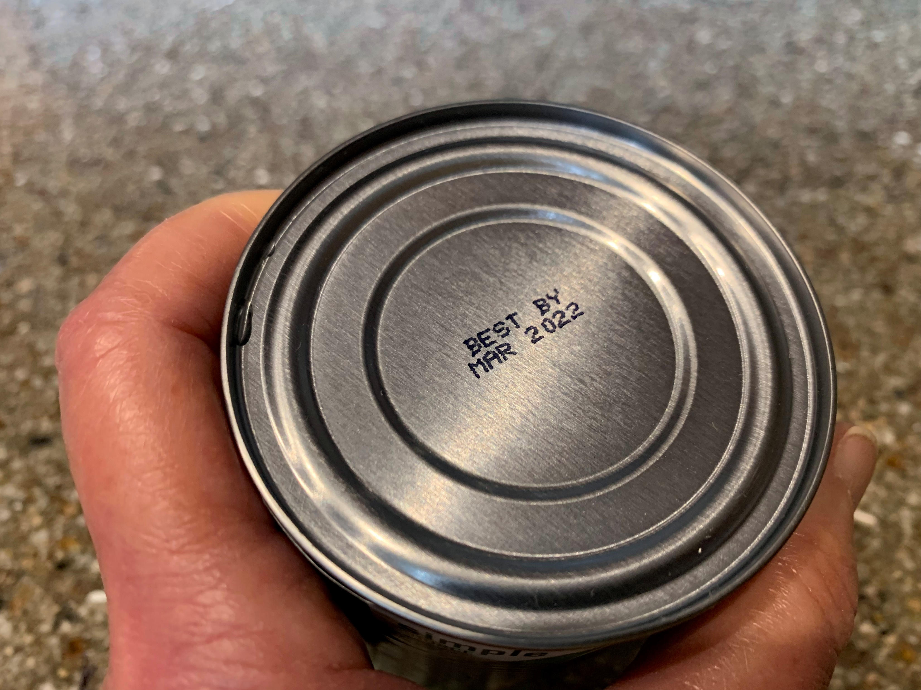
Food Date Labels – What Do They Mean?
Food Date Labels: What Do They Mean?
Image source: Photo by Alice Henneman
Notes:
Now, on to food date labels …

Slide 55


Label confusion contributes to food waste.
84% of consumers in a 2016 study by Johns Hopkins discarded food near the package date at least occasionally.
Notes:
Read slide.
https://www.sciencedaily.com/releases/2019/02/190219132805.htm

Slide 56
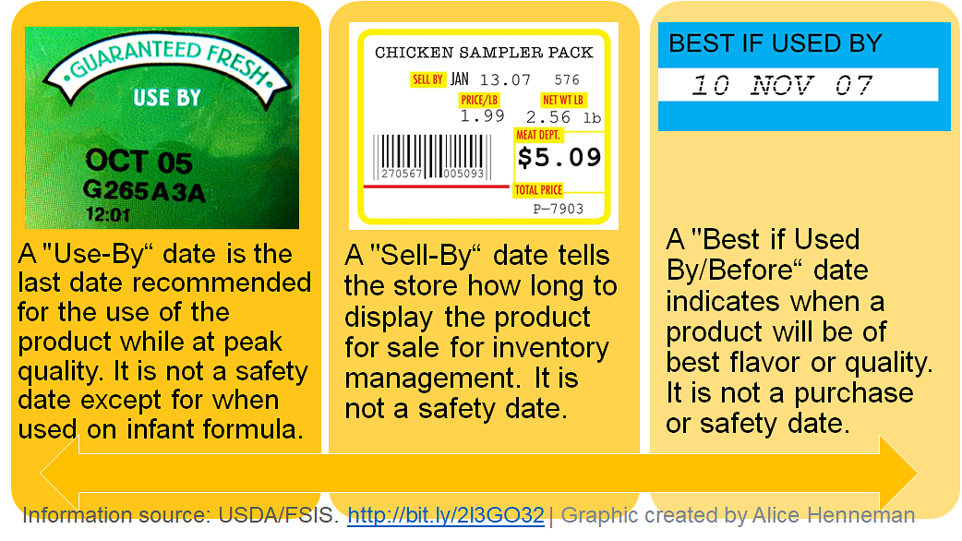
Label Dates on Foods (Voluntary
Except for Infant Formula)
Notes:
These are examples of types of dating that have been used on foods.
“Use By” Date (or expiration date)
last date recommended for the use of the food product while it is at peak quality.
Infant formula is required to have a “Use By”, do not purchase formula that is past this date.
“Sell-By” Date
lets the store know how long to display the product for sale. Consumers should buy the food product before this “sell by” date.
“Best if Used by (or Before)” Date
lets you know the best flavor or quality of the product. This date is not a purchase or safety date.

Slide 57
Movement to Less Confusing Date Labels*
H.R. 3981, referred to as the “Food Date Labeling Act of 2019,” was introduced (July 25, 2019) to establish requirements for quality and discard dates that may voluntarily be used in food packaging. Terms under consideration are:
“BEST If Used By” or “BB” to designate a “quality” date.
“USE By” or “UB” would designate a discard date for foods that the producer, manufacturer, distributor, or retailer advises the product not be consumed.
NOTE: This Act shall only apply to food products that are labeled on or after the date following the final passage of the bill.
Notes:
Read slide.
Source: https://www.congress.gov/116/bills/hr3981/BILLS-116hr3981ih.pdf

Slide 58

A required “Use by” date is currently (and will continue to be) used on infant formulas. The date is selected by the manufacturer based on tests and other information to inform retailers and consumers that the formula:
will contain no less than the amount of nutrient declared on the label, and
will be of acceptable quality until that declared date.
Image source: Pixabay.com
Notes:
Read slide.
https://www.fda.gov/food/foodborneillnesscontaminants/peopleatrisk/ucm108079.htm#9

Slide 59
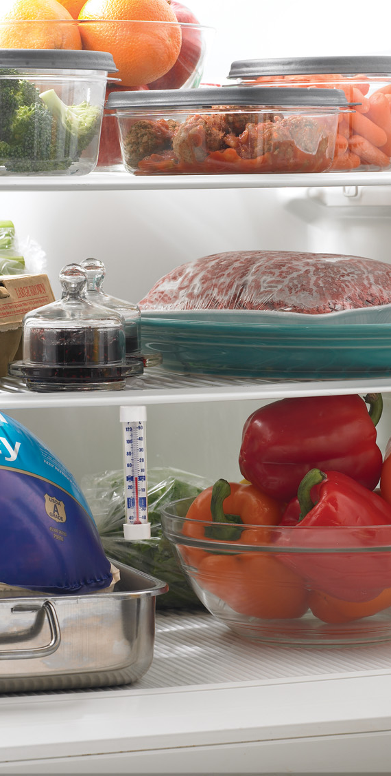
Proper Storage
After the date passes, the product may not be the best quality, but the product may still be safe, wholesome and of good quality, if handled properly.
Store refrigerated foods at 40⁰ F or below.
Consider the following
canned food guidelines….
Image source: USDA/FSIS
Notes:
Read the slide.

Slide 60
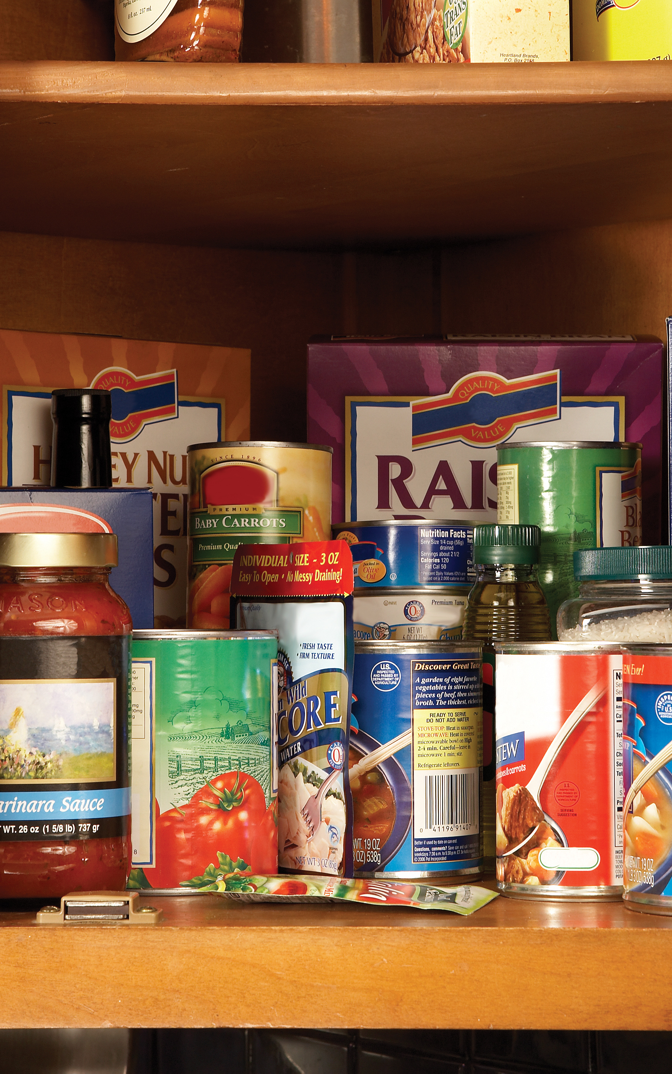
Storing Commercial Canned Foods (in a Cool Dry Place, Below 85⁰F)
High-acid foods keep 12 to 18 months.
Examples: juices (tomato, orange, lemon, lime and grapefruit); tomatoes; grapefruit, pineapple, apples and apple products, mixed fruit, peaches, pears, plums, all berries, pickles, sauerkraut and foods treated with vinegar-based sauces or dressings like German potato salad and sauerbraten
Image source: USDA/FSIS
Notes:
Summarize slide
https://www.fsis.usda.gov/wps/wcm/connect/77ffde83-dc51-4fdf-93be-048110fe47d6/Shelf_Stable_Food_Safety.pdf?MOD=AJPERES

Slide 61
Storing of Commercial Canned Foods (in a Cool Dry Place, Below 85⁰F)
Low-acid foods keep 2 to 5 years.
Examples: meat and poultry, stews, soups (except tomato), spaghetti (noodle and pasta) products, potatoes, corn, carrots, spinach, beans, beets, peas, pumpkin
Image source: USDA/FSIS
Notes:
Read the slide.
https://www.fsis.usda.gov/wps/wcm/connect/77ffde83-dc51-4fdf-93be-048110fe47d6/Shelf_Stable_Food_Safety.pdf?MOD=AJPERES

Slide 62
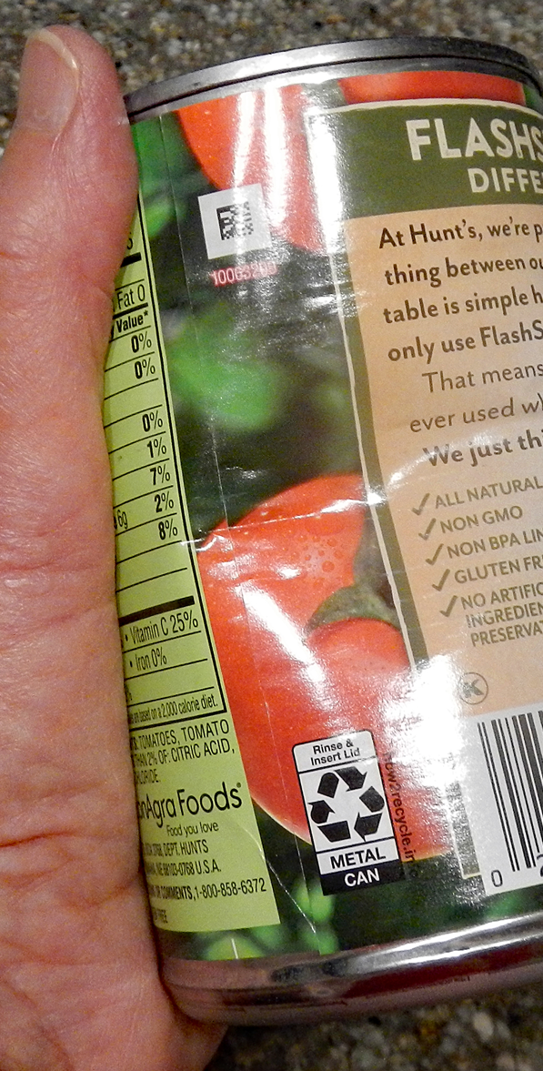
Canned Food Safety: Dented Cans
A small dent in a can that is in otherwise good shape should be safe.
Discard deeply dented cans (a dent you can lay your finger into).
A sharp dent on either the top or side seam can damage the seam and let bacteria enter. Discard!
When in doubt, throw it out!
Image source: Photo by Alice Henneman
Notes:
Summarize slide. https://www.fsis.usda.gov/wps/wcm/connect/77ffde83-dc51-4fdf-93be-048110fe47d6/Shelf_Stable_Food_Safety.pdf?MOD=AJPERES

Slide 63

Canned Food Safety: Rusted Cans
Discard heavily rusted cans. They can have tiny holes in them allowing bacteria to enter.
Surface rust that you can remove by rubbing with your finger or a paper towel isn’t serious and can be kept.
If there is any rust inside, do not eat the food! Rust isn’t safe to eat.
Image source: Pixabay.com
Notes:
Summarize slide
https://www.fsis.usda.gov/wps/wcm/connect/77ffde83-dc51-4fdf-93be-048110fe47d6/Shelf_Stable_Food_Safety.pdf?MOD=AJPERES

Slide 64

Don’t Use Bulging or Leaking Cans!
Notes:
https://www.fsis.usda.gov/wps/wcm/connect/77ffde83-dc51-4fdf-93be-048110fe47d6/Shelf_Stable_Food_Safety.pdf?MOD=AJPERES

Slide 65
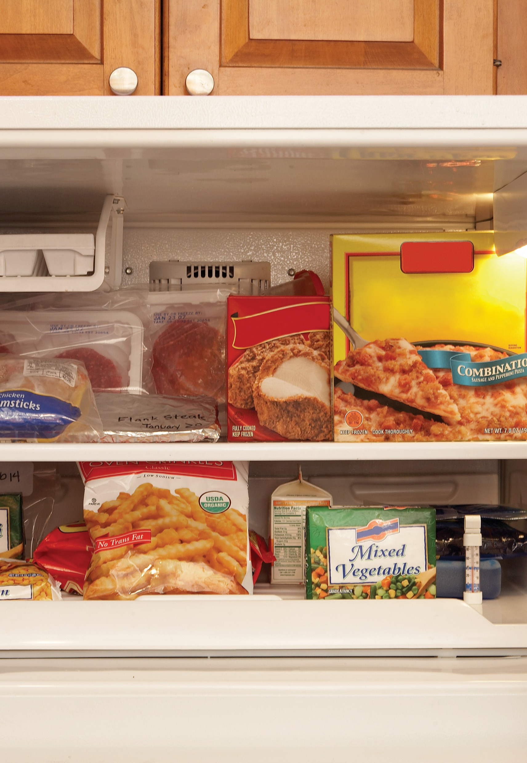
Storing Frozen Foods
Food stored constantly at 0⁰F will always be safe. Only the quality suffers with lengthy freezer storage.
Image source: USDA
Notes:
Remember … if a food is stored constantly at 0 degrees F, it will always be safe but the quality may go down considerably.

Slide 66
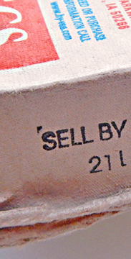
Storing Raw Eggs in the Shell
Eggs cartons may contain a “Sell-By” or “EXP” date so retailers don’t keep them on the shelves past a certain date. Though not federally required, they may be state required in some areas.
After eggs are purchased, they will maintain their best quality for about
3 weeks beyond the expiration or sell by date.
Refrigerate eggs in original carton in coldest part of refrigerator (40⁰F or below), not the door due to loss of coolness from repeated
opening of the door.
Image source: Photo by Alice Henneman
Notes:
Read the slide.
Sources:
https://www.incredibleegg.org/cooking-school/tips-tricks/egg-storage/
https://www.incredibleegg.org/eggcyclopedia/c/carton-dates/
https://www.incredibleegg.org/cooking-school/faqs/egg-carton-dates/
https://stilltasty.com/fooditems/index/17144
https://www.fsis.usda.gov/wps/portal/fsis/topics/food-safety-education/get-answers/food-safety-fact-sheets/egg-products-preparation/shell-eggs-from-farm-to-table/CT_Index
https://www.fsis.usda.gov/shared/PDF/Egg_Products_and_Food_Safety.pdf
https://www.fsis.usda.gov/wps/portal/fsis/topics/food-safety-education/get-answers/food-safety-fact-sheets/food-labeling/food-product-dating/food-product-dating#12

Slide 67
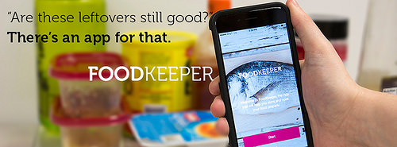
Food Storage App
Image source: USDA/FSIS
Notes:
Read the slide.
Note: if you have a smart phone bring up the app and show participants how the app works. It is available as a mobile application for Android and Apple devices.
http://blogs.usda.gov/2015/04/02/new-usda-foodkeeper-app-your-new-tool-for-smart-food-storage/

Slide 68
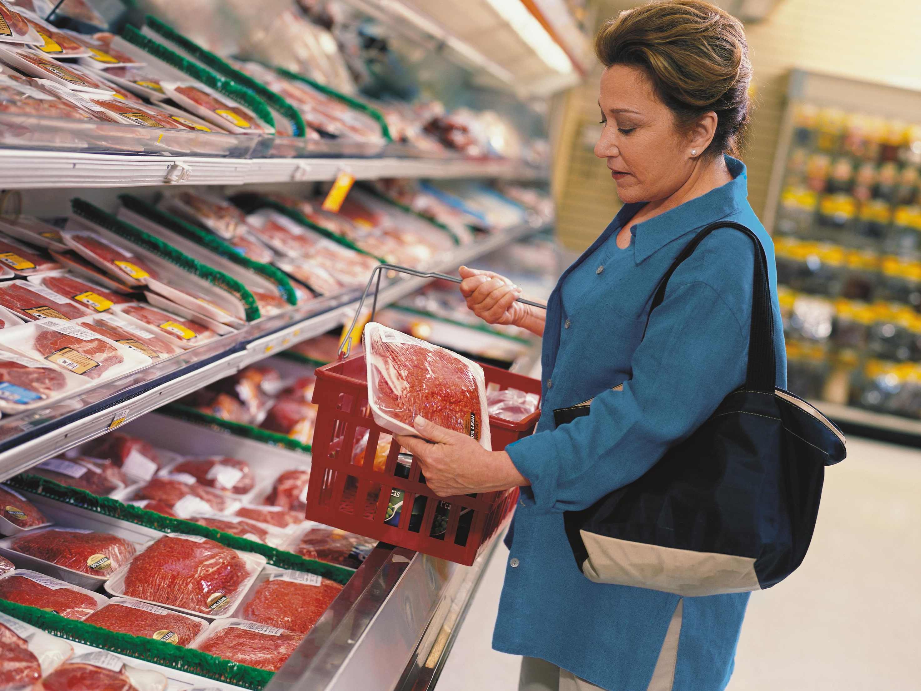
In conclusion, become an able label reader!
Image source: USDA/SNAP-Ed
Notes:
Read the slide.

Slide 69
General reference
U.S. Department of Health and Human Services, Food and Drug Administration. A Food Labeling Guide. (2013) at
https://www.fda.gov/media/81606/download
Notes:
This is the general reference used. Additional references are in the speaker’s notes and can be provided to participants if desired.

Slide 70

Questions?
Extension is a Division of the
Institute of Agriculture and Natural Resources at the University of Nebraska–Lincoln cooperating with the Counties and the United States Department of Agriculture.
University of Nebraska–Lincoln Extension educational programs abide with the nondiscrimination policies of the University of Nebraska–Lincoln and the United States Department of Agriculture.
Reference to commercial products or trade names is made with the understanding that no discrimination is intended of those not mentioned and no endorsement by University of Nebraska–Lincoln Extension is implied for those mentioned.
Notes:
Any questions?

