Slide 1
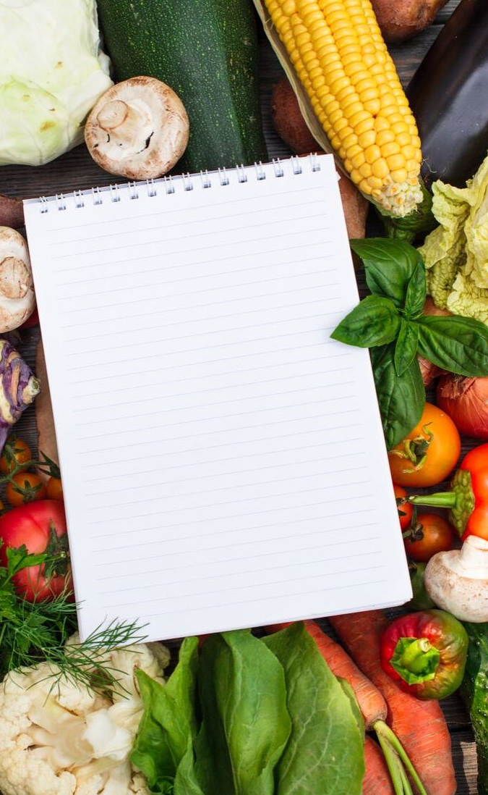


LET'S TEST YOUR VEGGIE IQ

Slide 2

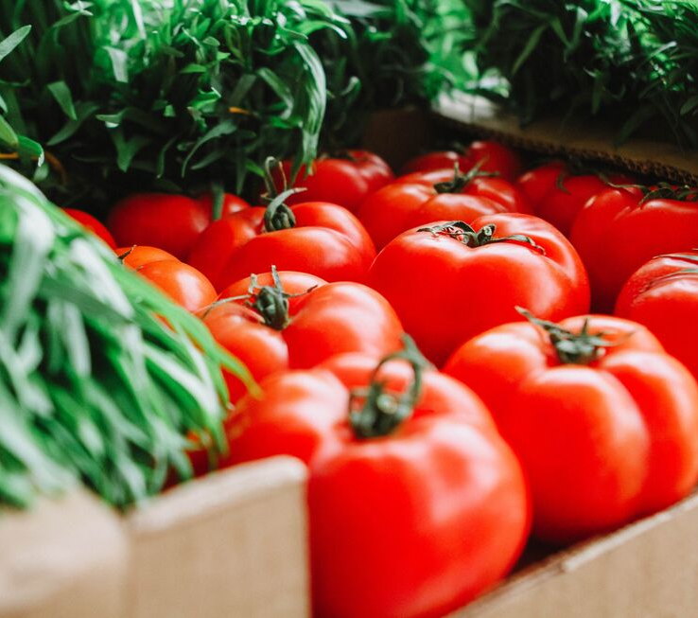

Authors:
Hannah Guenther, MS
Alice Henneman, MS, RDN
University of Nebraska-Lincoln Extension
food.unl.edu
Updated February 2021

Slide 3
HOW WELL DO YOU KNOW YOUR VEGETABLES?

Slide 4
Why do we need to eat vegetables?
FULL OF NUTRIENTS AND LOW IN CALORIES
VITAMIN A
VITAMIN C
Keeps eyes and skin healthy and helps fight infections.
Vitamin C helps cuts and wounds and keeps gums and teeth healthy.
Vegetables are low in fat and calories but full of nutrients we need.
POTASSIUM
Potassium helps maintain a healthy blood pressure.
Notes:
Source: https://www.myplate.gov/eat-healthy/vegetables

Slide 5
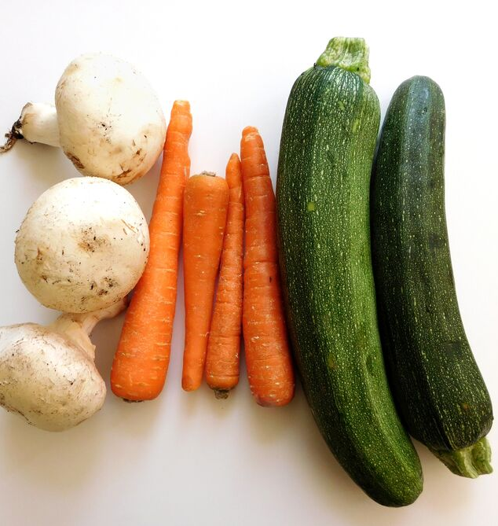
MULTIVITAMINS ARE NOT THE SAME AS EATING WHOLE VEGETABLES
Multivitamins are missing fiber, antioxidants, phytochemicals, and flavonoids.

Slide 6
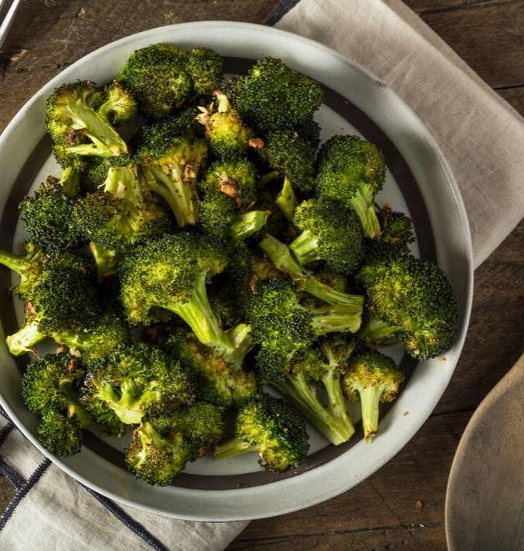
IT IS IMPORTANT TO ALWAYS BE TRYING NEW VEGETABLES
You don't know you don't like it unless you try it! Make sure you don't
YUCK MY YUM.

Slide 7
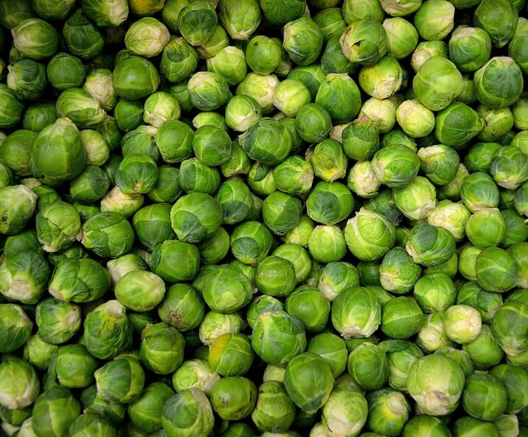
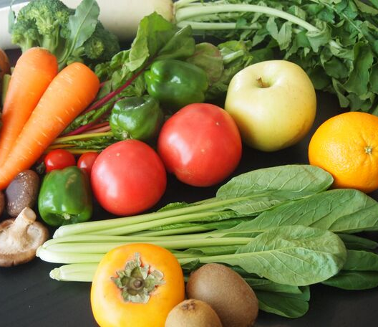
1-3 cups of vegetables
should be eaten each day.
We need different amounts of vegetables depending on our age, gender, and level of physical activity.
https://www.myplate.gov/eat-healthy/vegetables
Notes:
See Daily Vegetable Table for specific recommendations at https://www.myplate.gov/eat-healthy/vegetables

Slide 8
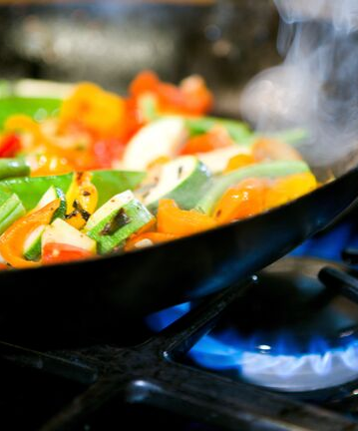
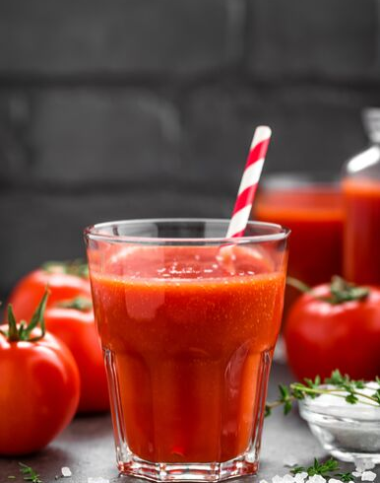
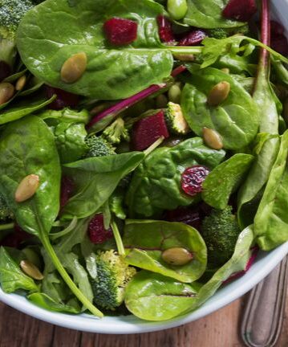
1 CUP OF VEGETABLES IS EQUAL TO:
1 CUP OF RAW OR COOKED VEGETABLES
1 CUP 100% VEGETABLE JUICE
2 CUPS OF RAW LEAFY GREENS

Slide 9
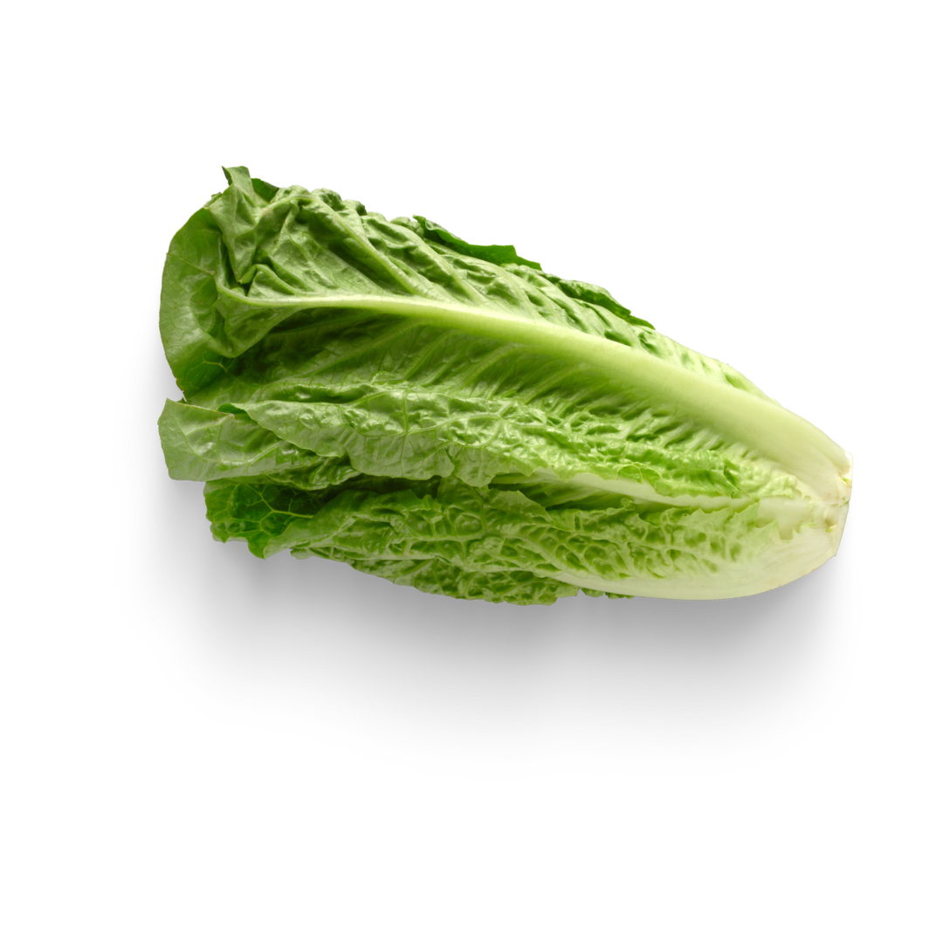
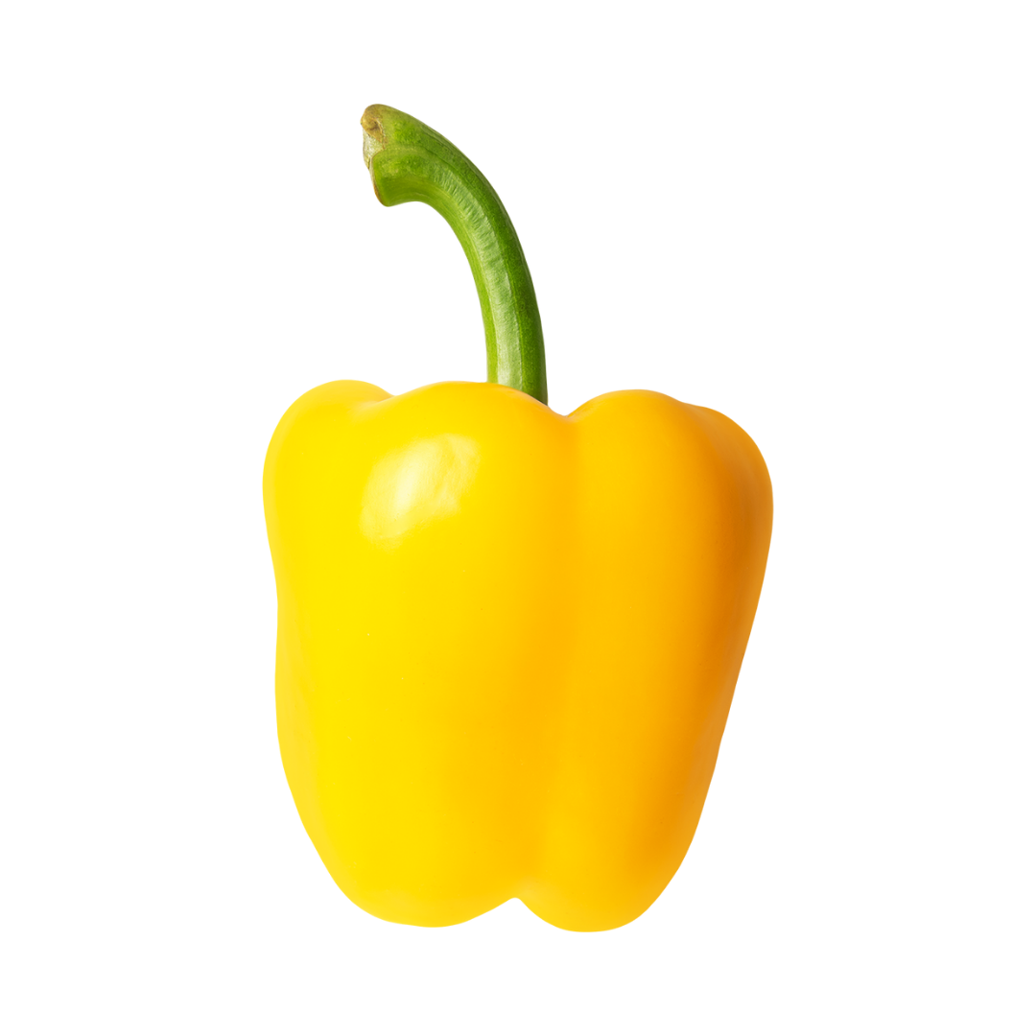
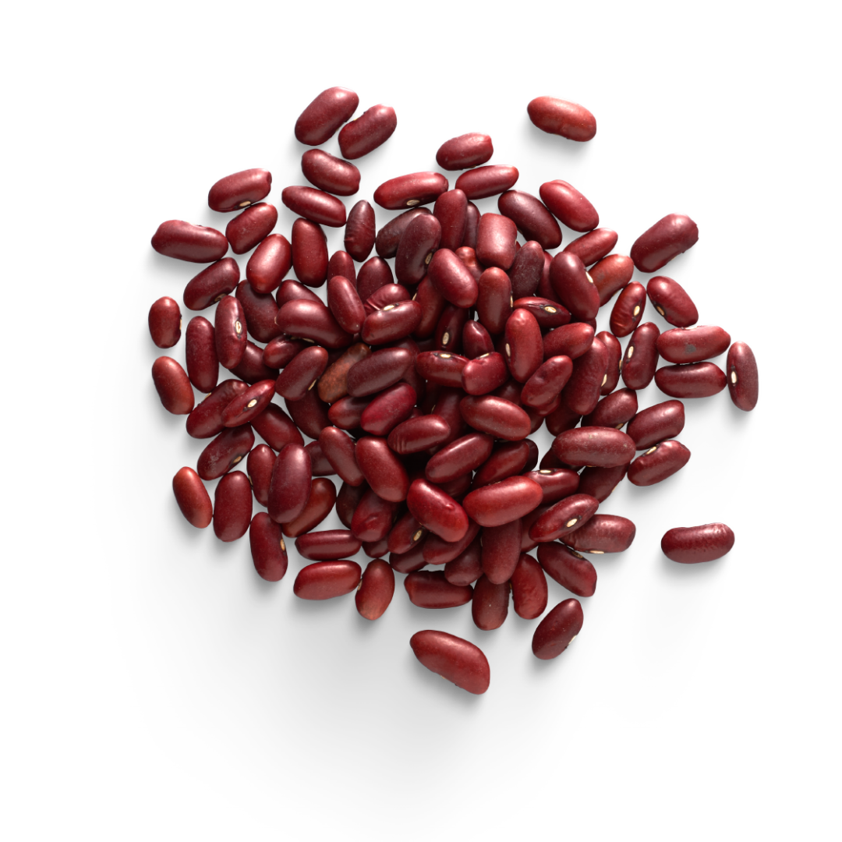
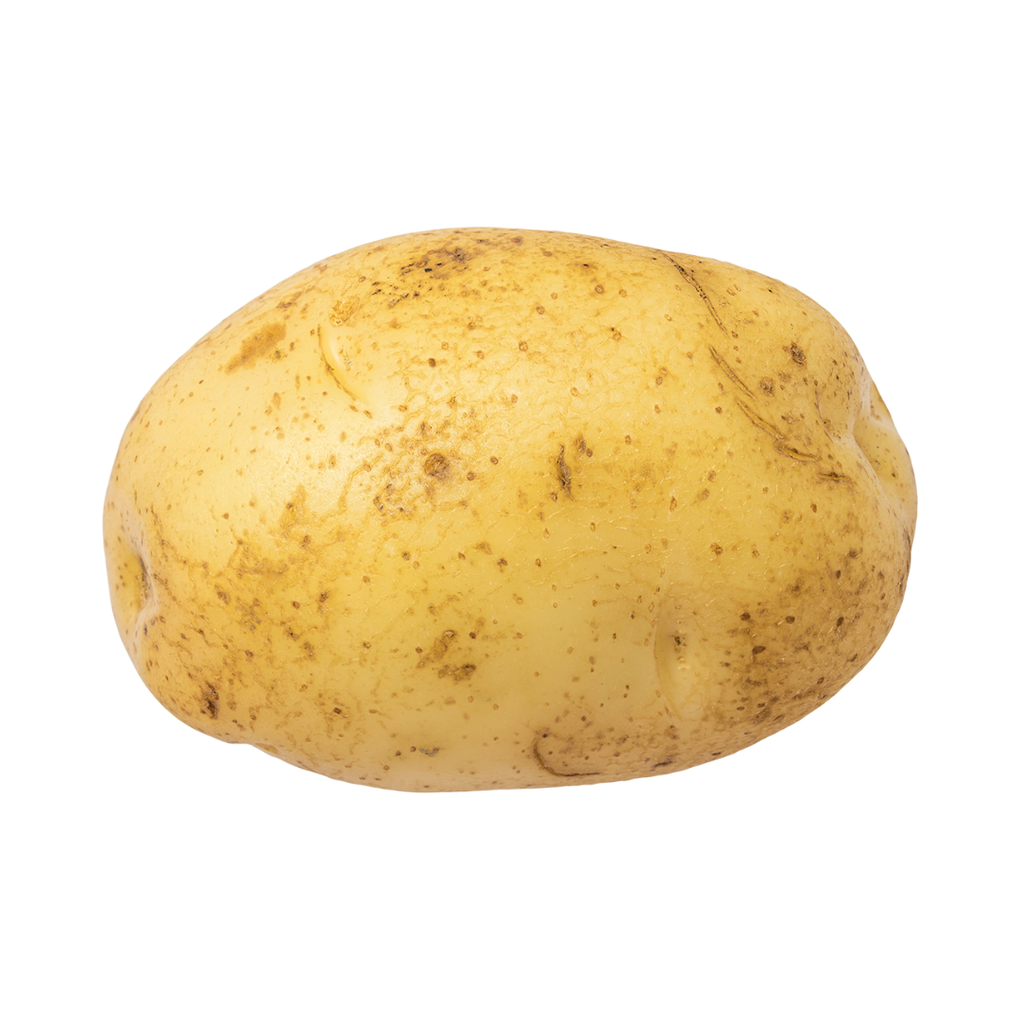
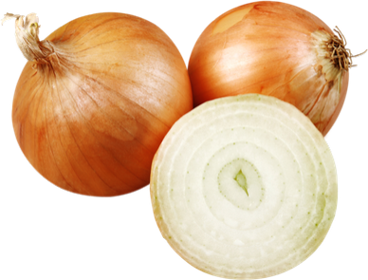
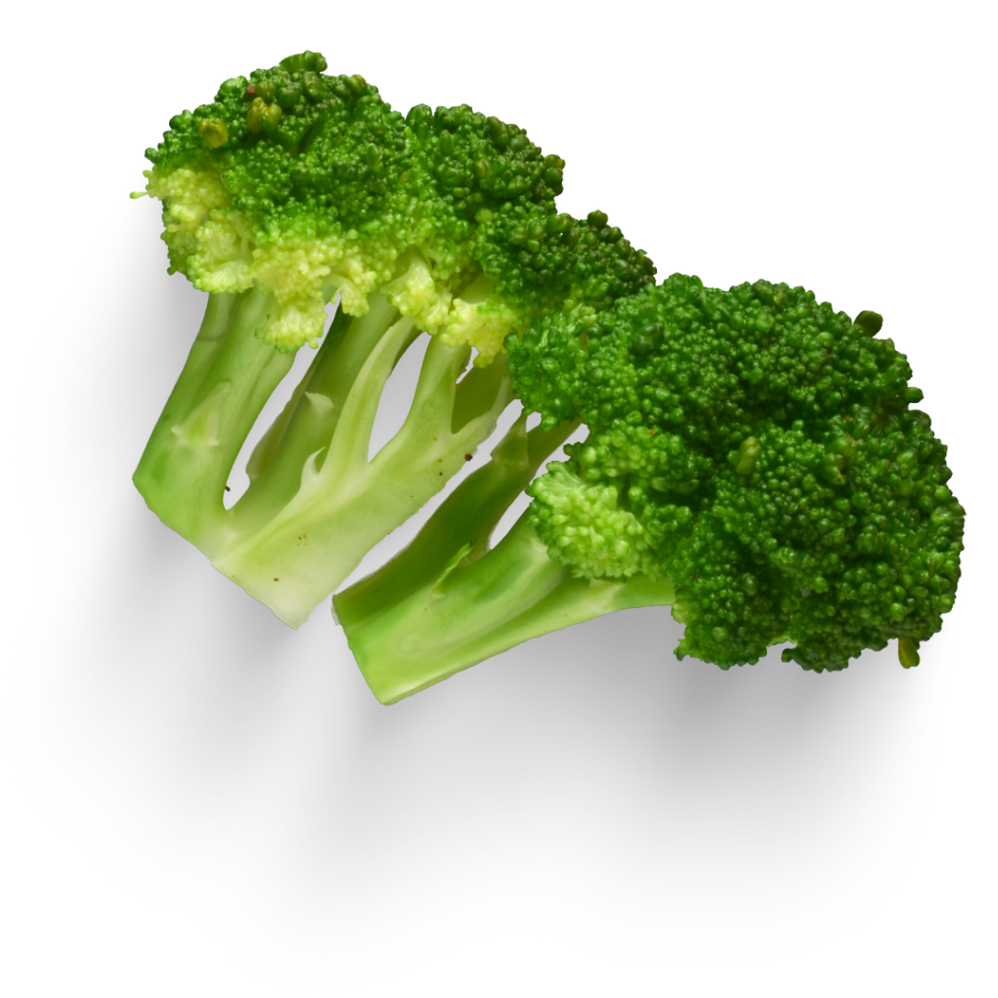
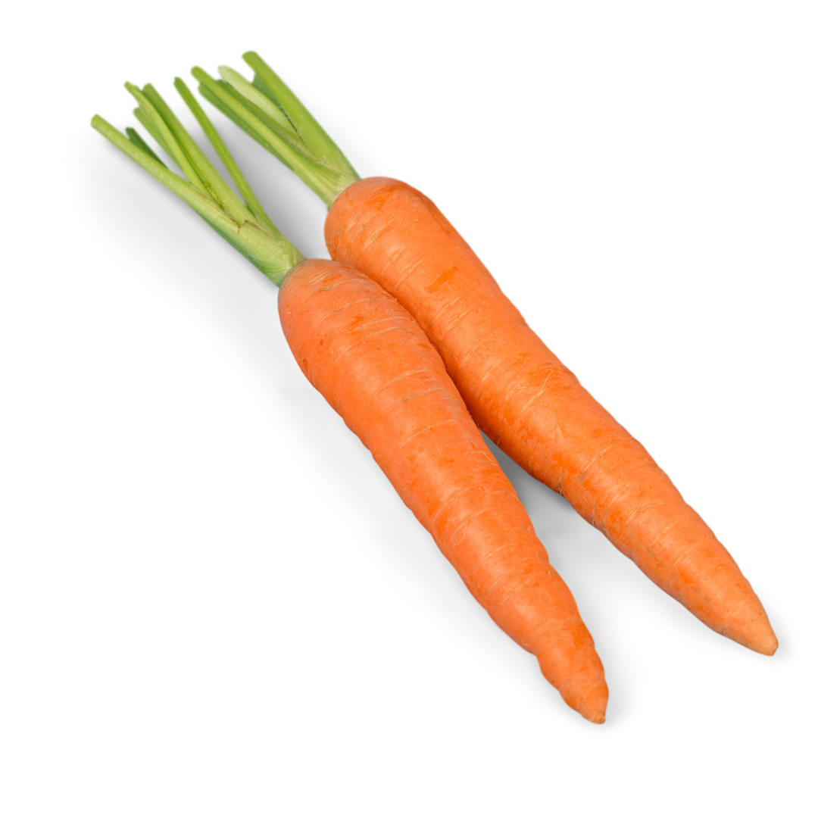

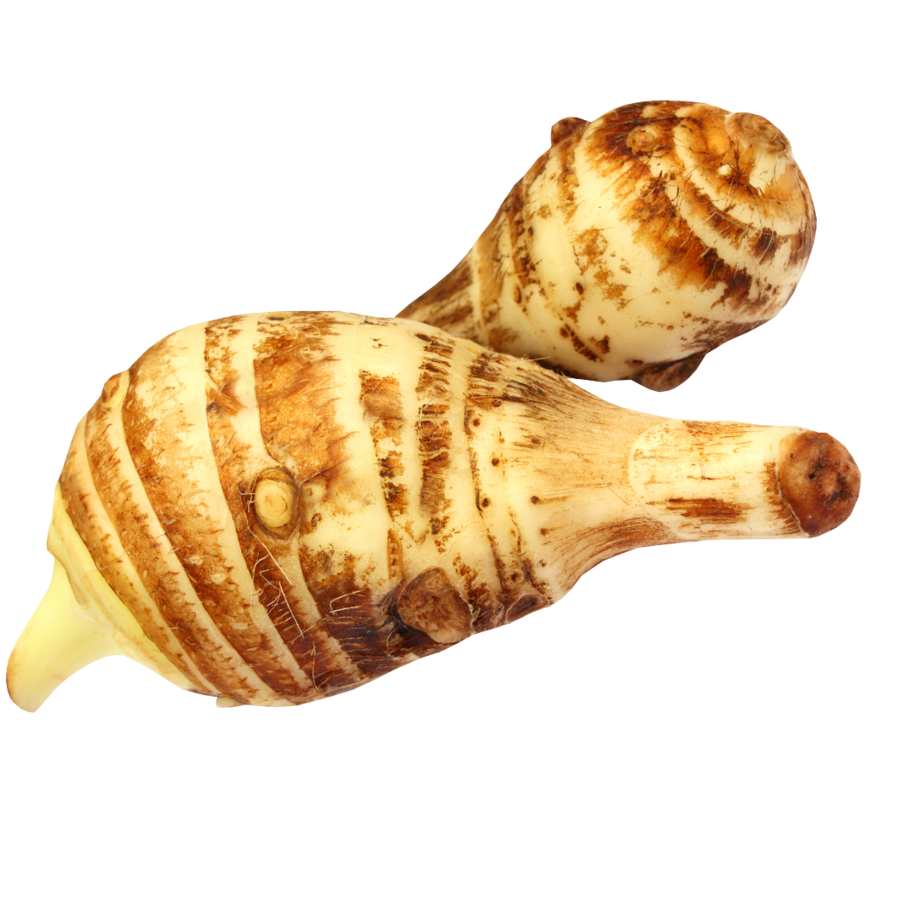
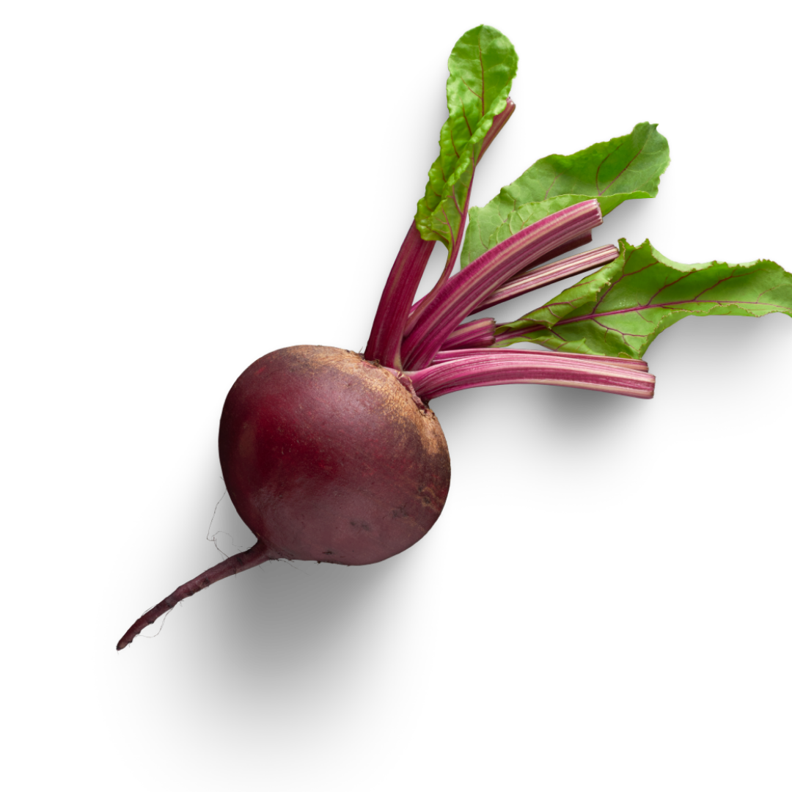
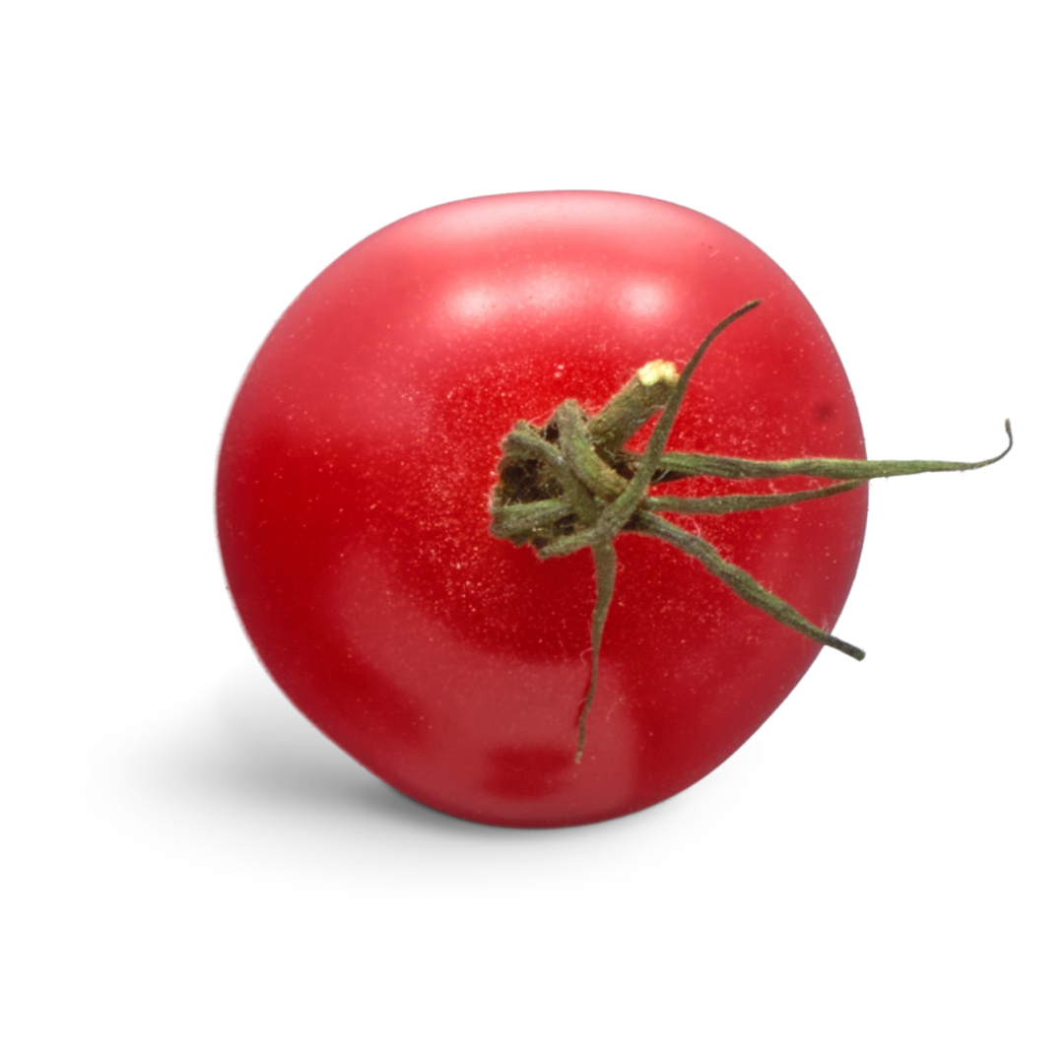
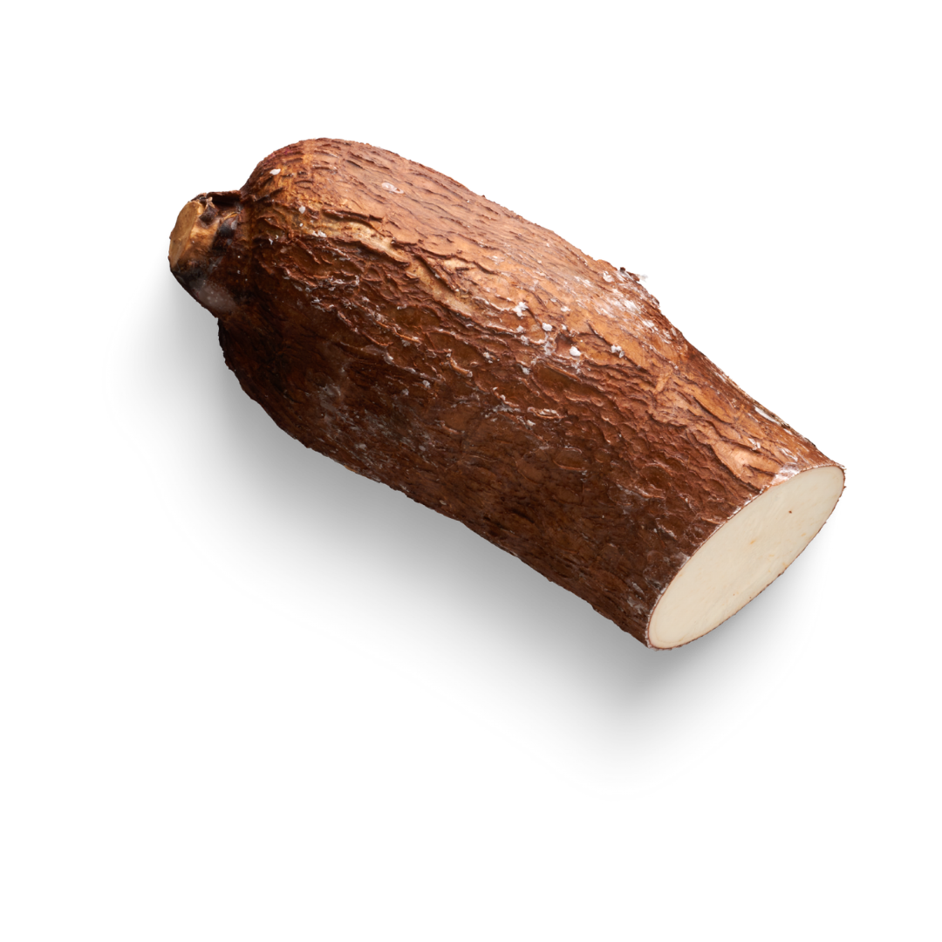
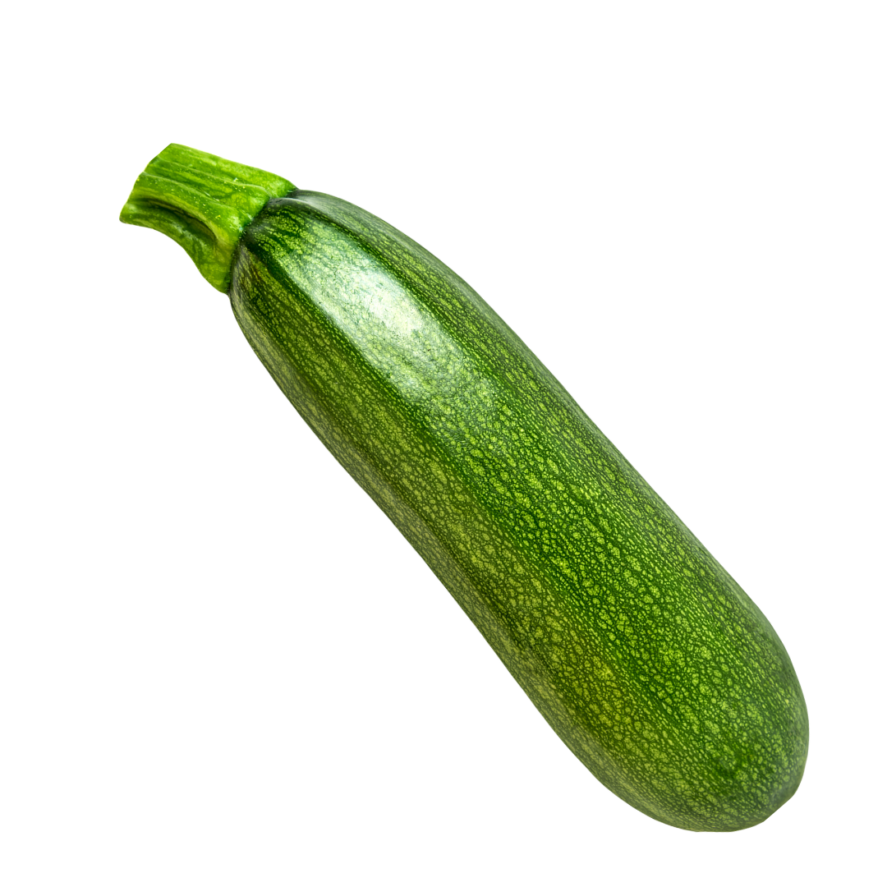
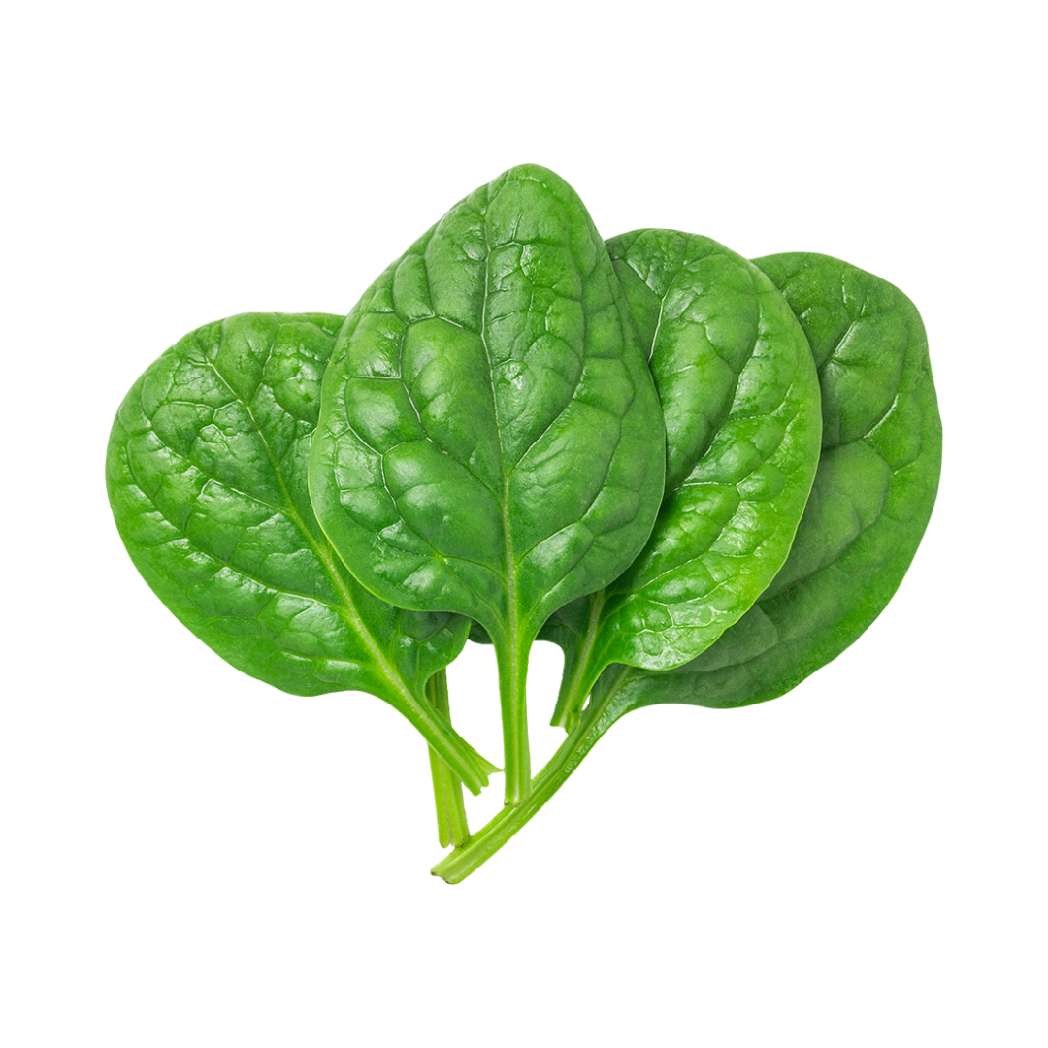
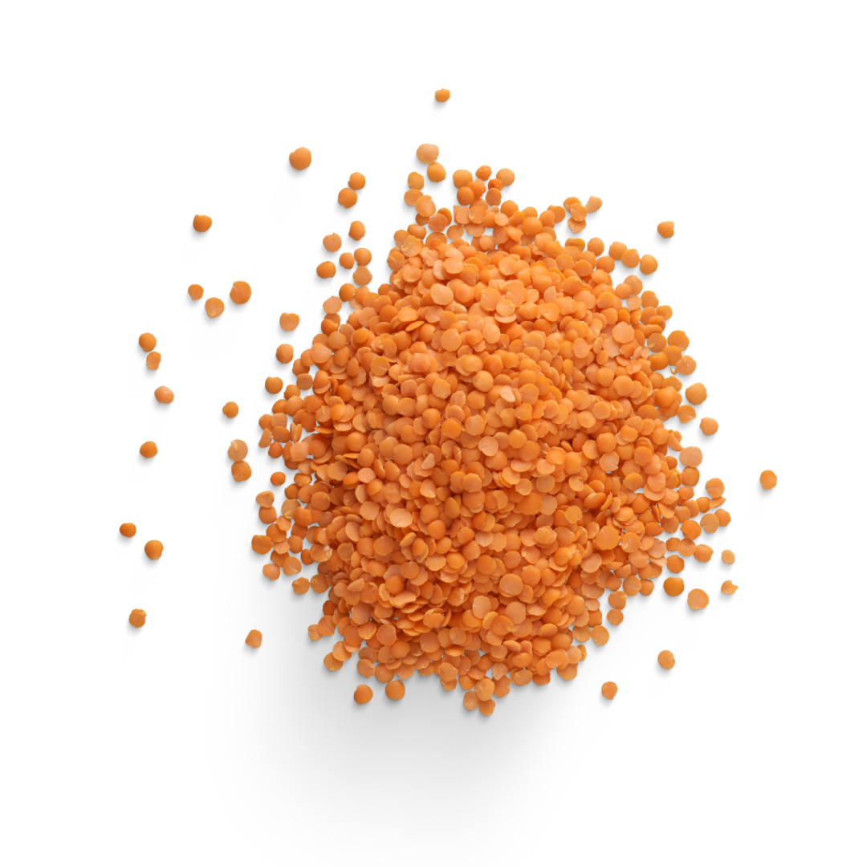
Pick a variety of vegetables from each subgroup
Dark-Green | Red and Orange | Beans, Peas, and Lentils | Starchy | Other

Slide 10
LET'S SEE IF YOU CAN GUESS THE FOLLOWING VEGETABLES.
THERE WILL BE ONE FROM EACH SUBGROUP

Slide 11

VEGETABLE #1
EXCELLENT SOURCE OF PROTEIN, HIGH IN FIBER, POTASSIUM, AND FOLATE
OFTEN EATEN COLD IN SALADS OR HOT IN SOUPS
CREAM-COLORED, SMALL AND ROUND
MAIN INGREDEIENT IN HUMMUS
NAME THAT VEGGIE!

Slide 12
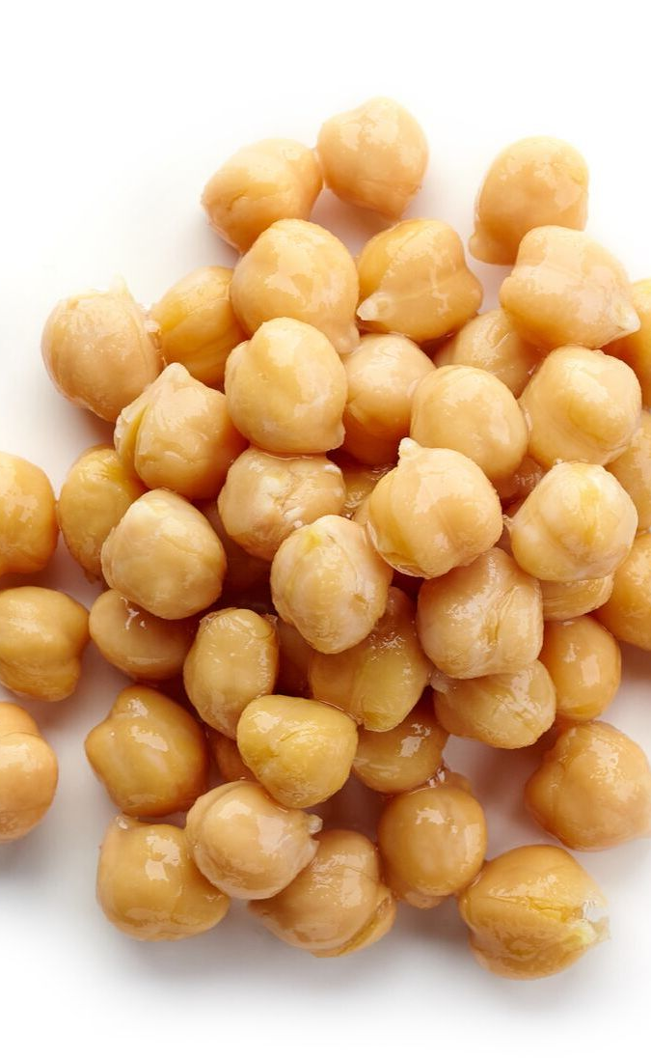
GARBANZO BEANS OR CHICKPEAS
Beans, Peas, and Lentils Subgroup

Slide 13
VEGETABLE #2
COMES IN A VARIETY OF COLORS INCLUDING ORANGE, RED, YELLOW, AND GREEN
YOU MAY THINK THEY ARE SPICY BECAUSE OF THEIR NAME BUT THEY ARE NOT
THEY DO NOT RING
EXCELLENT SOURCE OF VITAMIN A, VITAMIN C, AND POTASSIUM
NAME THAT VEGGIE!

Slide 14
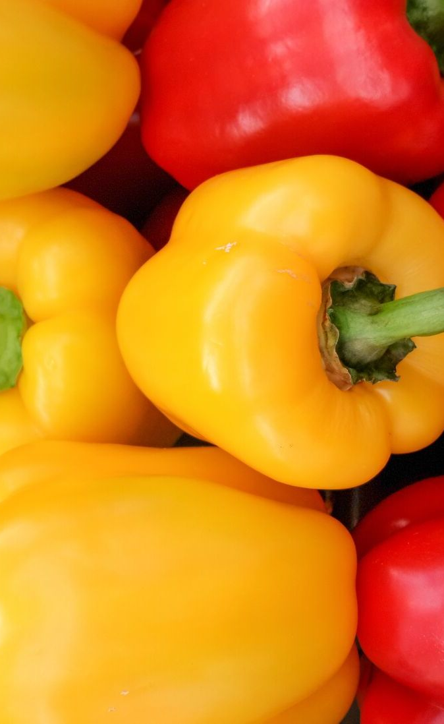
BELL PEPPERS
Red and Orange Vegetables and Other Vegetables Subgroup

Slide 15
VEGETABLE #3
IT LOOKS LIKE BIG, WHITE, PUFFY KERNELS
IT IS USED IN SOUPS, STEWS, AND CASSEROLES
THEY ARE SMALL, FLAT AND ROUND
IT CONTAINS FIBER, IRON, and VITAMIN B3
NAME THAT VEGGIE!

Slide 16
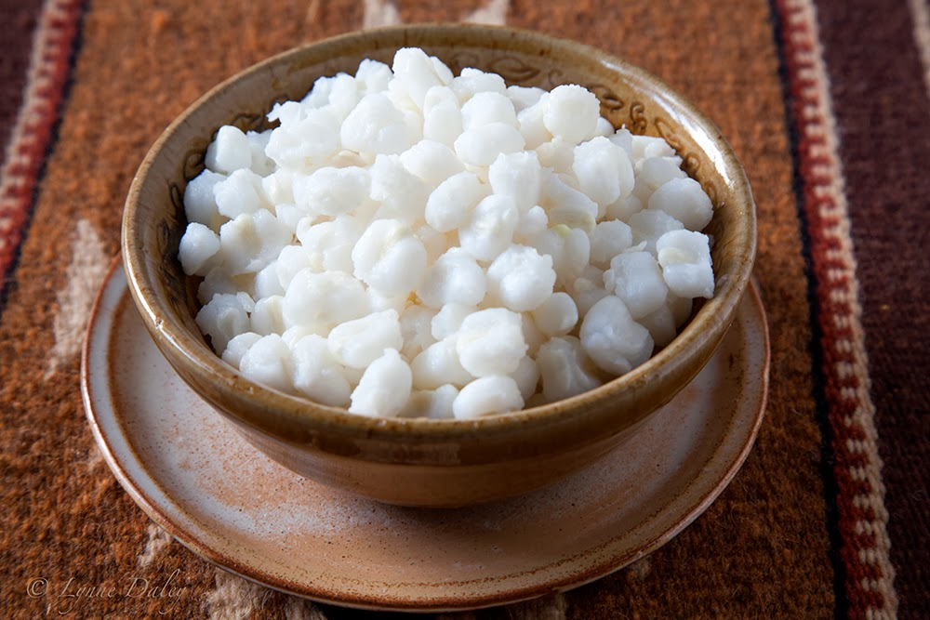
HOMINY
Starchy Vegetables Subgroup

Slide 17
VEGETABLE #4
THIS VEGETABLE IS GREEN AND LEAFY
IT IS LOADED WITH NUTRIENTS
YOU CAN COOK IT OR EAT IT RAW
THIS IS POPEYE'S FAVORITE VEGETABLE
NAME THAT VEGGIE!

Slide 18
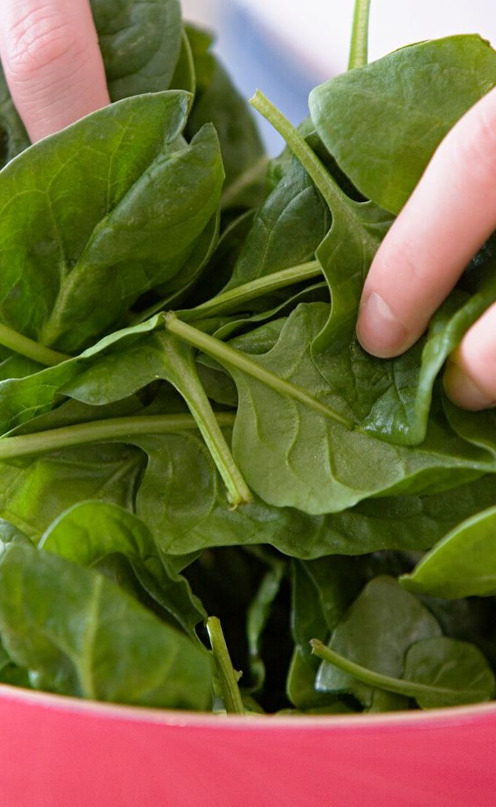
SPINACH
Dark-Green Vegetables Subgroup

Slide 19
VEGETABLE #5
THIS VEGETABLE IS 96% WATER
IT IS USUALLY EATEN RAW
THEY ARE SOMETIMES PICKLED
THEY HAVE WAXY SKIN ON THE OUTSIDE
THEY CONTAIN B VITAMINS AND FIBER
NAME THAT VEGGIE!

Slide 20
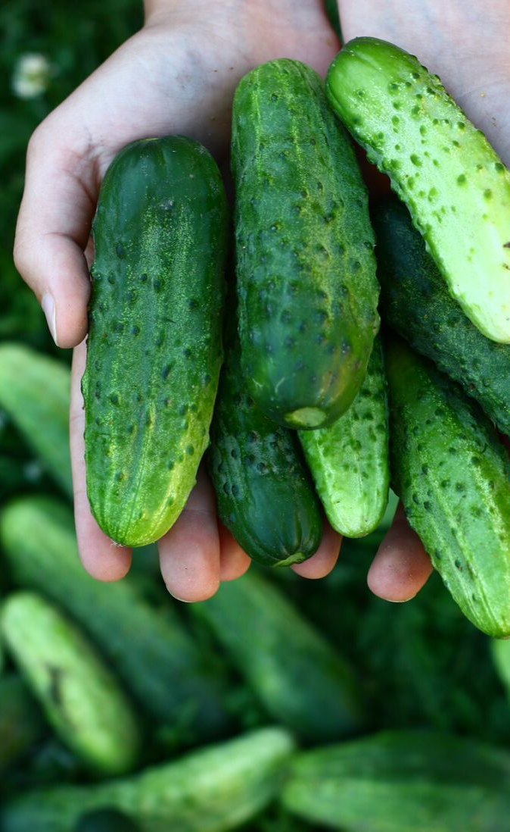
CUCUMBERS
Other Vegetables Subgroup

Slide 21
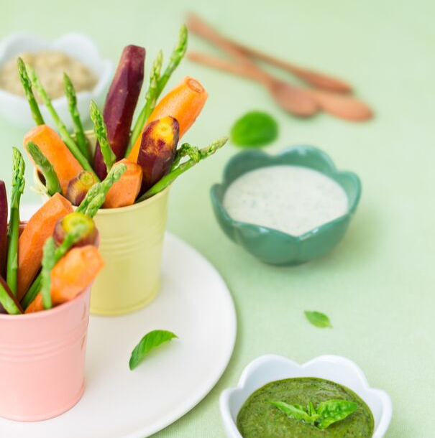
IN SMOOTHIES
AS A SNACK
WITH A DIP
IN A WRAP
ON A SANDWICH
THERE ARE LOTS OF OTHER WAYS TO ENJOY VEGETABLES.
How do you like to eat vegetables?

Slide 22
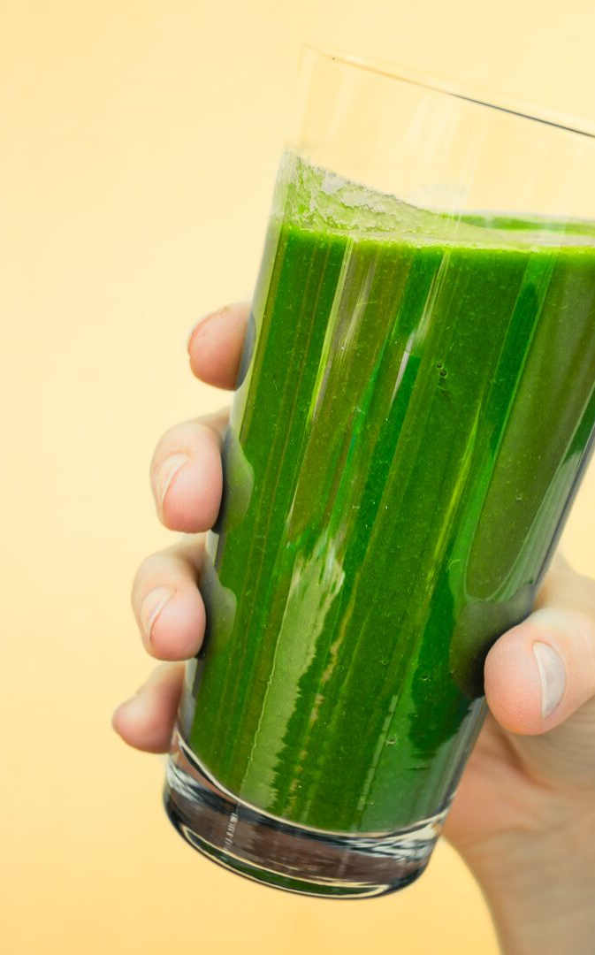
EATING VEGETABLES KEEPS YOU HEALTHY!
EAT MORE VEGETABLES EVERYDAY

Slide 23
References
Vegetables, United States Department of Agriculture (USDA), https://www.myplate.gov/eat-healthy/vegetables
U.S. Department of Agriculture and U.S. Department of Health and Human Services. Dietary Guidelines for Americans, 2020-2025. 9th Edition. December 2020. Available at DietaryGuidelines.gov.

