Slide 1
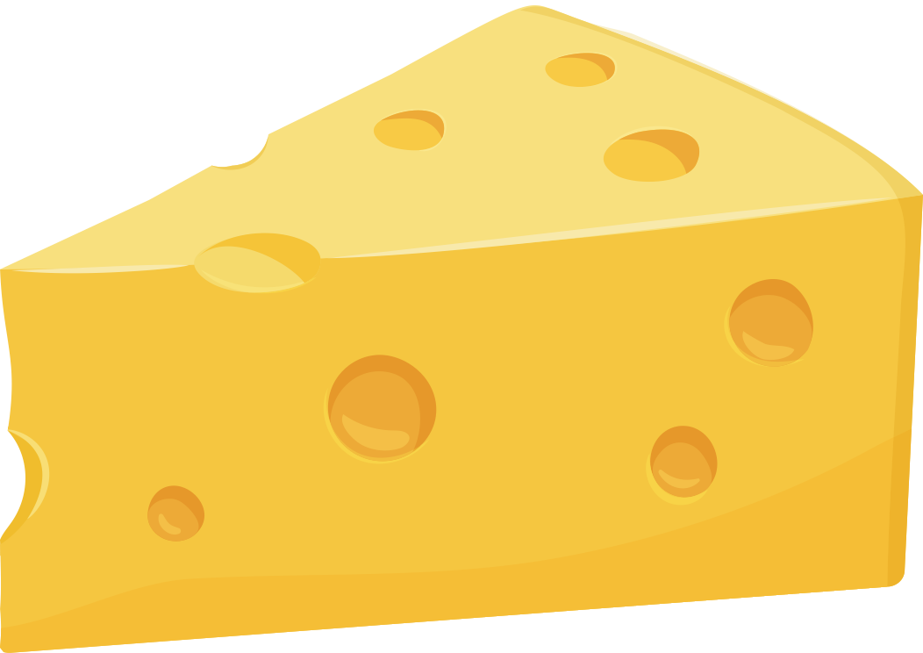
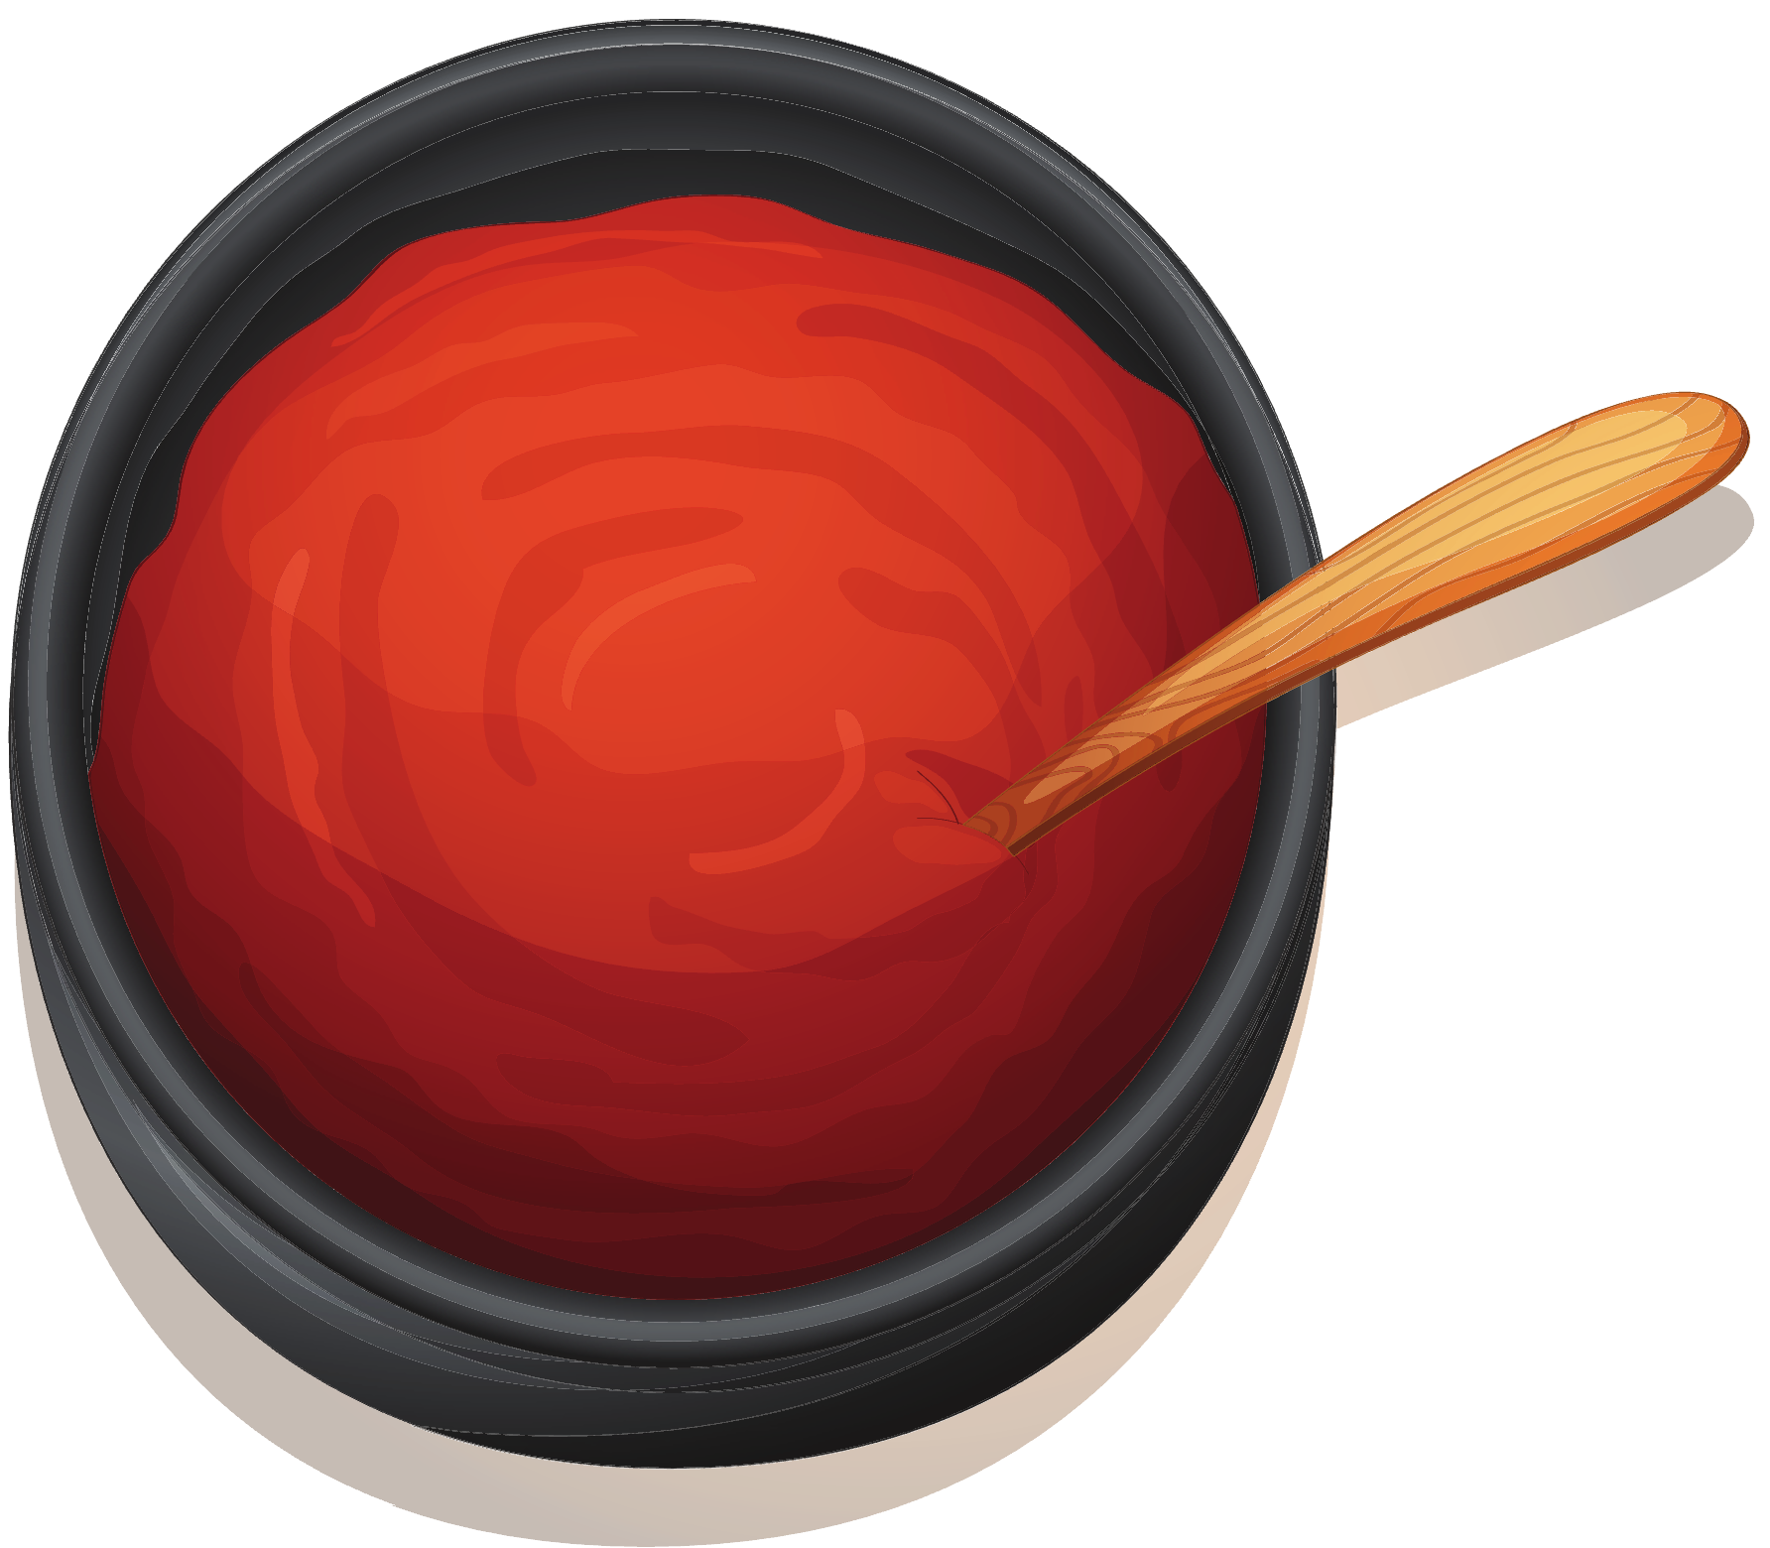
THE SCIENCE OF PIZZA
Created by:
Andreia Bianchini, PhD
Jayne Stratton, PhD
Food Science and Technology
University of Nebraska – Lincoln
Department of Food Science and Technology
University of Nebraska-Lincoln (2023)
Notes:
Department

Slide 2
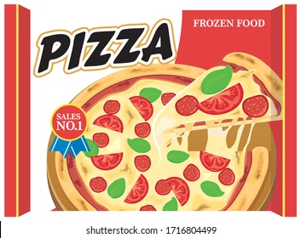
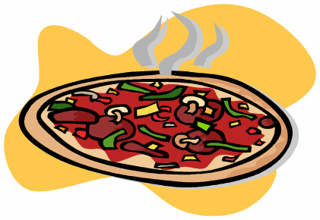
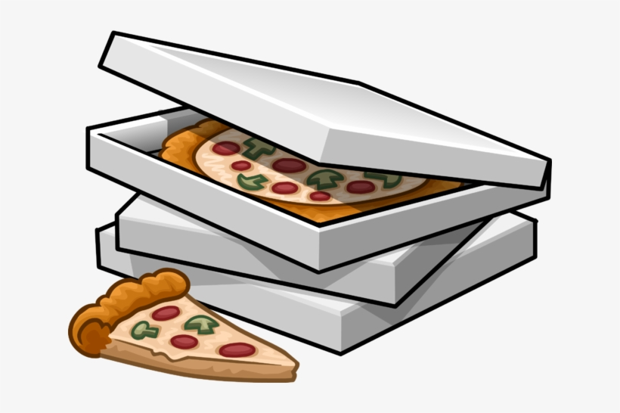
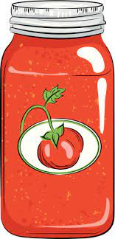
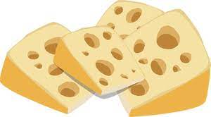
PIZZA ANYONE???

Slide 3
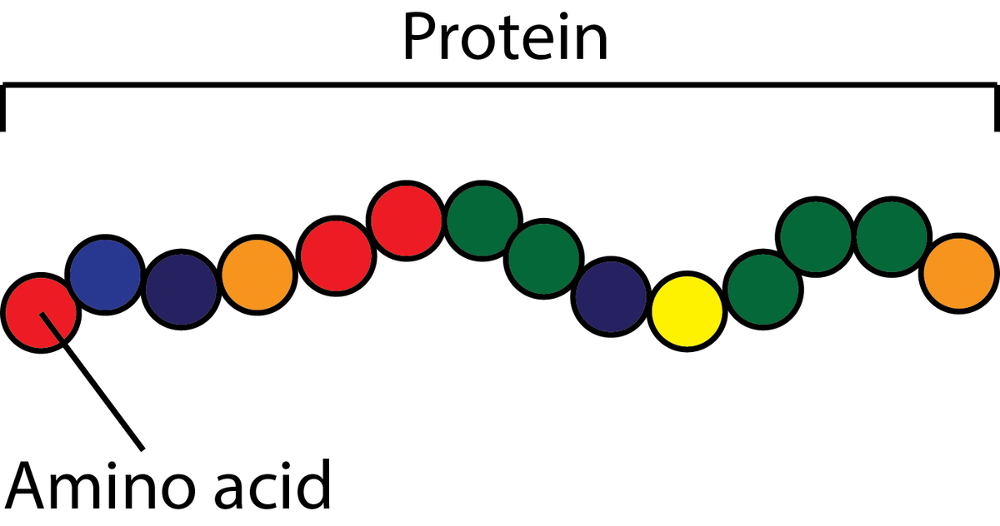
THE SCIENCE OF
CROSS-LINKING
Foods are made of ingredients. The major ingredients of pizza - tomatoes, cheese, and bread - are networks of macromolecules that are either linked together or in association with each other to form the food matrix.
Macromolecules are made of single subunits or building blocks that are linked together. One example is protein, which is made of a chain of aminoacids.
Atoms to Molecules to Macromolecules to Networks
Atom
Molecule
(Monomer)
Macromolecule
(Polymer)
Network
(Cross-Linked Polymer)

Slide 4
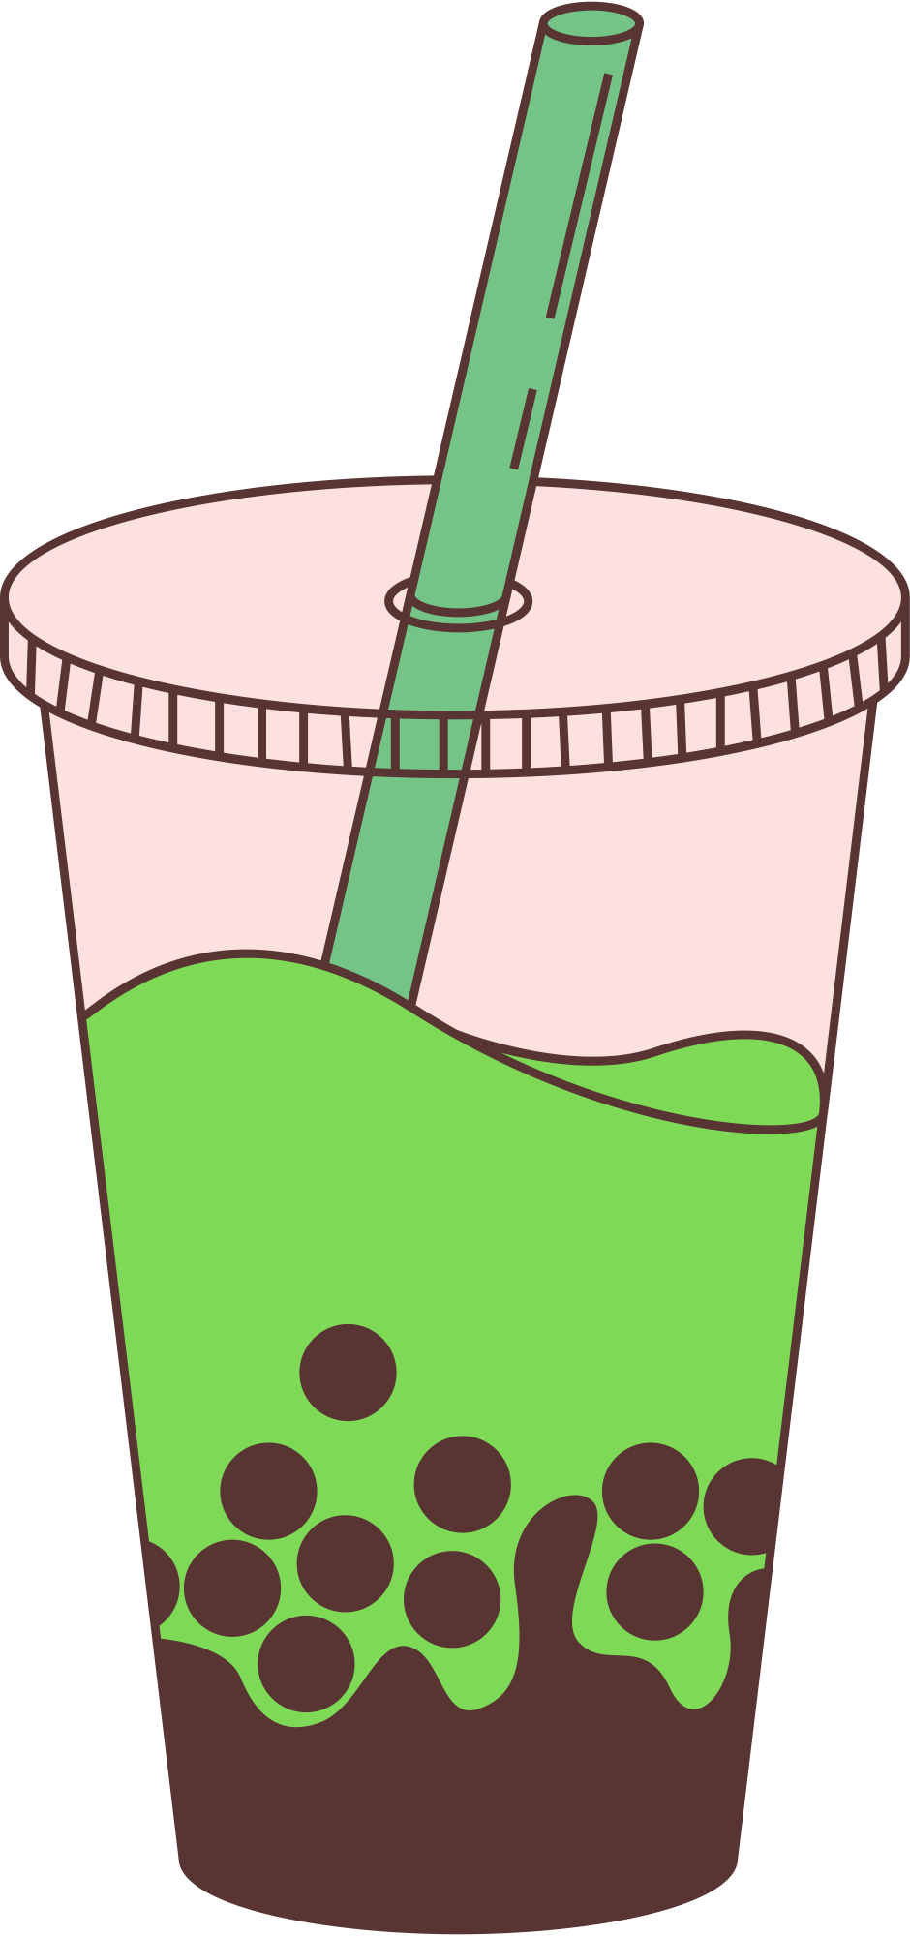
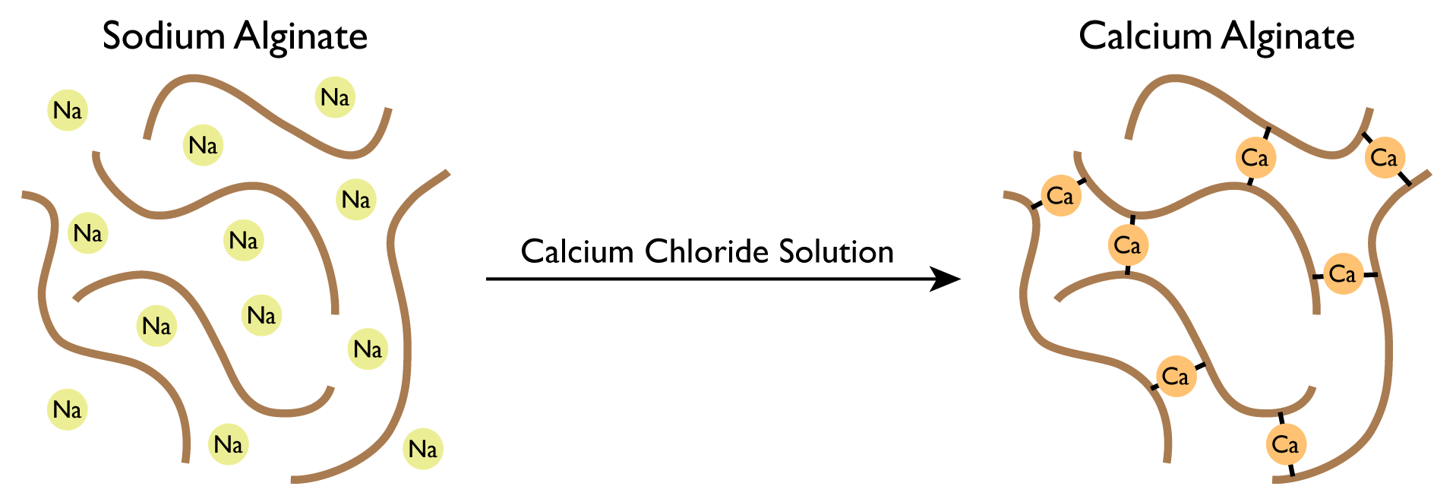
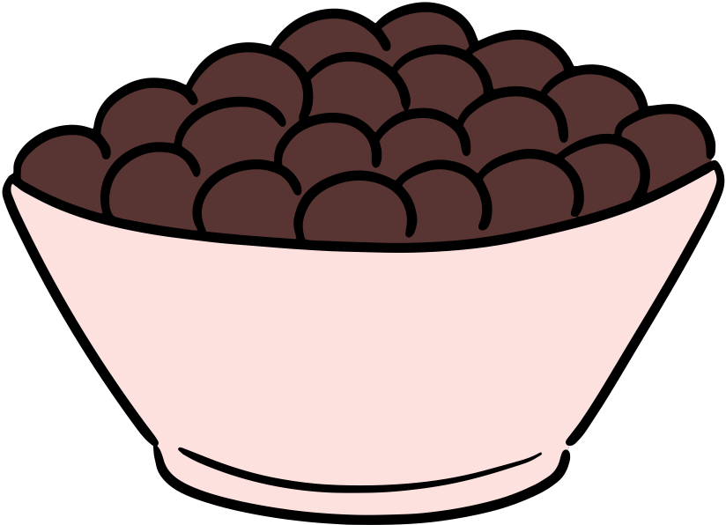
THE SCIENCE OF
CROSS-LINKING
The Reaction
Sodium alginate is a polysaccharide made of alginate linked to sodium ions. When mixed with water, the sodium (Na+) ions dissociate giving an opportunity for other ions to interact with the alginate chains.
In the presence of calcium (Ca²+) ions, the alginate chains are cross-linked together. The result is an intertwining network that has a variety of applications in food science.
Applications
Gummy worms can be made by mixing sodium alginate, water, and flavoring to form a mixture. This mixture is later added as a continuous stream to a calcium chloride solution forming a gel that can be further cut/formed into different candies.
Spheres, such as the pearls found in bubble tea are also made by combining alginate and calcium ions. However, in this process known as spherification the flavored alginate is “dropped” into a bath of calcium chloride solution.

Slide 5
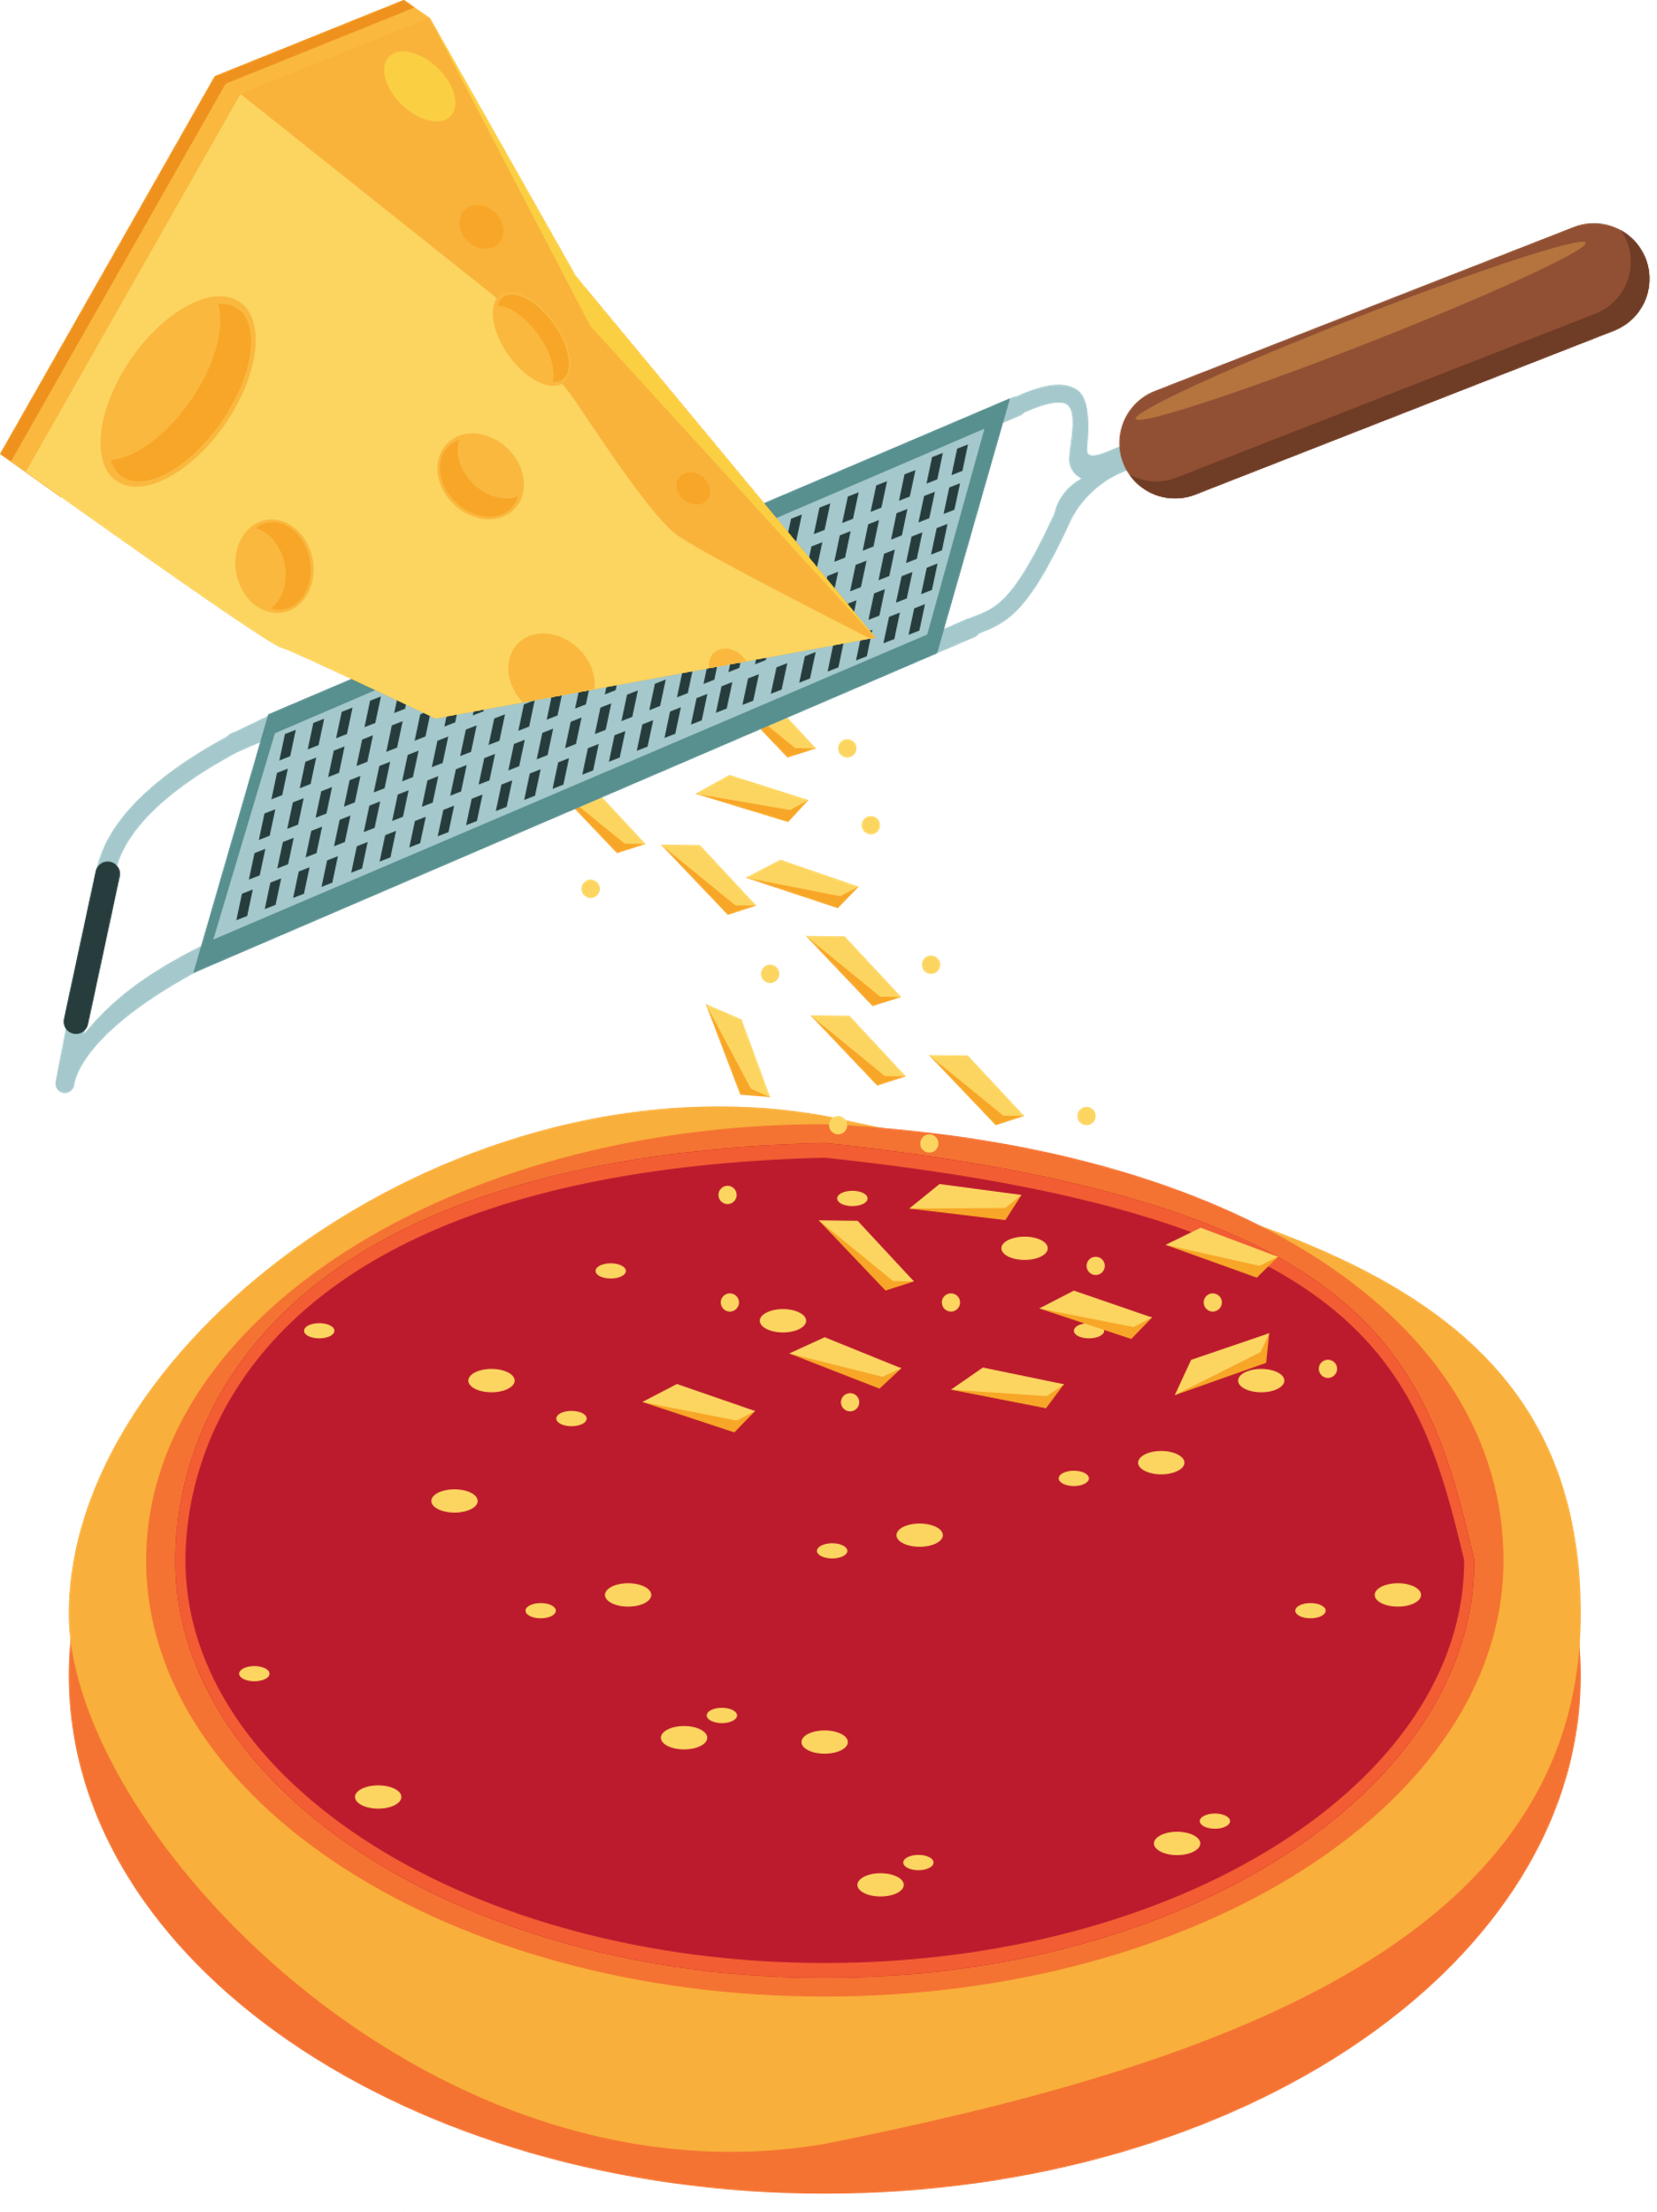
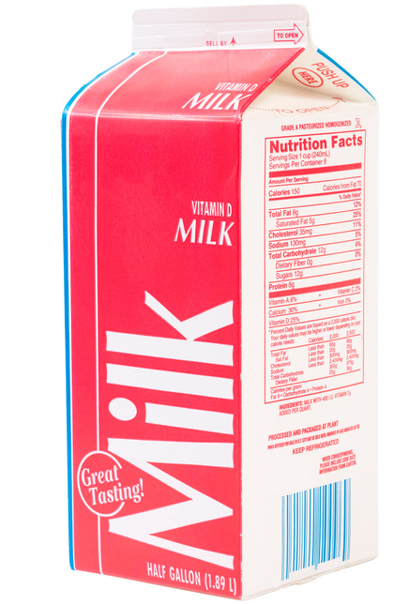
THE SCIENCE OF CHEESE
All cheeses start as milk. Studying the label of a milk container reveals that there are many components in milk; including fat, protein, and carbohydrates.
To make cheese, the proteins in milk need to coagulate or curdle. Coagulation occurs by acidifying milk, by heating it up, adding an enzyme called Rennet, or by adding good bacteria.
Milk Proteins in Solution
The side chains of milk proteins carry an electric charge which is determined by the pH of the milk.
Naturally, milk has a pH of 6.6. At this pH protein molecules remain in solution and separated because they have a net negative charge.
^{Protein Molecules at pH 6.6}
Notes:
Separate milk: casein and whey

Slide 6
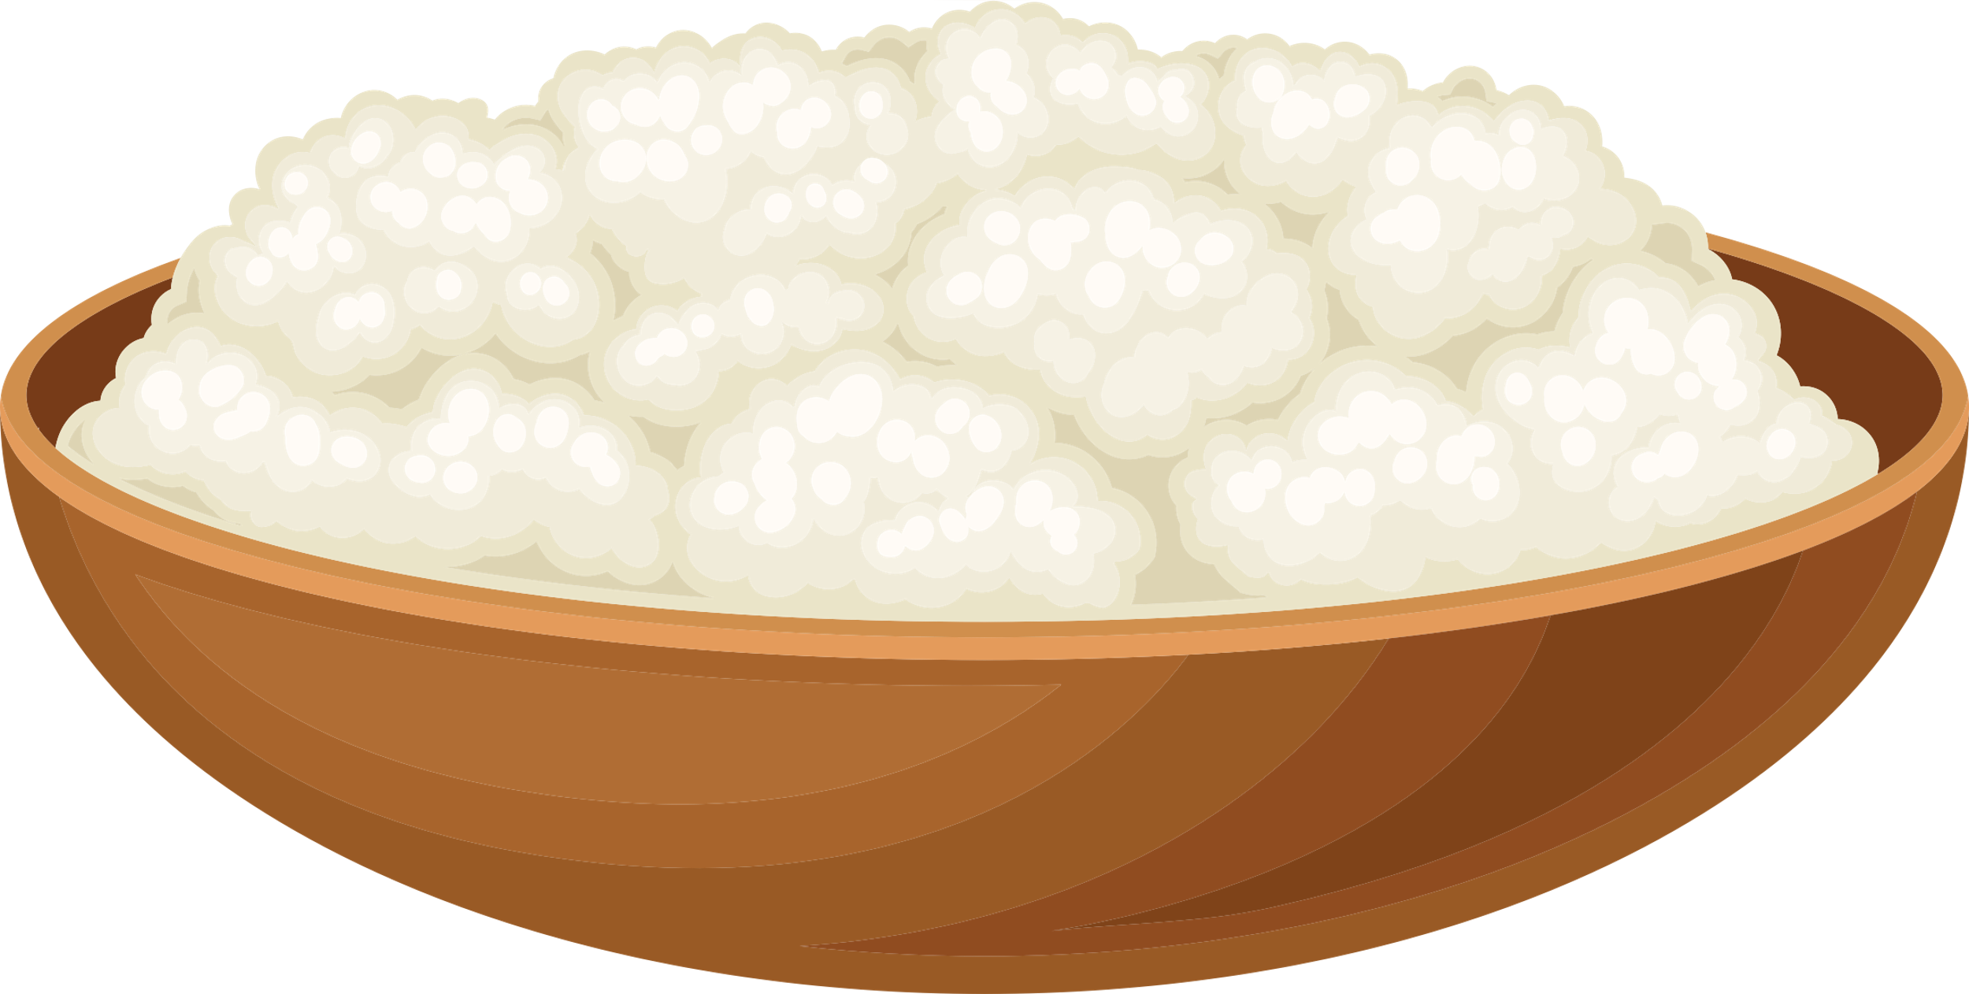
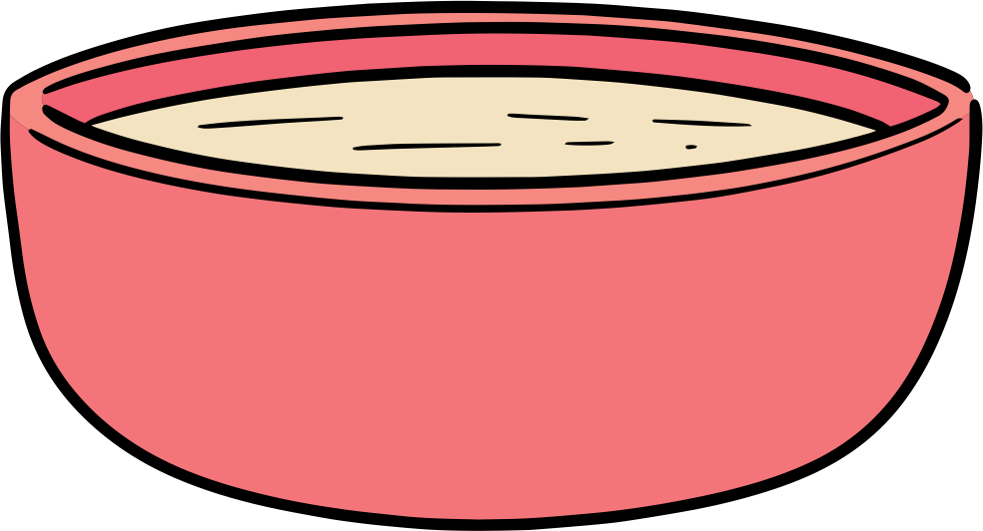
THE SCIENCE OF CHEESE
Acid Precipitation
When the pH of milk is changed by addition of an acid (i.e., vinegar) the charge distribution of the proteins is also changed.
When the milk pH is lowered to pH 4.6 the total charge of the protein becomes zero, and molecules no longer repel each other. The acidification causes the protein to precipitate from the solution.
The pH at which this happens is called the isoelectric point of the protein.
^{Protein Molecules}
^{at pH 4.6}
From Milk to Cheese
^{Cheese Curds}
^{(Casein)}
^{Acidification}
H⁺
^{Strainer}
^{Whey}
^{(Soluble Protein)}
^{Milk}
Notes:
Separate milk: casein and whey

Slide 7
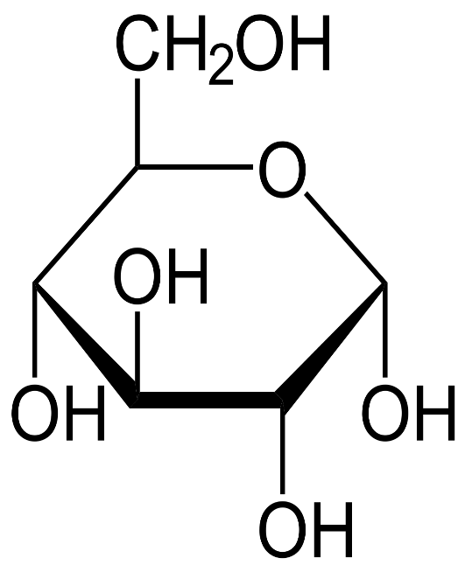
THE SCIENCE OF BREAD
Bread is a common staple food throughout the world ranging from bagels to rye bread to pizza dough. All bread products derive from flour, which the major components are proteins and carbohydrates.
Proteins in bread include glutenins and gliadins, which are large molecules built up of a large number of amino acids. These are collectively referred to as gluten. When water is added, the proteins form a network held together by hydrogen bonds and disulfide cross-links.
Bread Fermentation
Flour contains starch, which is made of long chains of sugar molecules. During bread fermentation amylase, an enzyme, converts starch into maltose; then maltase, another enzyme produced by yeasts, converts maltose in glucose. Along with other sugars, glucose can be used by yeast for fermentation.
Yeast
Glucose
Yeast are single-celled fungi that help convert sugars in the bread to carbon dioxide. The CO₂ causes the bread to rise because the gluten protein is very elastic and allows the bread to increase in volume like a balloon.
Wheat Flour
OH
Carbon dioxide
Ethanol
Notes:
Idea: Gluten network helps traps the gas, vs flatbread network can't do it by itself
Compare leavened bread v. flatbead
Reference: Baking Bread: The Chemistry of Bread-Making – Compound Interest (compoundchem.com)

Slide 8
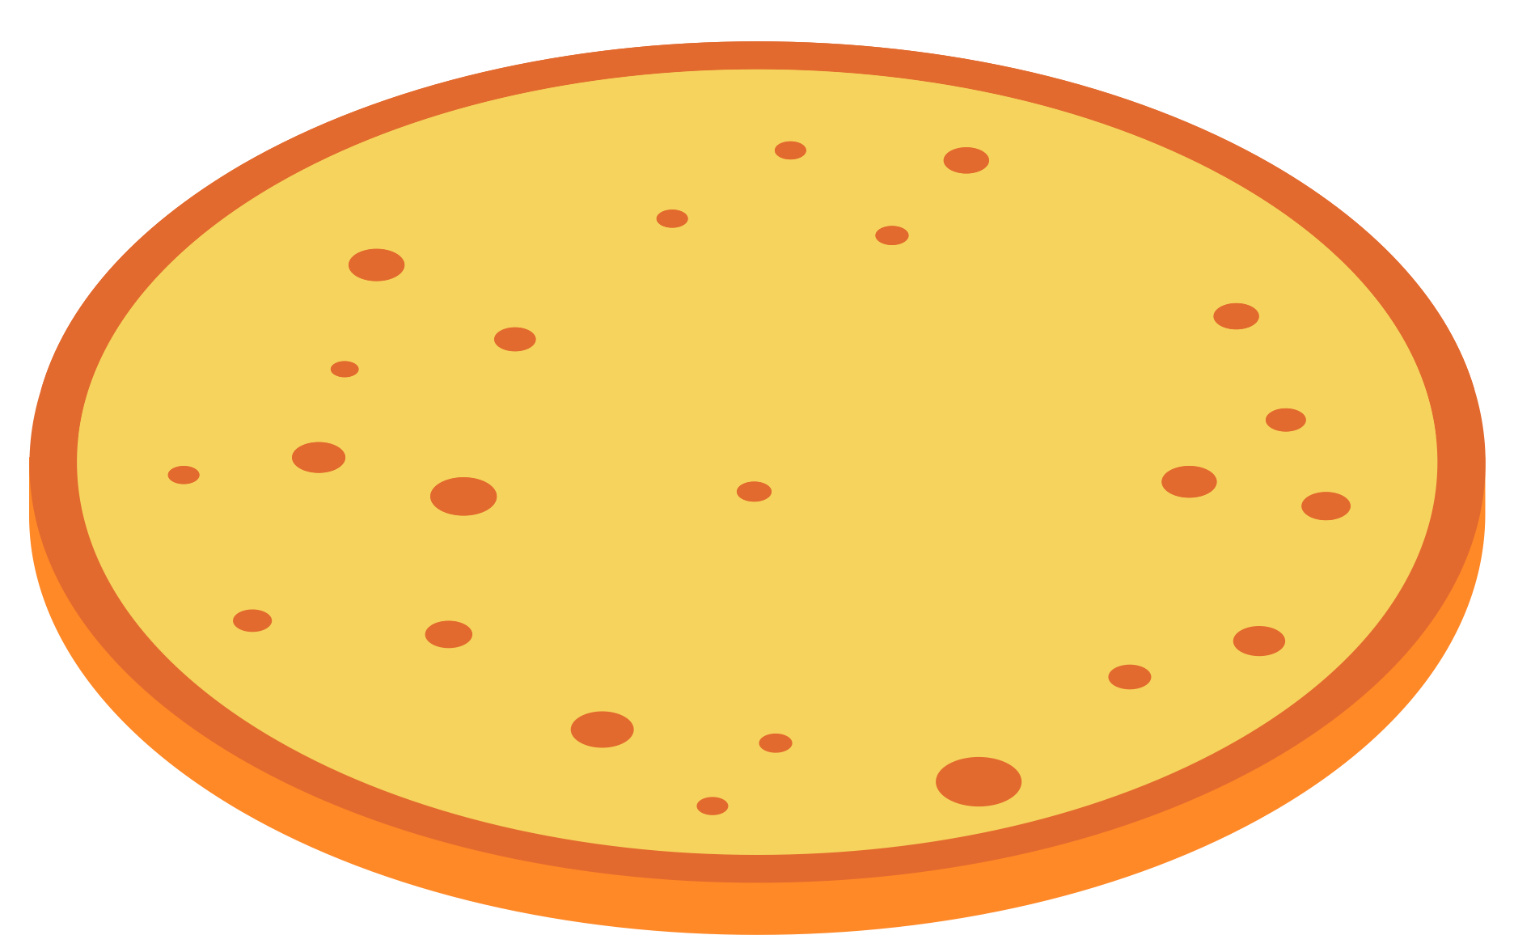
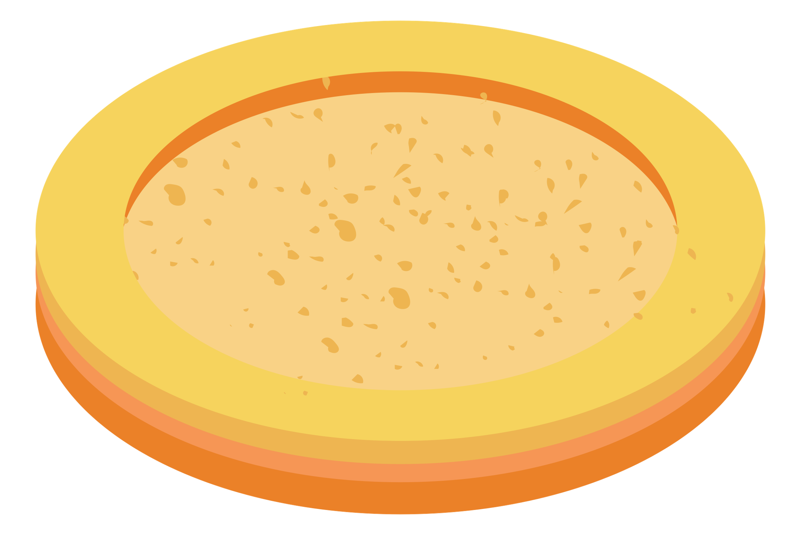
THE SCIENCE OF BREAD
Mixing flour and water produces a basic bread that remains flat when baked. Imaging by electron microscopy reveals aggregates of starch granules, but no holes within the structure.
Adding yeast to this mixture yields a bread with holes, as the yeast consumes simple sugars and produces gas (CO₂).
This image shows the starch granules in a network of flour proteins, along with holes formed by entrapped CO₂, giving fermented bread a lighter, airy texture.
Notes:
Gluten netwoek helps traps the gas, vs flatbread network cant do it by itself
Compare leavened bread v. flatbead
Baking Bread: The Chemistry of Bread-Making – Compound Interest (compoundchem.com)

Slide 9
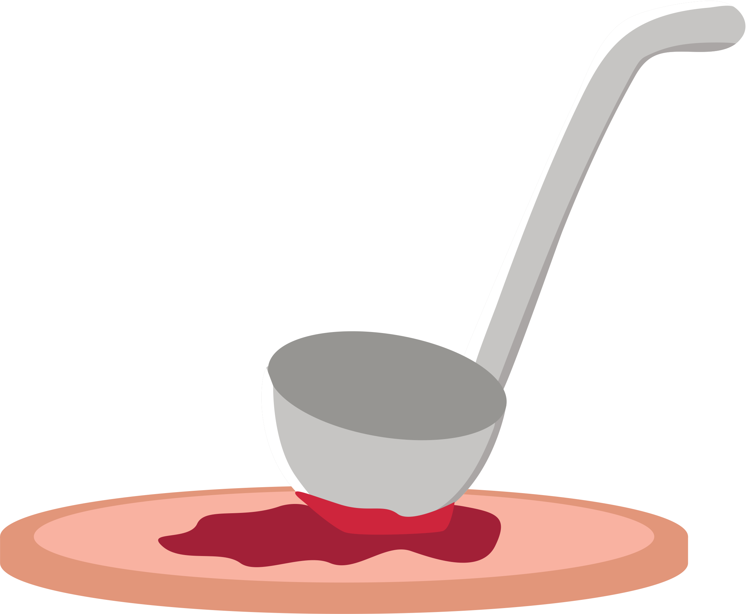
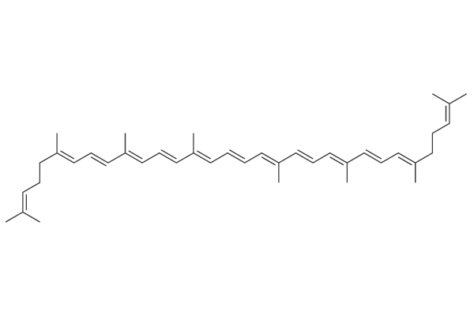
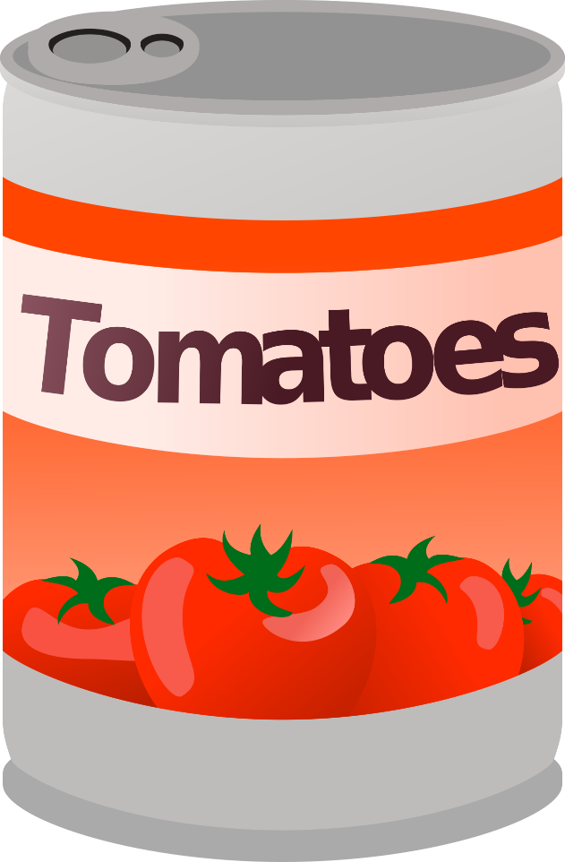
THE SCIENCE OF TOMATO SAUCE
Tomatoes are versatile and healthy foods. They can be consumed raw in salads or as an ingredients in sauces, soups, and juices. They contain high levels of vitamin C, and pigments such as carotene and lycopene, which are powerful antioxidants.
Thermal Processing: Canning
Food processing, especially thermal processing, may improve lycopene bioavailability. Higher temperatures break down cell walls, which weakens the bonding forces between lycopene and the tissue matrix. This reaction makes lycopene more accessible.
Temperature also contributes to the release of pectin. Pectins are polysaccharides that contribute to the texture and nutritional characteristics of foods. As a result, canned tomatoes are thicker due to the gel that is formed.
Lycopene
This thermal processing leads to chemical reactions that result in physical and chemical changes in canned tomatoes; altering its color, texture, and nutritional value.
Notes:
Changes during thermal processing, chabge color, texture, and pectin.

Slide 10
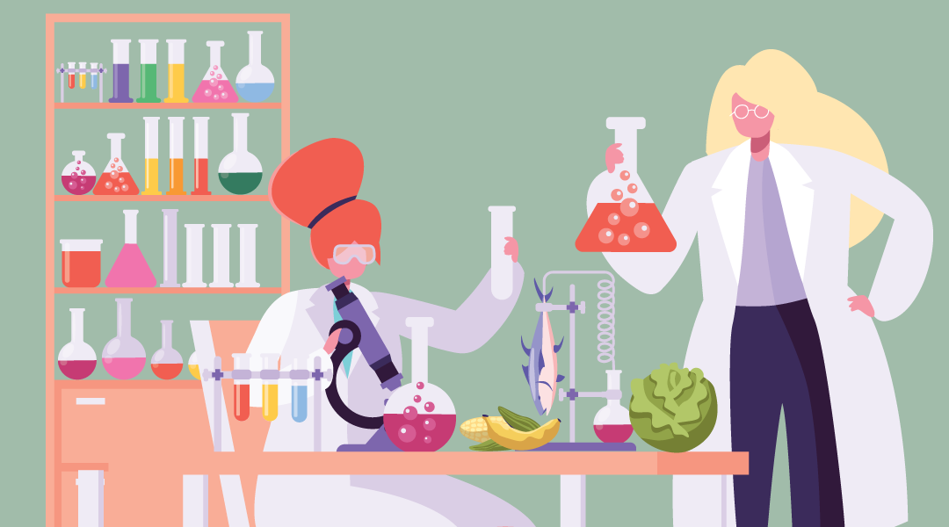
Food Science & Technology
Main Areas of Knowledge:
Food Chemistry
Food Engineering
Food Safety
Quality Assurance
Product Development
Food Law
Why Food Science & Technology Matters:
Availability of Food
Food Safety
Food Sustainability
Nutrition
Special Foods
Convenience and Cost

Slide 11
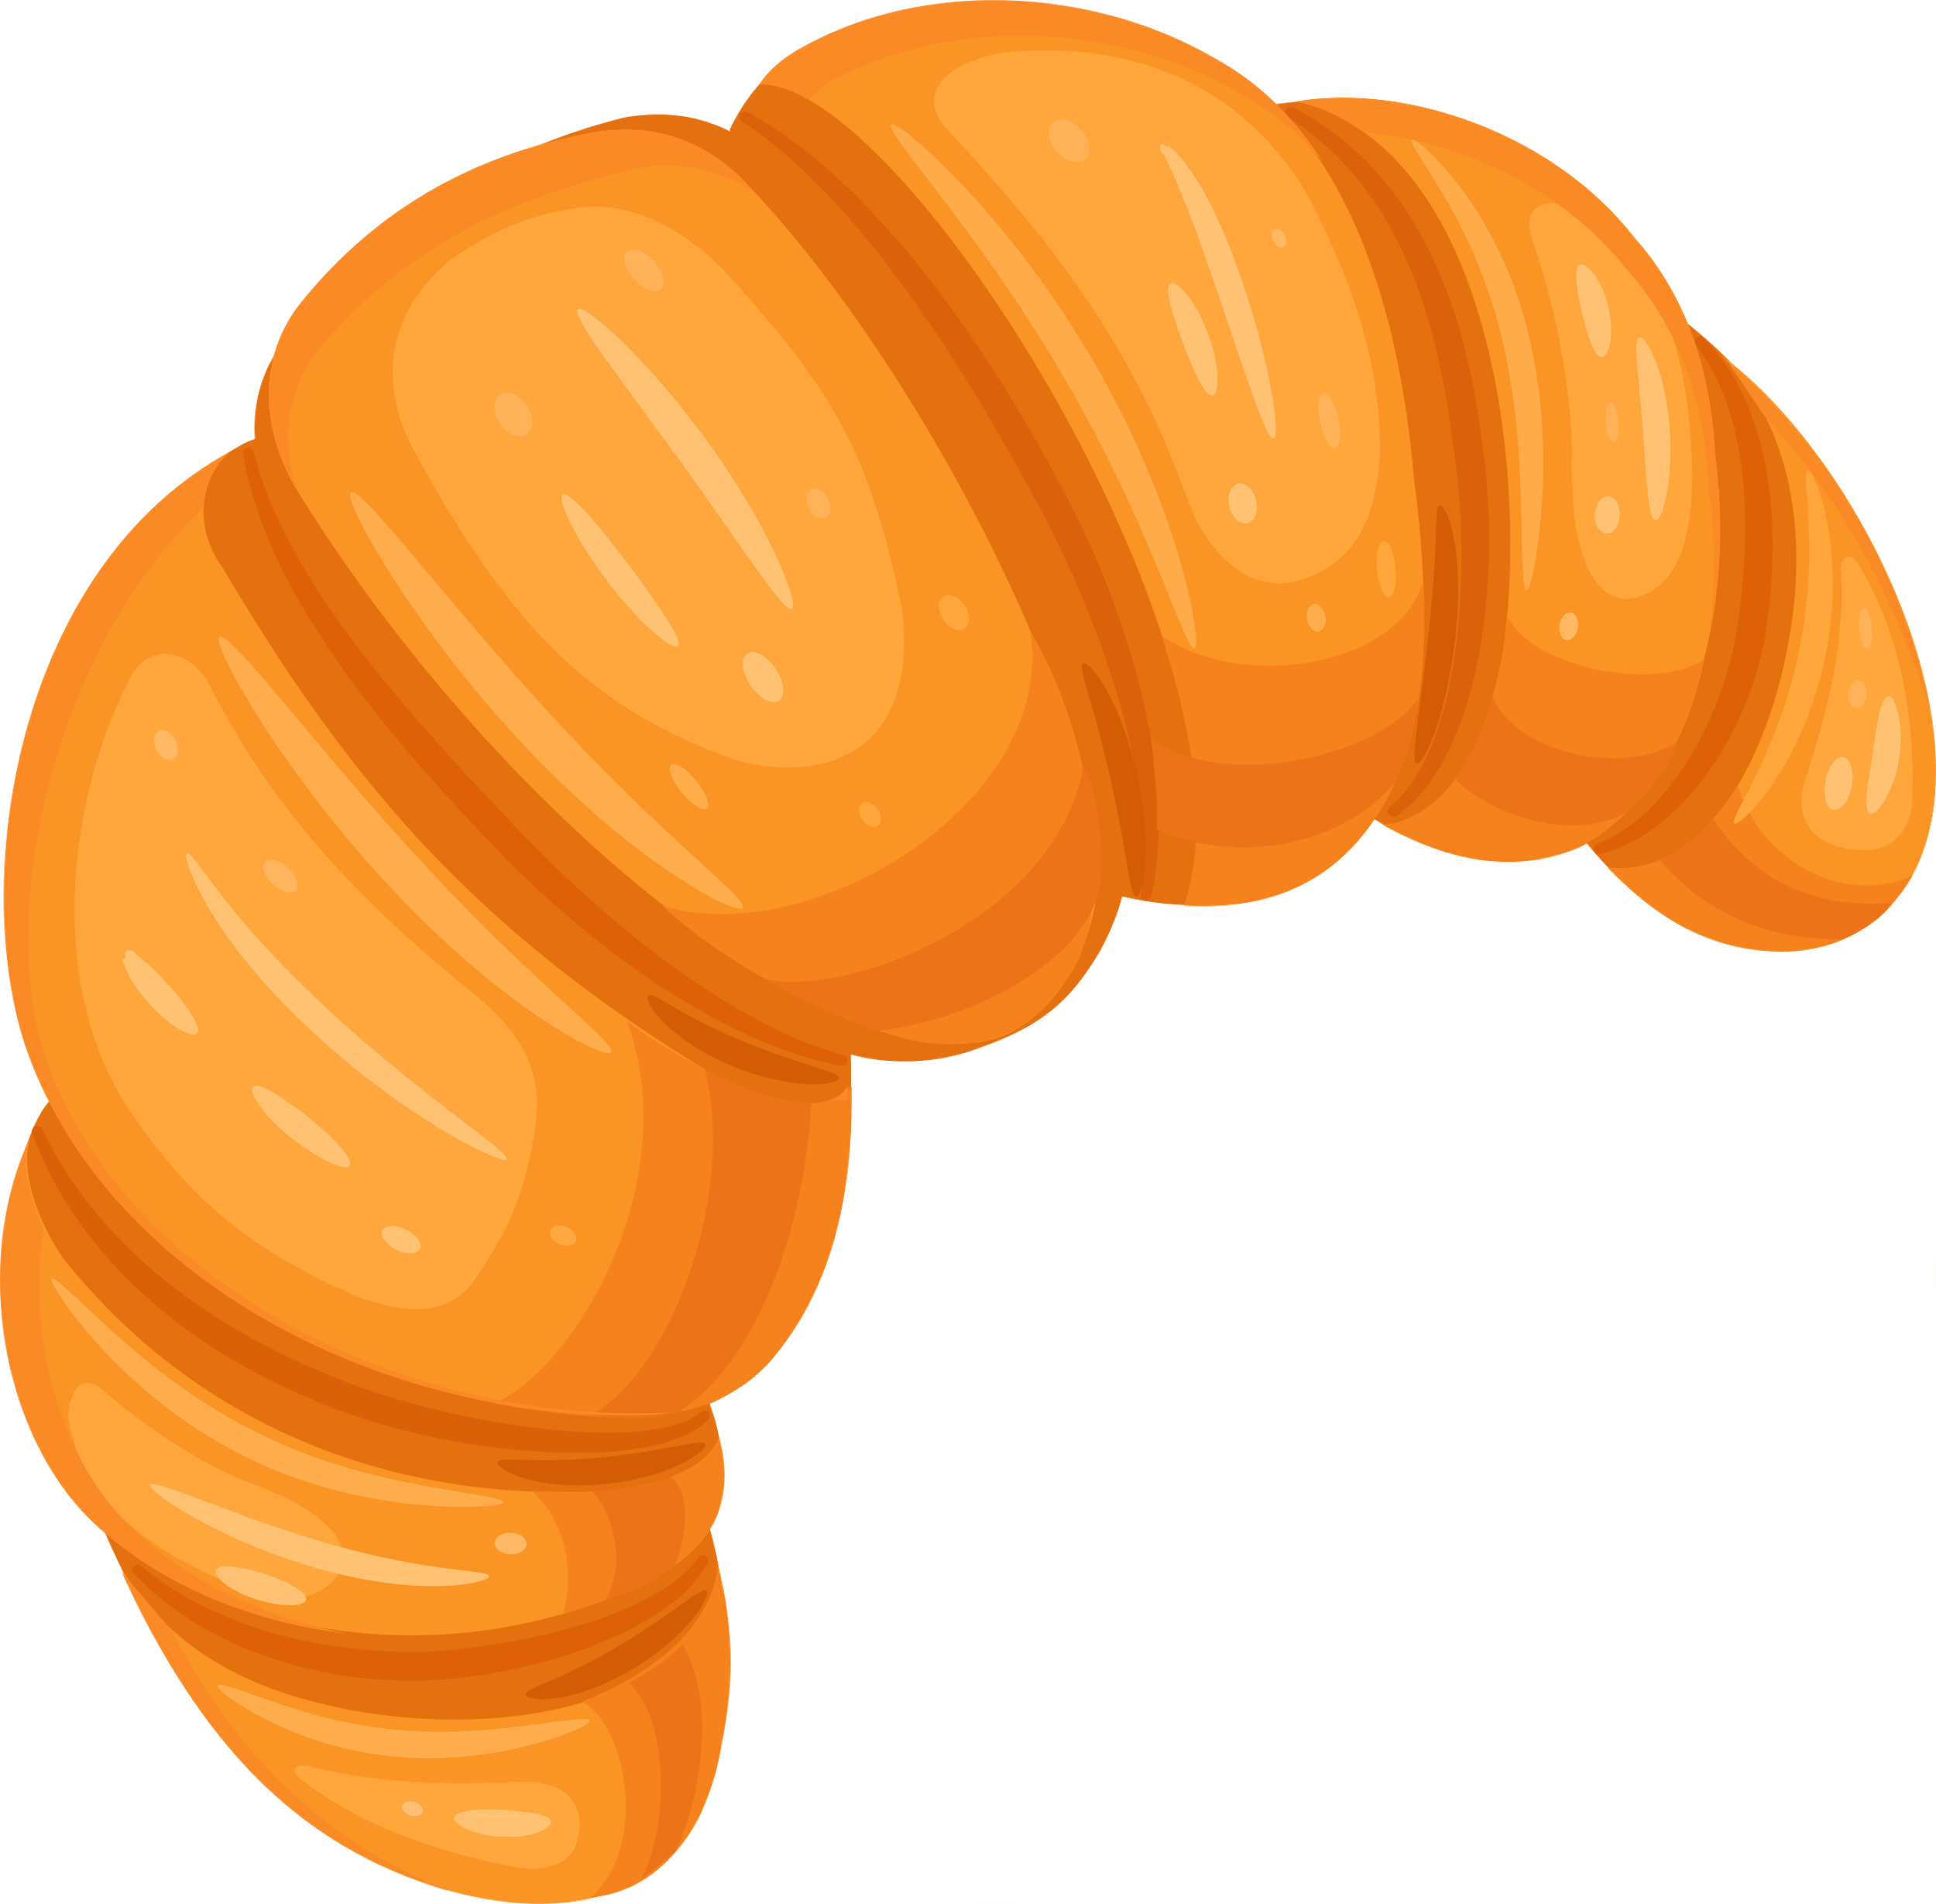
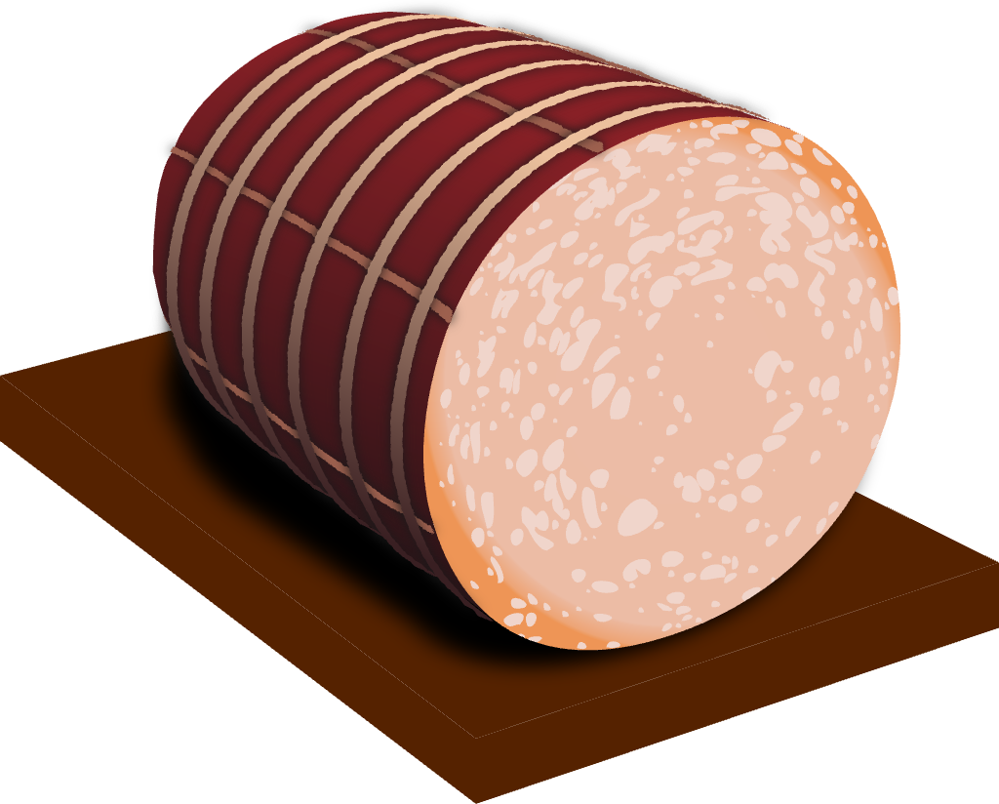
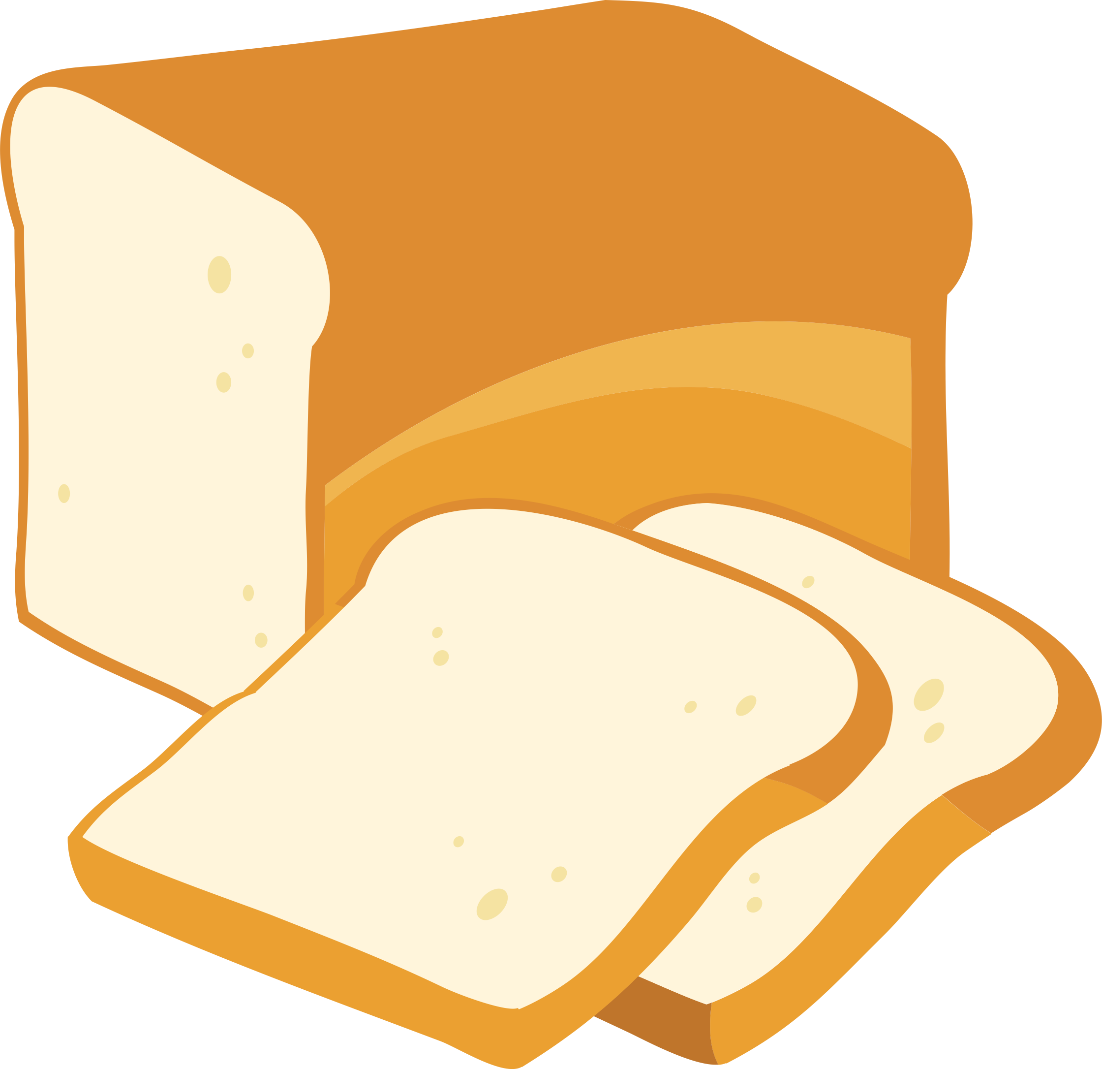
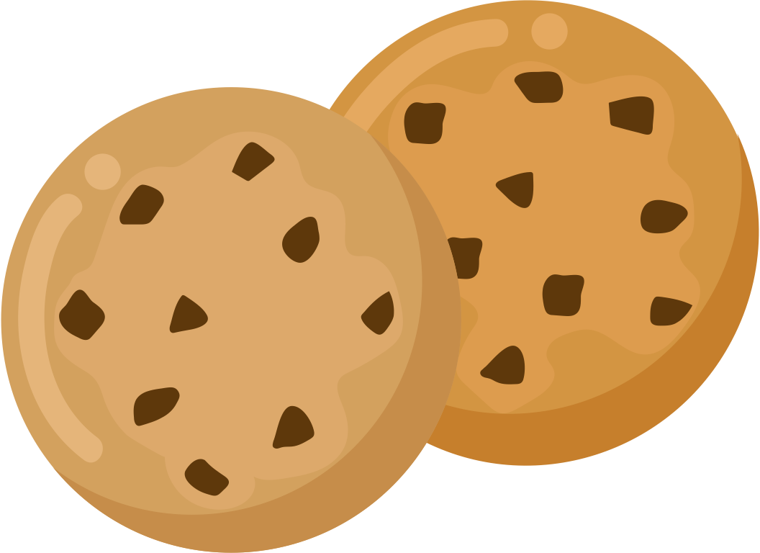
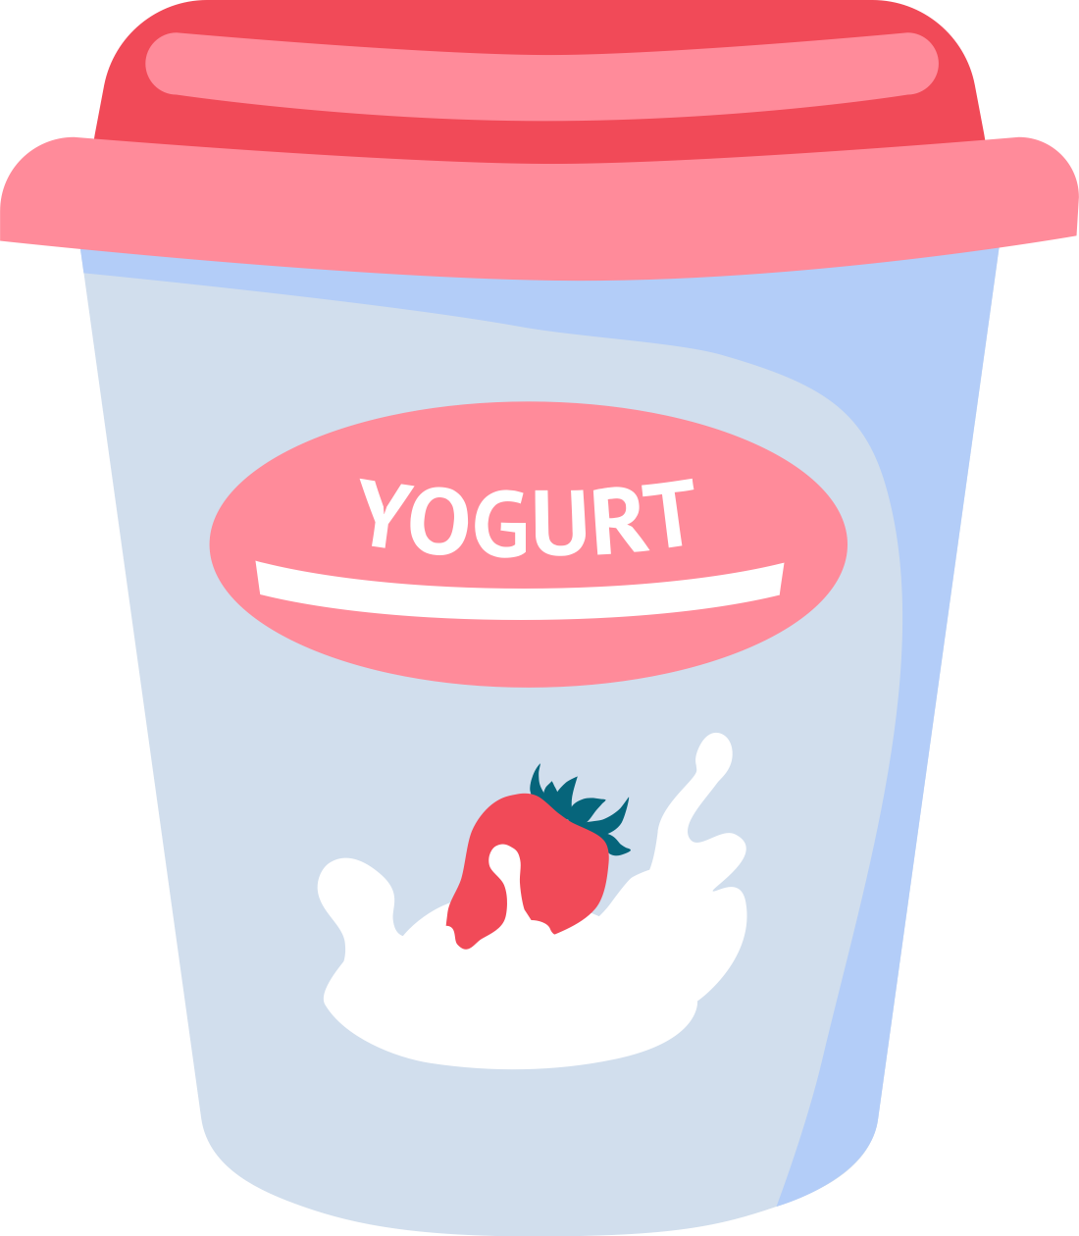
FOOD SCIENTISTS
TRANSFORM!
Notes:
Alternative Slide for Middle School: raw materials and processed products

Slide 12
The University of Nebraska does not discriminate based on race, color, ethnicity, national origin, sex, pregnancy, sexual orientation, gender identity, religion, disability, age, genetic information, veteran status, marital status, and/or political affiliation in its programs, activities, or employment.

