Slide 1
Feeding without the Fuss
Feeding without the Fuss!
Nebraska Extension

Slide 2
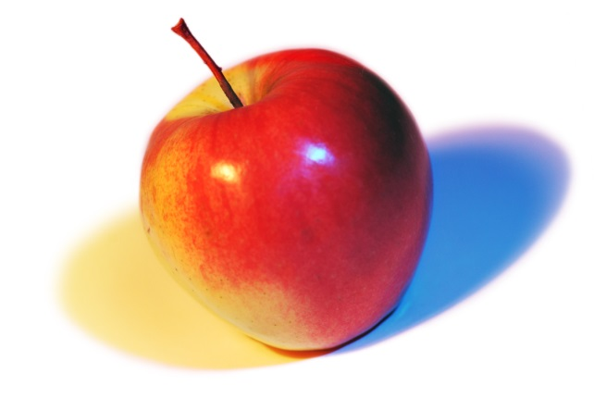
Cami Wells, MS, RD Extension Educator
cwells2@unl.edu
http://food.unl.edu
http://food.unl.edu/food-fun-young-children
This is a peer-reviewed publication, updated August 2016

Slide 3
Menu
Who Does What
Reasonable Expectations
Coping with Picky Eaters
Other Challenging Mealtime Behaviors
Phrases that Help and Phrases that Hinder
Creating a Pleasant Mealtime Environment

Slide 4
Menu
Who Does What
Reasonable Expectations
Coping with Picky Eaters
Other Challenging Mealtime Behaviors
Phrases that Help and Phrases that Hinder
Creating a Pleasant Mealtime Environment

Slide 5
What is your greatest challenge
when feeding kids?
Lack of preparation/shopping time
Little variety
Acceptance by kids
Cost
Other
Notes:
What is your greatest challenge when feeding kids? Does it change depending on their age?

Slide 6
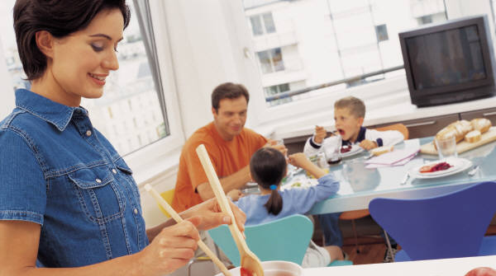
What was mealtime like for
you as a child?
Notes:
What was mealtime like for you as a child? Did you family have any “rules” you followed at meals?

Slide 7
Ellyn Satter's Division of Responsibility in Feeding
For toddlers through adolescents:
The adult is responsible for what, when, where.
The child is responsible for how much and whether.
For more about raising healthy children who are a joy to feed, read Part two, "How to raise good eaters," in Ellyn Satter’s Secrets of Feeding a Healthy Family. For the evidence, read The Satter Feeding Dynamics Model. - See more at: http://bit.ly/2bx6scs
©2016 by Ellyn Satter published at www.EllynSatterInstitute.org
Notes:
Ellyn Satter's Division of Responsibility in Feeding
Fundamental to parents’ jobs is trusting children to decide how much and whether to eat. If parents do their jobs with feeding, children do their jobs with eating.
For specific examples and more information see www.ellynsatter.com
For more about raising healthy children who are a joy to feed, read Part two, "How to raise good eaters," in Ellyn Satter’s Secrets of Feeding a Healthy Family. For the evidence, read The Satter Feeding Dynamics Model. - See more at: http://bit.ly/2bx6scs
©2016 by Ellyn Satter published at www.EllynSatterInstitute.org

Slide 8
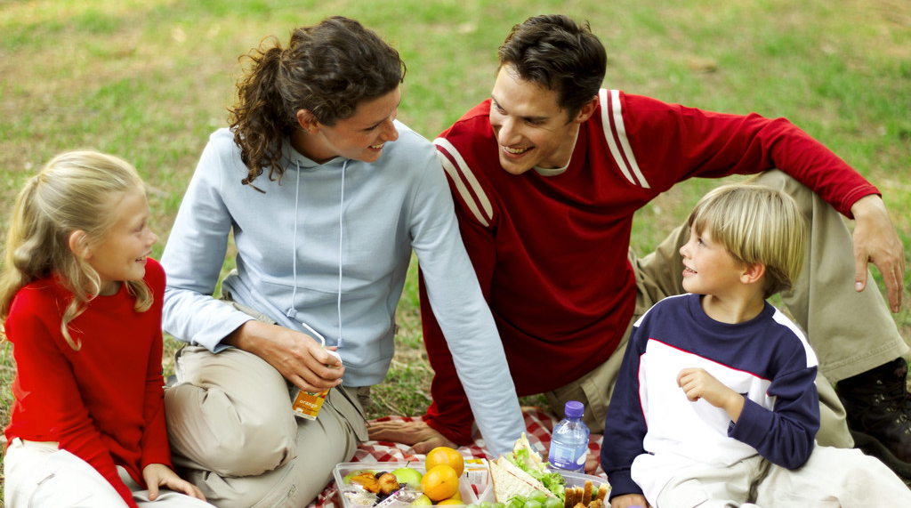
What are some examples of
your “job” as the adult?
Notes:
What are some examples of your “job” as the adult?
What are some challenges to the role of the adult?
Fundamental to parents’ jobs is trusting children to determine how much and whether to eat from what parents provide. When parents do their jobs with feeding, children do their jobs with eating. Parents’ feeding jobs:
Choose and prepare the food.
Provide regular meals and snacks.
Make eating times pleasant.
Step-by-step, show children by example how to behave at family mealtime.
Be considerate of children’s lack of food experience without catering to likes and dislikes.
Not let children have food or beverages (except for water) between meal and snack times.
Let children grow up to get bodies that are right for them.
©2016 by Ellyn Satter published at www.EllynSatterInstitute.org. - See more at: http://ellynsatterinstitute.org/dor/divisionofresponsibilityinfeeding.php#sthash.YjQTgRaE.dpuf

Slide 9
What would be some examples
of the “job” of the child?
Notes:
What would be some examples of the “job” of the child?
Does a child really know how much they should eat?
Children’s eating jobs:
Children will eat.
They will eat the amount they need.
They will learn to eat the food their parents eat.
They will grow predictably.
They will learn to behave well at mealtime.
©2016 by Ellyn Satter published at www.EllynSatterInstitute.org. - See more at: http://ellynsatterinstitute.org/dor/divisionofresponsibilityinfeeding.php#sthash.YjQTgRaE.dpuf

Slide 10
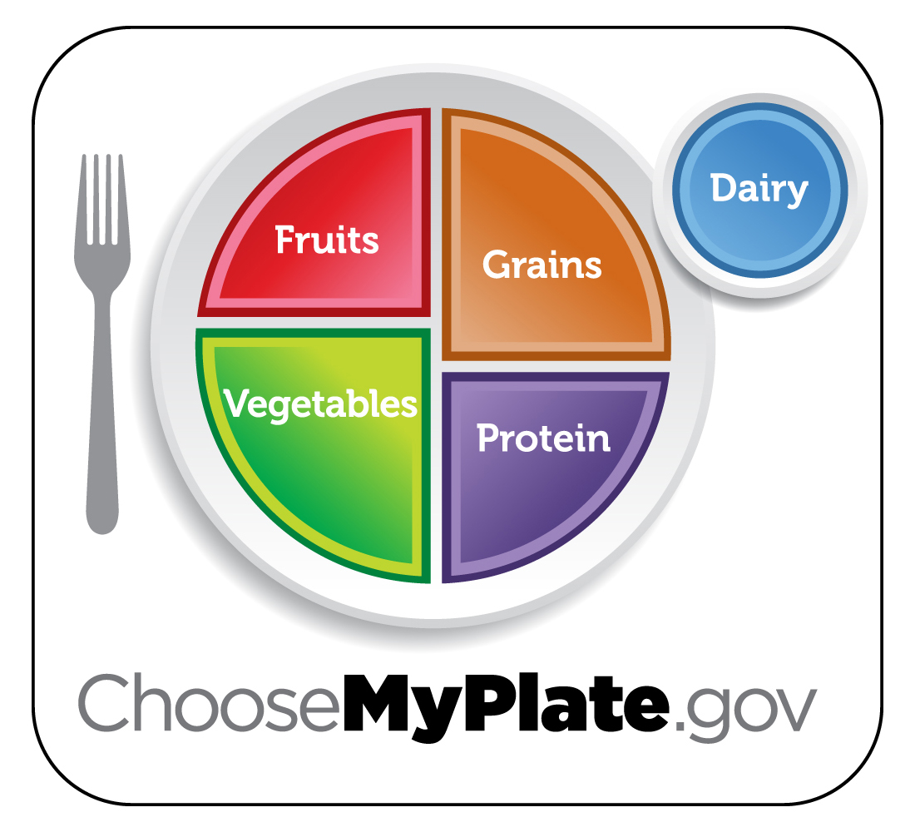
How does MyPlate fit?
Notes:
How does MyPlate fit with feeding kids?
-It is a great tool for planning meals and gives us an overall plan of what to provide.
-It recommends all the basic food groups: protein, grains, fruits and vegetables, and dairy and shows that we need some from each food group at mealtime.
-It encourages sitting down and having a meal, not just snacking throughout the day.
Source: https://www.choosemyplate.gov/health-and-nutrition-information

Slide 11
Start with smaller portions
Use smaller bowls, plates and utensils for your child.
Don't insist that children finish all the food on their plate. Let your child know it is okay to only eat as much as he or she wants at that time.
Notes:
As children are able, allow them to serve themselves. Even young children can practice serving from small bowls that you hold for them. They'll learn new skills and feel "all grown up.“ Teach them to take small amounts at first. Tell them they can get more if they are still hungry. Serve foods that are "too hot" for your child to serve themselves safely (for example, soups). Ask your child how much they want. Make sure food isn't too hot for children to eat.
Go to http://www.choosemyplate.gov/preschoolers.html for more specifics on amounts when feeding young children.

Slide 12
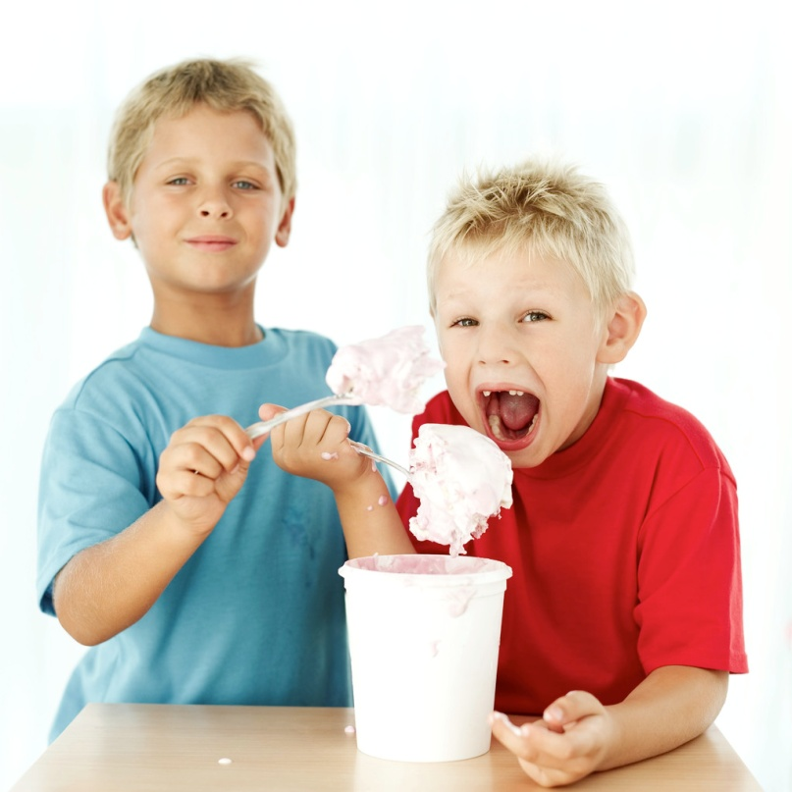
Why do children eat the way they do?
Certain tastes are preferred
Neophobia (aversion to new foods) is very common
Repeated opportunities to experience food
Influences of other children and the media
Notes:
We know that children don’t think about MyPlate or any dietary “recommendations” when they sit down at the table? Why do they eat what they do?
Certain tastes are innately preferred: Taste (which includes sweet, sour, salty, bitter and umami or savory) preferences have a strong natural component. Sweet, umami, and salty substances are preferred at very young ages, whereas bitter and many sour substances are often refused. Many times we prefer high calorie, energy dense foods. If we put a plate of broccoli and a plate of brownies in front of children, they are generally going to prefer the brownies.
Neophobia or the aversion to new food is common and normal in the years between 2 and 5. Food neophobia appears to be a evolutionary response which results in young children initially rejecting a new food. In hunter gatherer societies this neophobia was a protective response as ingesting new and unfamiliar foods was potentially risky and could result in illness or even death. Neophobia changes with age and is minimal in infancy, may increase in early childhood and then usually declines to adulthood.
Repeated opportunities to experience food - Some research shows that repeating a child’s exposure to food and increase the likelihood of accepting the food. It may take 5 or 10 opportunities to taste a new food before it becomes a preferred food. The significance of this is that caregivers need to persevere and to continue to reoffer a new food. Unfortunately, many caregivers interpret first responses to a new food as dislike and may try new foods only one or two times, often not giving the child enough opportunities to develop a preference for a particular food.
Influences of peers and the media - Some research also suggests that the greater consumption by tablemates is a good predictor of acceptance of foods. If children see their friends eating the food, they will be more likely to consume that food. How much of an influence do you think the media plays in a young child’s food decisions?
Beauchamp, G. & Mennella, J. (2009). Early flavor learning and its impact on later feeding behavior. Journal of Pediatric Gastroenterology and Nutrition 48, S25–S30.
Birch, L. (1999). Development of food preferences. Annual Review of Nutrition 19, 41–62.
Salvy S.J., de la Haye K., Bowker J.C., Hermans R.C. Influence of peers and friends on children's and adolescents' eating and activity behaviors. (2012) Physiol Behav. 106(3):369-78.

Slide 13
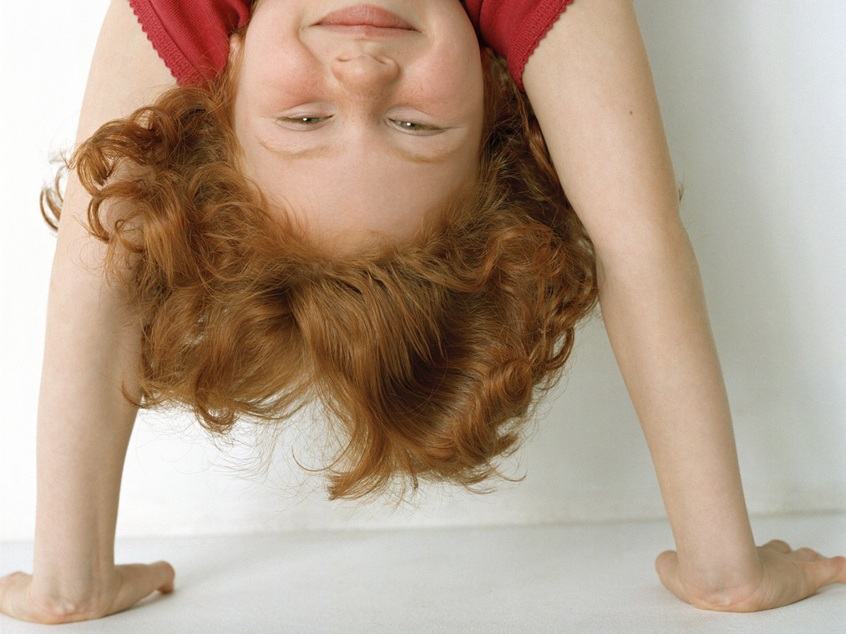
Children are UNPREDICTABLE eaters
Notes:
Children are UNPREDICTABLE eaters
Eat quite a bit one day and very little the next
Eat what tastes good to them, not what they “should”
Accept foods one day, reject the next
However, there are some things we can generally expect by age:

Slide 14
Menu
Who Does What
Reasonable Expectations
Coping with Picky Eaters
Other Challenging Mealtime Behaviors
Phrases that Help and Phrases that Hinder
Creating a Pleasant Mealtime Environment

Slide 15
What are your expectations?
Notes:
As adults we need to have reasonable expectations from the children in our care. What we would expect from a one-year old can not be the same as a five-year old.

Slide 16
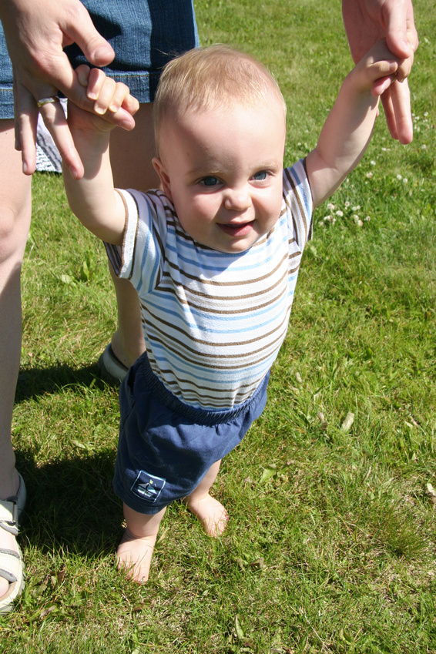
1 year olds:
Appetite varies from day to day
Drinks from a cup with assistance
Eats with fingers and utensils
Very messy!
Notes:
1 year olds:
Appetite varies from day to day
Drinks from a cup with assistance
Eats with fingers and utensils
Very messy!
Source: https://choosemyplate-prod.azureedge.net/sites/default/files/audiences/behavioral-milestones.pdf

Slide 17
2 year olds:
Can use a spoon and drink from a cup
Can be easily distracted
Growth slows and appetite drops
Develop likes and dislikes
Can be very messy
May suddenly refuse certain foods
Notes:
2 year olds:
Can use a spoon and drink from a cup
Can be easily distracted
Growth slows and appetite drops
Develop likes and dislikes
Can be very messy
May suddenly refuse certain foods the they previously consumed
Source: http://www.choosemyplate.gov/preschoolhttps://choosemyplate-prod.azureedge.net/sites/default/files/audiences/behavioral-milestones.pdfers.html

Slide 18
3 year olds:
Make simple either/or food choices
Pours liquid with some spills
Are comfortable using fork and spoon
Can follow simple requests
Start to request favorite foods
Likes to imitate cooking
May suddenly refuse certain foods
Notes:
3 year olds:
Makes simple either/or food choices, such as a choice of apple or orange slices
Pours liquid with some spills
Comfortable using fork and spoon
Can follow simple requests such as “Please use your napkin.”
Starts to request favorite foods
Likes to imitate cooking
May suddenly refuse certain foods
Source: https://choosemyplate-prod.azureedge.net/sites/default/files/audiences/behavioral-milestones.pdf

Slide 19
4 year olds:
Are influenced by TV, media, and peers
May dislike many mixed dishes
Rarely spills with spoon or cup
Knows what table manners are expected
Can be easily sidetracked
May suddenly refuse certain foods
Notes:
4 year olds:
Are influenced by TV, media, and peers
May dislike many mixed dishes
Rarely spills with spoon or cup
Knows what table manners are expected
Can be easily sidetracked
May suddenly refuse certain foods
Source: https://choosemyplate-prod.azureedge.net/sites/default/files/audiences/behavioral-milestones.pdf

Slide 20
5 year olds:
Have fewer demands
Will usually accept the food that‛s available
Eat with minor supervision
Notes:
5 year olds:
Have fewer demands
Will usually accept the food that‛s available
Eat with minor supervision
Source: https://choosemyplate-prod.azureedge.net/sites/default/files/audiences/behavioral-milestones.pdf

Slide 21
Menu
Who Does What
Reasonable Expectations
Coping with Picky Eaters
Other Challenging Mealtime Behaviors
Phrases that Help and Phrases that Hinder
Creating a Pleasant Mealtime Environment

Slide 22
Are picky eaters born or made?

Slide 23
Picky eaters – born or made?
Twins study – Researchers reported 78% of neophobia (aversion to new foods) may be genetic, while 22% is due to environmental factors.
Notes:
According to a study published in the American Journal of Clinical Nutrition, genetics may play a greater role in “food neophobia” (aversion to new foods) than previously believed.
The researchers studied 5,390 sets of twins and reported that 78 percent of neophobia may be genetic, while 22 percent is due to environmental factors. In other words, we may be born with certain aversions to foods. However, our experiences play a role in our preferences.
Genetic and environmental Influences on Children's Food Neophobia, Lucy J Cooke, Claire MA Haworth, and Jane Wardle, Am J Clin Nutr August 2007 vol. 86 no. 2 428-433

Slide 24
Picky eaters – born or made?
Some studies have shown a mother’s food choices during pregnancy may influence a child’s taste preferences.
Notes:
Other researchers have studied whether exposures to certain flavors during the prenatal and early infancy phase of life affect later acceptance of the food. Some studies have shown that your mom’s food choices during pregnancy may influence your taste preferences. After all, you were nourished by all the flavorful foods of your mom’s diet while floating around, growing and preparing to greet the outside world.
Early Flavor Learning and Its Impact on Later Feeding Behavior, Journal of Pediatric Gastroenterology & Nutrition: March 2009 - Volume 48 - Issue - p S25-S30

Slide 25
Picky eaters – born or made?
Some researchers have shown breast-fed babies are more apt to try new foods because they have experienced a variety of flavors.
Notes:
If your first “beverage” was breast milk, you tasted the unique flavors of your mom’s food choices, whether that was broccoli, Brussels sprouts or other distinctive-flavored foods. Some researchers have shown that breast-fed babies are more apt to try new foods because they have experienced a variety of flavors in their first months of life.
Early Flavor Learning and Its Impact on Later Feeding Behavior, Journal of Pediatric Gastroenterology & Nutrition: March 2009 - Volume 48 - Issue - p S25-S30

Slide 26
Picky eating – how to cope
Notes:
Here are a few tips to help you “cope” with feeding challenges.

Slide 27
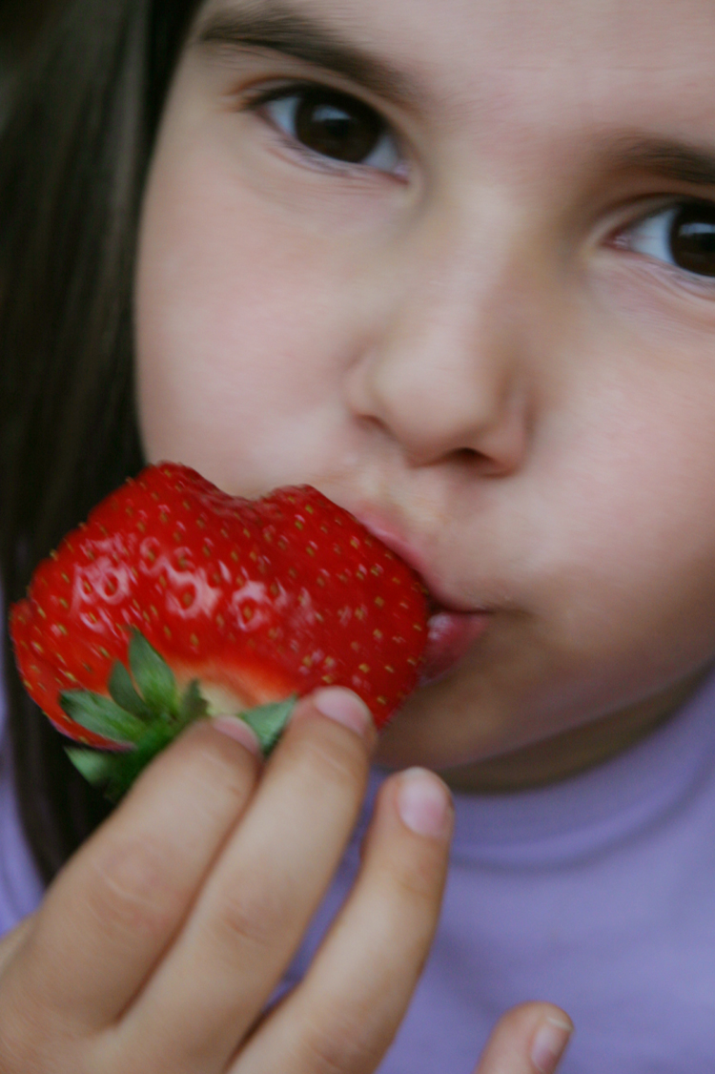
Offer a variety of foods and let children choose how much of these foods to eat.
Notes:
Offer a variety of foods and let children choose how much of these foods to eat.
Offer only one new food at a time. Serve something that you know your child likes along with the new food. Offering too many new foods all at once could be overwhelming.
Source: https://www.choosemyplate.gov/preschoolers-picky-eating

Slide 28
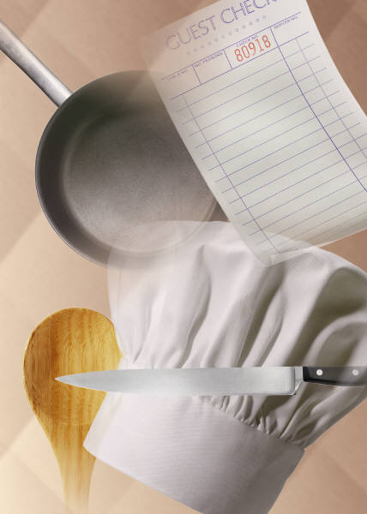
Don't be a “short-order cook.”
Notes:
Source: https://www.choosemyplate.gov/preschoolers-picky-eating

Slide 29
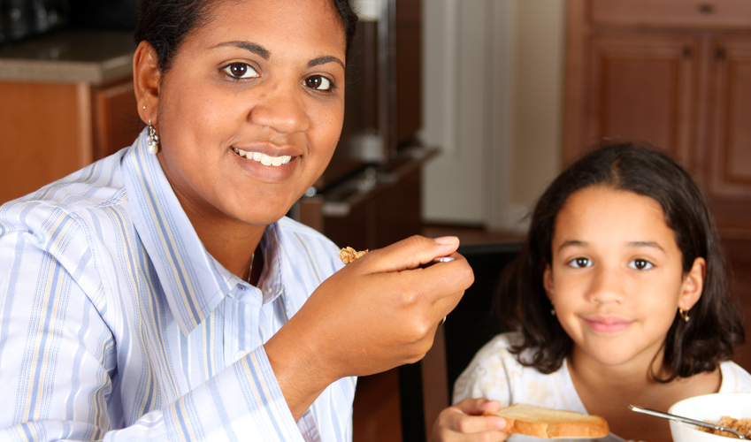
Try to make meals a stress-free time and set a good example.
Notes:
Source: https://www.choosemyplate.gov/preschoolers-picky-eating

Slide 30
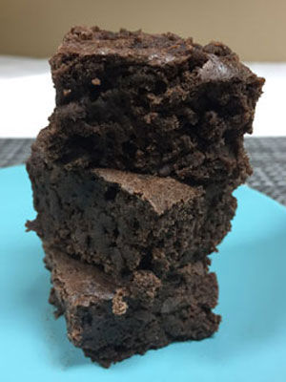
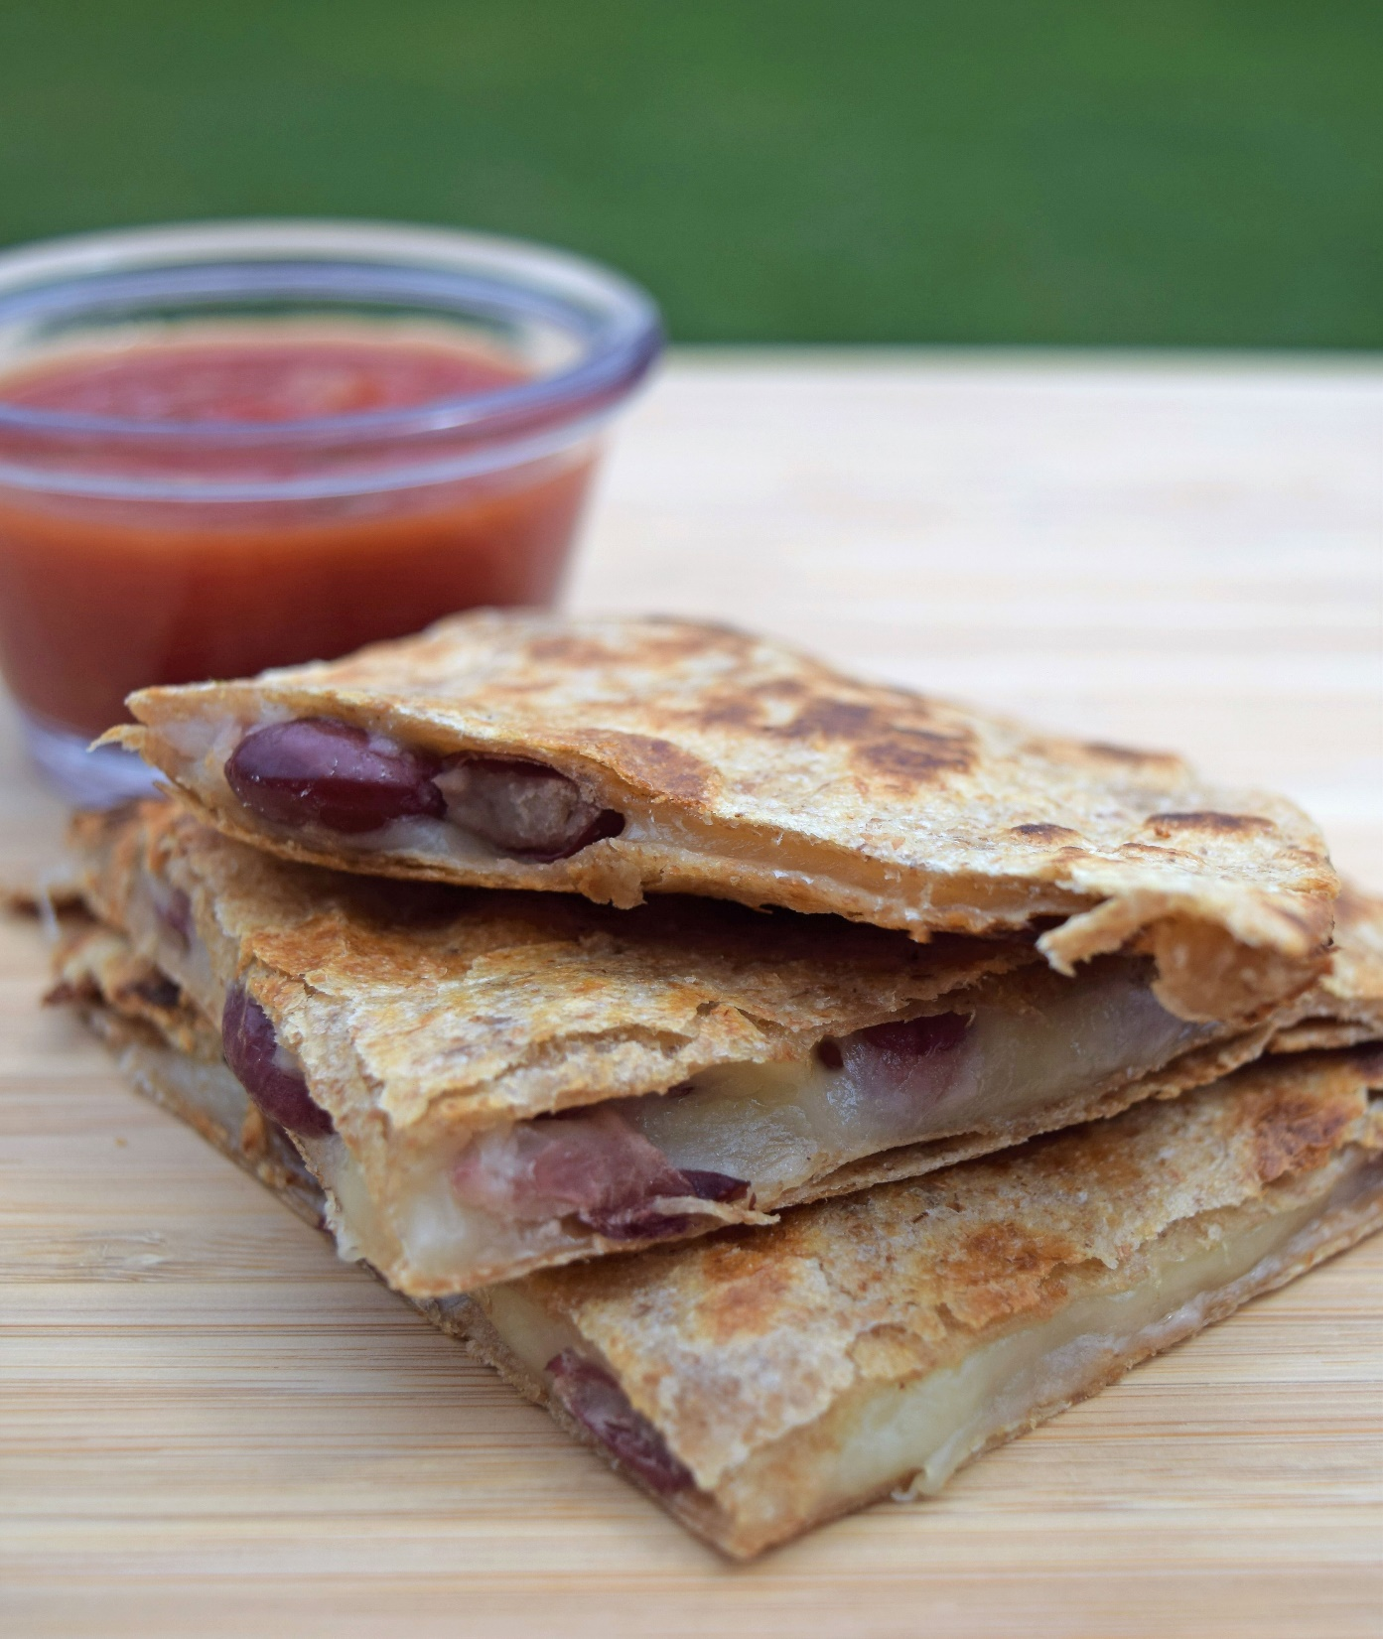
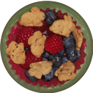
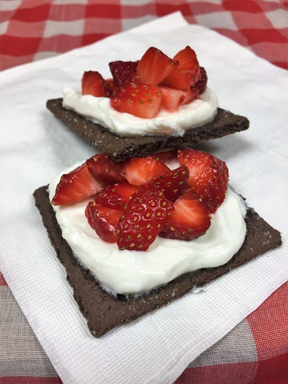
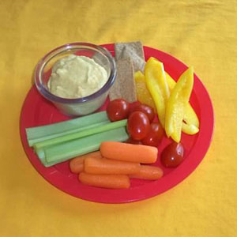
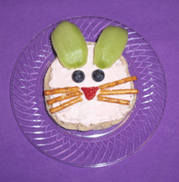
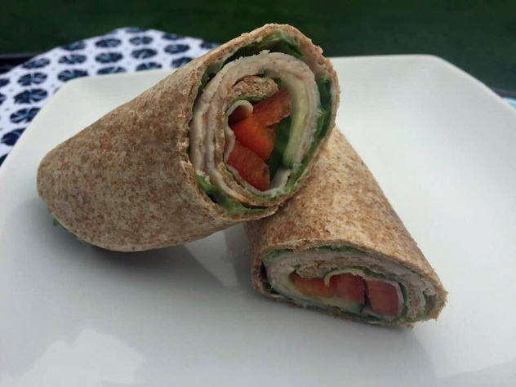
Make food fun!
http://pinterest.com/cwellsrd/food-fun-for-young-kids
Notes:
While we probably don’t need to spend hours making food “fun” it can help make food look a little more enticing and help break out of a boring food routine. These are just some of the ideas on our “Food Fun” Pinterest site (if you are into “pinning”). Feel free to check it out if you have time.

Slide 31
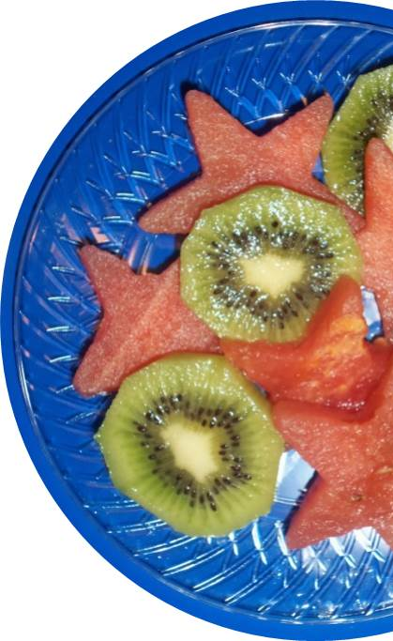
Mealtime tips
Make a game out of eating by making up funny names for foods such as “broccoli trees”.
Cut foods into fun shapes and have them try eating the smile or stars, etc.
Add chopped broccoli, shredded zucchini or carrots, applesauce, chopped pears, etc., to make it more nutritious but not so obvious.
Notes:
Make a game out of eating by making up funny names for foods such as Sam’s silly spaghetti or amazing asparagus.
Cut foods into fun shapes and have them try eating the smile or stars, etc. The picture on the slide was using a seedless watermelon.
Add chopped broccoli, shredded zucchini or carrots, applesauce, chopped pears, etc. , to make foods such as meatloaf, gelatin or baked goods more nutritious but not so obvious. We probably don’t want to “deceive” kids by hiding their fruits and veggies but it might help kids try some foods in a familiar form.
Source: https://www.choosemyplate.gov/preschoolers-picky-eating

Slide 32
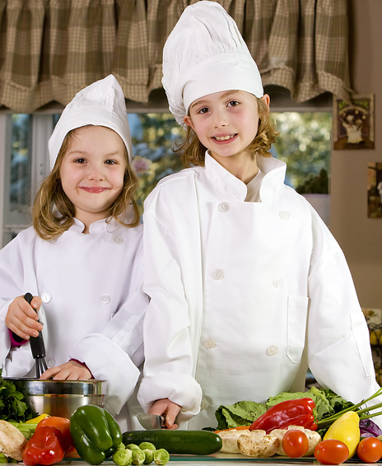
Help children enjoy fruits and vegetables
Notes:
There seems to be a lot of focus these days on “getting” kids to eat more fruits and vegetables. If you are caring for a child that turns down either - or both - you are likely to be concerned because you have learned that they are important and hear that message continually. Relax. Yes, we would like kids to eat their fruits and vegetables today but more importantly is helping children enjoy fruits and vegetables for a lifetime so when they are older, they will select them and feed them to their families.
Eat vegetables and fruits with meals or as snacks. Let your child see that you like to munch on raw vegetables. Be a good role model by enjoying fruits and vegetables yourself, keep offering and have patience. Cook together, eat together, talk together, and make mealtime a family time!
Source: https://www.choosemyplate.gov/preschoolers-picky-eating

Slide 33
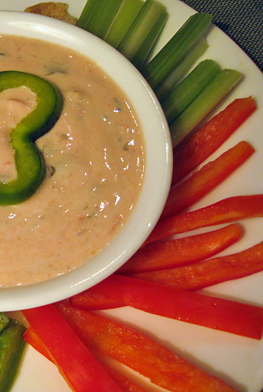
Offer “dip” with vegetables
Children with a sensitivity to bitterness may avoid certain vegetables.
Offering a low-fat dip could make it easier for those foods to become an accepted part of children's diets.
Notes:
As we discussed earlier, dislike of bitter foods is considered by many a defense mechanism to protect children from eating things that are poisonous.
A study, published in the recently in the Journal the American Dietetic Association, looked at 152 preschoolers in the Head Start program. They were served broccoli at snack time over a 7-week period, and found that offering ranch dressing as a dip increased broccoli consumption by 80 percent among bitter-sensitive children. Low-fat and regular versions were tested, and both were equally effective.
However, the dip did not increase broccoli consumption among those children who were not sensitive to bitter. About 70% of the children in this study were sensitive to bitter. Other studies have shown that children tend to outgrow their aversion to bitter.
Besides dip, other strategies include:
serving those bitter vegetables like broccoli, cauliflower or spinach with a sauce or additional toppings like cheese. Serving them with a glaze.
serve them raw. Most vegetables like peas or green beans are sweeter when they are raw.
choosing to serve starchier or sweeter vegetables such as potatoes, corn, sweet potatoes and carrots more often.
Source: Offering Dip Promotes Intake of a Moderately-Liked Raw Vegetable among Preschoolers with Genetic Sensitivity to Bitterness. Journal of the Academy of Nutrition and Dietetics – February 2012.

Slide 34
Kids like to try foods they help make.
Notes:
Source: http://www.choosemyplate.gov/preschoolers.html

Slide 35
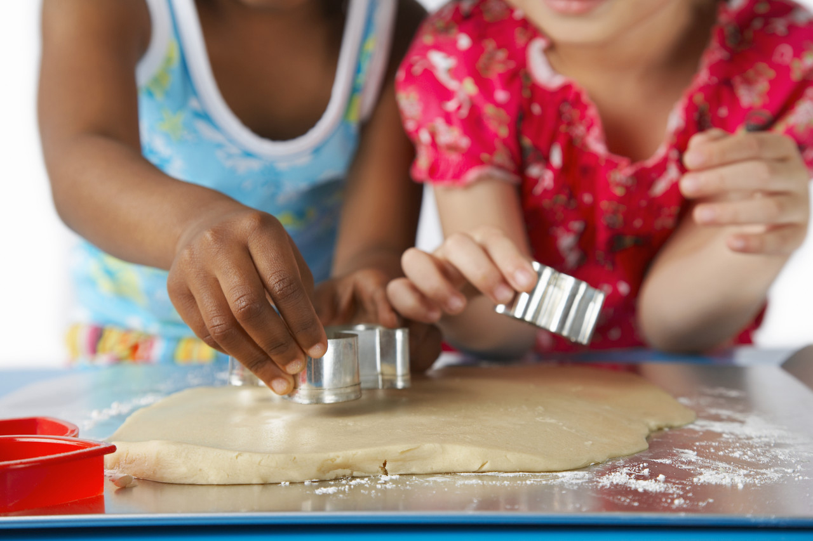
A child that helps in the kitchen…
Notes:
Source: http://www.choosemyplate.gov/preschoolers.html

Slide 36
Tries and likes more foods
Notes:
Source: http://www.choosemyplate.gov/preschoolers.html

Slide 37
Gains confidence, feels important and proud
Notes:
Source: http://www.choosemyplate.gov/preschoolers.html

Slide 38
Learns early math and science concepts
Notes:
Source: http://www.choosemyplate.gov/preschoolers.html

Slide 39
Develops small muscle skills
Learns new vocabulary
Notes:
Source: http://www.choosemyplate.gov/preschoolers.html

Slide 40
Learns new vocabulary
Notes:
Source: http://www.choosemyplate.gov/preschoolers.html

Slide 41
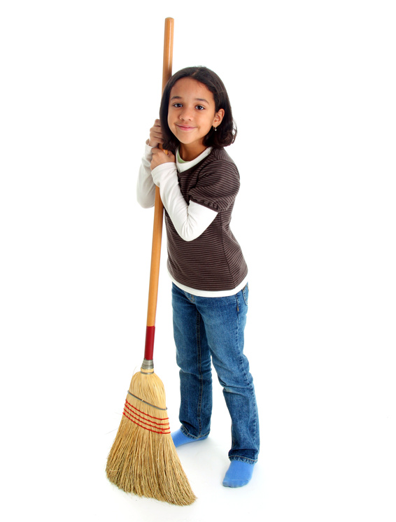
Learns responsibility with cleanup
Notes:
Source: http://www.choosemyplate.gov/preschoolers.html

Slide 42
Menu
Who Does What
Reasonable Expectations
Coping with Picky Eaters
Other Challenging Mealtime Behaviors
Phrases that Help and Phrases that Hinder
Creating a Pleasant Mealtime Environment

Slide 43
Mealtimes can be challenging
Notes:
Besides picky eating, there can be many other challenges when feeding children.

Slide 44
Food jags
Avoid focusing on the food.
If the desired food is generally nutritious and easy to prepare, consider offering it along with a variety of other foods at each meal.
Most children will usually start eating other foods before too long.
Notes:
Food jags are a normal developmental stage for children when a child wants to eat a particular item all of the time. Many times children's eating habits are a way for them to feel independent.
Some strategies for feeding children may include:
Avoid focusing on the behavior, which may cause the behavior to continue. If they feel like there are getting a lot of attention with the food jag, they may keep on it just for the extra attention.
If the desired food is nutritious and easy to prepare, you may want to consider offering it along with a variety of other foods at each meal. Or you may want to say “sorry” these are the foods we are having today for lunch. We will have _______ again tomorrow. Try to minimize the situation.
Most children will usually start eating other foods before long. If the child does not receive additional benefits (like extra attention) they are going to get tired of eating the same thing just like you would.
Source: Food Jags, MedlinePlus, U.S. National Library of Medicine - http://www.nlm.nih.gov/medlineplus/ency/article/002425.htm

Slide 45
Aggressive behavior
Serve meals and snacks at regular times
Have transition activities before meals
Check mealtime environment
Notes:
Aggressive behavior includes actions such as throwing, fighting and yelling. It may reflect a desire for attention, over-stimulation, hunger or frustration.
Be sure that meals and snacks are served at regular times. Children who are overly hungry or who have just eaten may have a hard time focusing at the meal.
Have transition activities before meals such as reading a story or quiet playtime to help children make the switch from active physical play to sitting and eating.
Take note of the mealtime environment. Are there ways to make it calmer and less distracting? Are all forms of media turned-off?
Mealtime Environment, Healthy and Active Preschoolers, the California Department of Education. http://www.healthypreschoolers.com/?page_id=23
Source: Mealtime Environment, Healthy and Active Preschoolers, the California Department of Education. http://www.healthypreschoolers.com/?page_id=23

Slide 46
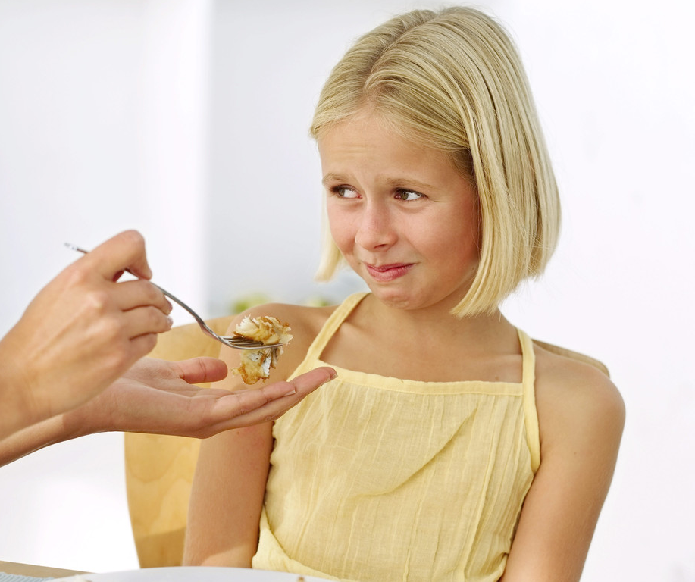
Help them know when they've had enough
Let them learn by serving themselves.
Avoid praising a clean plate.
Reward children with attention and kind words, not food.
Try not to restrict specific foods.
Notes:
Kids who "listen" to their own fullness cues stop eating when they feel full and are less likely to become overweight. Give kids a chance to stop eating when they feel full, even if you think they aren't. They'll feel more independent and more likely keep a healthy weight.
Let children serve themselves if possible. Teach them to take small amounts at first. Young children can practice serving from small bowls that you hold for them. Tell them they can get more if they are still hungry.
Avoid praising a clean plate. Children should stop eating when he or she is full, rather than when the plate is clean.
Reward children with attention and kind words, not food. Show your love with hugs and kisses. Console with hugs and talks. Giving your child sweets when they feel sad or as a special treat can teach children to eat when he or she is not hungry. This may cause children to ignore body signals of fullness and overeat. Rewarding with sweets also lets your child think sweets or dessert foods are better than other foods. For example, telling your child "no dessert until you finish your vegetables" may make them like the vegetable less and the dessert more.
Try not to restrict specific foods. If that restricted food becomes available to your child, he or she might eat it despite feeling full. This can lead to a habit of overeating. Also, don't restrict sweets or other treats as punishment for bad behavior.
Source: http://www.choosemyplate.gov/preschoolers.html

Slide 47
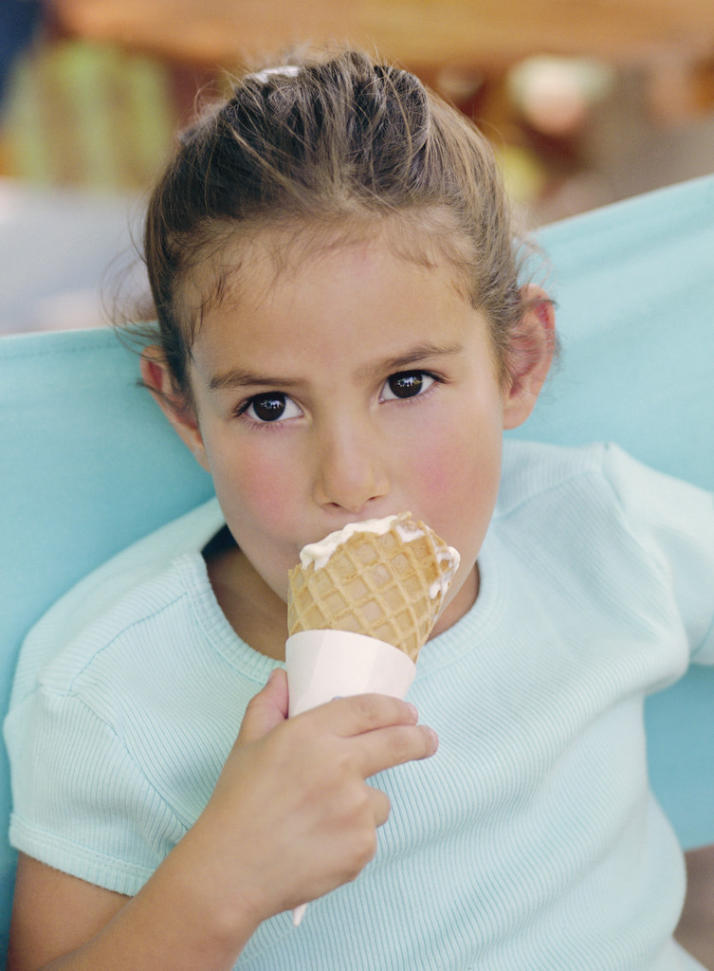
What is the best way to handle “sweets” and “treats”?
Notes:
Limit the amount of foods and beverages with added sugars your kids eat and drink. If you don’t buy them, your kids won’t get them very often. Sweet treats and sugary drinks have a lot of calories but few nutrients. Most added sugars come from sodas, sports drinks, energy drinks, juice drinks, cakes, cookies, ice cream, candy, and other desserts.
As with everything else, try to keep a balance. If you give a child access to these easy-to-like foods all of the time, they are likely to fill up on them and not be interested in trying other foods. On the other hand, if you restrict them, research shows the child may overeat on these foods when they get the chance.
Source: Cut Back on Your Kid’s Sweet Treats from USDA’s MyPlate: http://www.fns.usda.gov/cnd/healthierschoolday/pdf/18_TNES-CBOST.pdf

Slide 48
Menu
Who Does What
Reasonable Expectations
Coping with Picky Eaters
Other Challenging Mealtime Behaviors
Phrases that Help and Phrases that Hinder
Creating a Pleasant Mealtime Environment

Slide 49
What should I say……
Notes:
The language you use about does make a difference in how a child feels about eat and themselves. Here are a few examples.

Slide 50
Instead of:
“Eat that for me.” OR “If you don’t eat one more bite, I will be sad.”
Notes:
Phrases like these teach children to eat for your approval and love. This can lead children to have unhealthy behaviors, attitudes, and beliefs about food and about themselves. If kids are eating to please you as opposed to listening to their bodies, they may be eating more than they need.
Source: http://www.choosemyplate.gov/preschoolers.html

Slide 51
Try:
“This is a mango; it’s sweet like a strawberry.” OR “This celery is very crunchy!”
Notes:
Phrases like these help to point out the sensory qualities of food. They encourage children to try new foods. You don’t need overdue it but talk about how the food tastes, smells and feels, can help children become more comfortable with new foods.
Source: http://www.choosemyplate.gov/preschoolers.html

Slide 52
Instead of:
“You’re such a big boy; you finished all your broccoli.” OR “Look at Maria. She ate all of her peaches.” OR “You have to take two more bites before you leave the table.”
Notes:
Phrases like these teach children to ignore fullness. It is better for kids to stop eating when full or satisfied than when all of the food has been eaten.
Source: http://www.choosemyplate.gov/preschoolers.html

Slide 53
Try:
“Is your stomach telling you that you’re full?” OR “Has your tummy had enough?”
Notes:
Phrases like these help children to recognize when he or she is full. is can prevent overeating.
Source: http://www.choosemyplate.gov/preschoolers.html

Slide 54
Instead of:
“No dessert until you eat your vegetables.” OR “Stop crying and I will give you some candy.”
Notes:
Offering some foods, like dessert, in reward for finishing others, like vegetables, makes some foods seem better than others. Getting a food treat when upset teaches children to eat to feel better. Again, this can lead to overeating.
Source: http://www.choosemyplate.gov/preschoolers.html

Slide 55
Try:
“We can try these vegetables again another time.” OR “I am sorry you are sad. Come here and let me give you a hug.”
Notes:
We can try these vegetables again another time. Take away the pressure – children need to feel like there are no negative consequences for not liking a food. I generally tell kids (and adults) our taste buds change over time so we may start liking a food that we used to not want. It is good to keep trying but again no pressure, no forcing.
I am sorry you are sad. Come here and let me give you a hug. Reward children with attention and kind words and not food. Comfort him or her with hugs and talks and extra attention.
Source: http://www.choosemyplate.gov/preschoolers.html

Slide 56
Menu
Who Does What
Reasonable Expectations
Coping with Picky Eaters
Other Challenging Mealtime Behaviors
Phrases that Help and Phrases that Hinder
Creating a Pleasant Mealtime Environment

Slide 57
What makes a great meal?
Notes:
The first step to great mealtimes with children is to think about what makes a great meal: good food, good conversation, and a relaxed and pleasant environment.

Slide 58
Eliminate distractions
Notes:
All distractions should be eliminated; turn off all music, television, and put away all toys and video games. Focus on the conversation and enjoying each others company.

Slide 59
Make a smooth transition to mealtime
Notes:
When children are involved in high energy activities, it may be difficult for them to slow down to sit and eat. Allow time for a “transition activity” to prepare them for mealtime.
Some examples of activities that help children slow down include:
Coloring
Playing with blocks
Listening to soft music
Reading a story
Talking about the meal
Preparing and setting the table
Source: UDSA’s Nutrition and Wellness Tips for Young Children, Supplement D, Create a Positive Meal Environment: http://www.fns.usda.gov/sites/default/files/tn/Supplement_D.PDF

Slide 60
Show excitement and enthusiasm!
Notes:
The more involved you are in creating a pleasant environment, the higher the chances are of implementing healthy eating habits in children. Set a good example with a positive attitude about meal time. If you dread mealtime, your children will too.
Try to make meals a stress-free time. Talk about fun and happy things. If arguments often happen at mealtimes, your child may learn unhealthy attitudes toward food.
https://www.choosemyplate.gov/health-and-nutrition-information

Slide 61
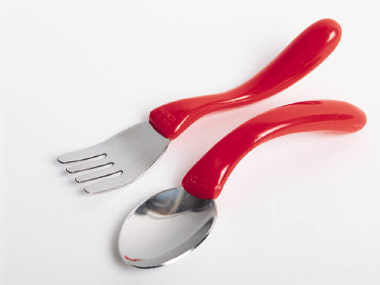
Stress age-appropriate table manners and use child-sized eating utensils
Notes:
As we plan for a great meal, we need to help children understand what to expect at mealtimes but making sure those expectations are appropriate for their age. A one-year is going to make a mess learning to eat and will probably use their hands. A four-year should be able to use utensils appropriately.

Slide 62
Dine “family-style” if possible
Notes:
As children are able, allow them to serve themselves. Even your 3 to 5 year old can practice serving from small bowls that you hold for them. They'll learn new skills and feel "all grown up.“ Teach them to take small amounts at first. Tell them they can get more if they are still hungry. Serve foods that are "too hot" for your child to serve themselves safely (for example, soups). Ask your child how much they want. Make sure food isn't too hot for children to eat.
Source: https://www.choosemyplate.gov/health-and-nutrition-information

Slide 63
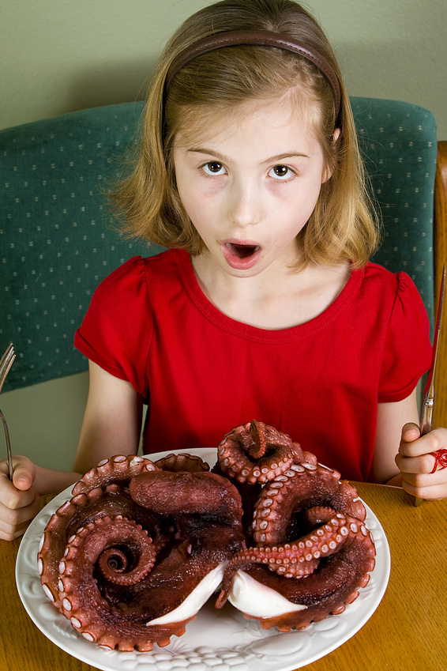
Teach how to politely decline food
Notes:
Stress that saying “Yuck”, “Gross” or “Disgusting” are not appropriate at mealtimes. Teach them that it is perfectly fine not to like a food but they don’t need to verbalize it. It is perfectly fine to leave the food on the plate.

Slide 64
Table Talkers
Cut apart and place cards into bowl.
Have children take turns drawing one each day.
Fun for kids and a great way to increase vocabulary and creative thinking.
http://food.unl.edu/table-talkers-young-children
Notes:
The table talker handout is available on our website. These are questions generally appropriate for 2 to 5 year olds.
Cut apart and place cards into bowl.
Have children take turns drawing one (or two) each day.
Fun for kids and a great way to increase vocabulary and creative thinking and to learn more about each other.
http://food.unl.edu/table-talkers-young-children

Slide 65
References and Resources:
Beauchamp, G. & Mennella, J. (2009). Early flavor learning and its impact on later feeding behavior. Journal of Pediatric Gastroenterology and Nutrition 48, S25–S30.
Birch, L. (1999). Development of food preferences. Annual Review of Nutrition 19, 41–62.
Create a Positive Meal Environment (2016). UDSA’s Nutrition and Wellness Tips for Young Children. Retrieved from: http://www.fns.usda.gov/sites/default/files/tn/Supplement_D.PDF
Cooke LJ, Haworth CM, Wardle J. (2007). Genetic and environmental Influences on Children's Food Neophobia. American Journal of Clinical Nutrition, vol. 86 no. 2 428-433.
Danaher C, Fredericks, C, Bryson, SW, Agras, WS, Ritchie, L. (2011). Early childhood feeding practices improved after short-term pilot intervention with pediatricians and parents. Childhood Obesity, Volume 7, Number 6.
Fisher JO, Mennella JA, Hughes SO, Liu Y, Mendoza PM, Patrick H. (2012). Offering “dip” promotes intake of a moderately-liked raw vegetable among preschoolers with genetic sensitivity to bitterness. Journal of the Academy of Nutrition and Dietetics. 112(2):235-45.
Food Jags (2015). MedlinePlus, U.S. National Library of Medicine. Retrieved from: http://www.nlm.nih.gov/medlineplus/ency/article/002425.htm

Slide 66
References and Resources:
Health and Nutrition Information for Preschoolers, USDA’s ChooseMyPlate: Retrieved from: https://www.choosemyplate.gov/health-and-nutrition-information
Mealtime Environment, Healthy and Active Preschoolers. The California Department of Education. http://www.healthypreschoolers.com/?page_id=23
Knaapila A, Tuorila H, Silventoinen K, Keskitalo K, et al. 2007. Food neophobia shows heritable variation in humans. Physiol Behav 91(5): 573-578.
Memorable Mealtimes: Putting it all Together, National Food Service Management Institute, No. 1, 2009. Retrieved from: http://www.eed.state.ak.us/tls/cnp/pdf/CACFP_MealTimeMemo_01.pdf
Salvy S.J., de la Haye K., Bowker J.C., Hermans R.C. (2012). Influence of peers and friends on children's and adolescents' eating and activity behaviors. Physiol Behav. 106(3):369-78.
Satter, E. (2007). Eating competence: definition and evidence for the Satter Eating Competence Model. J Nutr Educ Behav;39:S142-S153.
Satter, E. Ellyn Satter’s Division of Responsibility in Feeding. Retrieved from http://ellynsatterinstitute.org/dor/divisionofresponsibilityinfeeding.php
The Picky Eater, National Food Service Management Institute, Jan. 2011. Retrieved from: http://www.nfsmi.org/documentlibraryfiles/PDF/20110106110856.pdf

Slide 67
Acknowledgements:
Thanks to the following Educators who helped review and prepare this presentation (in alphabetical order):
Lisa Franzen-Castle, PhD, RD
Alice Henneman, MS, RD
Amy Peterson, MS, RD
Carol Schwarz, MS, RD
Cheryl Tickner, MS
Kayte Tranel, MS, RD

Slide 68
Extension is a Division of the Institute of Agriculture and Natural Resources at the University of Nebraska–Lincoln cooperating with the Counties and the United States Department of Agriculture.
University of Nebraska–Lincoln Extension educational programs abide with the nondiscrimination policies of the University of Nebraska–Lincoln and the United States Department of Agriculture.
Notes:
Are there any questions??

Slide 69
Extension is a Division of the Institute of Agriculture and Natural Resources at the University of Nebraska–Lincoln cooperating with the Counties and the United States Department of Agriculture.
University of Nebraska–Lincoln Extension educational programs abide with the nondiscrimination policies of the University of Nebraska–Lincoln and the United States Department of Agriculture.

