Slide 1
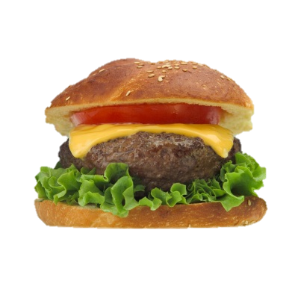
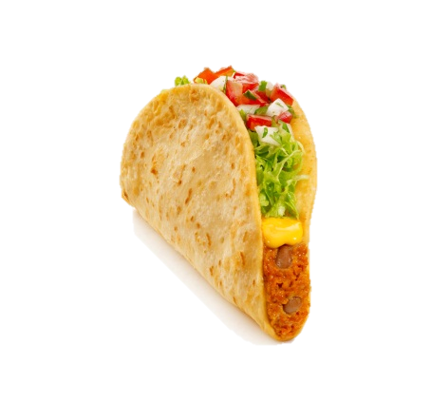
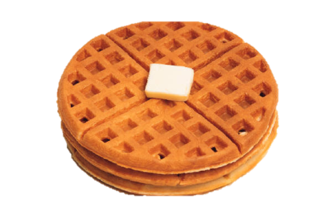
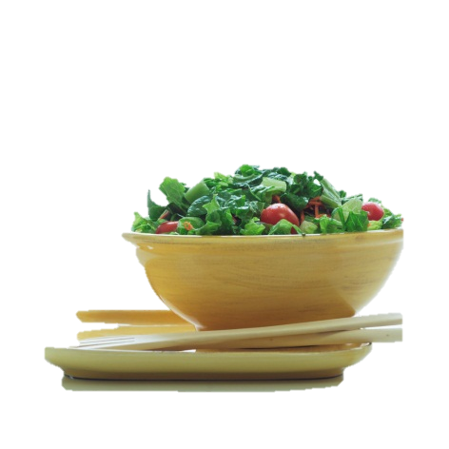
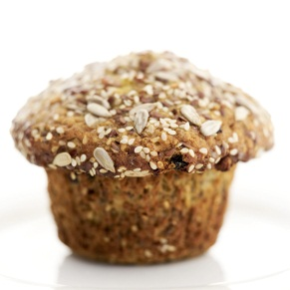
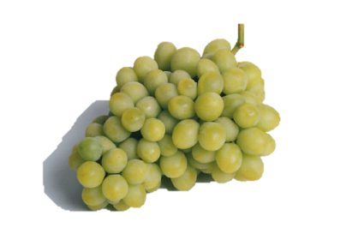
$pending Your
CALORIE
$alary
For Teens!
Images on this slide courtesy of NCI, Renee Comet, photographer, and the Microsoft Clip Art Gallery
Notes:
Images courtesy of NCI, Renee Comet, photographer

Slide 2
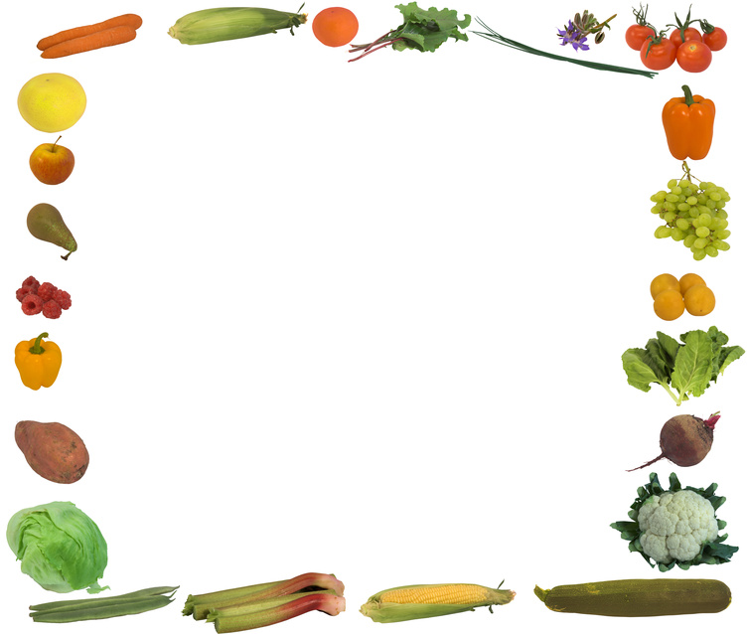
Alice Henneman, MS RD University of Nebraska–Lincoln Extension ahenneman1@unl.edu
Amy Peterson, MS RD University of Nebraska–Lincoln Extension apeterson3@unl.edu
Save Time – Do More with our FREE educational resources:
http://food.unl.edu/web/fnh/educational-resources
This publication has been peer-reviewed ● August 2012

Slide 3
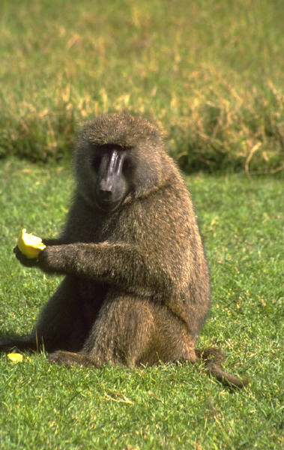
“If you don’t take care of your body, where are you going to live?”
~Author unknown

Slide 4
Today’s Lesson Plan
Stay Within Your Calorie Budget!
“Essential” vs. “Extra” calories
Join the Portion Control Patrol
Move your feet more to eat more!

Slide 5
Today’s Lesson Plan
Stay Within Your Calorie Budget!
“Essential” vs. “Extra” calories
Join the Portion Control Patrol
Move your feet more to eat more!

Slide 6
Budgeting your “Calorie Salary”
Plan calories the same as major expenses.
What are you saving for?

Slide 7
Or, you may have trouble ahead!

Slide 8
Build your foundation first!
After you have a “foundation” built around MyPlate, if you have calories to spare in your calorie budget, then you can spend some on extras

Slide 9
Food is to be enjoyed!
“Food is not nutritious until its eaten.” ~ Smarter Lunchrooms 2011
Notes:
Eating is one of life’s pleasures. Use MyPlate to plan healthy, enjoyable meals!

Slide 10
Eat until “satisfied,” not “full”
“Your stomach shouldn’t be a waist (waste) basket.”
~ Author Unknown
Notes:
Eat only until you are satisfied, not full. If you tend to overeat, be aware of the time of day, place and your mood while eating so you can better control the amount you eat.

Slide 11
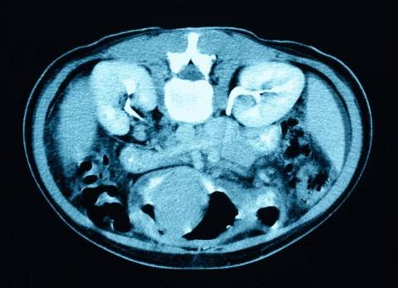
It takes about 20 minutes for stomach to tell your brain you’re full
20 minutes
11
Notes:
Slow down to slim down!

Slide 12
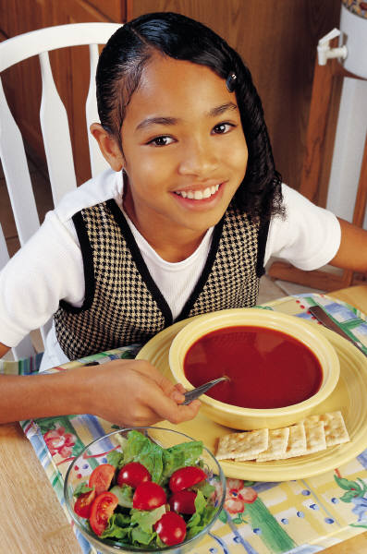
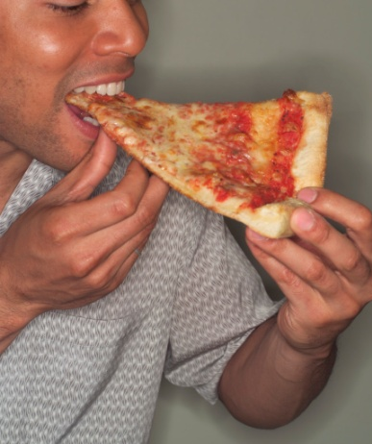
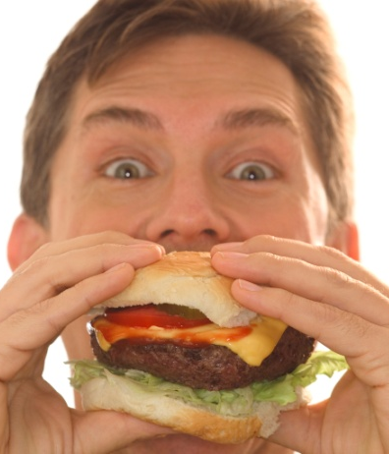
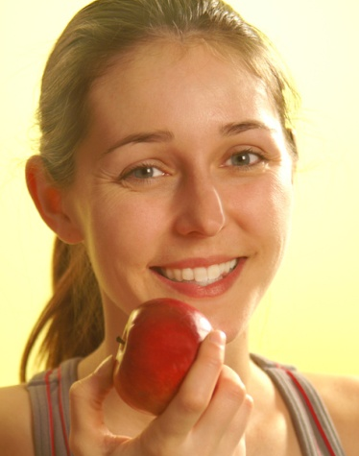
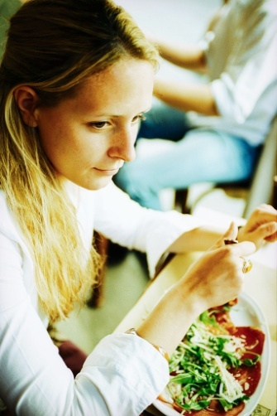
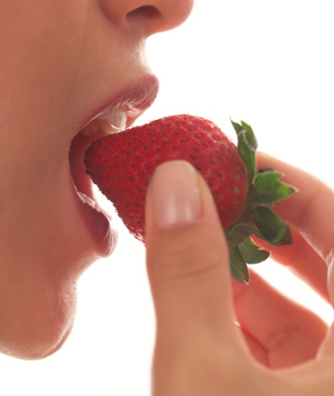
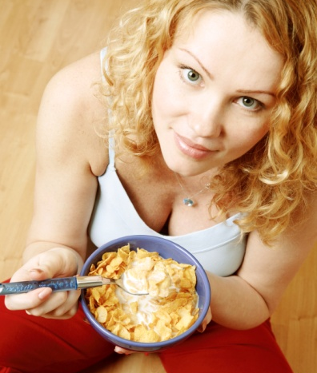
Think of the MyPlate guidelines
as a “calorie salary”

Slide 13
3,500 calories adds up to about 1 pound

Slide 14
Beware the cost of extra calories
100 extra calories per day
10 extra pounds per year
Notes:
Knowing one’s daily calorie needs from a calorie table based on age, gender, height, weight and level of physical activity may be a useful reference point in determining the calories a person eats and drinks are appropriate in relation to the number needed daily. However, monitoring whether you maintain your weight over time by adjusting calories and physical activity is the most helpful.
It doesn’t take many extra calories a day to add 10 pounds a year! The good news is by reducing daily calorie intake by 100 calories, you can lose 10 pounds per year.

Slide 15
Example of 100 calories
10 jelly beans

Slide 16
6 cups microwave popcorn

Slide 17
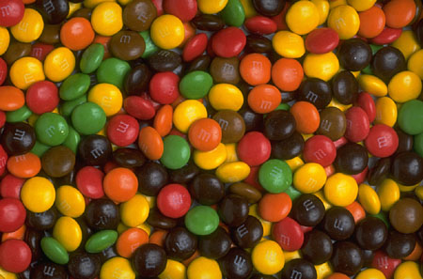
25 pieces candy covered
chocolate candies
25 pieces

Slide 18
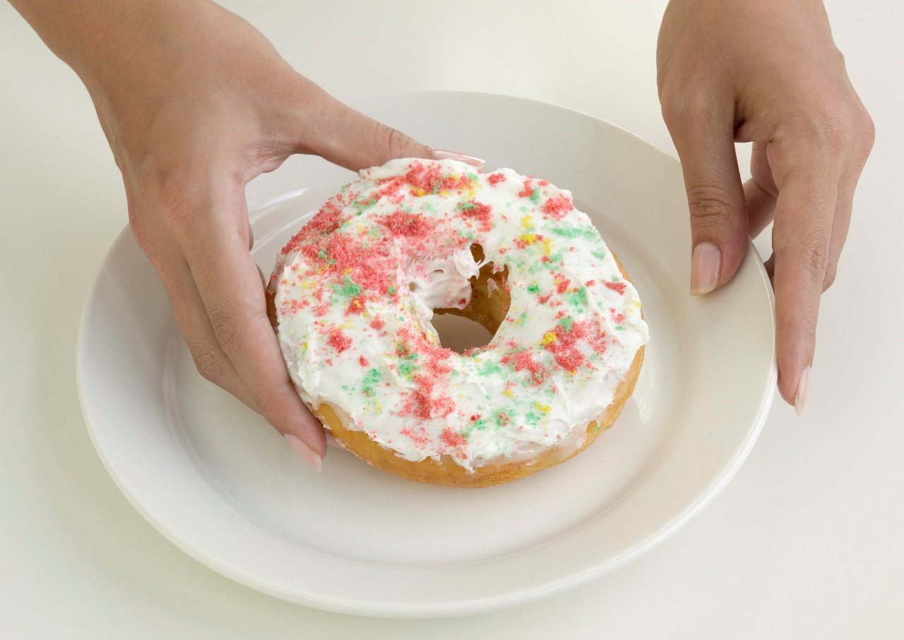
Example of 100 calories
⅓ large (4-inch diameter) doughnut

Slide 19
Example of 100 calories
⅔ can of a regular soft drink

Slide 20
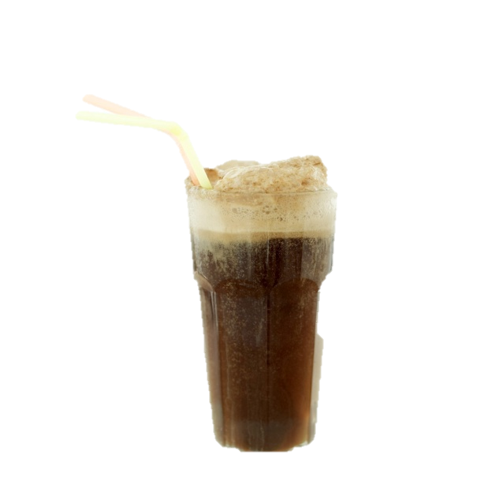
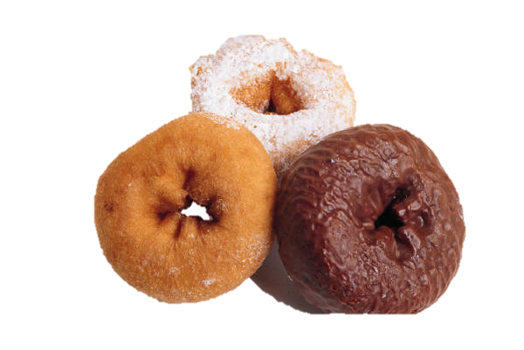
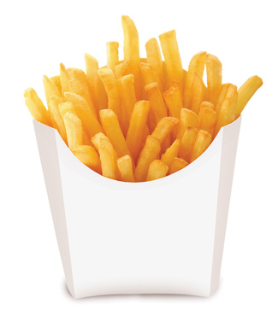
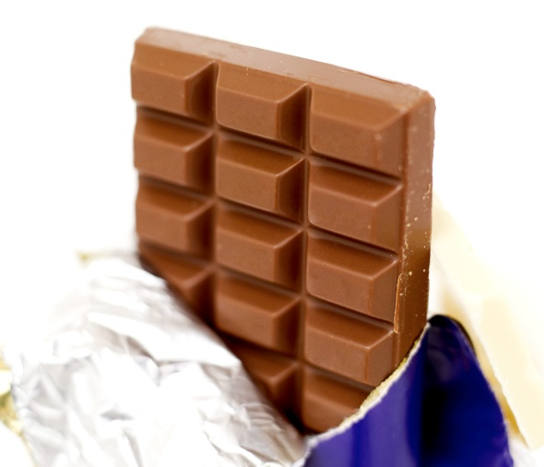
Average calories …
150 calories/12 oz.
Regular Soda
240 calories/
Medium Glazed Doughnut
200 calories/ 1.5 oz
Chocolate Bar
460 calories/
medium order French Fries

Slide 21
The Latte Factor®
David Bach, author of The Automatic Millionaire, popularized the term Latte Factor® to demonstrate the power of saving a few dollars daily by forgoing unnecessary purchases

Slide 22
The Latte Factor®
Over several years, you can save thousands of dollars!
When you save by forgoing unnecessary food, you also save calories!

Slide 23
Today’s Lesson Plan
Stay Within Your Calorie Budget!
“Essential” vs. “Extra” calories
Join the Portion Control Patrol
Move your feet more to eat more!

Slide 24
“Essentials”
“Extras”

Slide 25
“Essential” vs. “extra” calories
“Essential” calories are the minimum calories needed to eat the foods your body needs

Slide 26
“Essential” calories are like car payments.
What happens if you skip car payments?

Slide 27
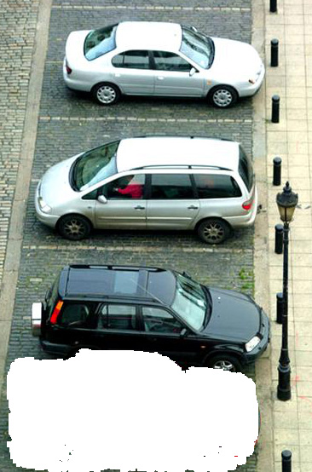

Slide 28
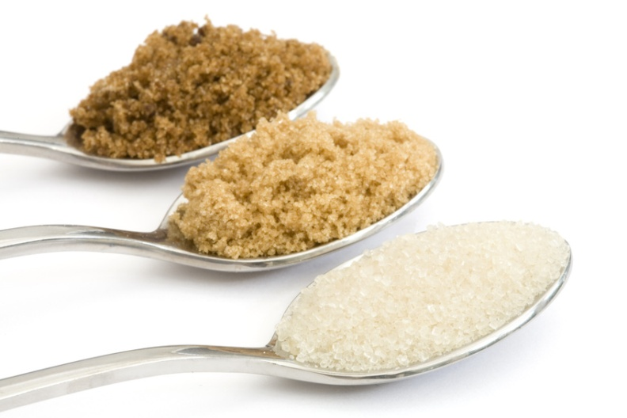
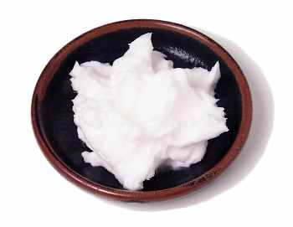
The best food “buys” are foods with:
No added sugar
The least amount of fat, especially solid fat

Slide 29
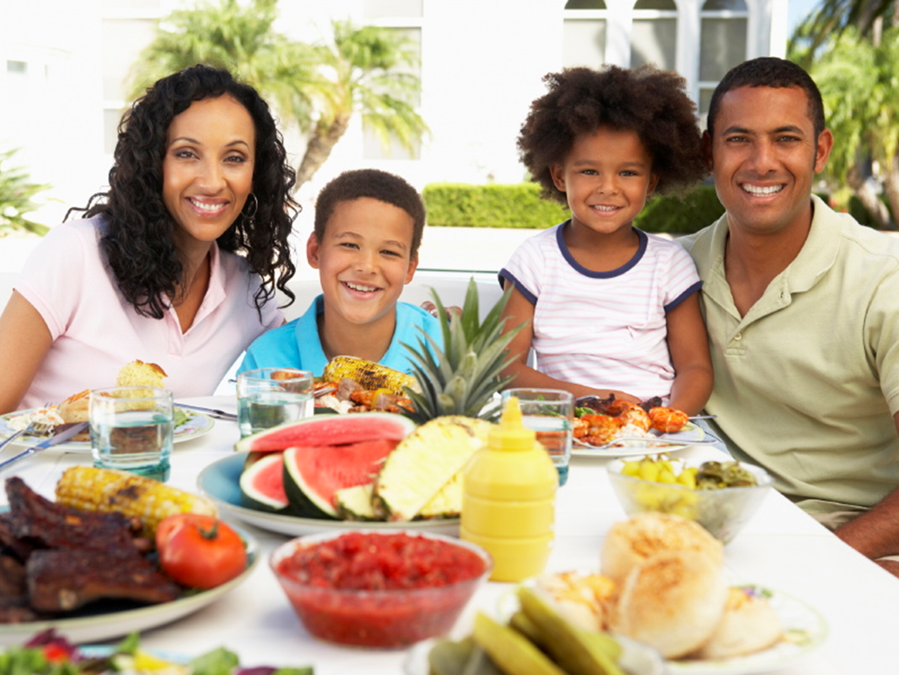
Get the most for your “calorie salary” by eating more “nutrient-dense” foods

Slide 30
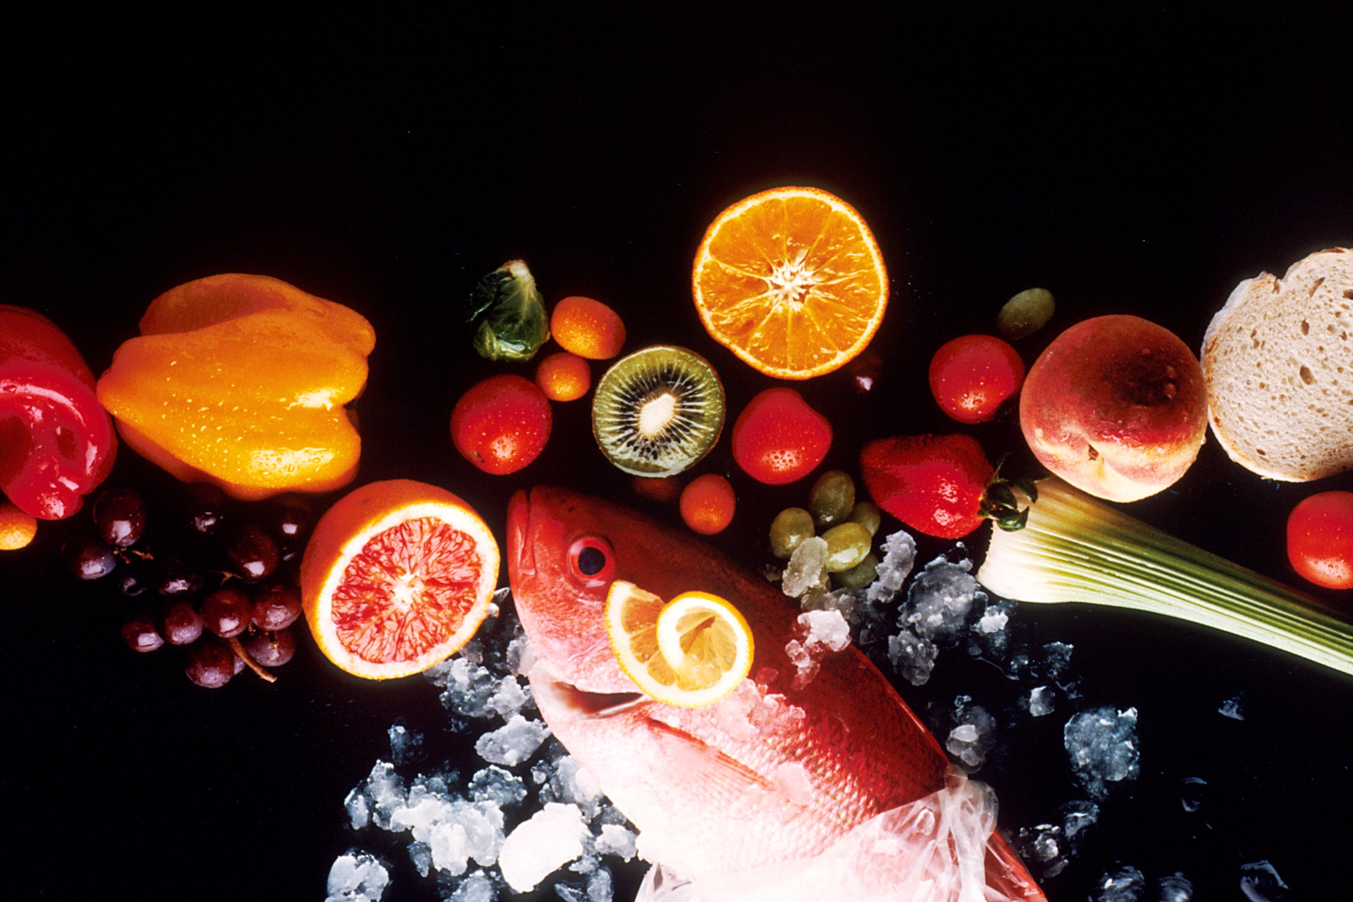
Nutrient-dense foods provide vitamins, minerals, and other beneficial substances while being relatively low in calories, and without solid fats (in or added to the food) and without added sugars, refined starches, or sodium
“Dietary Guidelines, 2010 at a Glance “PowerPoint, USDA CNPP

Slide 31
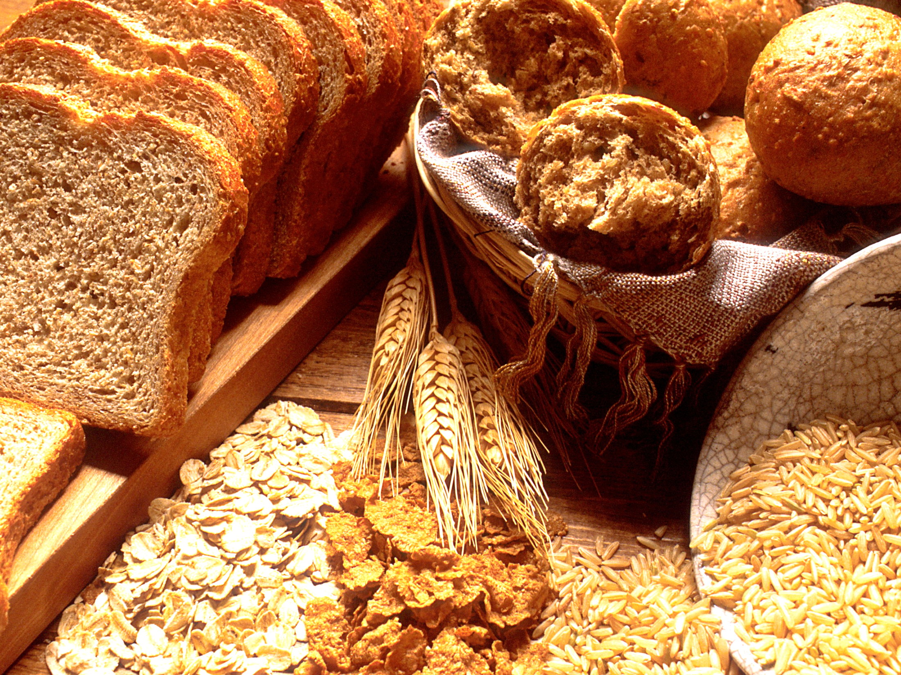
Nutrient-dense foods retain naturally occurring components, such as dietary fiber
Photo courtesy of National Cancer Institute, photographer unknown

Slide 32
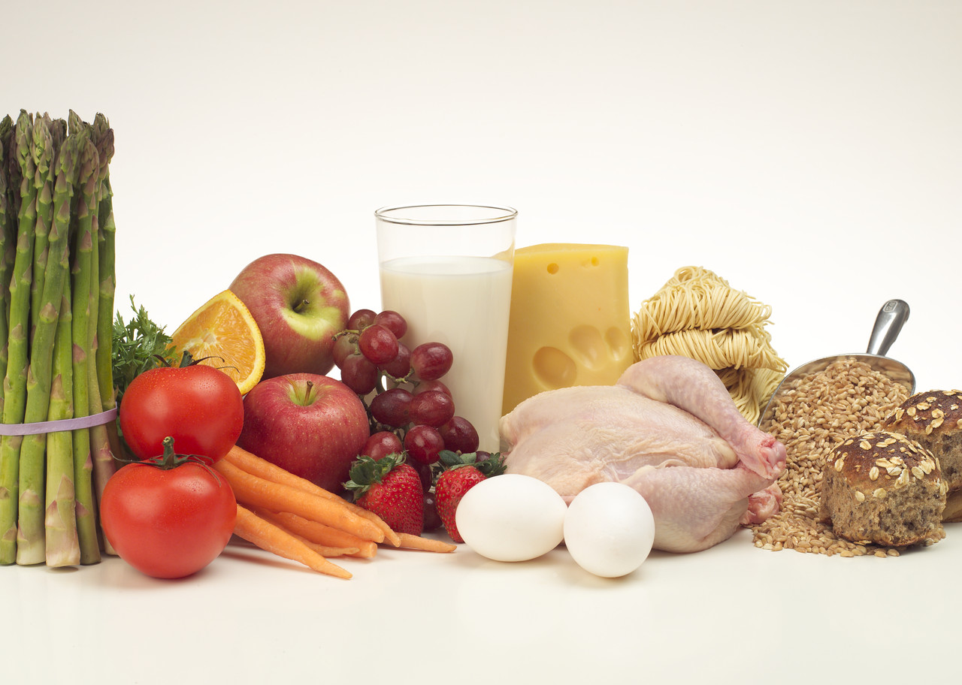
All vegetables, fruits, whole grains, seafood, eggs, beans and peas, unsalted nuts and seeds, fat-free and low-fat dairy, and lean meats and poultry are nutrient-dense when prepared without solid fats or sugars

Slide 33
Nutrient-dense vs. not nutrient-dense
Notes:
This figure illustrates the concept of nutrient-dense foods comparing a baked form of chicken with a breaded and fried form.
Data from the U.S. Department of Agriculture, Agricultural Research Service, Food and Nutrient Database for Dietary Studies 4.1. http:// www.ars.usda.gov/Services/doc

Slide 34
Nutrient-dense vs. not nutrient-dense
Notes:
This figure illustrates the concept of nutrient-dense foods comparing a baked form of chicken with a breaded and fried form.
Data from the U.S. Department of Agriculture, Agricultural Research Service, Food and Nutrient Database for Dietary Studies 4.1. http:// www.ars.usda.gov/Services/doc

Slide 35
Nutrient-dense vs. not nutrient-dense
Notes:
This figure illustrates the concept of nutrient-dense foods comparing a baked form of chicken with a breaded and fried form.
Data from the U.S. Department of Agriculture, Agricultural Research Service, Food and Nutrient Database for Dietary Studies 4.1. http:// www.ars.usda.gov/Services/doc

Slide 36
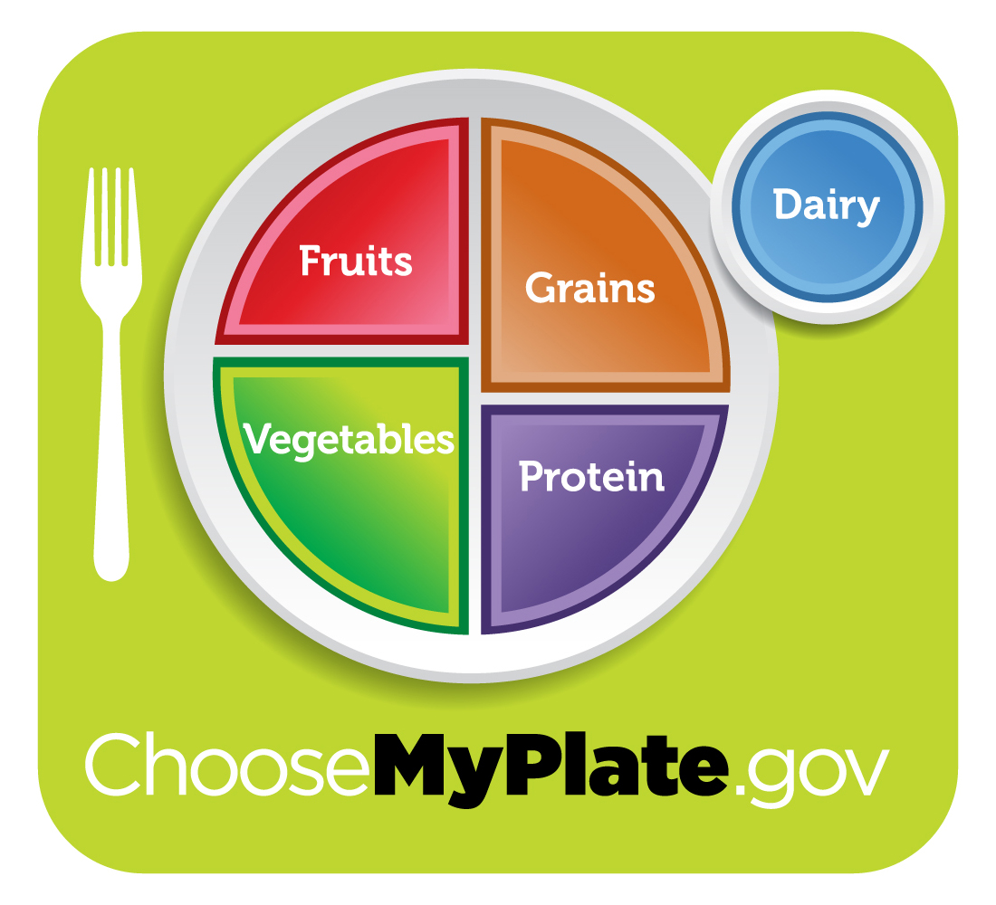
Choose MyPlate “Menu”
Foods to increase
Make half your plate fruits and vegetables
Make at least half your grains whole grains
Switch to fat-free or low-fat (1%) milk
Notes:
These are three main messages under “Foods to increase.”

Slide 37
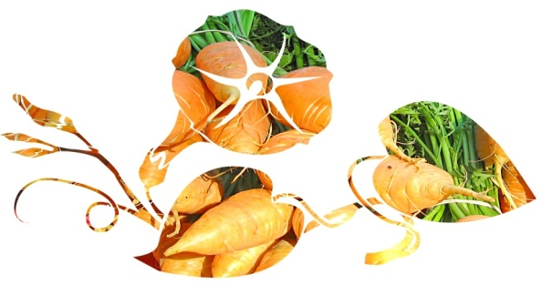
Pick a variety of vegetables from each vegetable subgroup
Red & orange
Beans & peas
(legumes)
Starchy
Dark-green
Other
Notes:
Formerly the Dietary Guidelines included an orange vegetable subgroup. In 2010, they added red foods and now refer to a red-orange subgroup, to include tomatoes, because of the tomato’s nutritive value and the extent to which it occurs in American diets. Tomatoes are high in the antioxidant lycopene. They also are a significant source of vitamin C, fiber and potassium.
Examples of food from the five vegetable subgroups include:
Dark-green vegetables: All fresh, frozen, and canned dark-green leafy vegetables and broccoli, cooked or raw: for example, broccoli; spinach; romaine; collard, turnip, and mustard greens.
Red and orange vegetables: All fresh, frozen, and canned red and orange vegetables, cooked or raw: for example, tomatoes, red peppers, carrots, sweet potatoes, winter squash, and pumpkin.
Beans and peas (legumes): All cooked beans and peas: for example, kidney beans, lentils, chickpeas, and pinto beans. Does not include green beans or green peas. (See additional comment under protein foods group.)
Starchy vegetables: All fresh, frozen, and canned starchy vegetables: for example, white potatoes, corn, green peas.
Other vegetables: All fresh, frozen, and canned other vegetables, cooked or raw: for example, iceberg lettuce, green beans, and onions.

Slide 38
Fill half your plate with fruits & veggies
Notes:
Divide the other half between a lean protein source and a whole grain.

Slide 39
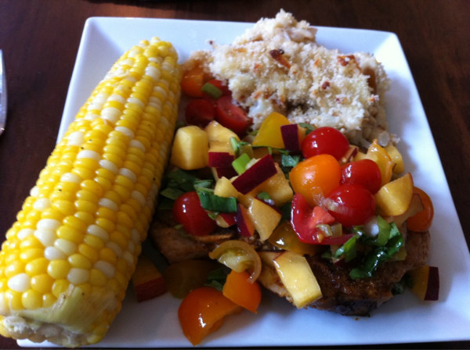
Overall dietary pattern is important
Photo courtesy of USDAgov on flickr
Notes:
http://www.flickr.com/photos/usdagov/5842870387/sizes/z/in/photostream/

Slide 40
“For optimum health, scientists say eat a rainbow of colors. Your plate should look like a box of Crayolas.”
~Janice M. Horowitz, TIME, January 12, 2002

Slide 41
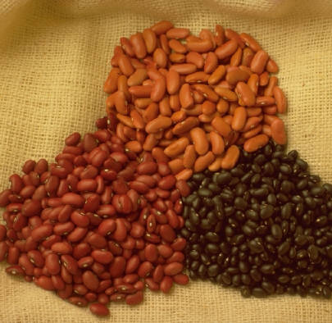
Did you know: The vegetable subgroup of “beans and peas (legumes)” includes ...
… all cooked beans and peas, for example:
Kidney beans
Lentils
Chickpeas
Pinto beans

Slide 42
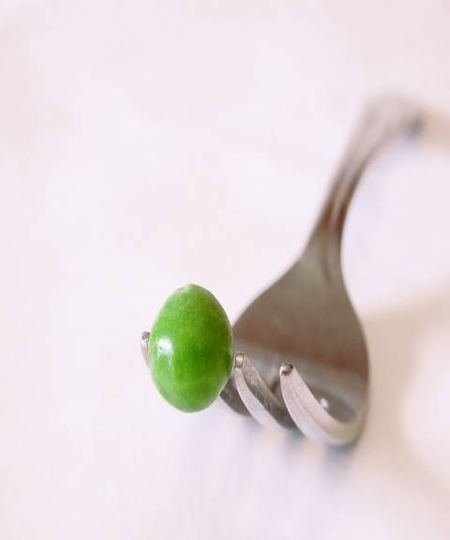
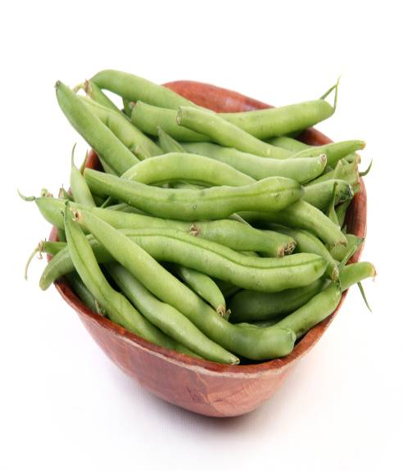
The “beans and peas (legumes)” subgroup does NOT include ...
Green peas
Green beans
Notes:
Green peas are in the “Starchy Vegetables” vegetable subgroup. Green beans are in the “Other Vegetables” vegetable subgroup.

Slide 43
Can you guess: What type of food are “beans and peas (legumes)” considered?
A. Vegetable
B. Protein
C. Both A and B
D. Neither A or B

Slide 44
Can you guess: What type of food are “beans and peas (legumes)” considered?
A. Vegetable
B. Protein
C. Both A and B
D. Neither A or B
Notes:
Answer C. Both A and B. The DGA2010 vegetable subgroup of “beans and peas (legumes)” refers to the mature forms of legumes. It includes kidney beans, pinto beans, black beans, garbanzo beans (chickpeas), lima beans, black-eyed peas, split peas, and lentils.
They contain protein and other nutrients similar to seafood, meat, and poultry. Plus, they are excellent sources fiber and other nutrients which also are found in vegetables.
Green peas and green (string) beans are not considered part of the “beans and peas (legumes)” subgroup.

Slide 45
At least half your grains should be whole grains
Notes:
Moderate evidence shows that adults who eat more whole grains, particularly those higher in dietary fiber, have a lower body weight compared to adults who eat fewer whole grains.

Slide 46
Can you guess: Which bread is highest in WHOLE grains?
A. INGREDIENTS: wheat flour, water, high fructose corn syrup, molasses, wheat, bran ...
B. INGREDIENTS: whole wheat flour, water, brown sugar ...

Slide 47
Can you guess: Which bread is highest in WHOLE grains?
A. INGREDIENTS: wheat flour, water, high fructose corn syrup, molasses, wheat, bran ...
B. INGREDIENTS: whole wheat flour, water, brown sugar ...
Notes:
Answer: B. a “whole grain” should be the first ingredient or the second ingredient, after water. For foods with multiple whole-grain ingredients, they should appear near the beginning of the ingredients list.

Slide 48
Switching to fat-free or low-fat (1%) milk makes a difference!
Whole | 2% | 1% | Fat-free
165 calories | 125 calories | 100 calories | 85 calories
Calories saved | 40 | 65 | 80
Notes:
Choosing fat-free or1% low-fat milk and milk products provides the same nutrients with less solid fat and thus fewer calories.
Soy beverages fortified with calcium and A and D are considered part of the milk and milk products group because they are similar to milk both nutritionally and in their use in meals.

Slide 49
Can you guess: Which is more nutrient-dense?
A. Fat-free and low fat (1%) milk
B. Whole milk
C. They are equally nutrient-dense

Slide 50
Can you guess: Which is more nutrient-dense?
A. Fat-free and low fat (1%) milk
B. Whole milk
C. They are equally nutrient-dense

Slide 51
Choose MyPlate “Menu”
Foods to reduce
Compare sodium in foods like soup, bread, and frozen meals ― and choose the foods with lower numbers
Drink water instead of sugary drinks
Notes:
These are two main messages under “Foods to reduce.”

Slide 52
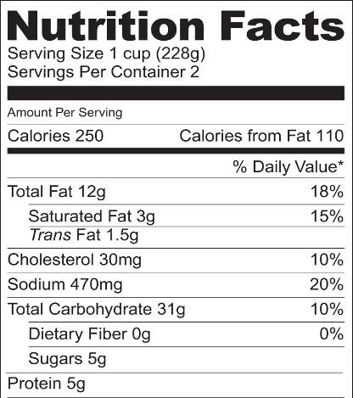
Nutrition Facts Label doesn’t separate “added” & “naturally occurring” sugars
“Added” sugars are sugars and syrups added to foods or beverages during preparation or processing
1 teaspoon sugar = about 4g of added and/or naturally occurring sugar
Notes:
Sometimes when people see the word “sugar” on the Nutrition Facts Label of a food that has “naturally occurring” sugar, such as milk, fruit, or some vegetables, they may feel they shouldn’t eat it. However, unless a person had to monitor total carbohydrate, it is the “added” sugars that are the concern of the DGA2010.

Slide 53
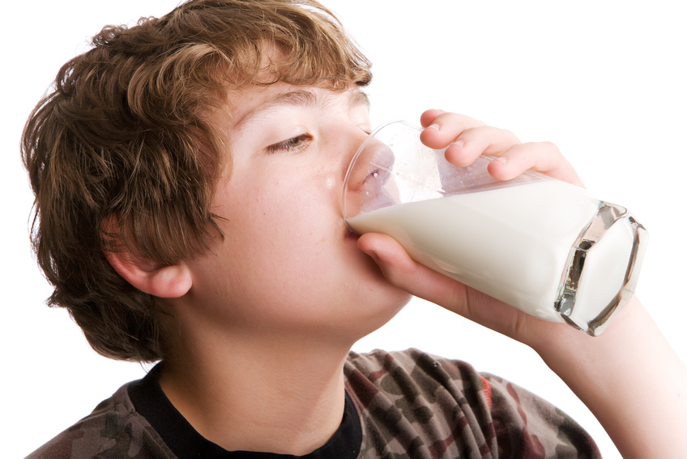
Other sugars occur “naturally” in foods like milk, fruit, and some vegetables – they aren’t the “added sugars” that are the concern

Slide 54
Can you guess: Which food has ADDED sugar according to the ingredient list?
A. INGREDIENTS: cultured pasteurized grade A nonfat milk, whey protein concentrate, pectin ...
B. INGREDIENTS: cultured grade A reduced fat milk, apples, high-fructose corn syrup, cinnamon, nutmeg, natural flavors, pectin ...

Slide 55
Can you guess: Which food has ADDED sugar according to the ingredient list?
A. INGREDIENTS: cultured pasteurized grade A nonfat milk, whey protein concentrate, pectin ...
B. INGREDIENTS: cultured grade A reduced fat milk, apples, high-fructose corn syrup, cinnamon, nutmeg, natural flavors, pectin ...
Notes:
Answer: B. If you are uncertain whether the sugar shown on the Nutrition Facts Label is “added” or “naturally occurring,” check the list of ingredients. Look for such words as syrup, sugar, honey, molasses, dextrin, and words ending on “ose” (such as dextrose, fructose, lactose, maltose, sucrose).

Slide 56
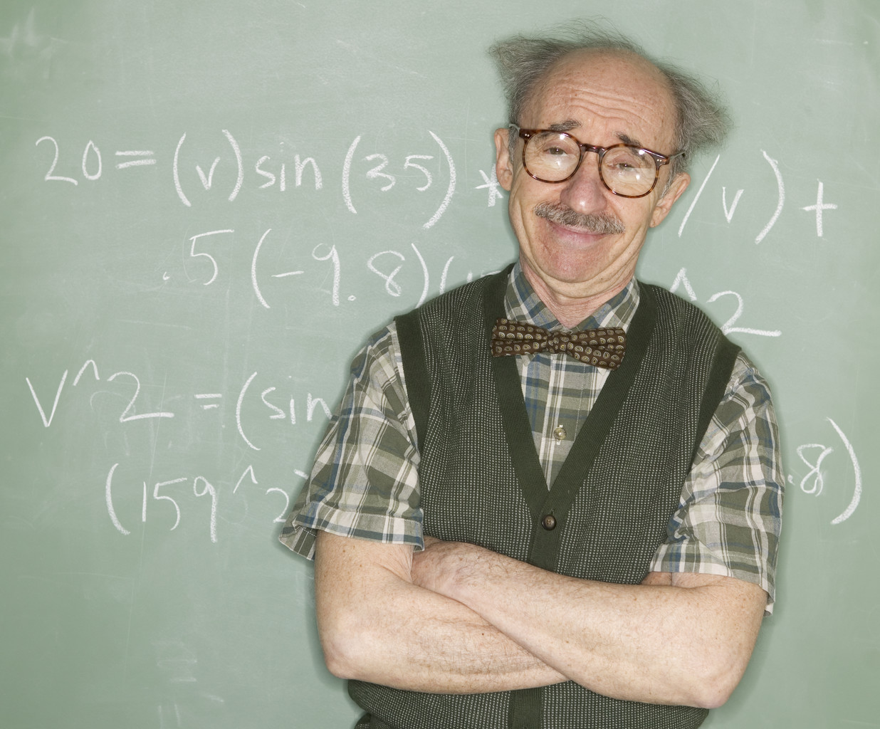
Quick Math Lesson
1 teaspoon added sugar = about 20 calories
1 teaspoon solid fat = about 35 calories
Check “Nutrition Facts” labels for more specific calorie counts and nutrition information.

Slide 57
Reduce sugar-sweetened beverage intake:
Drink fewer sugar-sweetened beverages
Consume smaller portions
Substitute water, unsweetened coffee and tea, and other beverages with few or no calories
Notes:
Strong evidence shows children and adolescents who consume more sugar-sweetened beverages have higher body weight compared to those who drink less, and moderate evidence also supports this relationship in adults.
Sugar-sweetened beverages provide excess calories and few essential nutrients to the diet and should only be consumed when nutrient needs have been met and without exceeding daily calorie limits.
Reduce the intake of these beverages by: drinking fewer sugar-sweetened beverages, consuming smaller portions, substituting water, unsweetened coffee and tea, and other beverages with few or no calories. Read the label or see new front of pack calorie information on an increasing number of beverages."

Slide 58
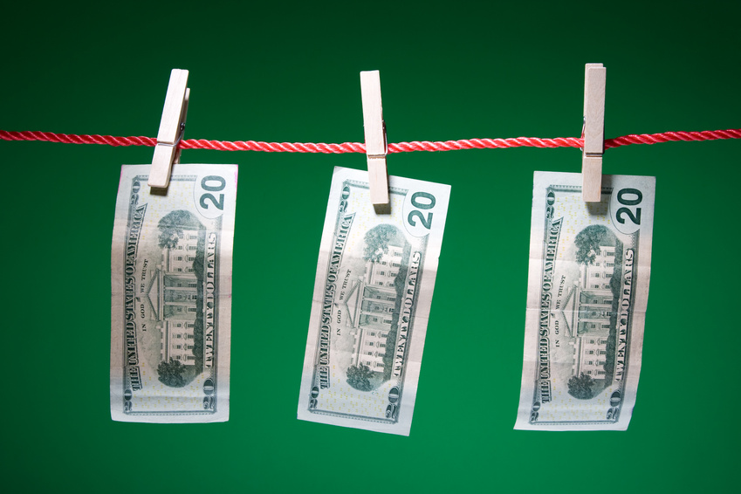
Spend your “calorie salary” wisely to have “extra” calories after meeting “essential” nutrient needs.

Slide 59
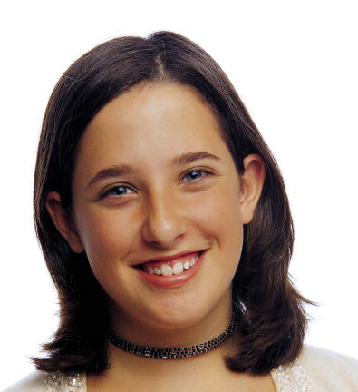
“Essential” vs. “extra” calories
“Extra” calories are like money left after car payments and other “essential” spending.
They’re like “extra” money you can spend on things like movies and so on.

Slide 60
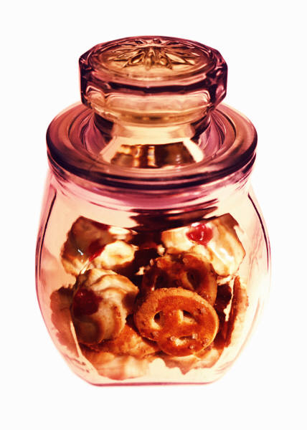
You can spend your “extra” calories on:
Foods with added sugar
Foods higher in fat
More foods from the MyPlate food groups

Slide 61
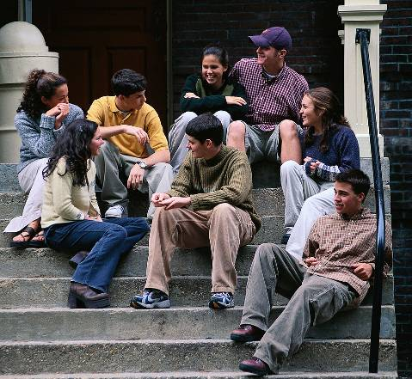
Total “extra” calories range from about 100 to 700 calories
YOUR level
depends on:
Age
Gender
Activity level

Slide 62
Find on the next slides …
Approximate total calories YOU need
About how many of YOUR total calories can be spent on “extras”

Slide 63
Calories for 9 - 13 years
Females
Not active
1600
130
Active
1600 – 2000
130 - 290
Males
Not active
1800
195
1800 - 2600
Active
195 - 410
Extra
Total

Slide 64
Calories for 14 - 18 years
Females
Not active
1800
195
2000 – 2400
Active
Males
265 - 360
2200
Not active
290
2400 - 3200
Active
360 - 650
Calories
Extra
Total

Slide 65
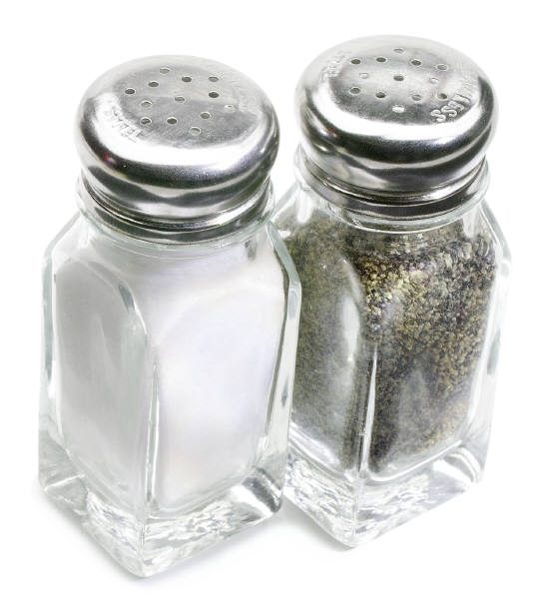
Food tastes boring without a little salt….
But how much is too much??

Slide 66
Can you guess: People ages 2 and older should reduce daily sodium intake to less than …
A. 2,300 mg or 1,500 mg, depending on age/other individual characteristics
B. 2,300 mg or 3,000 mg, depending on age/other individual characteristics

Slide 67
Can you guess: People ages 2 and older should reduce daily sodium intake to less than …
A. 2,300 mg or 1,500 mg, depending on age/other individual characteristics
B. 2,300 mg or 3,000 mg, depending on age/other individual characteristics
Notes:
Answer: A. 2,300 mg or 1,500 mg, depending on age/other individual characteristics

Slide 68
Groups reduced to 1,500 mg
African Americans ages 2+
Adults ages 51+
People ages 2+ with high blood pressure, diabetes, or chronic kidney disease
_{Ages 2+}
Notes:
The 1500 mg recommendation applies to half the total population (ages 2+) and to the majority of adults.

Slide 69
Can you guess: How much sodium is in a teaspoon of salt?
A. 1,300 mg
B. 2,300 mg
C. 3,300 mg

Slide 70
Can you guess: How much sodium is in a teaspoon of salt?
A. 1,300 mg
B. 2,300 mg
C. 3,300 mg

Slide 71
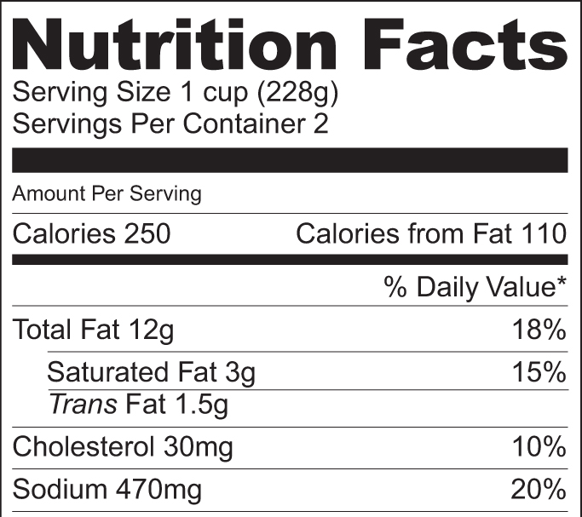
Can you guess: How much sodium is in 1 cup of this food?
A. 30 mg
B. 250 mg
C. 470 mg

Slide 72
Can you guess: How much sodium is in 1 cup of this food?
A. 30 mg
B. 250 mg
C. 470 mg
Notes:
Answer: C. 470 mg.

Slide 73
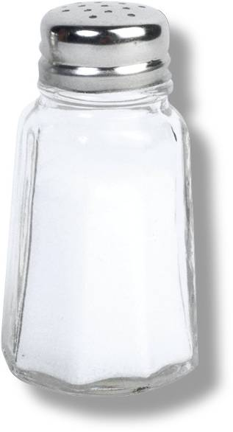
Easy ways to reduce sodium
Check labels
Try to avoid a lot of pre-packed foods high in sodium
Avoid adding salt (an exception may be when baking yeast breads)
Eat fresh foods, frozen veggies
Request salt be left off when eating out
Use other seasonings
Notes:
NOTE: Salt is typically used in yeast breads and other bread-type products made with yeast to regulate the growth of the yeast and prevent the food from rising too rapidly. While yeast breads can be made without salt, modifications in the ingredients and recipe techniques are usually made to create a product with a satisfactory texture. As salt also adds flavor, most bread is still made with salt.

Slide 74
Today’s Lesson Plan
Stay Within Your Calorie Budget!
“Essential” vs. “Extra” calories
Join the Portion Control Patrol
Move your feet more to eat more!

Slide 75
As portion sizes have gotten larger over the years, so have we!

Slide 76
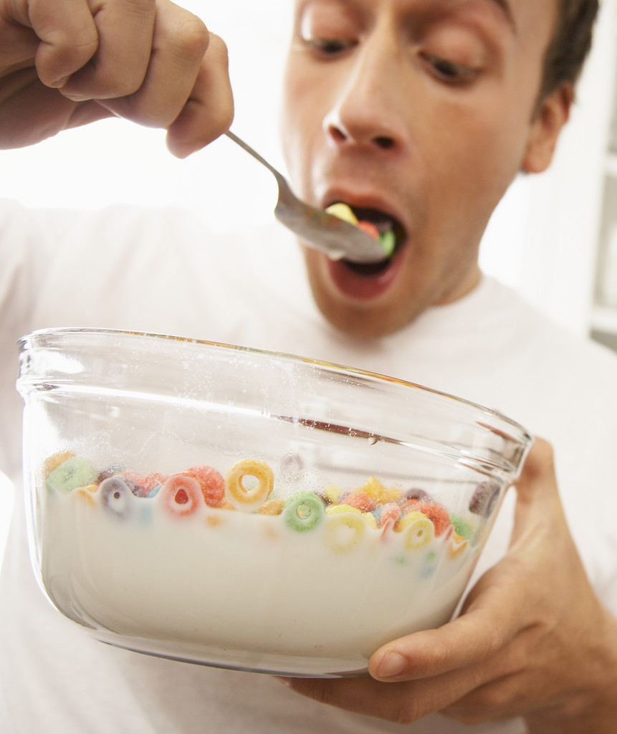
Larger portions add up!

Slide 77
Beware of the cost of extra calories
100 extra calories
per day
10 extra pounds
per year!
Notes:
Knowing one’s daily calorie needs from a calorie table based on age, gender, height, weight and level of physical activity may be a useful reference point in determining the calories a person eats and drinks are appropriate in relation to the number needed daily. However, monitoring whether you maintain your weight over time by adjusting calories and physical activity is the most helpful.
It doesn’t take many extra calories a day to add 10 pounds a year! The good news is by reducing daily calorie intake by 100 calories, you can lose 10 pounds per year.

Slide 78
Maintaining a healthy weight is a balancing act
Calories in
Calories out

Slide 79
Portion distortion over the years
Food portion sizes have changed in 25 years.
Slides marked by this icon are adapted from “Portion Distortion” by the National Heart, Lung and Blood Institute at http://hin.nhlbi.nih.gov/portion

Slide 80
Portion distortion
The following illustrations are representative of comparative sizes.
Calories expended by various physical activities are approximations and will vary with age, gender, height/weight, and intensity of the activity.
Several different weights are used as examples in the following slides.

Slide 81
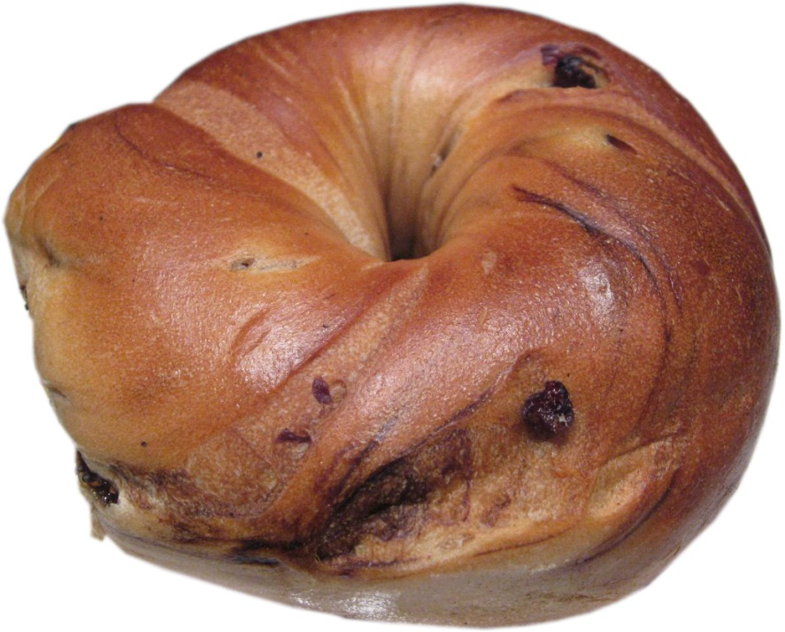
Guess the calorie difference!
25 Years Ago
Today
3-inch diameter
6-inch diameter
Blueberry bagel photo courtesy of pengrim™ at http://flic.kr/p/41qvEZ under a Creative Commons Attribution-NonCommerical license: http://creativecommons.org/licenses/by-nc/3.0/
Notes:
Blueberry bagel image courtesy of pengrim™ at http://flic.kr/p/41qvEZ under a Creative Commons Attribution-NonCommerical license: http://creativecommons.org/licenses/by-nc/3.0/

Slide 82
Guess the calorie difference!
140 calories
350 calories
210 more calories
Notes:
Blueberry bagel image courtesy of pengrim™ at http://flic.kr/p/41qvEZ under a Creative Commons Attribution-NonCommerical license: http://creativecommons.org/licenses/by-nc/3.0/

Slide 83
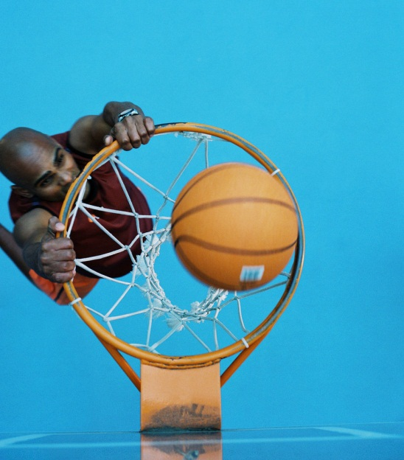
How long would you have to play basketball to burn 210 more calories?
Notes:
Blueberry bagel image courtesy of pengrim™ at http://flic.kr/p/41qvEZ under a Creative Commons Attribution-NonCommerical license: http://creativecommons.org/licenses/by-nc/3.0/

Slide 84
How long would you have to play basketball to burn 210 more calories?
30 minutes
Calorie Calculations: http://www.nutribase.com/exercala.htm
Based on 160-pound person

Slide 85
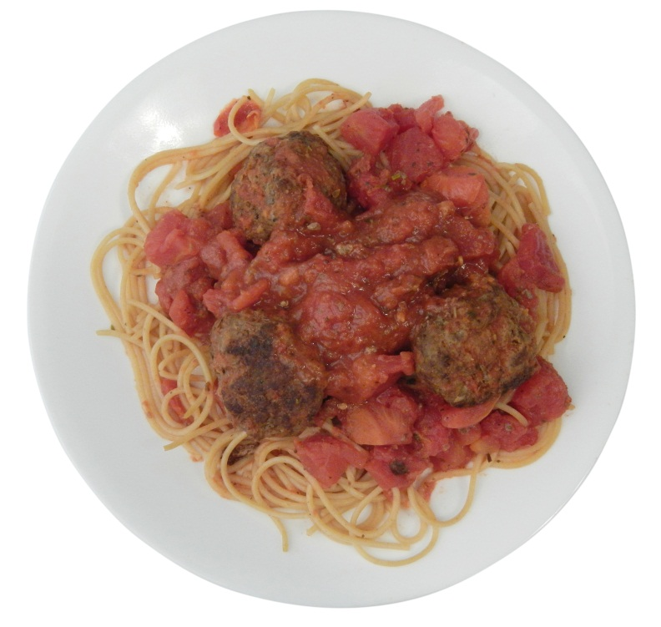
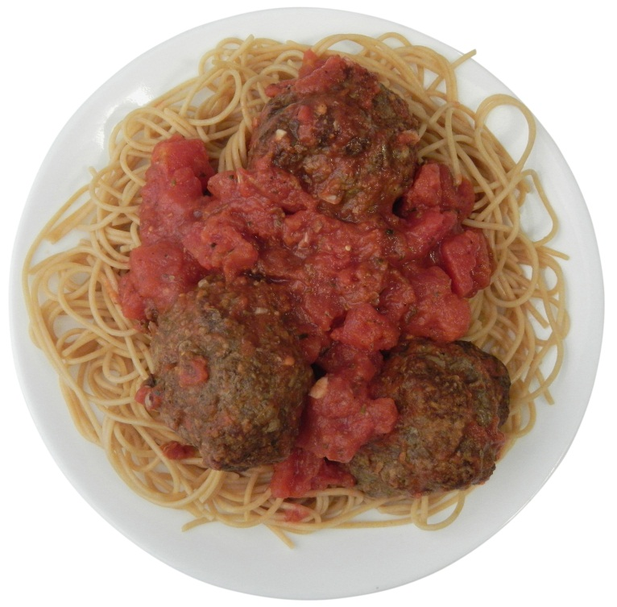
Guess the calorie difference!
20 Years Ago
Today
1 cups spaghetti with sauce & 3 small meatballs
2 cups spaghetti with sauce & 3 large meatballs

Slide 86
Guess the calorie difference!
500 calories
1,025 calories
525 more calories

Slide 87
How long would you have to jog to burn 525 more calories?

Slide 88
How long would you have to jog to burn 525 more calories?
60 minutes*
based on 12 minutes/mile
Calorie Calculations: http://www.nutribase.com/exercala.htm
Based on 140-pound person

Slide 89
Guess the calorie difference!
20 Years Ago
Today
2.4 ounces
6.9 ounces

Slide 90
Guess the calorie difference!
210 calories
610 calories
400 more calories

Slide 91
How long would you have to walk leisurely to burn 400 more calories?

Slide 92
How long would you have to walk leisurely to burn 400 more calories?
1 hour and 10 minutes
Based on 160-pound person

Slide 93
Guess the calorie difference!
20 Years Ago
Today
6.5-oz. soda
20-oz. soda

Slide 94
Guess the calorie difference!
85 calories
250 calories
165 more calories

Slide 95
How long would you have to dance to burn 165 more calories?

Slide 96
How long would you have to dance to burn 165 more calories?
30 minutes
Calorie Calculations: http://www.nutribase.com/exercala.htm
Based on 140-pound person

Slide 97
Guess the calorie difference!
20 Years Ago
Today

Slide 98
Guess the calorie difference!
333 calories
590 calories
257 more calories

Slide 99
How long would you have to lift weights to burn 257 more calories?

Slide 100
How long would you have to lift weights to burn 257 more calories?
1 hour and 30 minutes
Calorie Calculations: http://www.nutribase.com/exercala.htm
Based on 130-pound person

Slide 101
Guess the calorie difference!
20 Years Ago
Today
Coffee, 8 oz. (with whole milk & sugar)
Mocha coffee, 16 oz. (with steamed whole milk & mocha syrup)
Large coffee image courtesy of renee_mcgurk (Renee McGurk) at http://flic.kr/p/9agbB4 under a Creative Commons Attribution license: http://creativecommons.org/licenses/by/3.0/
Notes:
Large coffee image courtesy of renee_mcgurk (Renee McGurk) at http://flic.kr/p/9agbB4 under a Creative Commons Attribution license: http://creativecommons.org/licenses/by/3.0/

Slide 102
Guess the calorie difference!
45 calories
350 calories
305 more calories
Notes:
Large coffee image courtesy of renee_mcgurk (Renee McGurk) at http://flic.kr/p/9agbB4 under a Creative Commons Attribution license: http://creativecommons.org/licenses/by/3.0/

Slide 103
How long would you have to backpack to burn 305 more calories?
Notes:
Large coffee image courtesy of renee_mcgurk (Renee McGurk) at http://flic.kr/p/9agbB4 under a Creative Commons Attribution license: http://creativecommons.org/licenses/by/3.0/

Slide 104
How long would you have to backpack to burn 305 more calories?
30 minutes carrying a 10 pound load
Calorie Calculations: http://www.nutribase.com/exercala.htm
Based on 170-pound person

Slide 105
Guess the calorie difference!
20 Years Ago
Today
1.5 ounces
4 ounces

Slide 106
Guess the calorie difference!
210 calories
500 calories
290 more calories

Slide 107
How long would you have to play volleyball to burn 290 more calories?

Slide 108
How long would you have to play volleyball to burn 290 more calories?
1 hour
game
Calorie Calculations: http://www.nutribase.com/exercala.htm
Based on 120-pound person

Slide 109
Guess the calorie difference!
20 Years Ago
Today
5 cups
11 cups

Slide 110
Guess the calorie difference!
270 calories
630 calories
360 more calories

Slide 111
How long would you have to swim to burn 360 more calories?

Slide 112
How long would you have to do swim to burn 360 more calories?
30 minutes
at 50 yards a minute!
Calorie Calculations: http://www.nutribase.com/exercala.htm
Based on 160-pound person

Slide 113
Guess the calorie difference!
20 Years Ago
Today

Slide 114
Guess the calorie difference!
500 calories
850 calories
350 extra calories

Slide 115
How long would you have to golf (walking & carrying clubs) to burn 350 more calories?

Slide 116
How long would you have to golf (walking & carrying clubs) to burn 350 more calories?
1 hour
Based on 160-pound person

Slide 117
“You better cut the pizza in four pieces, because I’m not hungry enough to eat six.” ~Yogi Berra, former American Major League baseball player

Slide 118
Guess the calorie difference!
20 Years Ago
Today
1.5 inch diameter
3.5 inch diameter
Small cookie photo courtesy of National Cancer Institute / Renee Comet, Photographer
Notes:
Small cookie photo courtesy of National Cancer Institute / Renee Comet, Photographer

Slide 119
Guess the calorie difference!
55 calories
275 calories
220 more calories
Notes:
Small cookie photo courtesy of National Cancer Institute / Renee Comet, Photographer

Slide 120
How long would you have to wash the car to burn 220 more calories?

Slide 121
How long would you have to wash the car to burn 220 more calories?
1 hour and 15 minutes
Based on 130-pound person

Slide 122
“A balanced diet is a cookie in each hand” ~Author unknown
Unfortunately … NOT!

Slide 123
Keep an “eye” on your food portion sizes

Slide 124
Portion sizes: Cheese
1 ounce of cheese = 4 stacked dice

Slide 125
Portion sizes: Meat or Poultry
3 oz. cooked = a deck of cards

Slide 126
Portion sizes: Fish
3 oz. cooked = a check book

Slide 127
Portion sizes: ½ and 1 cup
1 cup = 1 baseball
½ cup = ½ baseball

Slide 128
Portion sizes: 1 teaspoon & 1 tablespoon
1 teaspoon = the tip of a thumb to the first joint
1 tablespoon = 3 thumb tips

Slide 129
Using a smaller plate, bowl, or glass can help you eat less
This cup of cereal looks like more in the smaller bowl.
Notes:
If you downsize your portion size and feel a smaller portion looks too small … serve it on a smaller plate so it looks larger. Note the difference in the appearance of one cup of cereal when a smaller bowl is used.
Using a smaller plate or bowl also can help you eat less according to research by Professors Brian Wansink and Koert van Ittersum. Larger plates can make a serving of food appear smaller. For example, in a study conducted at a health and fitness camp, campers given larger bowls consumed 16% more cereal than those given smaller bowls. Their estimates, however, were 7% lower than the estimates of those eating from the smaller bowls.

Slide 130
When possible, know how much you’re eating by dishing up a portion of food vs. eating directly from the container

Slide 131
Start with a smaller portion — have more if you’re still hungry
131

Slide 132
Cut portions by sharing restaurant meals — especially desserts — with others

Slide 133
Ask for a “to-go” box and take part of your restaurant meal home (refrigerate within 2 hours)
Photo courtesy of National Cancer Institute, Renee Comet, photographer

Slide 134
Be an able label reader
Check the size and number of servings … if you drank this entire 20 oz. beverage, you would consume 250 calories!
100 calories x 2.5 servings = 250 calories
Notes:
The Nutrition Facts label on this 20-oz. beverage bottle it lists the number of calories in an 8-oz. serving (100) even though the bottle contains 20 oz. or 2.5 servings. To figure out how many calories are in the whole bottle, you need to multiply the number of calories in one serving by the number of servings in the bottle (100 x 2.5). You can see that the contents of the entire bottle actually contain 250 calories even though what the label calls a "serving" only contains 100.

Slide 135
Be an able label reader
Check the size and number of servings … if you drank this entire 20 oz. beverage, you would consume 250 calories!
100 calories x 2.5 servings = 250 calories

Slide 136
Today’s Lesson Plan
Stay Within Your Calorie Budget!
“Essential” vs. “Extra” calories
Join the Portion Control Patrol
Move your feet more to eat more!

Slide 137
Balance food calories with physical activity level
Food calories
Physical activity

Slide 138
Recommended minimum levels of physical activity for kids, tweens, and teens: 6-17 years
60 minutes daily of moderate and vigorous activity

Slide 139
Moderate aerobic activity moderately increases heart rate and breathing
Notes:
Moderate activity is aerobic activity that increases a person’s breathing and heart rate somewhat. It includes brisk walking, dancing, swimming, or bicycling on a level terrain. You don’t need a partner to dance!

Slide 140
Vigorous aerobic activity greatly increases heart rate and breathing
Notes:
Examples of vigorous intensity activity that greatly increases a person’s heart rate and breathing include jogging, singles tennis, swimming continuous laps, or bicycling uphill.

Slide 141
Short on time?
Get up and get moving! Even 10 minutes of activity can count!
Notes:
Walk during a break, over the noon hour, while waiting for a load of laundry to get done, after dinner, etc.

Slide 142
NOT a solution!
“Whenever I feel the need to exercise, I lie down until it goes away.”
~ Robert Maynard Hutchins

Slide 143
Raise your hand for each activity that fits
your lifestyle …11 ways to get physically active without going to the gym

Slide 144
Ways to increase physical activity
Walk up and down the soccer or softball field sidelines while waiting to play or practice

Slide 145
Ways to increase physical activity
Replace a
soda break with a brisk walk

Slide 146
Ways to increase physical activity
Take a brisk walk around the mall BEFORE you shop

Slide 147
Ways to increase physical activity
Use the stairs as much as possible … even if you don’t need anything upstairs or downstairs!

Slide 148
Ways to increase physical activity
Stand while you’re on the phone

Slide 149
Ways to increase physical activity
Walk while waiting around

Slide 150
Ways to increase physical activity
Get off the bus or out of your car a distance from your destination and walk the rest of the way

Slide 151
Ways to increase physical activity
Use your exercise bicycle or treadmill while watching TV

Slide 152
Ways to increase physical activity
Speed clean your room!
Your parents will appreciate it!
© Monkey Business - Fotolia.com

Slide 153
Choose shoes that promote walking (at least some of the time!)

Slide 154
Take me for a walk … don’t just watch me walk!

Slide 155
Most important — have fun while being active!

Slide 156
And … don’t go to extremes unless you know what you’re doing!!!

Slide 157
Quick Quiz
What’s the minimum amount of activity needed daily for kids and teens?

Slide 158
At least 60 minutes, 10 minutes or more at a time

Slide 159
Most important …
Have fun while being active!

Slide 160
Give yourself a hand if you’re physically active at least 60 minutes a day!

Slide 161
A final thought …
“Never eat more than you can lift.”
~Miss Piggy, the Muppet

Slide 162
THE END
“The greatest wealth is health.”
~Virgil
Notes:
162

Slide 163
Thank You to the following Peer Reviewers (in alphabetical order). Your time and expertise was greatly appreciated!
Mary Abbott, RD
Whitney Ceas, RD, LMNT
Karen Erdman, DTR
Ann Fenton, MS
Susan Hansen, MS
Alice Henneman, MS, RD
Cathy Merickel, MS, RD, LD
Nannette Rankin, RD
Natali Shei, MS, RD
Karen Siebe, MS, RD, LMNT
Kathi Taylor, RD
Kayte Tranel, MS, RD
Joyce White, RD

Slide 164
Extension is a Division of the Institute of Agriculture and Natural Resources at the University of Nebraska–Lincoln cooperating with the Counties and the United States Department of Agriculture.
University of Nebraska–Lincoln Extension educational programs abide with the nondiscrimination policies of the University of Nebraska–Lincoln and the United States Department of Agriculture.

