Slide 1
Food for
Thought
FOOD QUOTES

Slide 2
The following food quotes are provided to use alone or together to add a touch of humor to presentations. The goal is to help start a discussion of how to eat in a way that is healthy and tastes good, too! Bon Appetit!
~ Alice Henneman, MS, RD
ahenneman1@unl.edu
This is a peer-reviewed publication
Content last reviewed, July 28, 2010

Slide 3
“Put ‘eat chocolate’ at the top of your list of things to do today. That way, at least you'll get one thing done.”
~ Author unknown

Slide 4
Calendar
“I've been on a diet for two weeks and all I've lost is two weeks.”
~ Totie Fields

Slide 5
“I believe humans get a lot done, not because we're smart, but because we have thumbs so we can make coffee.”
~ Flash Rosenberg

Slide 6
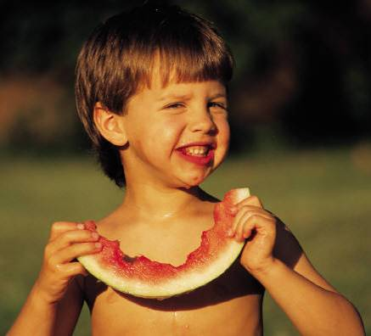
“Watermelon — it's a good fruit. You eat, you drink, you wash your face.”
~ Enrico Caruso

Slide 7
“You can say this for ready-mixes — the next generation isn't going to have any trouble making pies exactly like mother used to make.”
~ Earl Wilson

Slide 8
“My doctor told me to stop having intimate dinners for four. Unless there are three other people.”
~ Orson Welles

Slide 9
“The secret of staying young is to live honestly, eat slowly, and lie about your age.”
~ Lucille Ball

Slide 10

“A food is not necessarily essential just because your child hates it.”
~ Katharine Whitehorn

Slide 11

“Your stomach shouldn't be
a waist basket.”
~ Author Unknown

Slide 12
“I have this theory that chocolate slows down the aging process... It may not be true, but do I dare take the chance?”
~ Author Unknown

Slide 13

“If people say if you eat dessert before dinner it will ruin your appetite — won’t eating dinner before dessert ruin your appetite for dessert?”
~ Author Unknown

Slide 14
“I'm not gaining weight - I'm retaining food.”
~ Author Unknown

Slide 15
“I really don't think I need buns of steel. I'd be happy with buns of cinnamon.”
~ Ellen DeGeneres

Slide 16
“Part of the secret of a success in life is to eat what you like and let the food fight
it out inside.”
~ Mark Twain

Slide 17
“The only way to keep your health is to eat what you don't want, drink what you don't like, and do what you'd rather not.”
~ Mark Twain

Slide 18
“I’ve been on a constant diet for the last two decades. I’ve lost a total of 789 pounds. By all accounts, I should be hanging from a charm bracelet.”
~ Erma Bombeck

Slide 19
“There are four basic food groups: milk chocolate, dark chocolate, white chocolate, and chocolate truffles.”
~ Unknown

Slide 20
“Vegetables
are a must on a diet. I suggest carrot cake, zucchini bread, and pumpkin pie.”
~ Garfield/Jim Davis

Slide 21

“Strength is the capacity to break a chocolate bar into four pieces with your bare hands ― and then eat just one of the pieces.”
~Judith Viorst

Slide 22
“The 12-step chocoholics program: Never be more than 12 steps away from chocolate!”
~Terry Moore

Slide 23
“There is no such organization as Chocoholics Anonymous because no one wants to quit.”
~ Author Unknown

Slide 24
“Half the cookbooks tell you how to cook the food and the other half tell you how to avoid eating it.”
~ Andy Rooney

Slide 25
“I can’t cook.
I use a smoke alarm as a timer.”
~ Carol Siskind

Slide 26
“Everything you see I owe to spaghetti.”
~ Sophia Loren

Slide 27
How many believe …
Life is uncertain.
Eat dessert first!
~Ernestine Ulmer

Slide 28
“I come from
a family where gravy is considered a beverage.”
~ Erma Bombeck

Slide 29
“This recipe is certainly silly.
It says to separate two eggs, but it doesn’t say how far to separate them.”
~ Gracie Allen

Slide 30
“Food is an important part of a balanced diet.”
~ Fran Lebowitz

Slide 31
“My mother’s menu consisted of two choices:
Take it or leave it.”
~ Buddy Hackett

Slide 32
“Food for thought is no substitute for the real thing.”
~ Walt Kelly

Slide 33
The End

Slide 34
Know how. Know now.
Extension is a Division of the Institute of Agriculture and Natural Resources at the University of Nebraska–Lincoln cooperating with the Counties and the United States Department of Agriculture.
University of Nebraska–Lincoln Extension educational programs abide with the nondiscrimination policies of the University of Nebraska–Lincoln and the United States Department of Agriculture.

