Slide 1
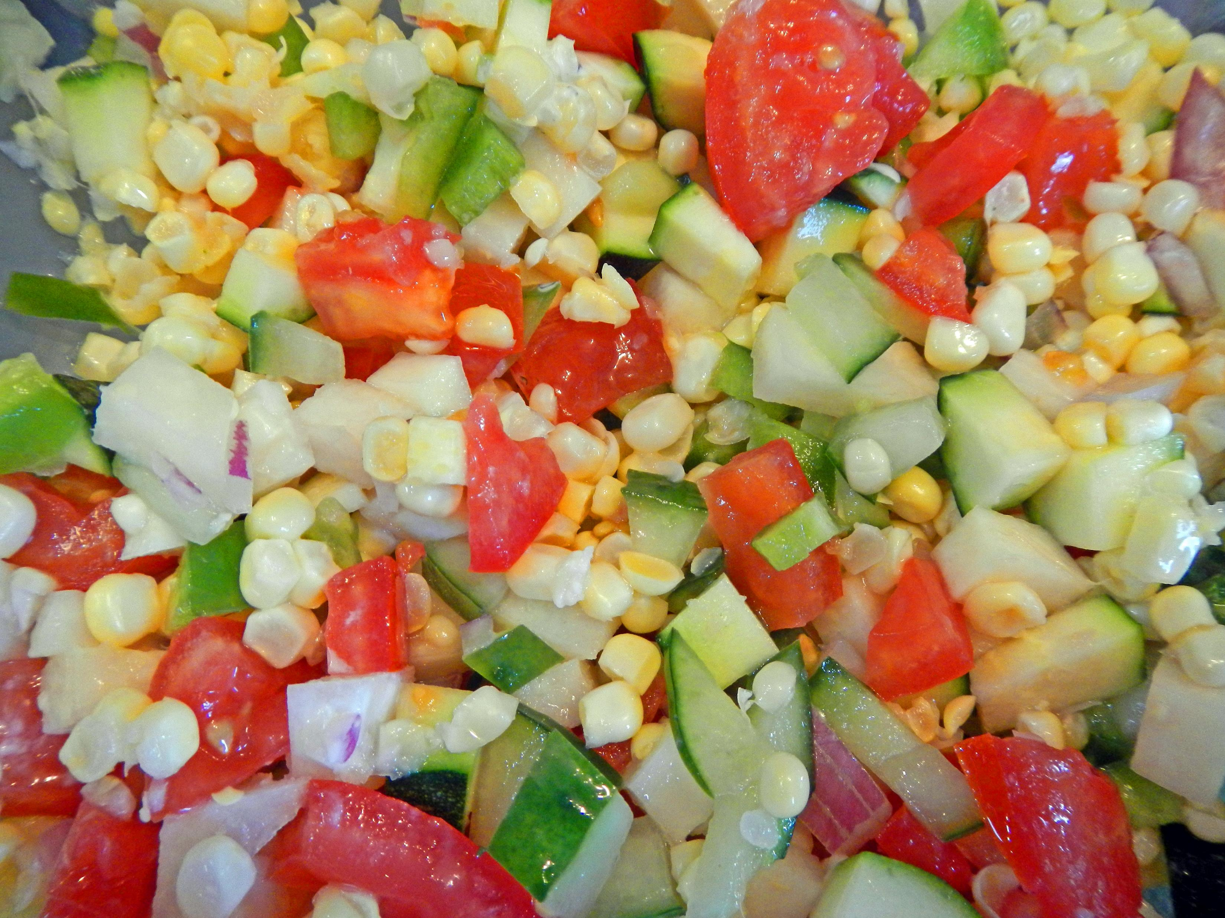
Makeover Your Leftovers

Slide 2
Alice Henneman, MS, RDN
Carol Schwarz, MS, RD
Cindy Brison, MS, RD
Nancy Frecks, MS
Amy Peterson, MS, RD
University of Nebraska–Lincoln Extension
For more information: ahenneman1@unl.edu • food.unl.edu

Slide 3
Download the handout that goes with these slides and gives more information and recipes at: http://bit.ly/recipes4leftovers

Slide 4
“Leftovers make you feel good twice. First, when you put it away, you feel thrifty and intelligent: ‘I’m saving food!’ Then a month later when blue hair is growing out of the ham, and you throw it away, you feel really intelligent: ‘I’m saving my life!’ ”
- George Carlin, comedian
Photo credit: Pixabay.com
Notes:
(Read slide)

Slide 5
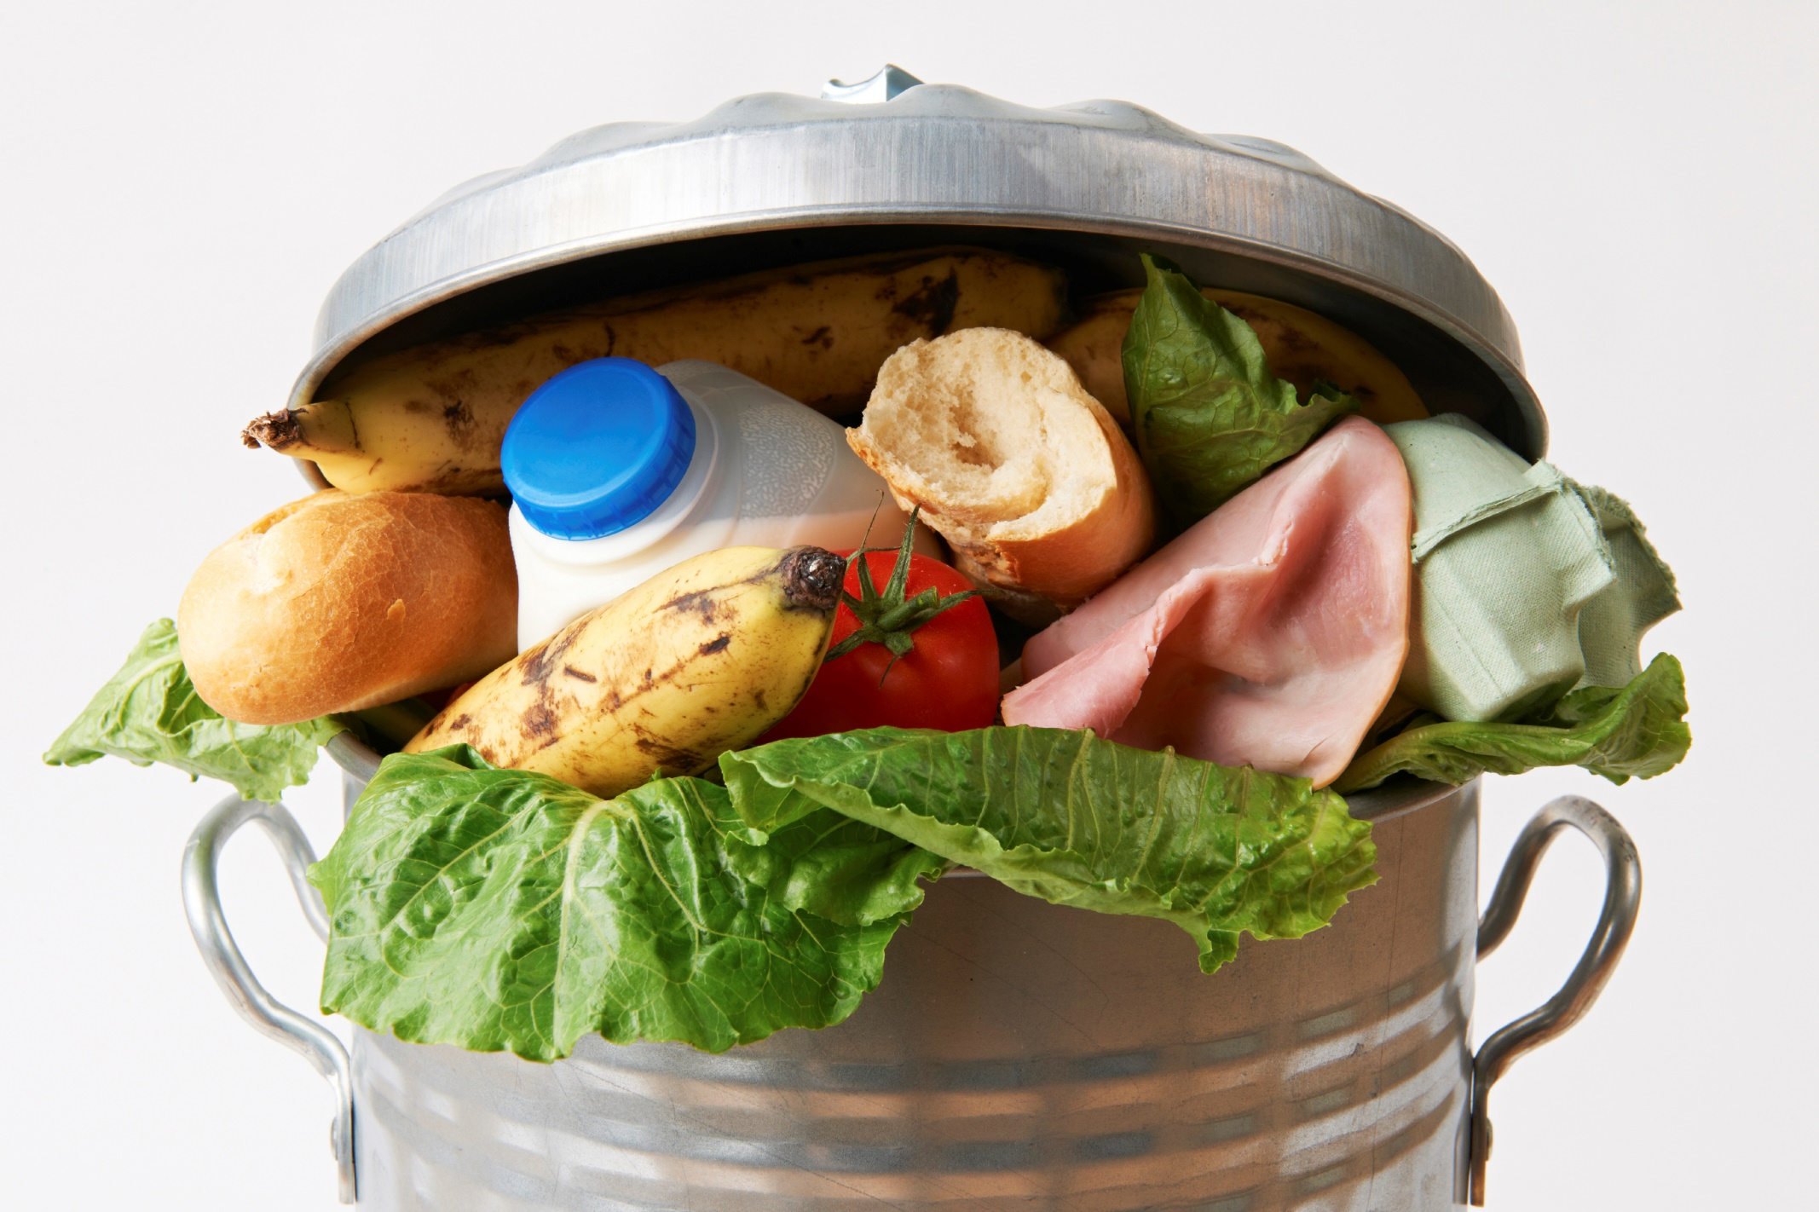
About 90 billion pounds of edible food goes uneaten each year in the United States
Photo credit: USDA
Notes:
About 90 billion pounds of edible food goes uneaten in the United States each year!

Slide 6
That amount equals…
Notes:
That amount equals …

Slide 7
123 x the weight of the Empire State Building
Photo credit: Pixabay.com
Notes:
123 times the weight of the Empire State Building!

Slide 8
Oh my!
Photo credit: Pixabay.com
Notes:
(Just show slide)

Slide 9
Raise your hand
if you toss from the following food groups at least a few times monthly …
Photo credit: Pixabay.com
Notes:
Raise your hand if you toss food from the following food groups at least a few times monthly …

Slide 10
Grains
Fruits
Protein Foods
Vegetables
Dairy
Source of photos: Used with permission by the Academy of Nutrition and Dietetics
Notes:
Grains

Slide 11
Grains
Fruits
Protein Foods
Vegetables
Dairy
Notes:
Fruits

Slide 12
Grains
Fruits
Protein Foods
Vegetables
Dairy
Notes:
Protein foods

Slide 13
Grains
Fruits
Protein Foods
Vegetables
Dairy
Notes:
Vegetables

Slide 14
Grains
Fruits
Protein Foods
Vegetables
Dairy
Notes:
Dairy

Slide 15
Costs of food waste per food group per person yearly
Grains
$22
Fruits
$45
Protein Foods
$140
Vegetables
$66
Dairy
$60
Added Fat & Sugar: $37
Information source: https://choosemyplate-prod.azureedge.net/sites/default/files/printablematerials/2015-LetsTalkTrash-2page.pdf
Notes:
Here’s the cost of food waste per food group per person yearly.

Slide 16
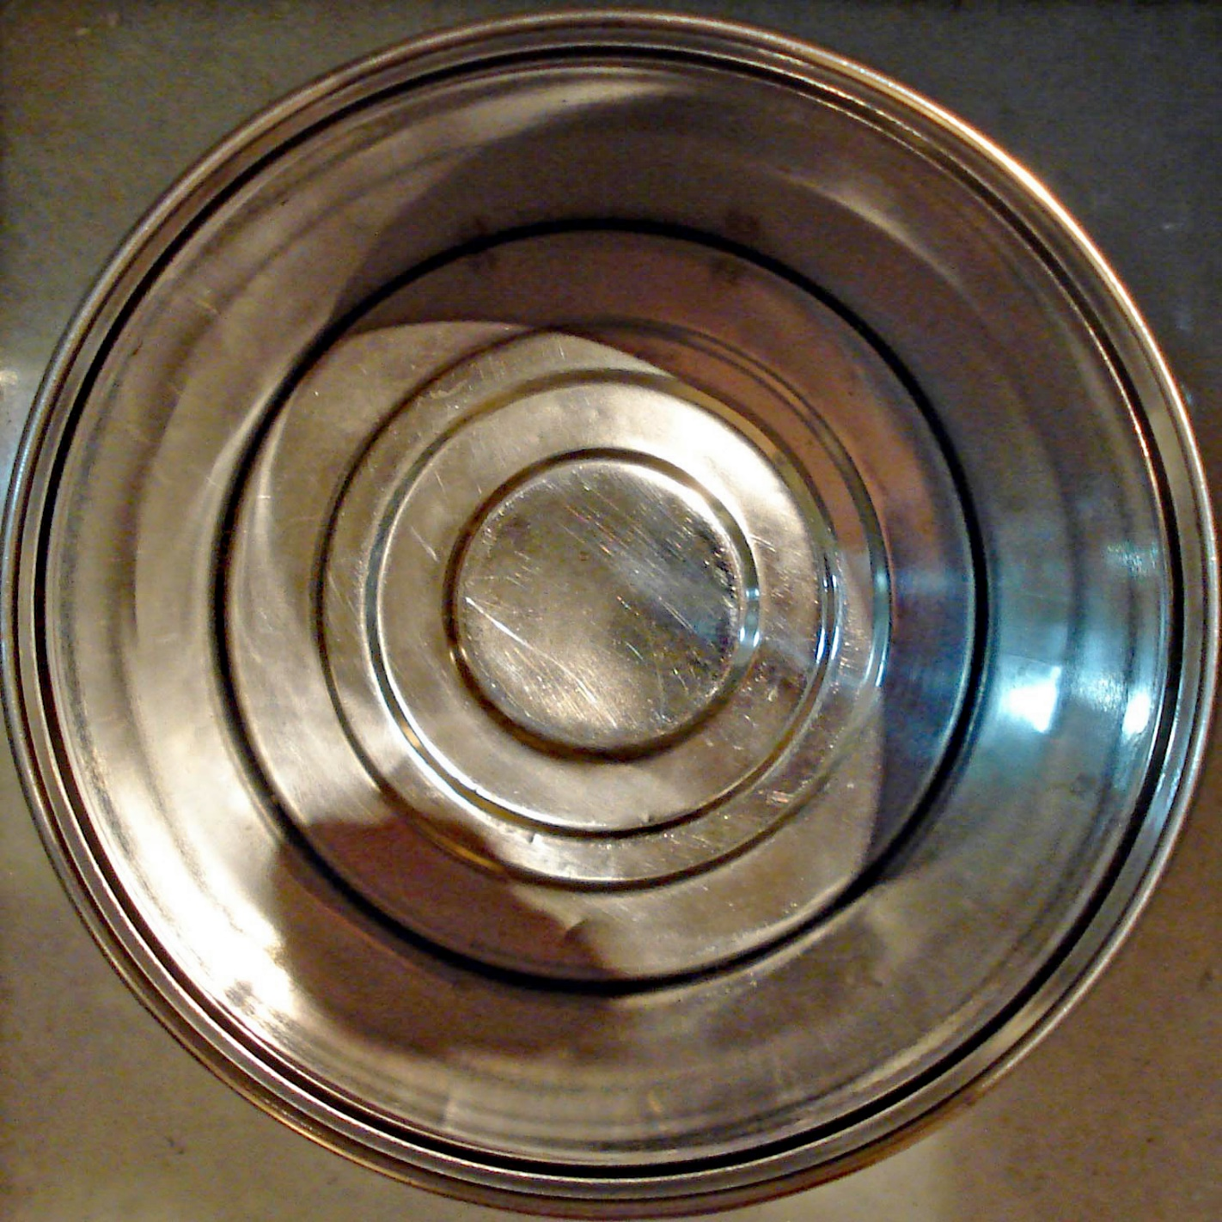
Food tossed is …
Photo credits: Garbage:“Trash Can” by Tom Magliery is licensed under CC BY NC SA 2.0 | Banana: Pixabay.com
Notes:
Food tossed is …

Slide 17
Money lost!
Money photo credit: Pixabay.com
Notes:
Money lost!

Slide 18
Tossed food costs consumers about $370 per person yearly
Photo credit: Pixabay.com
Notes:
Tossed food costs consumers about $370 per person yearly.

Slide 19
Here’s how to save some of that money ….
Photo credits: Pixabay.com
Notes:
Here’s how to save some of that money …

Slide 20
… and at the same time help the environment!
Resources used to produce uneaten food include:
30% of fertilizer
31% of cropland
25% of total fresh water consumption
2% of total energy consumption
Information source: https://www3.epa.gov/region9/waste/features/foodtoenergy/food-waste.html | Photo credit: Pixabay.com
Notes:
… and at the same time help the environment by helping save the resources used to produce the food. … (Then read slide)

Slide 21
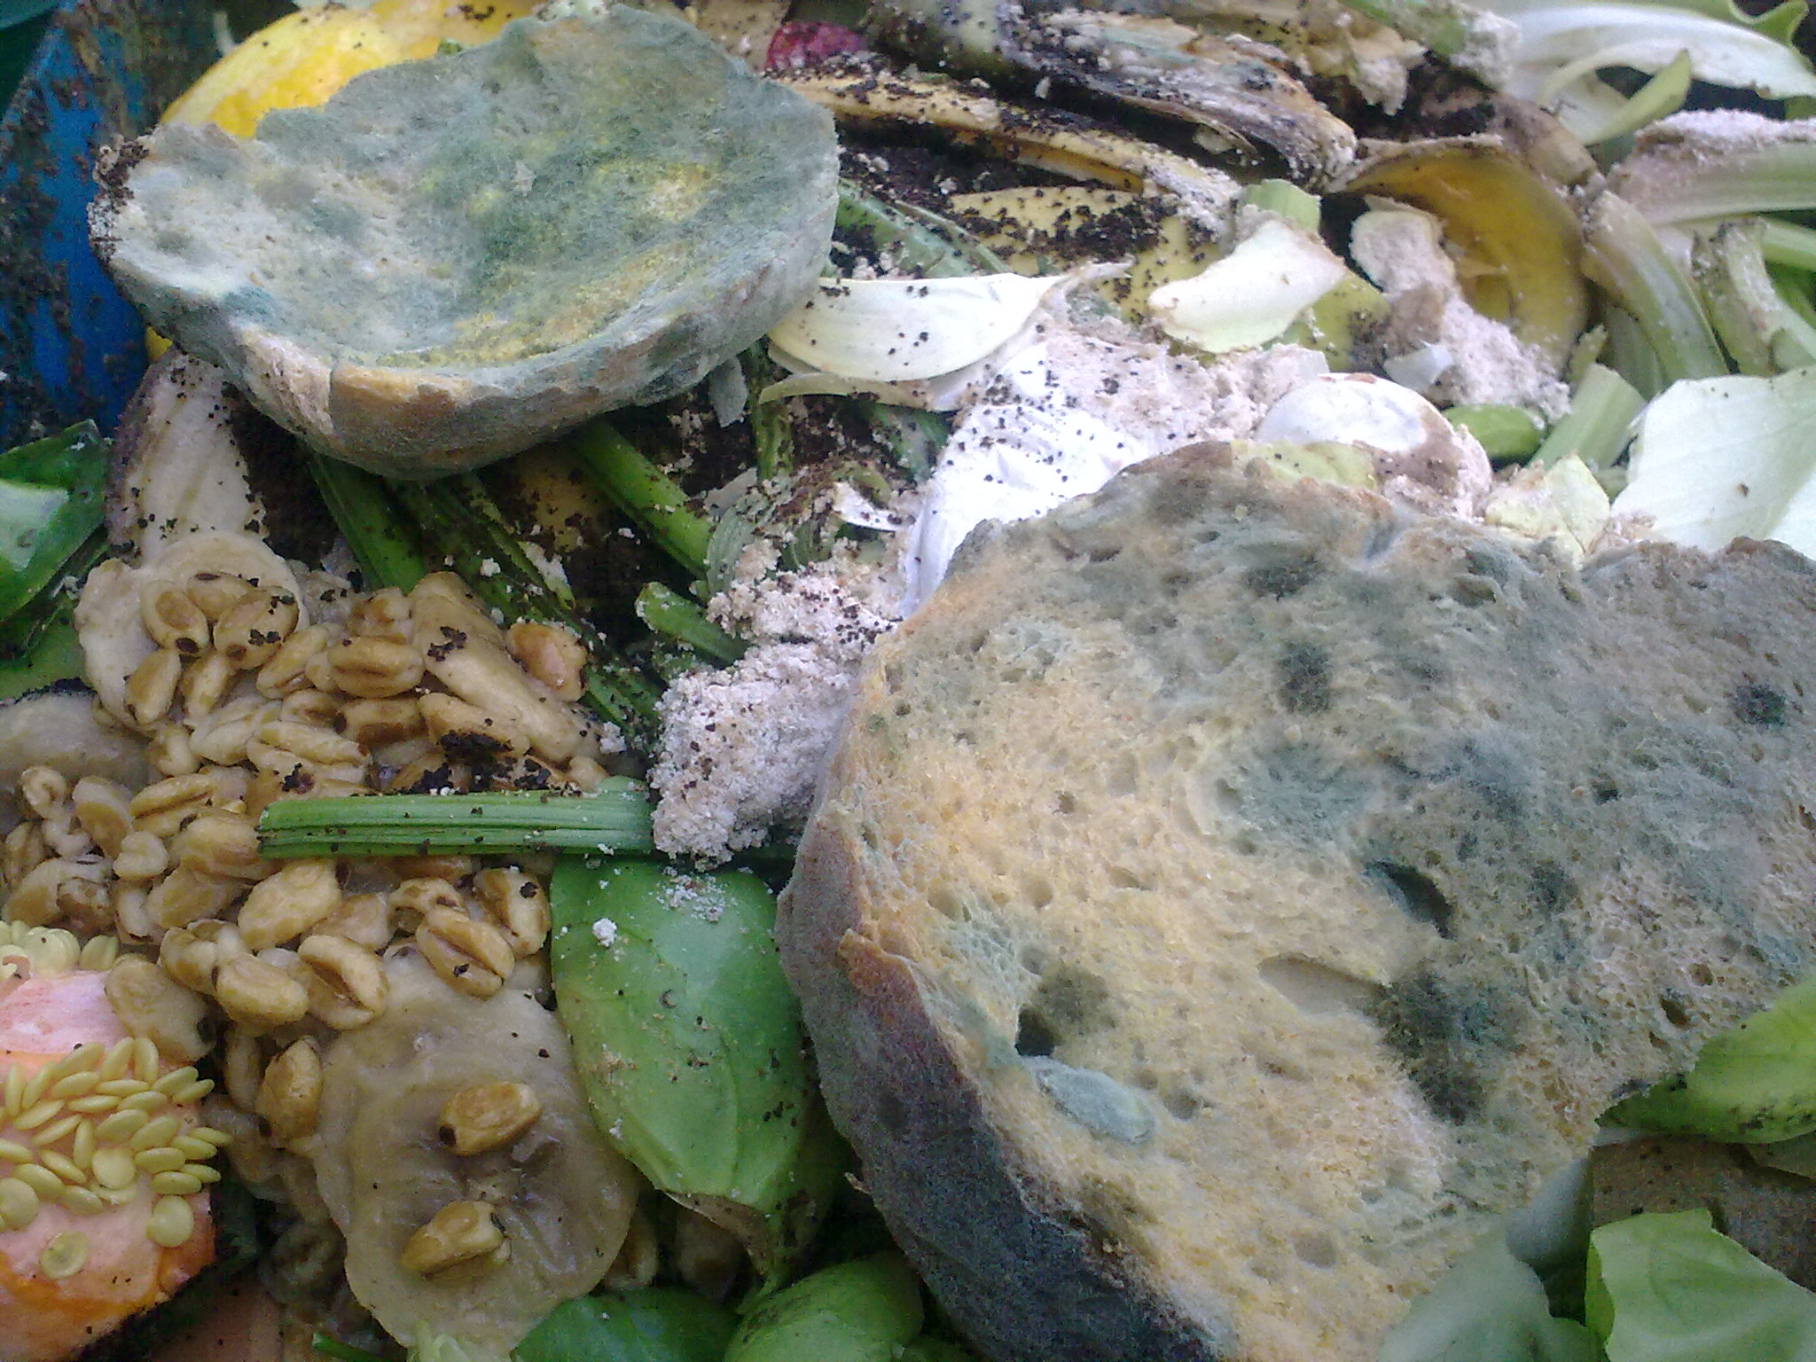
Food waste is a major contributor to municipal waste and decomposes to methane, a potent greenhouse gas
Photo credit: “Food waste 2” by Nick Saltmarsh is licensed under CC BY 2.0
Information source: https://www3.epa.gov/region9/waste/features/foodtoenergy/food-waste.html
Notes:
Food waste is a major contributor to municipal waste and decomposes to methane, a potent greenhouse gas.

Slide 22
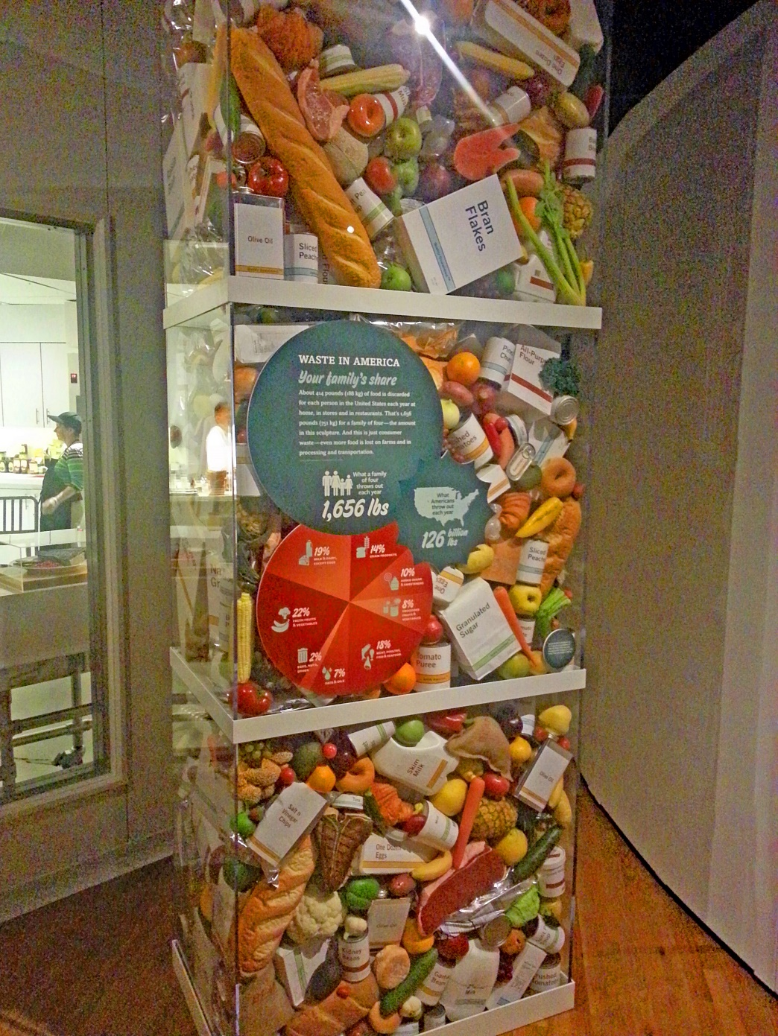
Reducing food waste helps reduce food insecurity
42 million Americans, including 13 million children are food-insecure
Reducing food waste by 15% could feed more than 25 million Americans yearly.
Reducing the amount of food wasted in the nation by 50% by 2030 is an initiative launched by USDA and EPA in 2015.
Photo credit: “Food waste” by Soli is licensed under CC BY 2.0
Information source: Feeding America: http://www.feedingamerica.org/hunger-in-america/news-and-updates/press-room/press-releases/usda-food-insecurity-report-reponse.html
National Resources Defense Council: https://www.nrdc.org/sites/default/files/wasted-food-IP.pdf
Notes:
(Read slide)

Slide 23
The following tips and recipes will help reduce food waste at home. Plus, they’ll save you money, help the environment and aid in food security!
WOW!
Photo credit: Pixabay.com
Notes:
(Read slide)

Slide 24
28 QUICK TRICKS TO ADD NEW LIFE TO LEFTOVERS Foods with * indicate a recipe is provided
Notes:
(Read slide)

Slide 25
And … everything includes basic ingredients so you don’t create new leftovers making over your leftovers!
Photo credit: Pixabay.com
Notes:
(Read slide)
(NOTE TO PRESENTER: for the “Quick Tricks to Add New Life to Leftovers” slides you might ask the audience for further suggestions as you go through the different categories. )

Slide 26
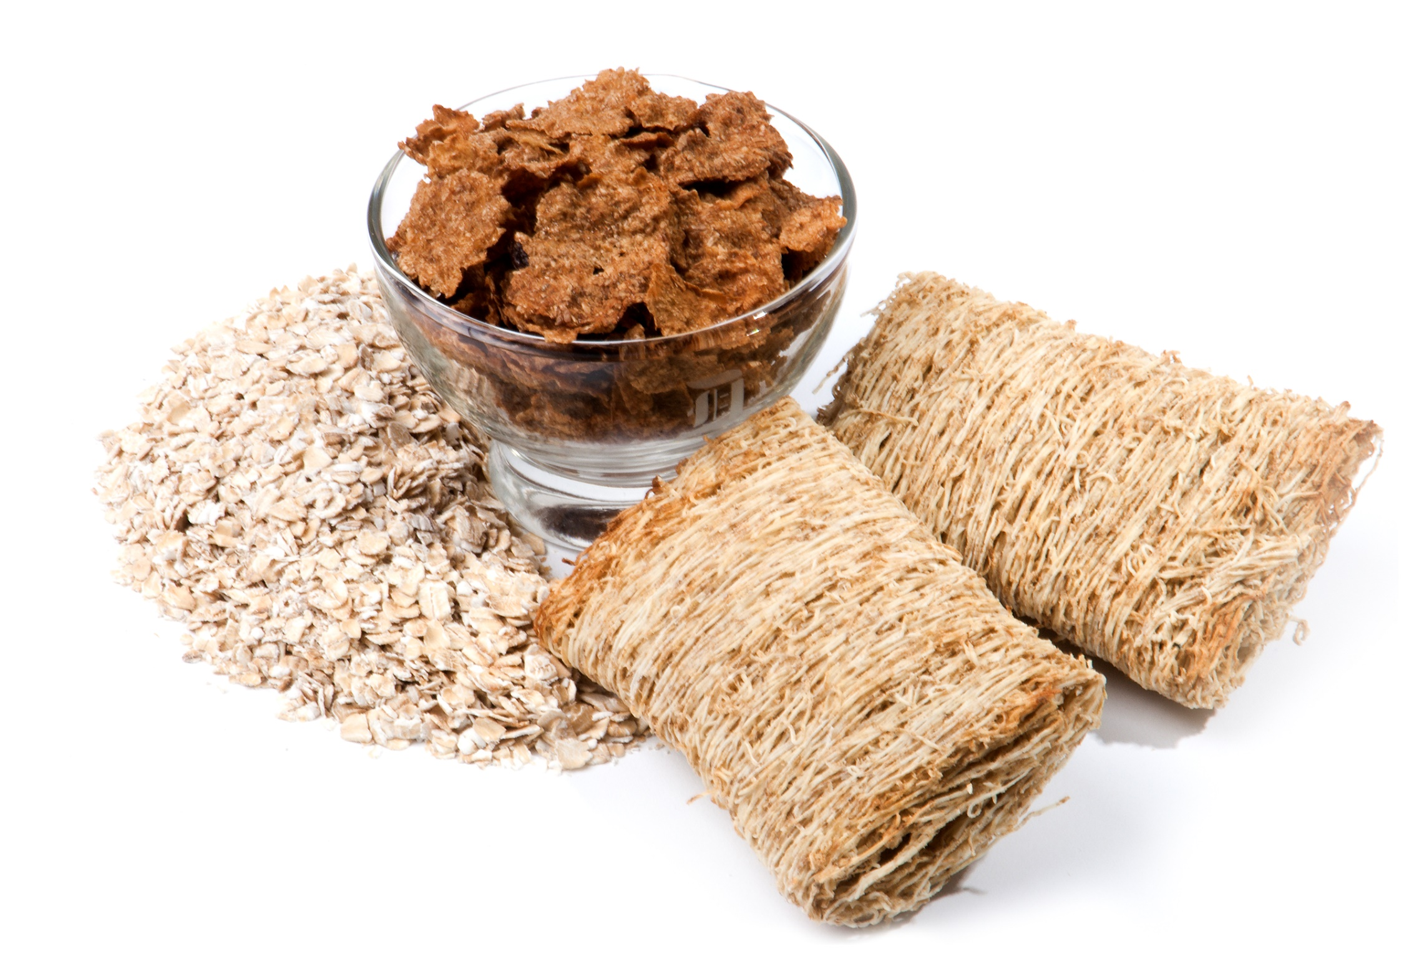
GRAINS
Source of photo: Used with permission by the Academy of Nutrition and Dietetics
Notes:
Let’s begin with the grains group.

Slide 27
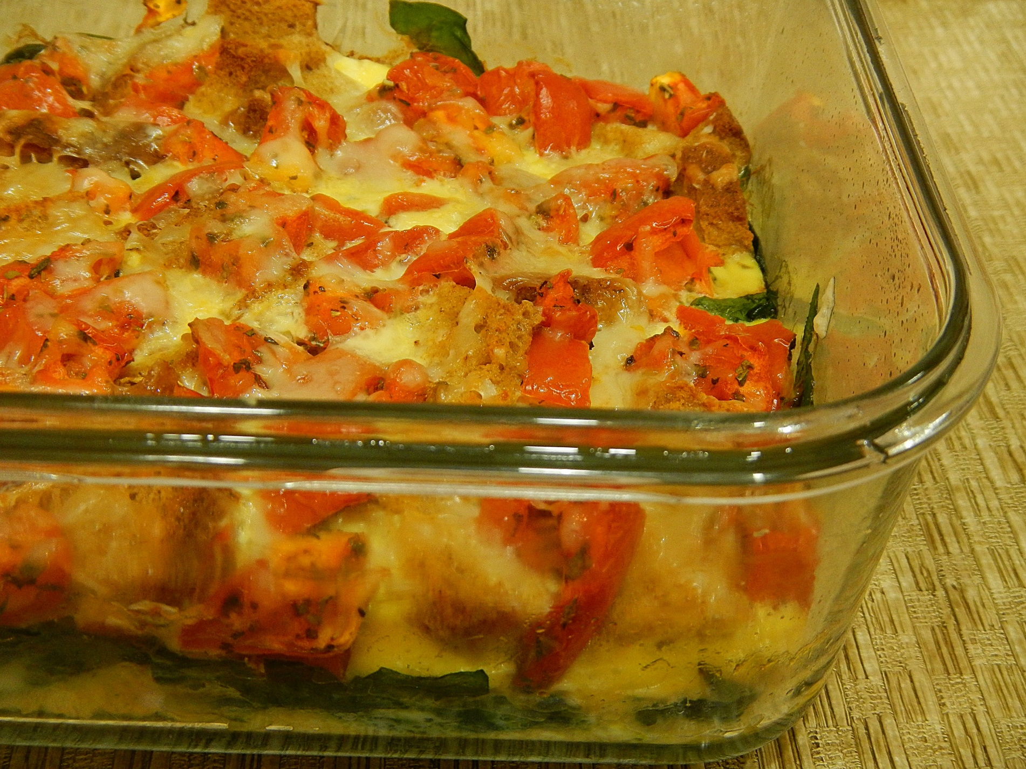
1
Use older
bread to make
croutons,*
bread crumbs,*
bread
pudding,*
stratas and
French toast*
Photo credit: Alice Henneman
Notes:
Bread, especially bread that may be getting a little dry, works well in bread crumbs, bread pudding, strata's and French toast.

Slide 28
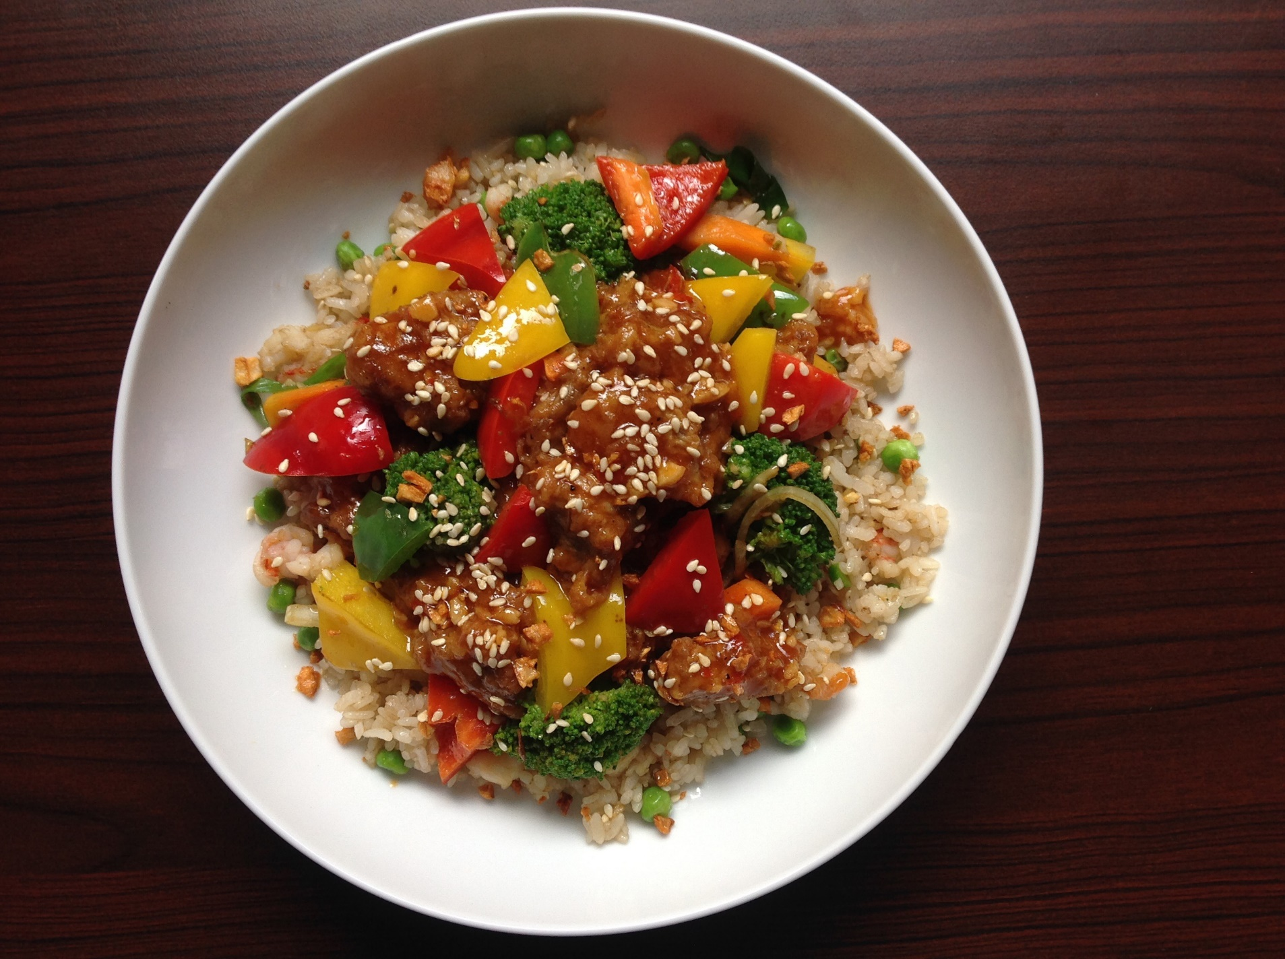
2
Use leftover
rice in stir-fried rice, rice pudding and rice bowls
Photo credit: Pixabay.com
Notes:
Rice bowls, puddings and fried rice work especially well with leftover rice.

Slide 29
3
Heat leftover pasta in a pan with some olive oil. Sprinkle with Parmesan
cheese.
Photo credit: Alice Henneman
Notes:
(Read slide)

Slide 30
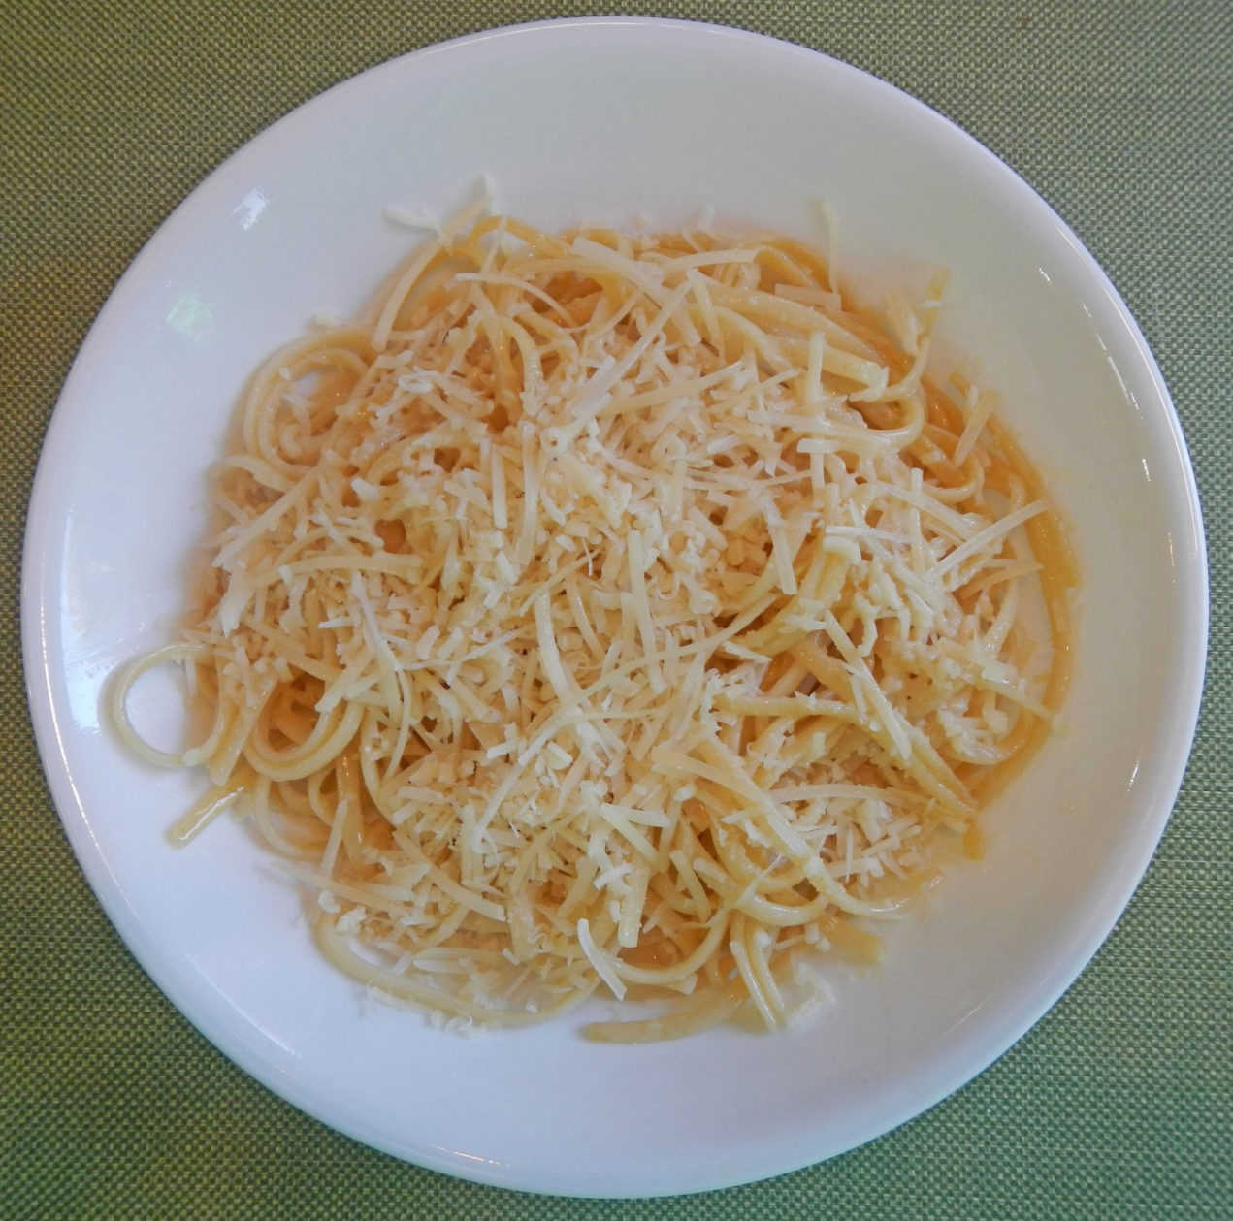
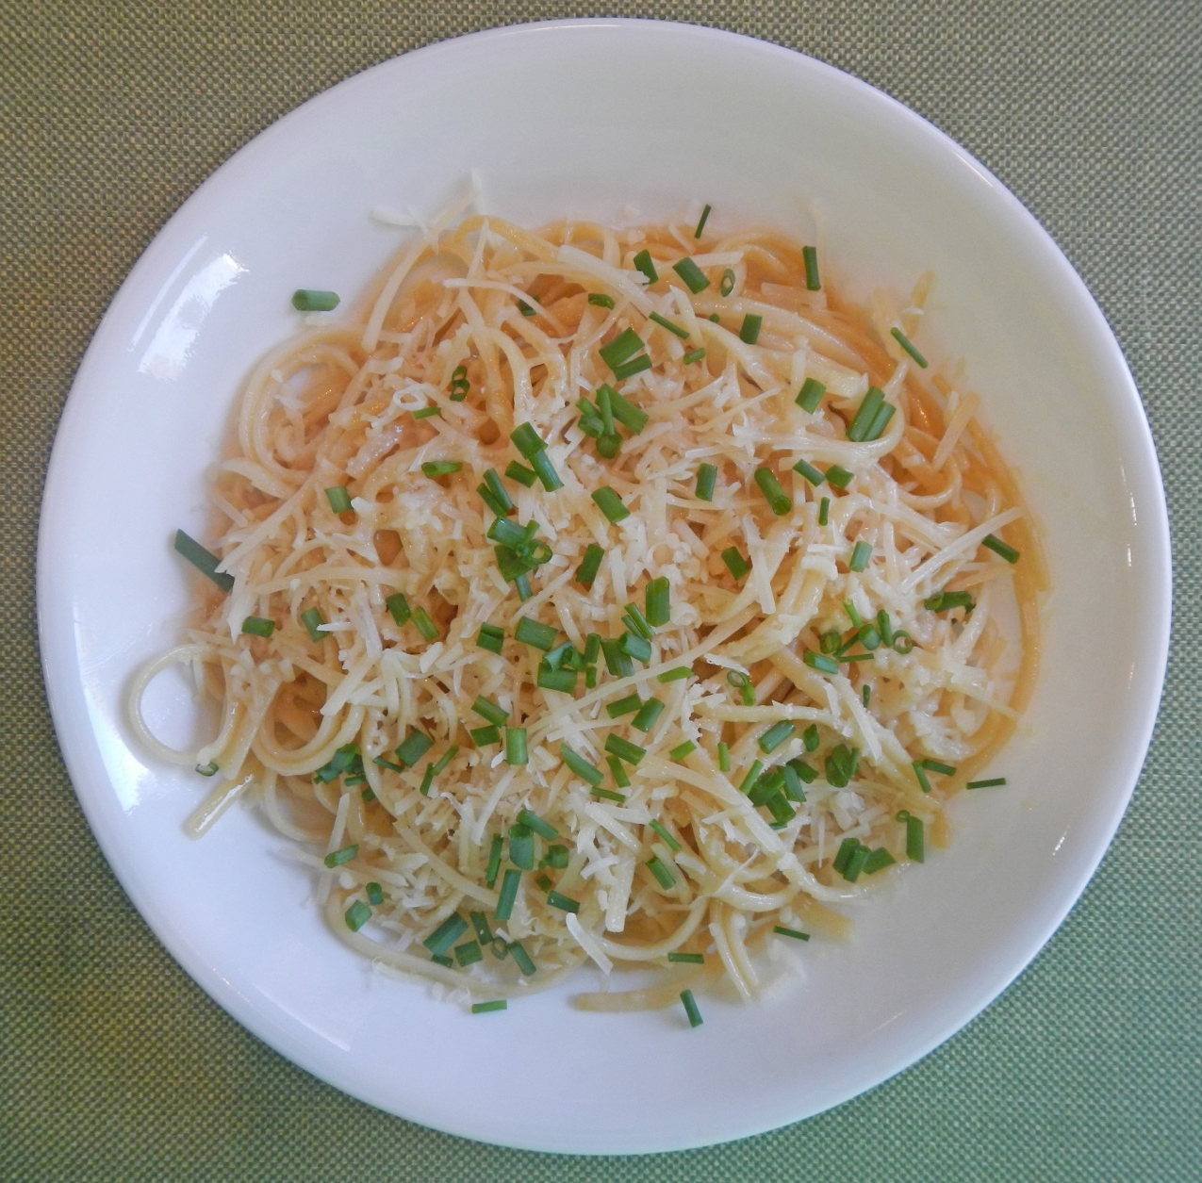
Garnish for added pizazz!
Photo credit: Alice Henneman
Notes:
Add a little extra pizazz by topping the pasta with fresh herbs.

Slide 31
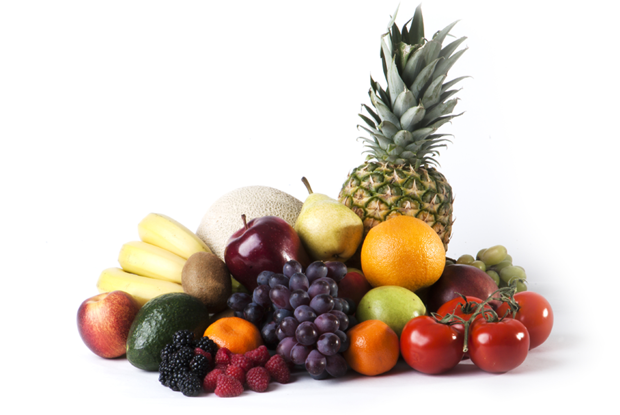
FRUITS
Source of photo: Used with permission by the Academy of Nutrition and Dietetics
Notes:
Here are some specific suggestions for the fruit group …

Slide 32
4
Freeze extra lemon or lime juice in ice cube trays; use for flavored water
Photo credit: Pixabay.com
Notes:
Freeze lemon or lime juice in ice cube trays. Transfer to freezer bags. Pop into water for flavored water. NOTE: It’s easier to remove frozen food from silicon ice cube trays and muffin pans than plastic trays or metal pans as silicon is more flexible.

Slide 33
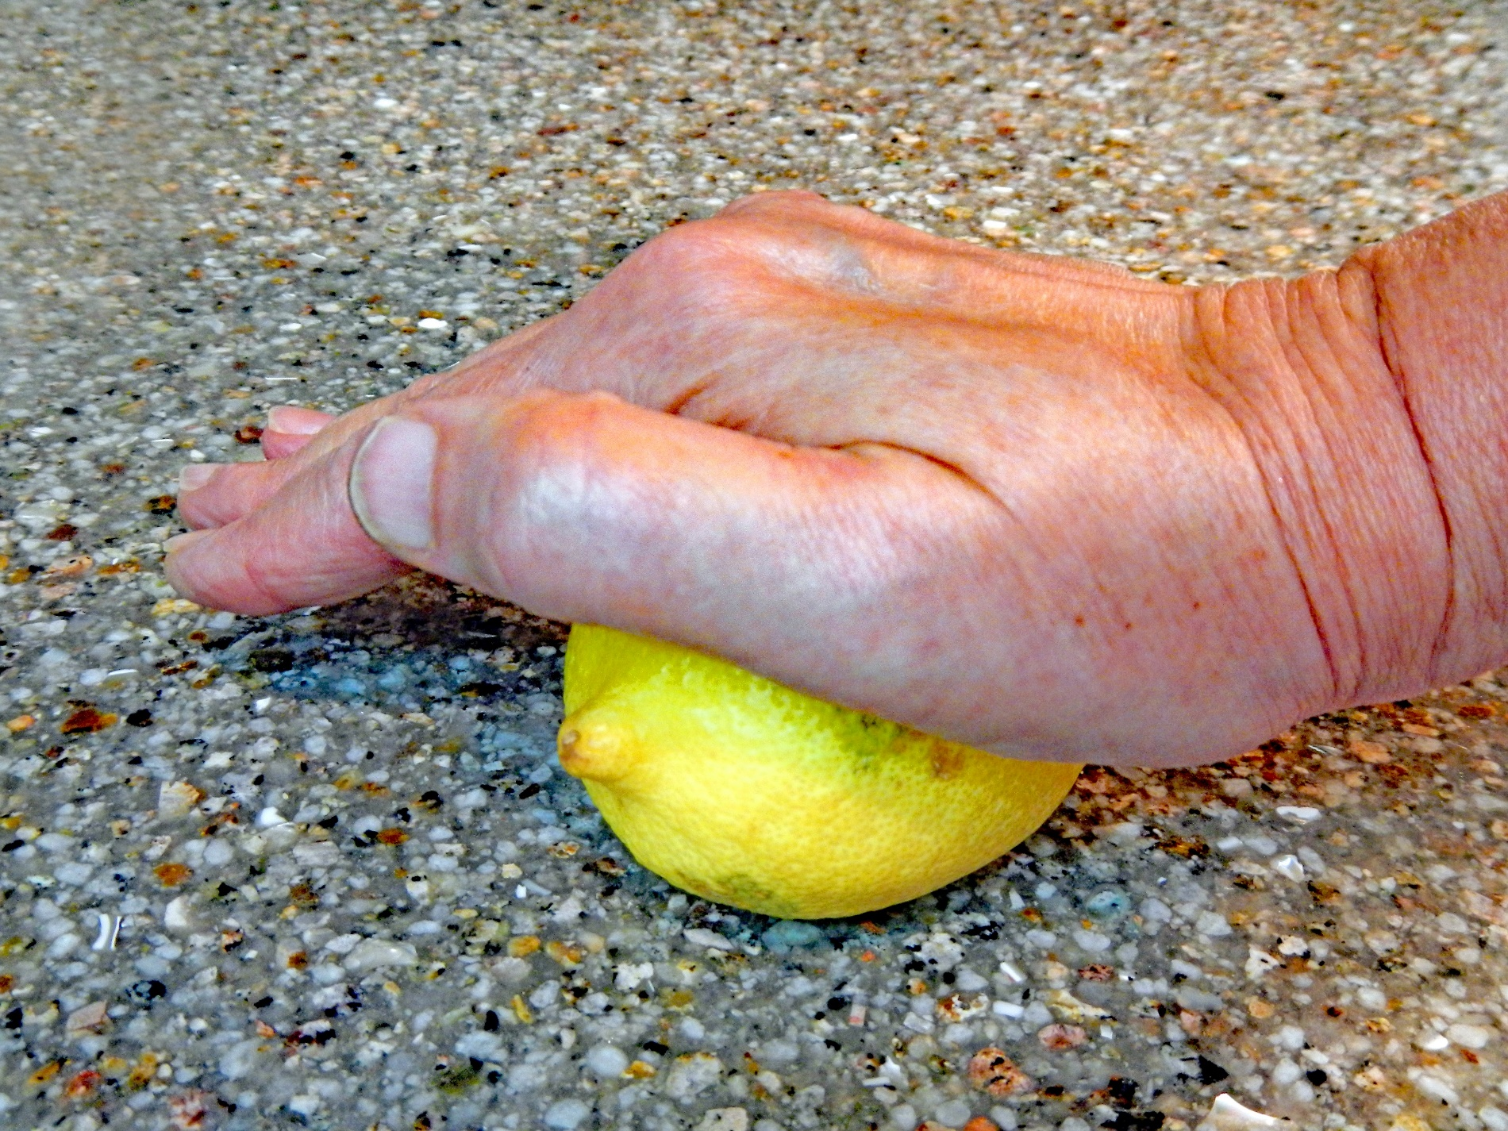
5
Roll citrus fruits with your hand on a hard surface
before juicing to get more juice from them
Photo credit: Alice Henneman
Notes:
(Read slide)

Slide 34
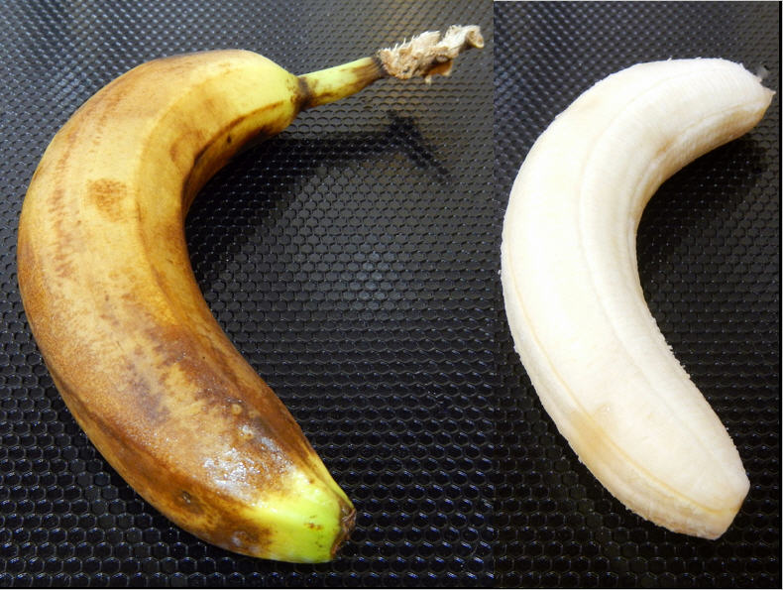
6
Refrigerate ripe
bananas to
make them last
a few days
longer
Photo credit: Alice Henneman
Notes:
Refrigerate ripe bananas to make them last a few days longer. They may be brown on outside, but still a good color on the inside.

Slide 35
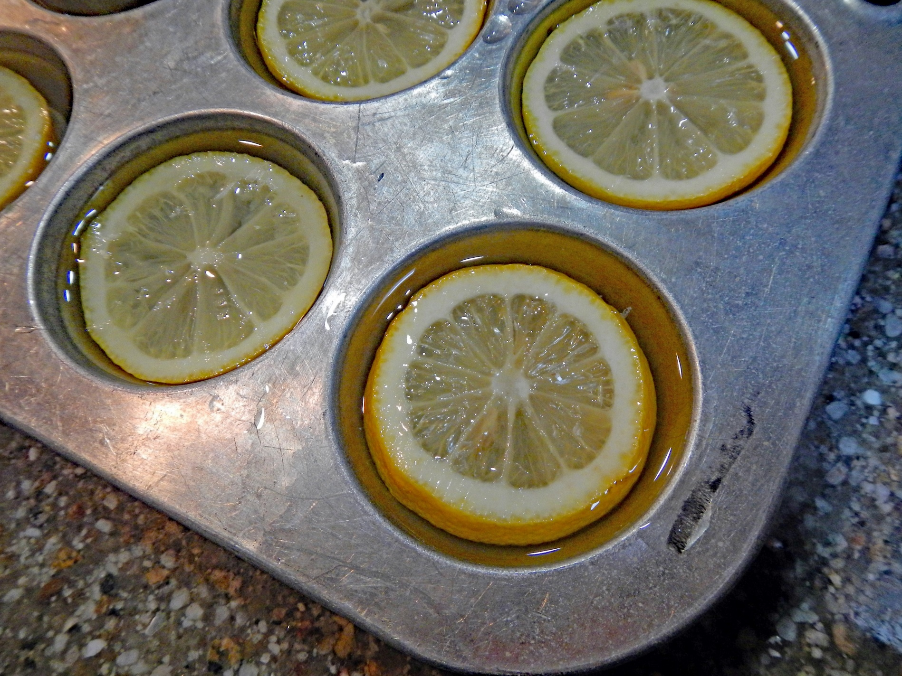
7
Freeze lemon
slices in water
in cupcake
pans for …
Photo credit: Alice Henneman
Notes:
(Read slide)

Slide 36
… large,
flavored ice cubes
Photo credit: Alice Henneman
Notes:
(read slide)

Slide 37
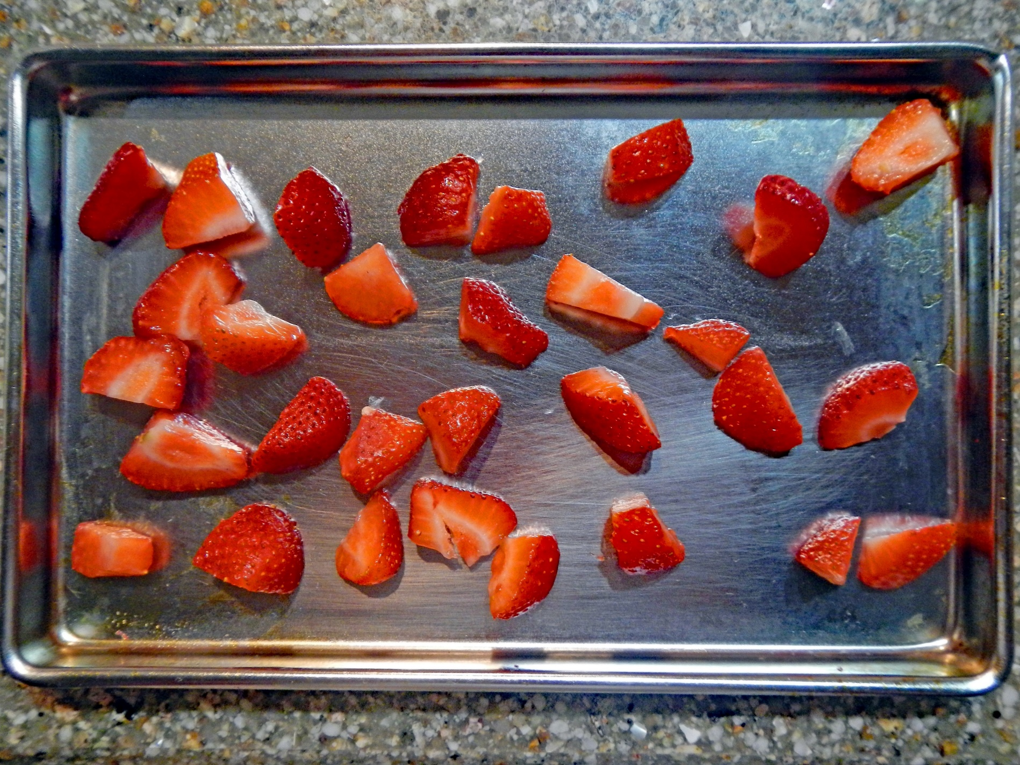
8
Freeze washed, peeled, bite-size pieces of fruit for smoothies*
Photo credit: Alice Henneman
Notes:
Freeze washed, peeled, bite-size pieces of fruit for smoothies. Place on baking sheet with sides and cover with plastic wrap. Transfer frozen pieces to freezer bags. Toss into smoothies.

Slide 38
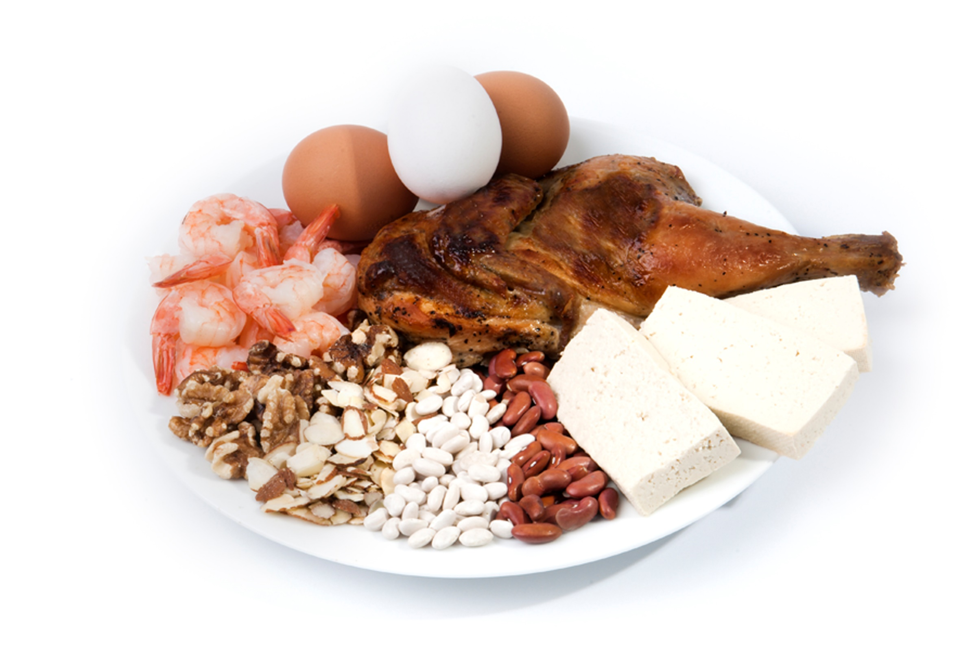
PROTEIN FOODS
Source of photo: Used with permission by the Academy of Nutrition and Dietetics
Notes:
On to protein foods …

Slide 39
9
Help prevent “warmed over meat” flavor:
Use leftover meats in flavorful foods
Cover with liquids, sauce or gravy
Photo credit: Alice Henneman
Notes:
Use leftover meat in flavorful foods such as barbecued meat dishes, chili and tacos to mask any flavor of “warmed over meat.” Plus, being covered by a sauce or gravy helps prevent further flavor changes in the meat.

Slide 40
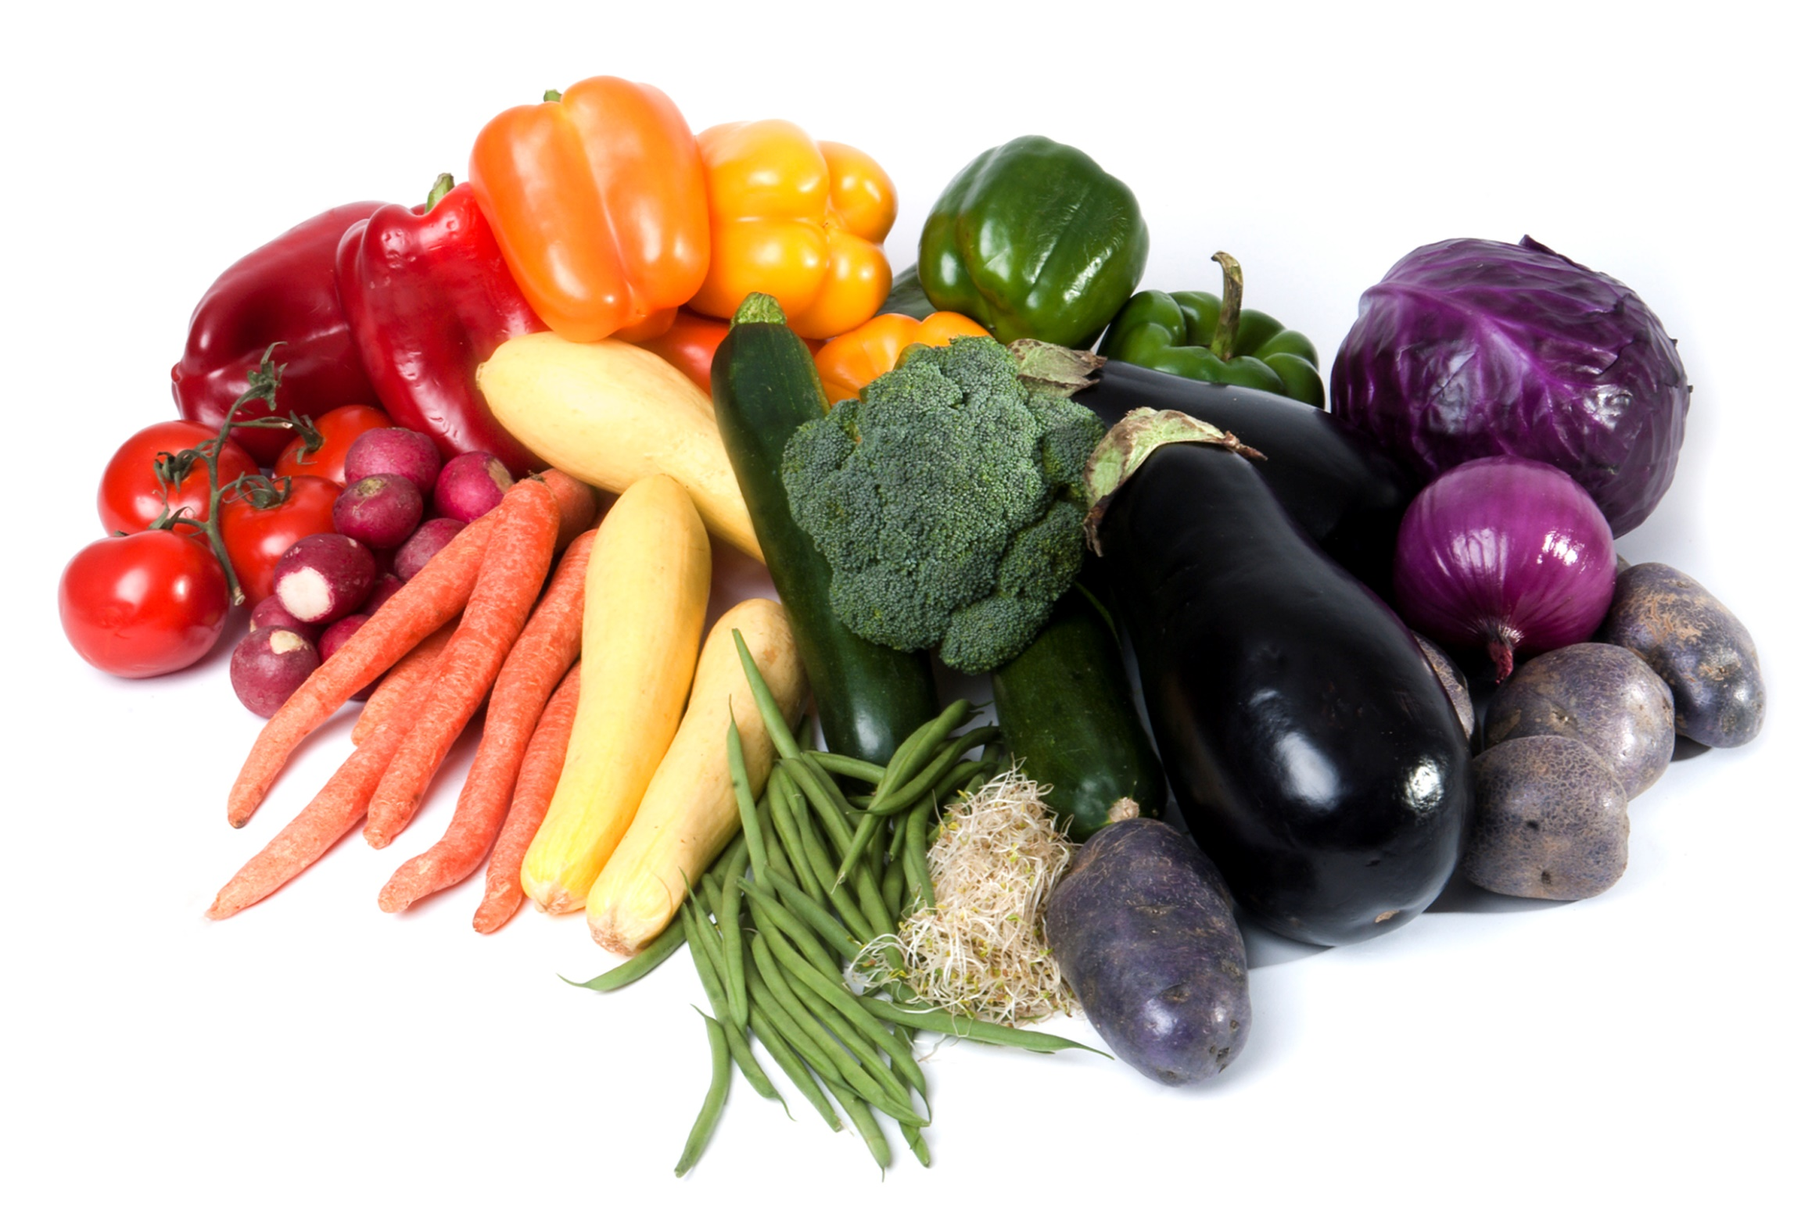
VEGETABLES
Source of photo: Used with permission by the Academy of Nutrition and Dietetics
Notes:
Next stop is vegetables …

Slide 41
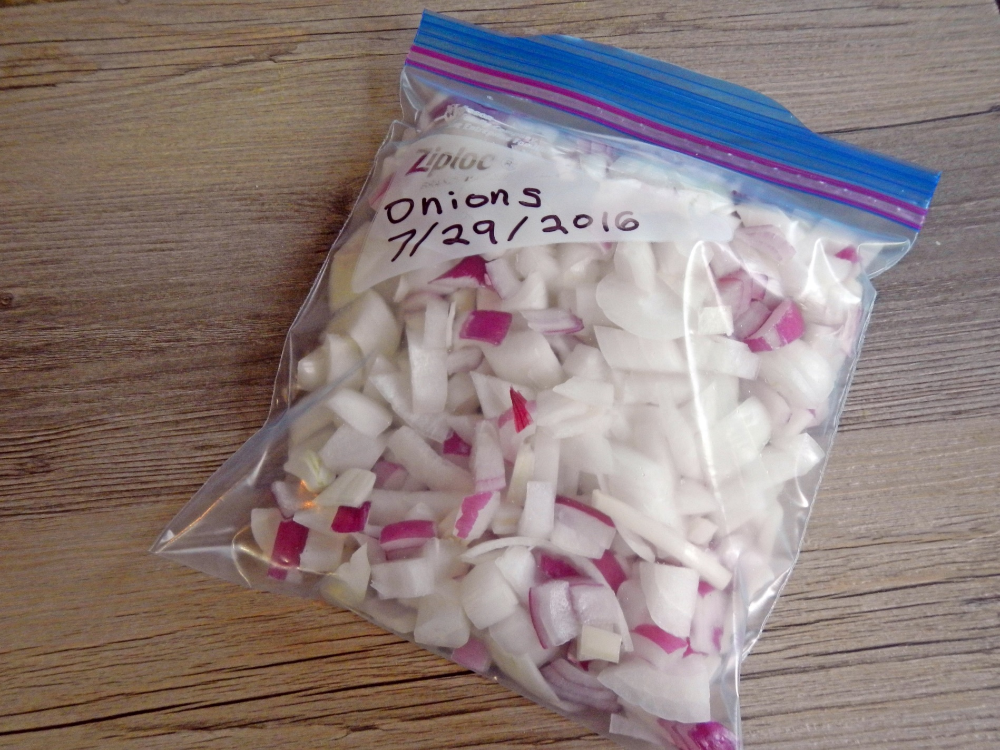
10
Add chopped,
mature onions
directly to a
freezer bag
Photo credit: Alice Henneman
Notes:
Add chopped, mature onions directly to a freezer bag. Lay flat to freeze. To separate the onions before use, give the bag a slight “whap” on the kitchen counter.

Slide 42
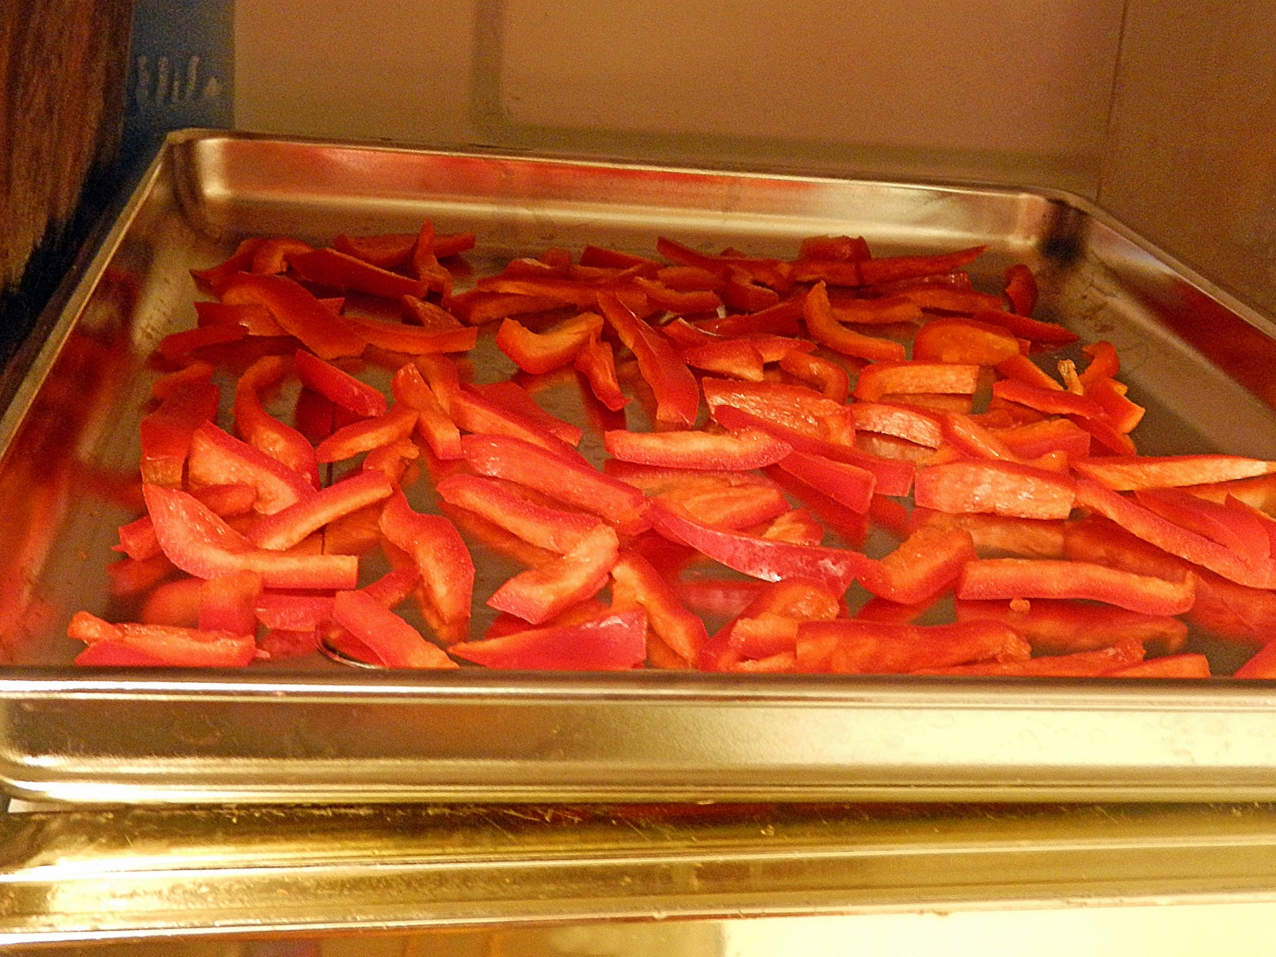
11
Freeze extra
bell peppers
in shapes
needed for
recipes
Photo credit: Alice Henneman
Notes:
Freeze extra bell peppers in shapes needed for recipes. Freeze for a few hours on a baking sheet with sides until hard. Transfer to a freezer bag.

Slide 43
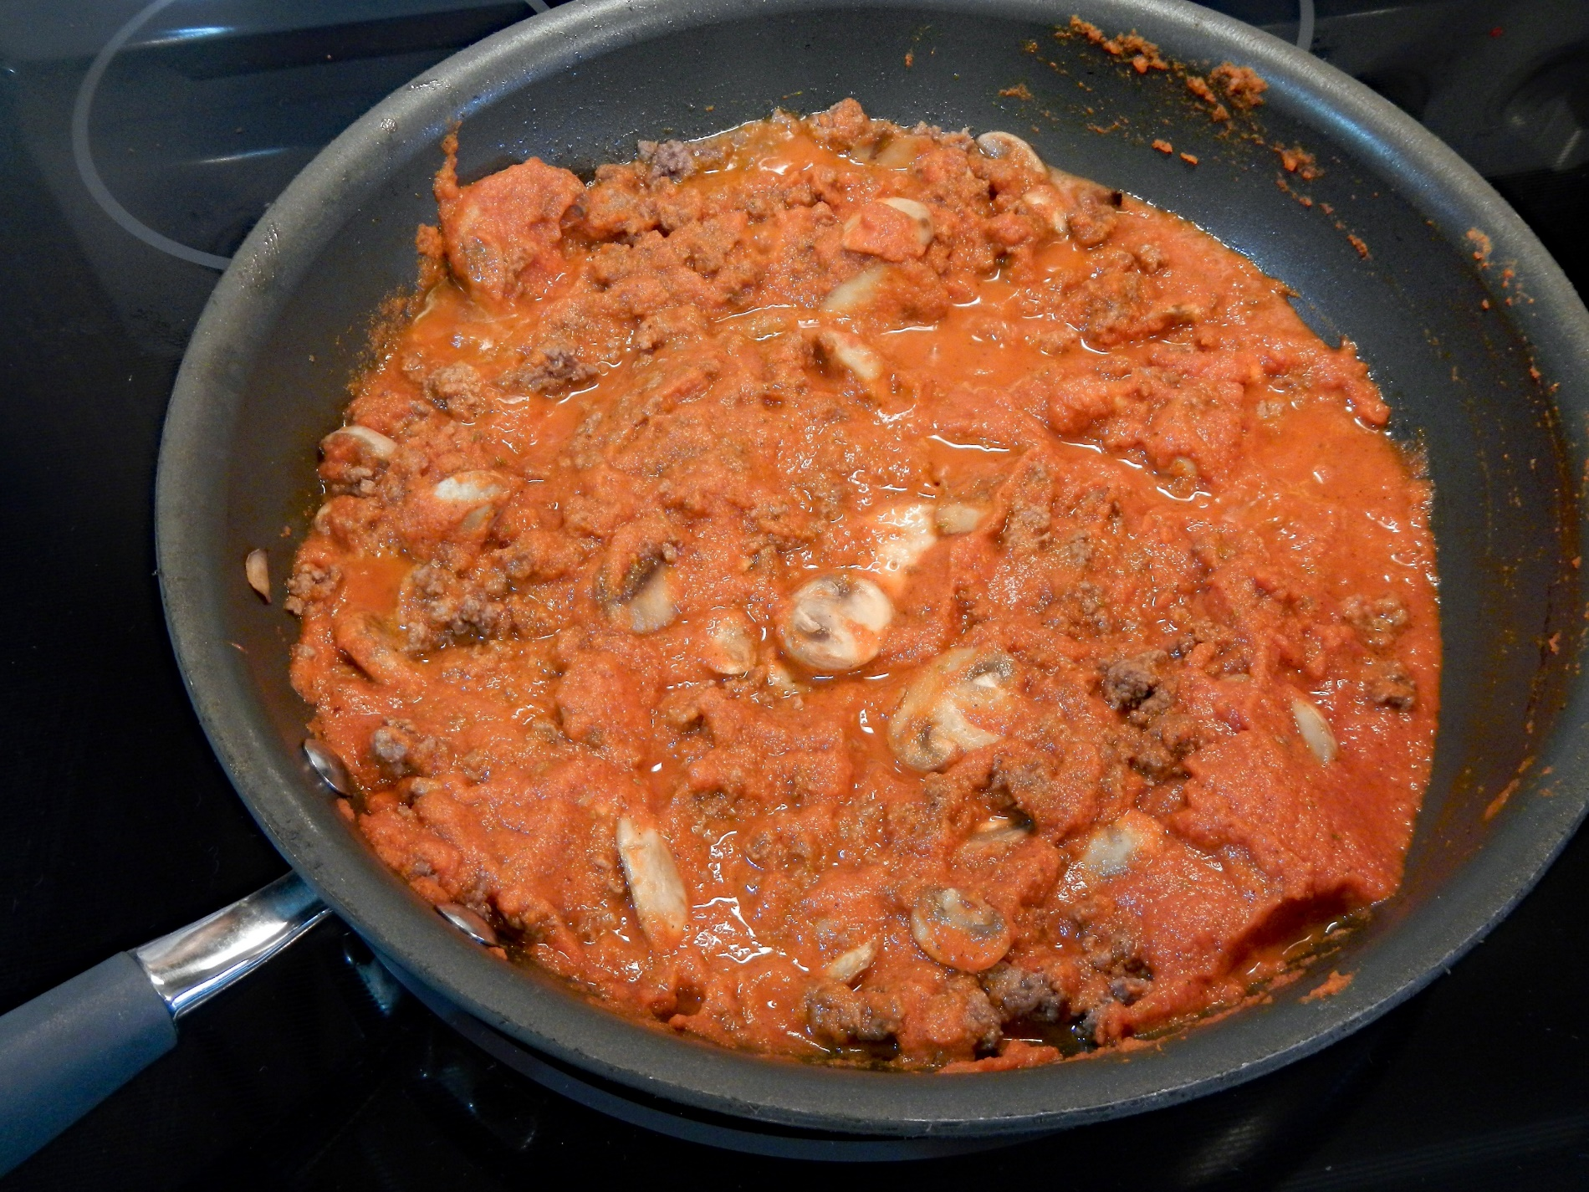
12
What was the
“secret
ingredient,” languishing in the refrigerator, that was added to this pasta sauce?
Photo credit: Alice Henneman
Notes:
(Read slide)

Slide 44
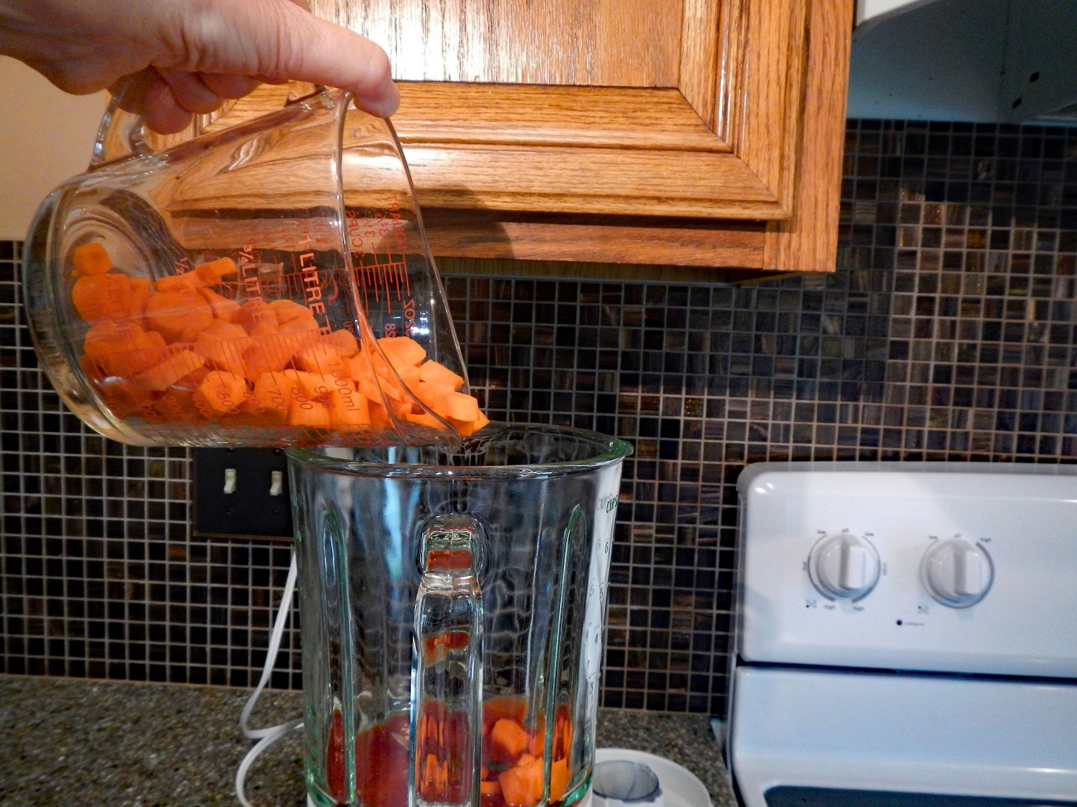
Purée extra vegetables in a blender or food
processor (about 1/2 cup per serving) and heat with pasta sauce. Possible additional
vegetables include carrots, butternut squash, red
bell peppers and zucchini.
Carrots!
Photo credit: Alice Henneman
Notes:
Puree the carrots or other vegetables in your food processor or blender and heat with the pasta sauce. Add about a 1/4 to 1/2 cup of vegetables per serving.

Slide 45
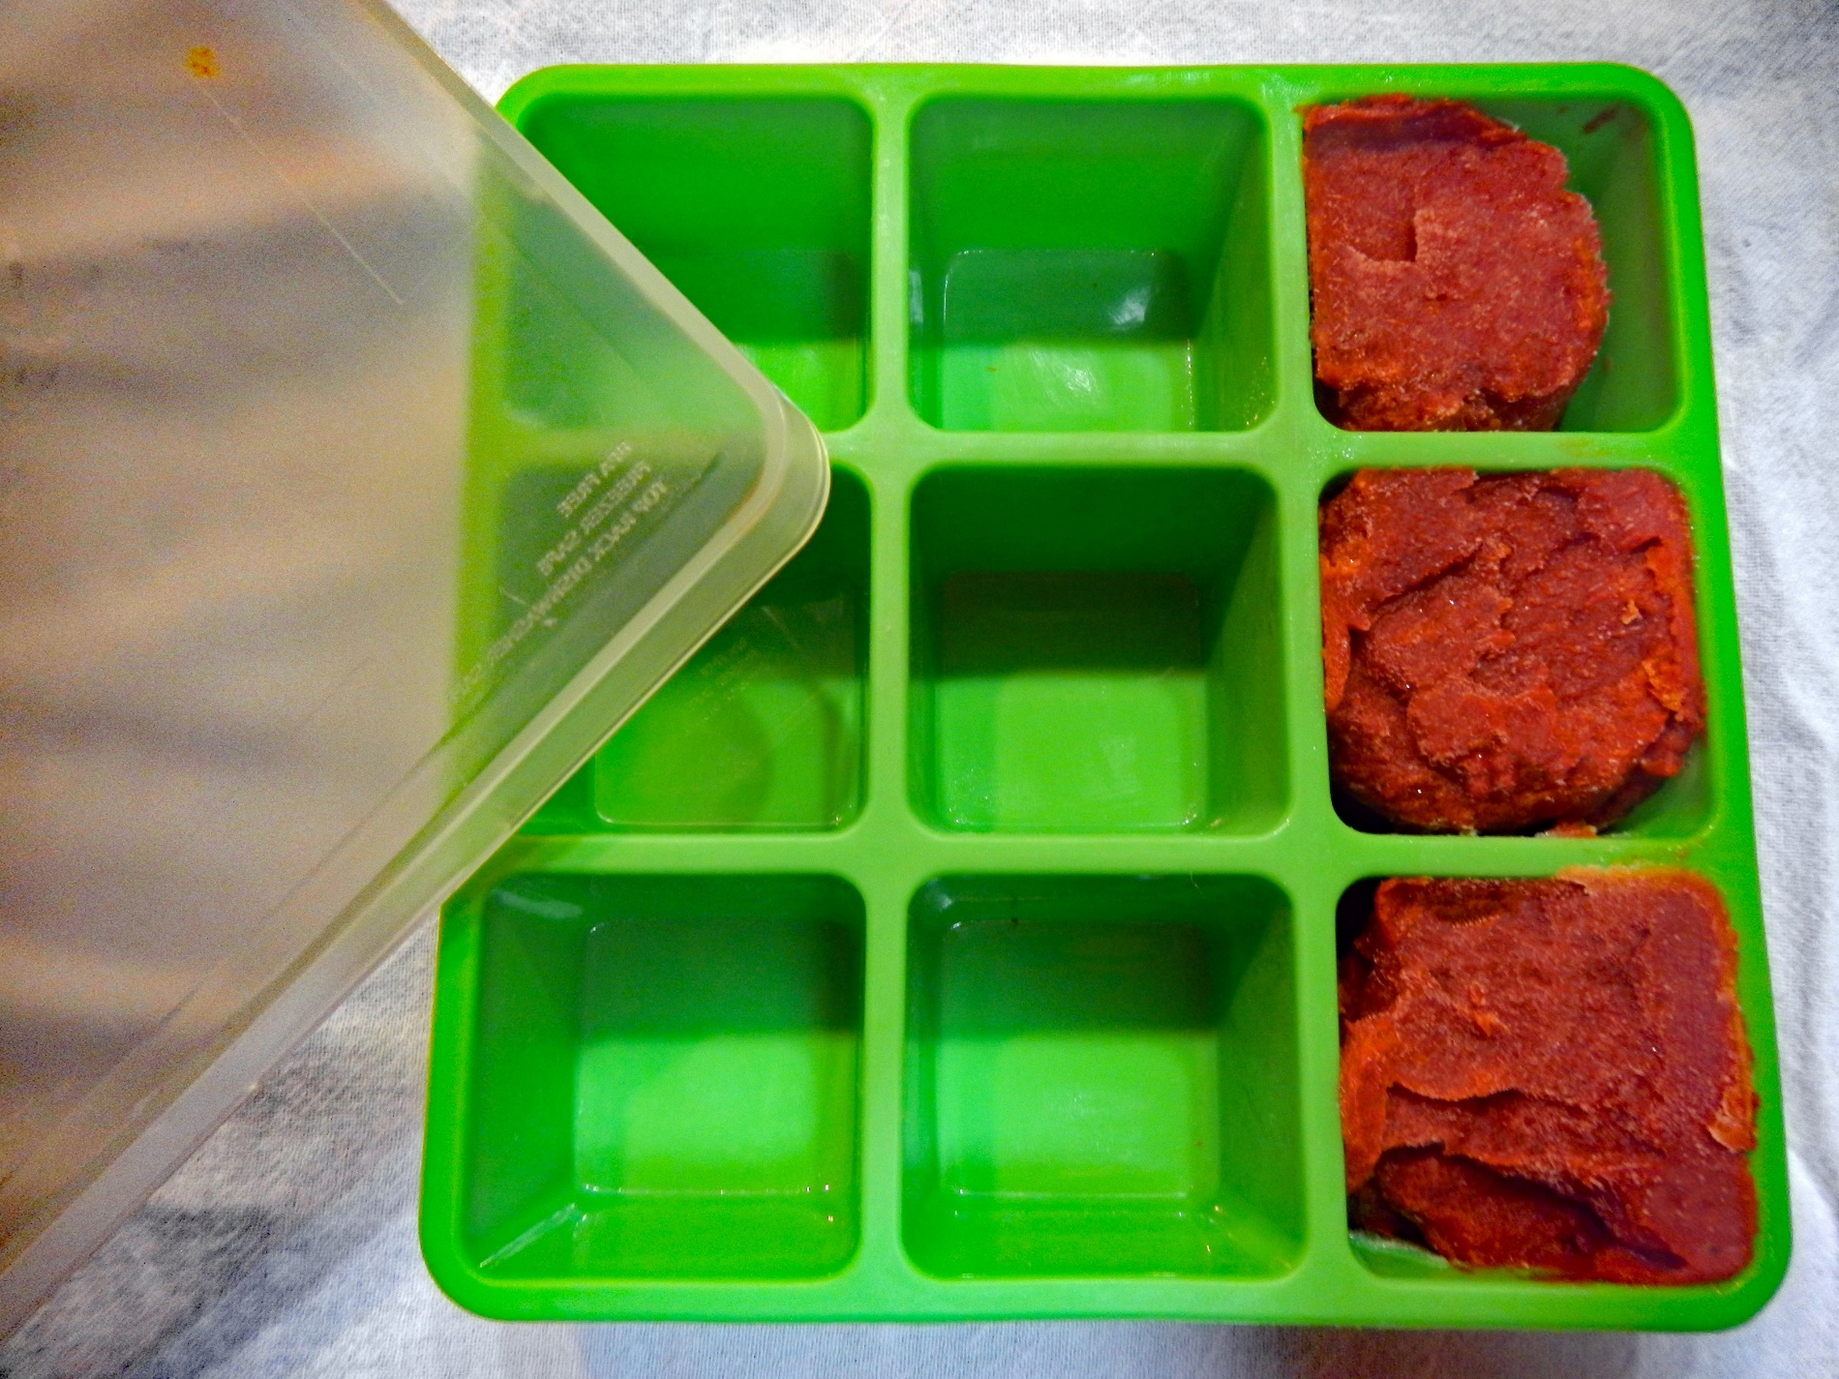
13
Freeze extra
tomato paste in
tablespoon-size
portions in an
ice cube tray.
Transfer to a
freezer bag.
Photo credit: Alice Henneman
Notes:
Freeze extra tomato paste in tablespoon-size portions in an ice cube tray. Here’s a tip … it’s easier to pop them out of silicone trays. Transfer to a freezer bag. Adding a tablespoon or two of tomato paste to soups, casseroles and pasta sauce enhances the flavor of these foods with its concentrated, almost meaty taste. Some people just plop dabs of extra tomato paste on a baking sheet and then transfer them to a freezer bag when they’re frozen.

Slide 46
What a great way to get my kids to eat more veggies!
Photo credit: Pixabay.com
Notes:
(Just show slide)

Slide 47
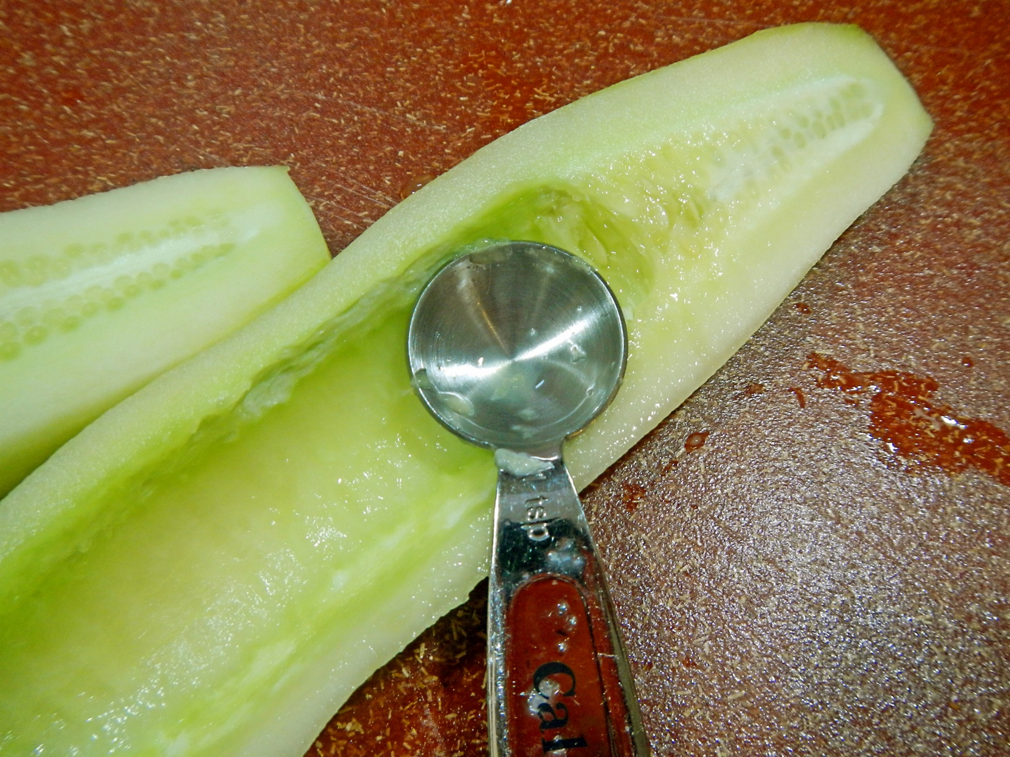
14
Use a melon baller or measuring spoon to scrape just the seeds from cucumbers and zucchini and the membrane from peppers when using these foods in recipes
Photo credit: Alice Henneman
Notes:
Easily scrape just the membrane part from peppers and the seeds from cucumbers and zucchini when preparing these foods to eat alone or use in recipes by using a melon baller or measuring spoon.

Slide 48
15
Freeze
chopped fresh
herbs in olive oil
Photo credit: Alice Henneman
Notes:
Freeze chopped fresh herbs in olive oil for a quick, delicious addition to sauces and pastas.

Slide 49
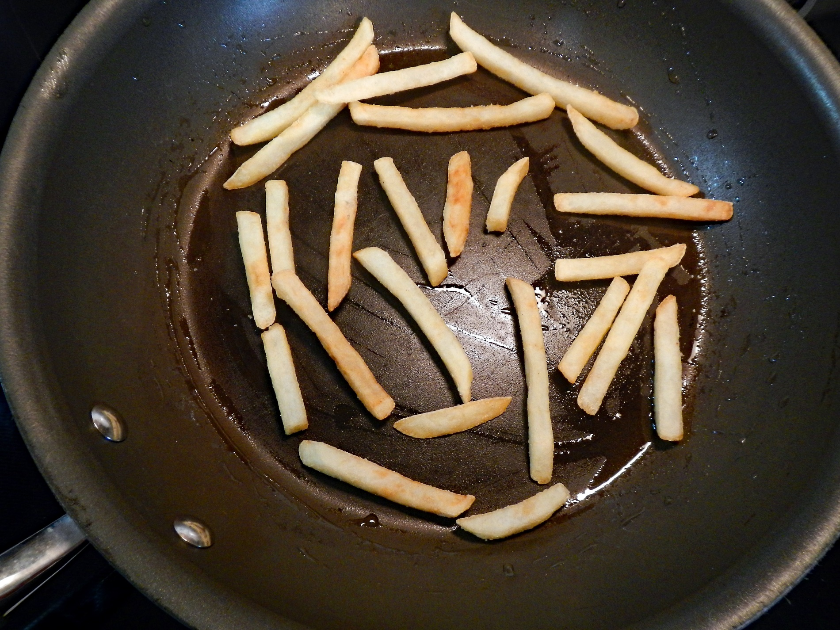
16
Revive French fries by heating in a small amount of oil in a heavy skillet over medium heat
Photo credit: Alice Henneman
Notes:
To revive leftover French fries, heat a small amount of olive or canola oil in a heavy skillet over medium heat. Spread fries in a single layer, leaving plenty of space around the fries. Otherwise, they’ll steam instead of sauté. Turn until all sides are evenly heated and crisp. Place on a paper towel to drain any extra fat.

Slide 50
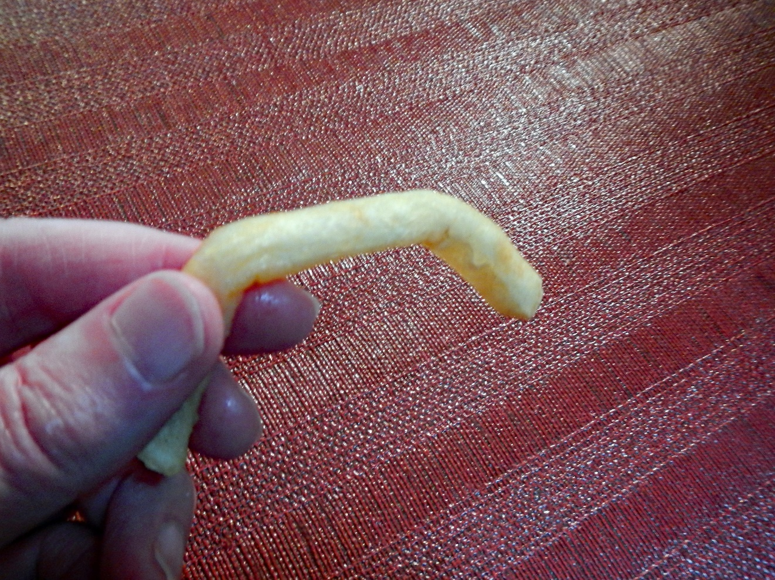
Which leftover fry would you eat?
Photo credit: Alice Henneman
Notes:
(Read slide)

Slide 51
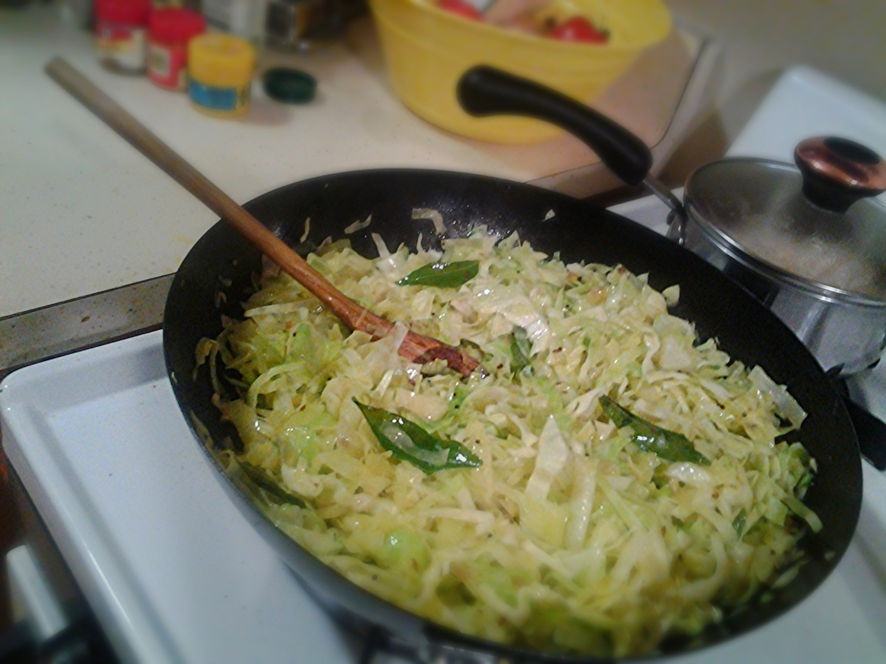
17
Sauté chopped cabbage
and onion in olive oil, margarine or butter over medium heat until tender; season with salt and pepper
Photo source: “Cabbage thoran” by goblinbox_(queen_of_ad_hoc_bento) is licensed under CC BY 2.0
Notes:
Sauté chopped cabbage and onion (about 1/2 head cabbage and 1/2 onion) in olive or canola in a skillet over medium heat until tender. Season as desired with salt and pepper.

Slide 52
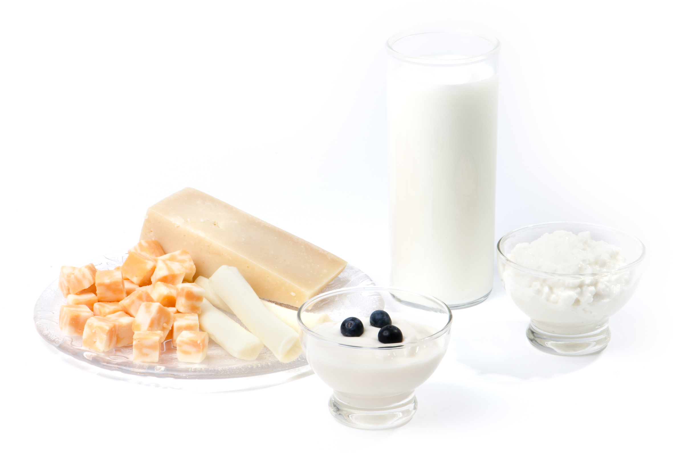
DAIRY
Source of photo: Used with permission by the Academy of Nutrition and Dietetics
Notes:
On to dairy …

Slide 53
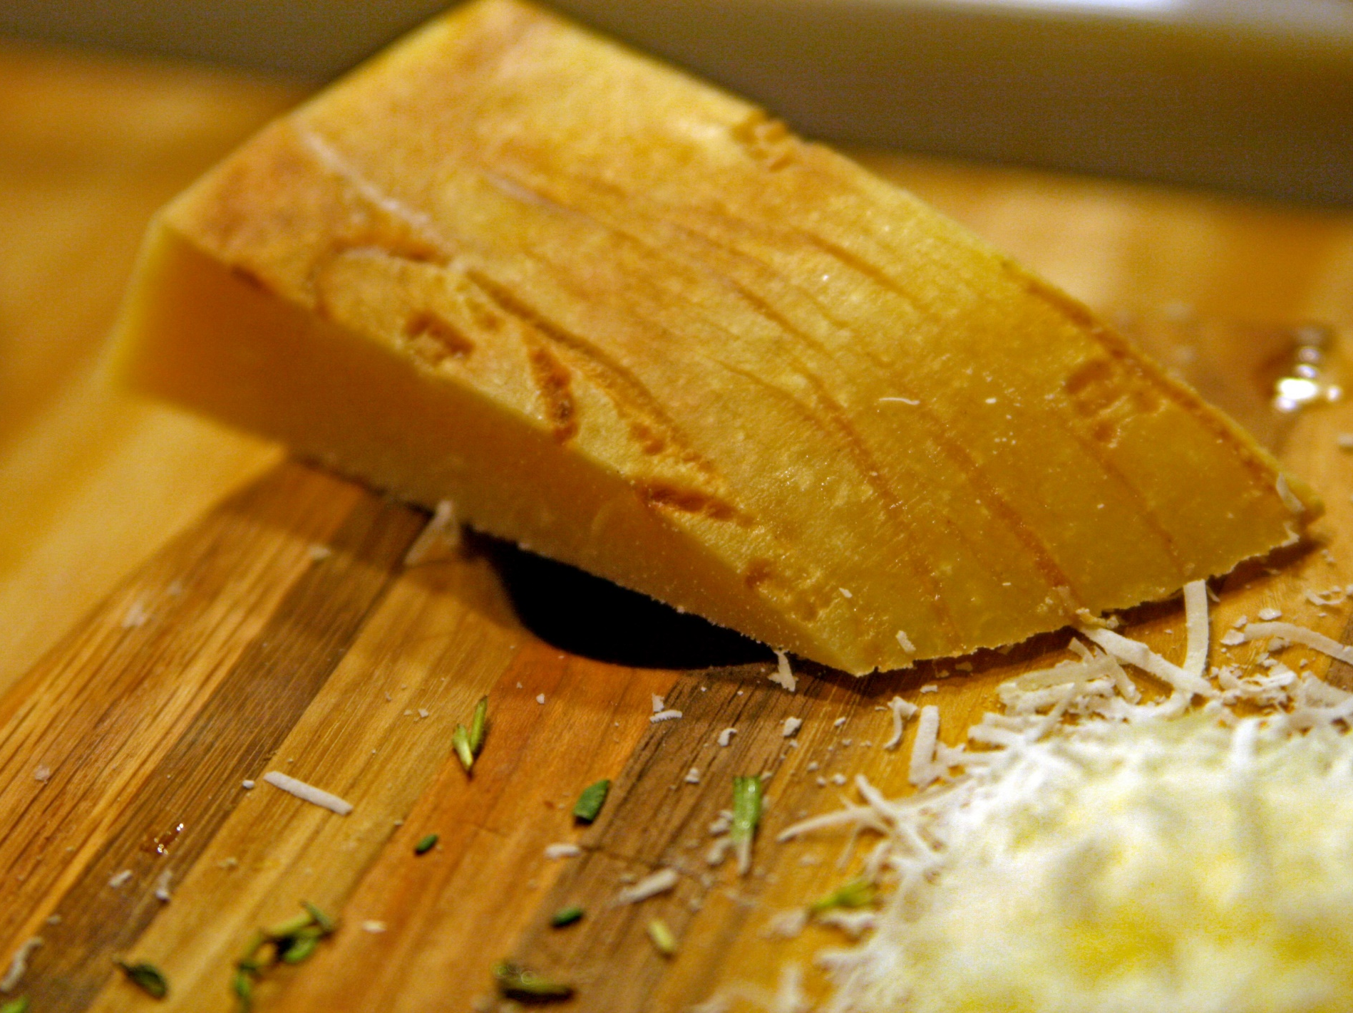
18
Freeze Parmesan rinds and add (frozen) to a soup or stew for extra flavor
Photo source: “Cheese” by Quinn Dombrowski is licensed under CC SA 2.0
Notes:
Freeze Parmesan rinds and add them while still frozen to a soup or stew for extra flavor.

Slide 54
Has anyone tried that?
Photo credit: Pixabay.com
Notes:
Has anyone tried that?

Slide 55
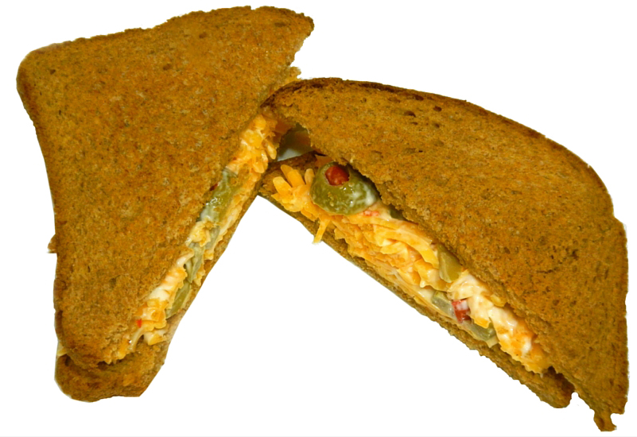
19
Make a cheese
spread with odds and ends of cheese, mayo and foods like chopped olives and walnuts
Photo credit: Alice Henneman
Notes:
Use up extra odds and ends of cheese by shredding them with a grater or in a food processor. Mix in your choice of ingredients, cut or chopped into small pieces; for example, add olives, pickles, pimientos, chives, walnuts or peppers. Add enough mayonnaise (regular or low-fat) to bind the ingredients together. Spread on your favorite bread.

Slide 56
Or, toss that cheese on a recipe that needs a little something extra to make it tasty!
Photo credit: Pixabay.com
Notes:
(Read slide)

Slide 57
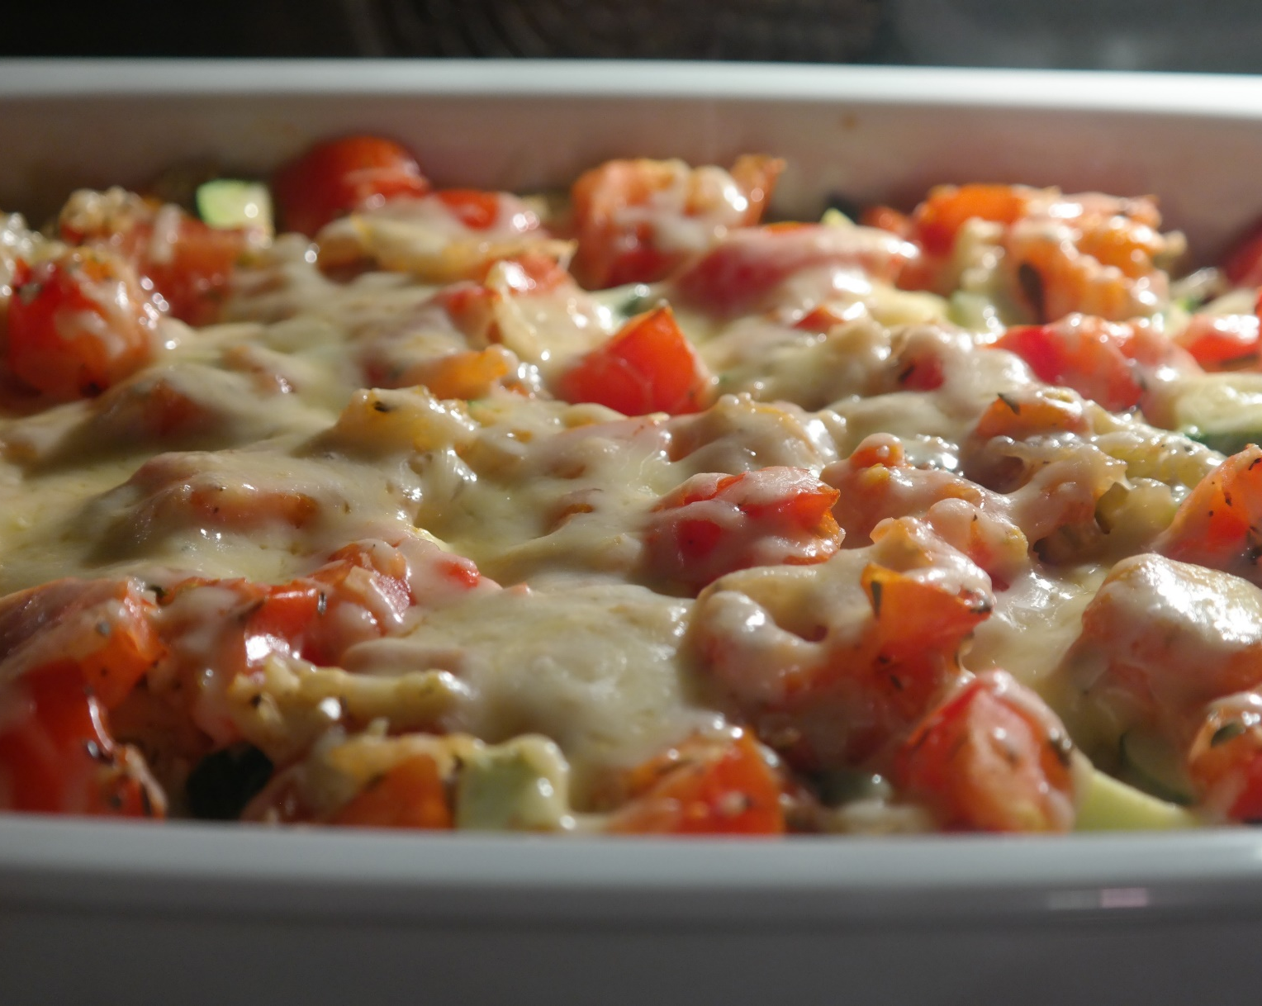
If you feel adding cheese won’t fit into your diet …
Need a cheese lower in sodium – try Swiss cheese …
54 mg sodium/ounce – about 1/3 the amount of sodium in 1 slice of bread
Want a lower fat cheese – try part-skim Mozzarella …
4.5 gm fat /ounce – a teaspoon of butter or margarine has about 3.5 gm fat
Also, check out other forms of “reduced-fat” or “low-fat” cheeses
Photo credit: Pixabay.com
Notes:
If you feel adding cheese won’t fit into your diet because you felt cheese was too high in sodium or fat, try these cheeses. (Then, read slide)

Slide 58
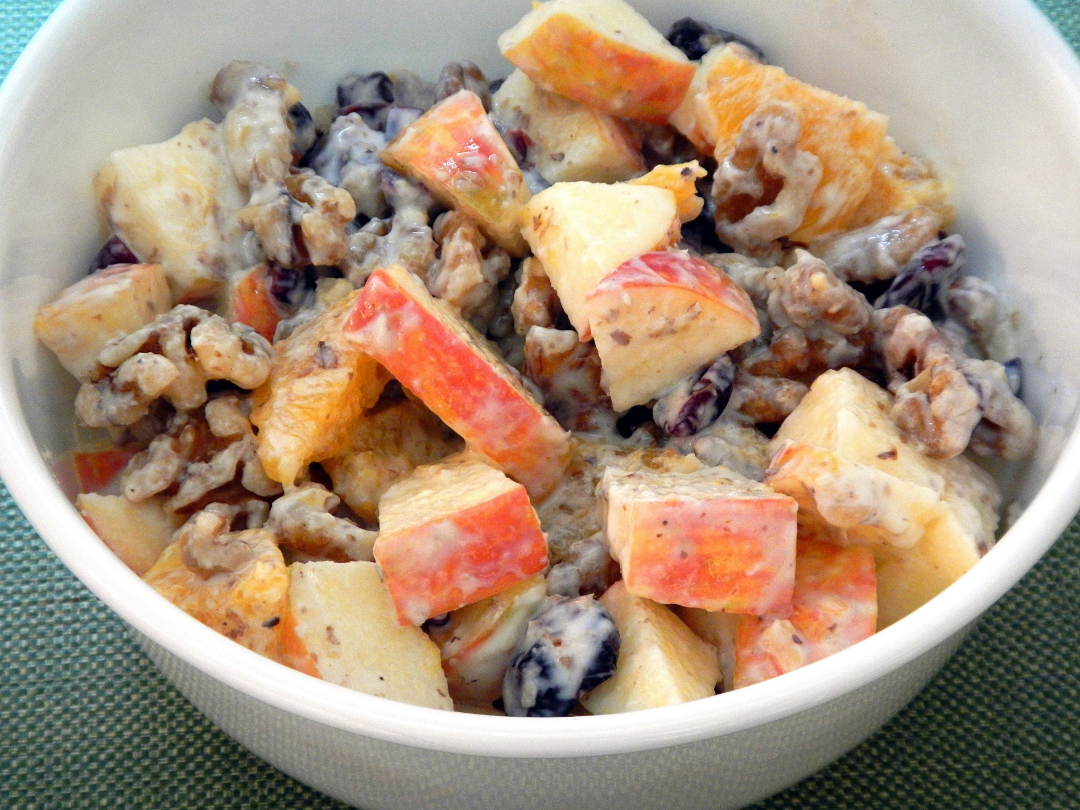
20
Use vanilla
and fruit-
flavored yogurts
as a dressing for fruit salads
Photo credit: Alice Henneman
Notes:
Use vanilla and fruit-flavored yogurts as a dressing for fruit salads. Lemon flavored yogurt is especially nice on waldorf salads

Slide 59
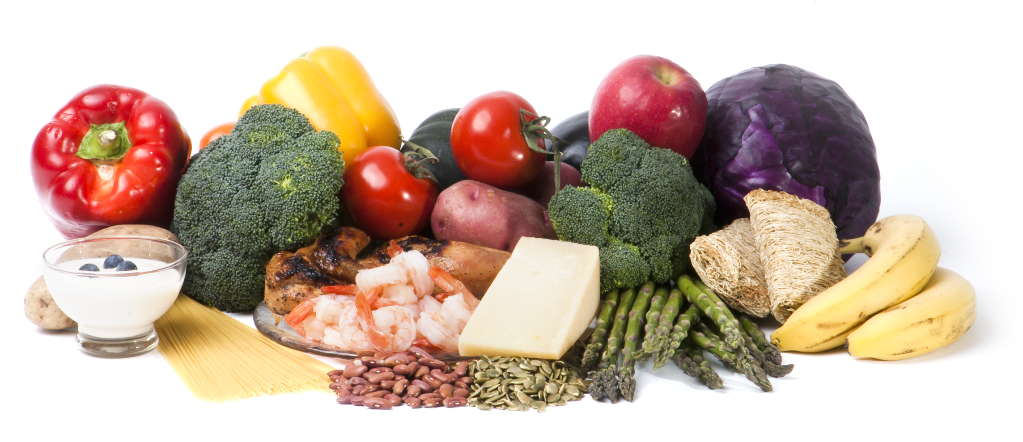
COMBINATIONS OF FOODS
Source of photo: Used with permission by the Academy of Nutrition and Dietetics
Notes:
Next stop: Combinations of foods …

Slide 60
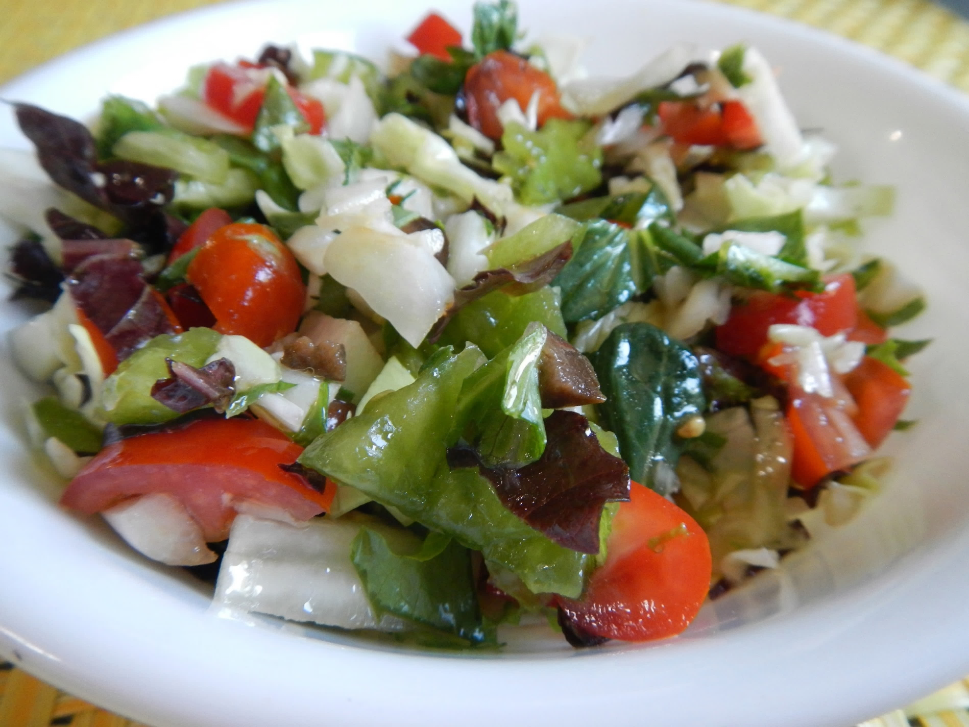
21
Make a chopped salad* with small amounts of extra fruits, vegetables, nuts, cooked eggs, etc.
Photo credit: Alice Henneman
Notes:
Use leftover fruits, vegetables, nuts, cooked eggs and so on to make a chopped salad.

Slide 61
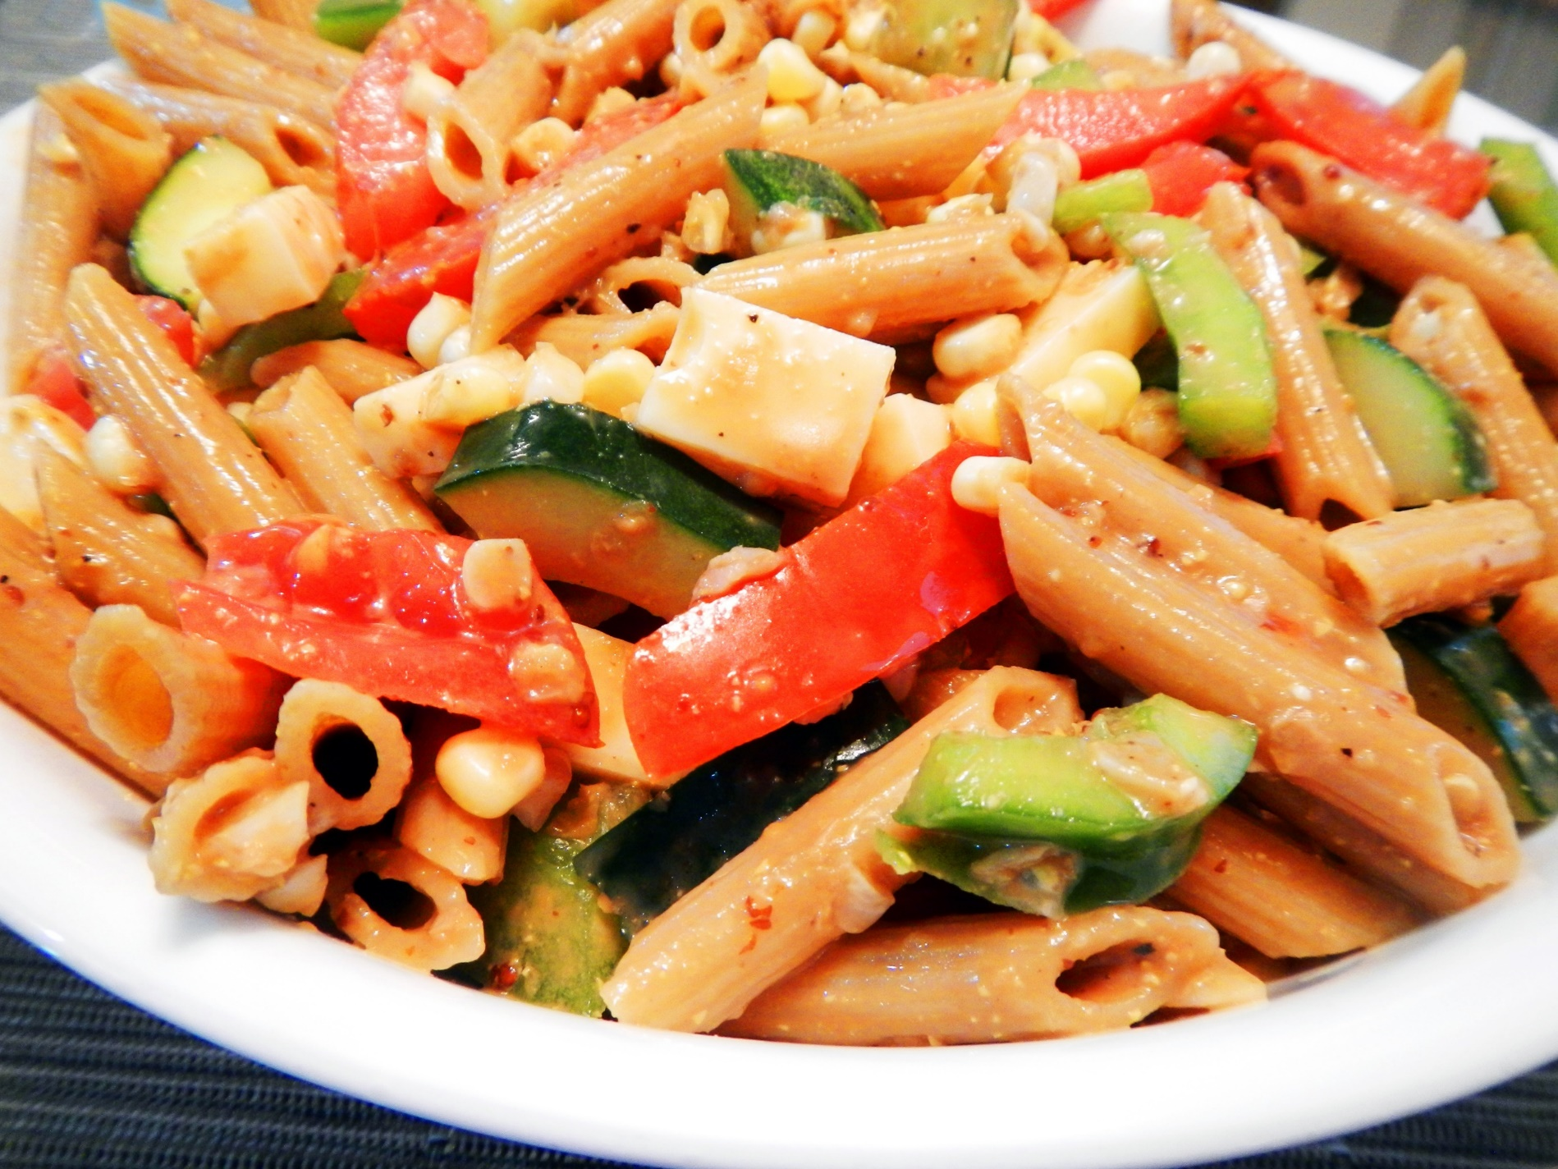
22
Combine leftover pasta with other foods; mix with your favorite oil and vinegar salad dressing
Photo credit: Alice Henneman
Notes:
Combine leftover pasta with foods such as boiled egg wedges or slices, bite-size chunks of cheese, chopped fresh vegetables and cooked dry beans. Mix with your favorite vinaigrette-type dressing. Refrigerate about an hour before serving to let the flavors blend.

Slide 62
23
Create a parfait of cookie crumbles, pudding, and fruit
Make shortly before serving and keep refrigerated
Photo credit: “Girl Scout Cookie Parfait” by Dennis Wilkinson is licensed under CC BY NC SA 2.0
Notes:
Prepare a pudding mix per package directions. Layer cookie crumbles, then pudding followed by fruit — such as berries — in parfait or wine glasses. Alternate as desired. Serve soon after preparation to prevent crumbles from becoming soggy. This parfait is made with crumbled Girl Scout Cookies.

Slide 63
Anyone have some cookies in the house they might try this with?
Photo credit: “Girl Scout Cookies” by Marit &amp; Toomas Hinnosaar is licensed under CC BY 2.0
Notes:
(Read slide)

Slide 64
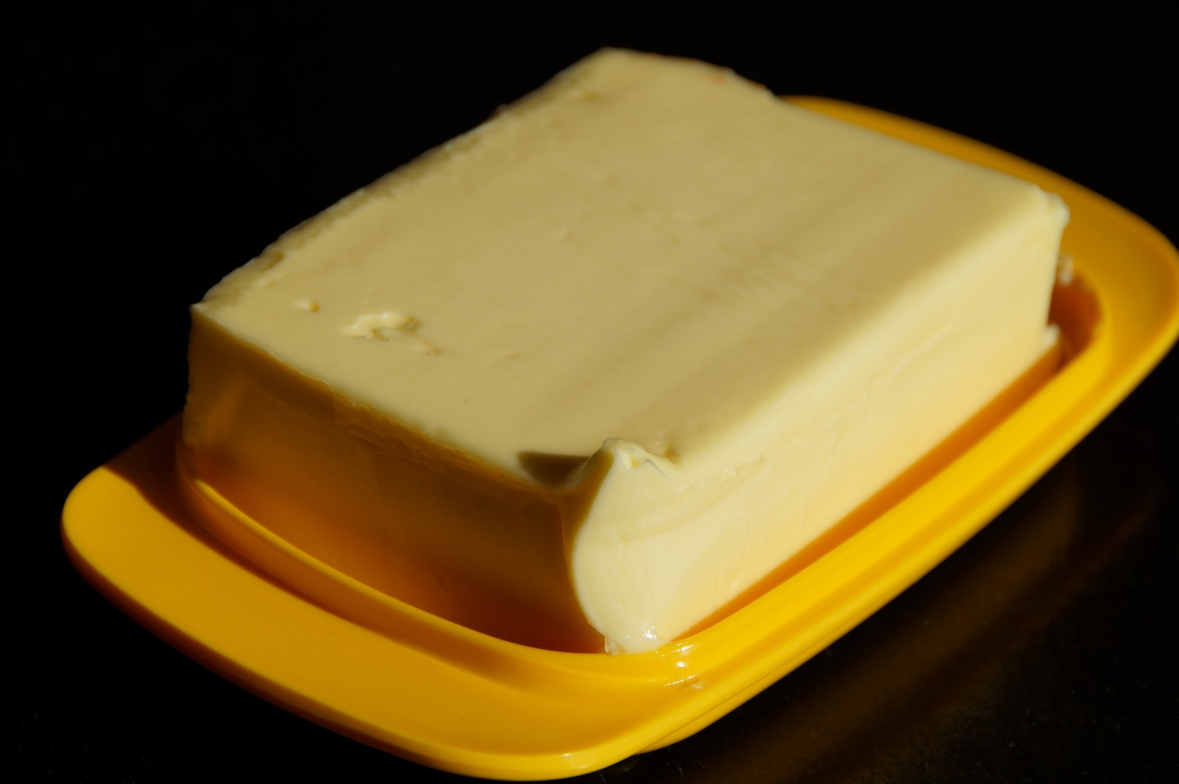
Other?
Photo credit: Pixabay.com
Notes:
Here are more tips on some miscellaneous foods …

Slide 65
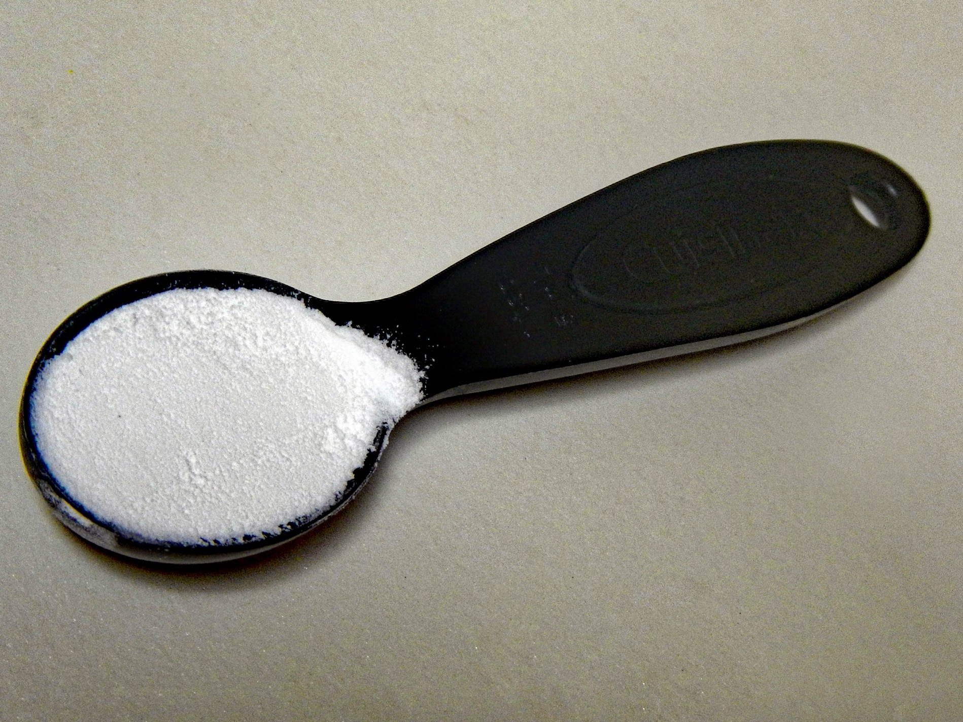
24
Use these tests to see if baking powder or soda still works (in handout)
Photo credit: Alice Henneman
Notes:
Test baking powder for freshness by mixing 1 teaspoon baking powder with 1/3 cup hot water. If it foams vigorously, it still has rising power.
To test baking soda: Place 1-1/2 teaspoons in a small bowl. Add 1 tablespoon vinegar. If it fizzes, then it will still help leaven a food. If it doesn’t fizz, use it as an odor catcher in the refrigerator.

Slide 66
25
Fix lumpy gravy by pouring it through a sieve or strainer
Photo source: “All-Purpose Gravy” by Kelvin Beecroft is licensed under CC BY NC SA 2.0
Notes:
Fix lumpy gravy by pouring it through a sieve or strainer. Has anyone done this?

Slide 67
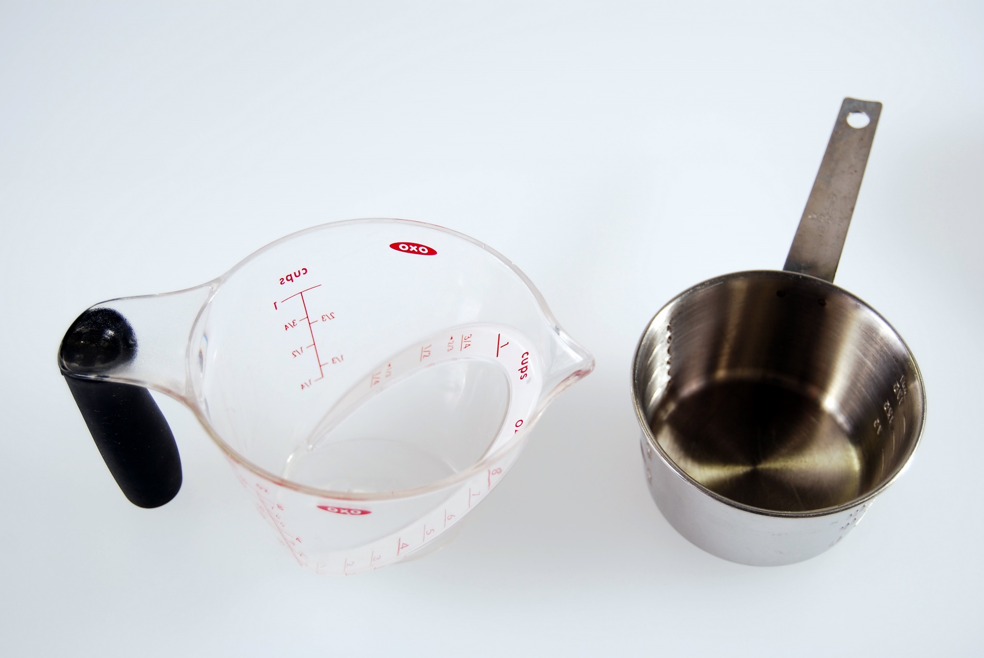
26
Coat measuring
cups with nonstick cooking
spray before
measuring sticky
ingredients
Photo credit: Alice Henneman
Notes:
Coat measuring cups with nonstick cooking spray before measuring sticky ingredients like honey, syrups and peanut butter. Has anyone tried this?

Slide 68
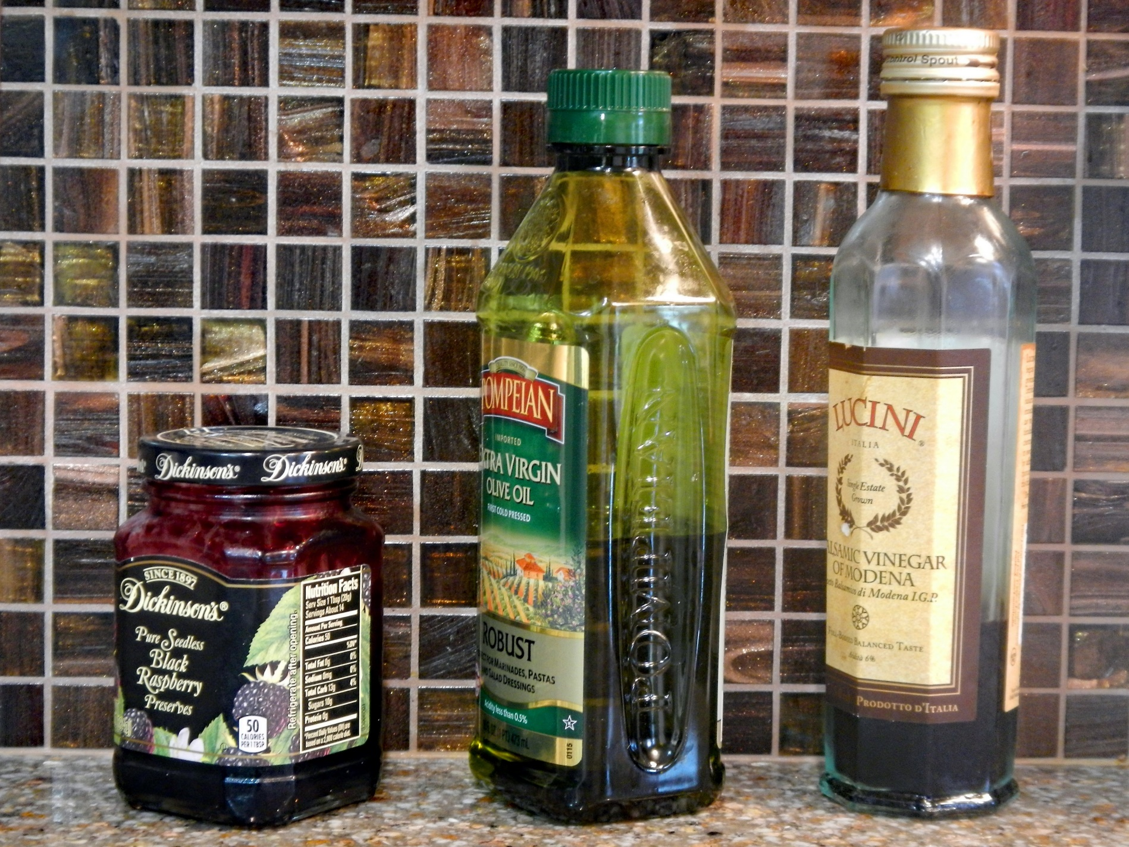
27
Add oil, vinegar, herbs and spices to an almost empty jelly or mayo jar to make salad dressing and shake. Use about 1 part vinegar to 3 parts oil.
Photo credit: Alice Henneman
Notes:
Add oil, vinegar, herbs and spices to an almost-empty mayo, jam or jelly jar. Shake and use for a quick salad dressing. Use about 1 part vinegar to 3 parts oil.

Slide 69
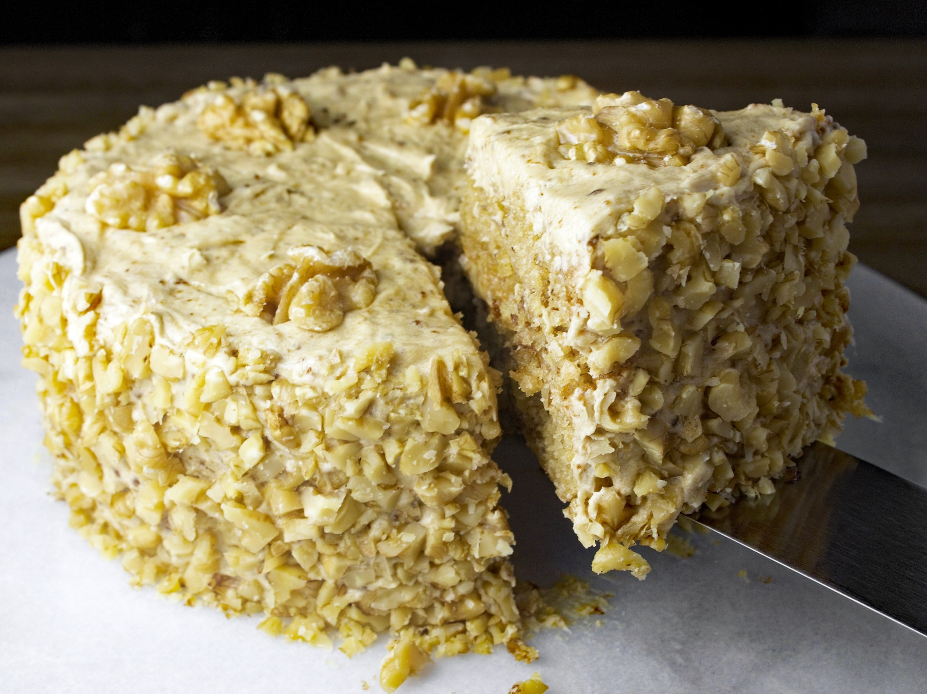
28
Fix lumpy frosting by adding something lumpy to it
Photo credit: Pixabay.com
Notes:
Fix lumpy frosting by adding something lumpy to it, such as chopped nuts or coconut.

Slide 70
Recipes

Slide 71
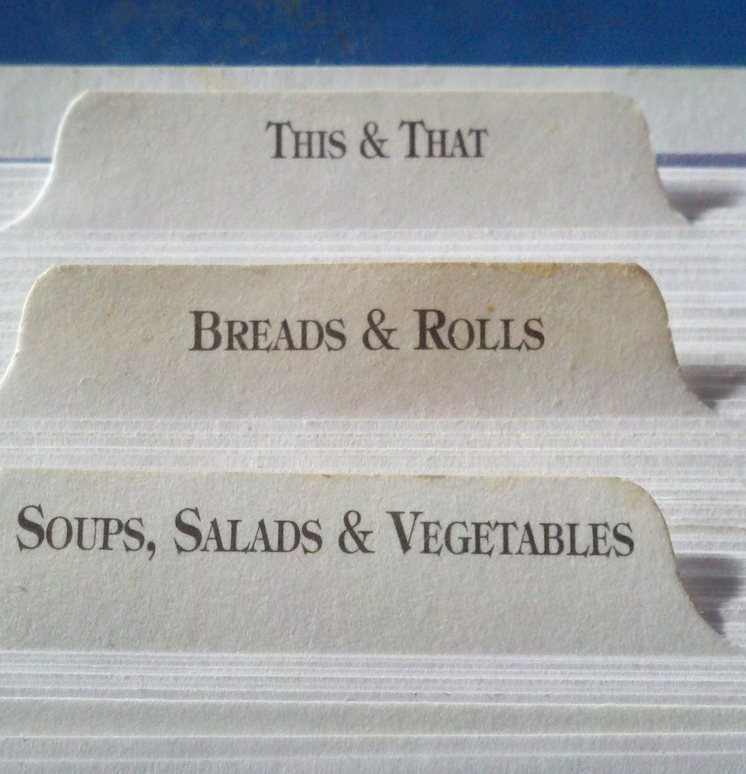
About the recipes …
According to the U.S. Department of Agriculture, part of a healthy diet is limiting the amounts of added sugars, saturated fats and sodium we consume.
The following recipes have been chosen to help promote or give substitutions that support these recommendations and at the same time provide important nutrients and taste good.
While saturated fat is kept at a minimum, to further reduce saturated fat in a recipe calling for a solid fat, substitute a soft (tub or squeeze) margarine.
Notes:
(Read slide)

Slide 72
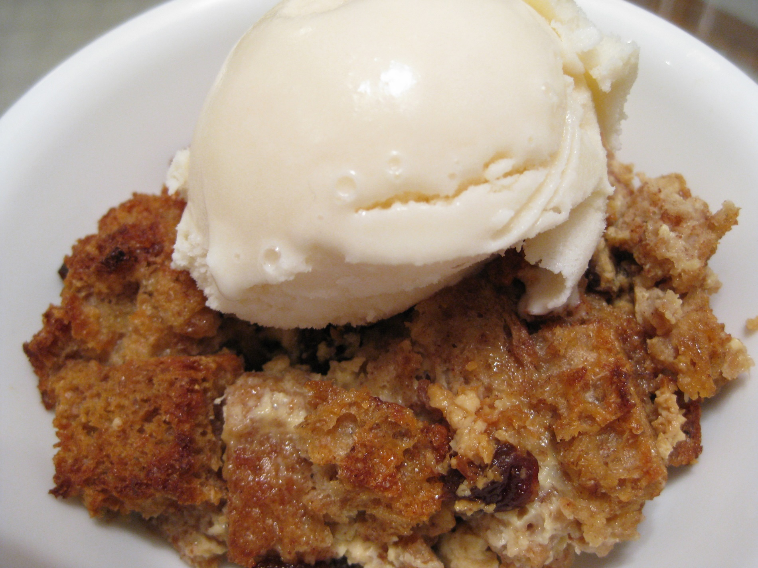
Old Fashioned
Bread Pudding
Photo credit: Alice Henneman
Notes:
"Old Fashioned Bread Pudding" is a delicious way to add whole grain breads to your meals and to use up bread that is beginning to dry out. Spreading each slice of bread with margarine or butter and sprinkling it with cinnamon before cutting it into cubes makes every bite especially tasty!

Slide 73
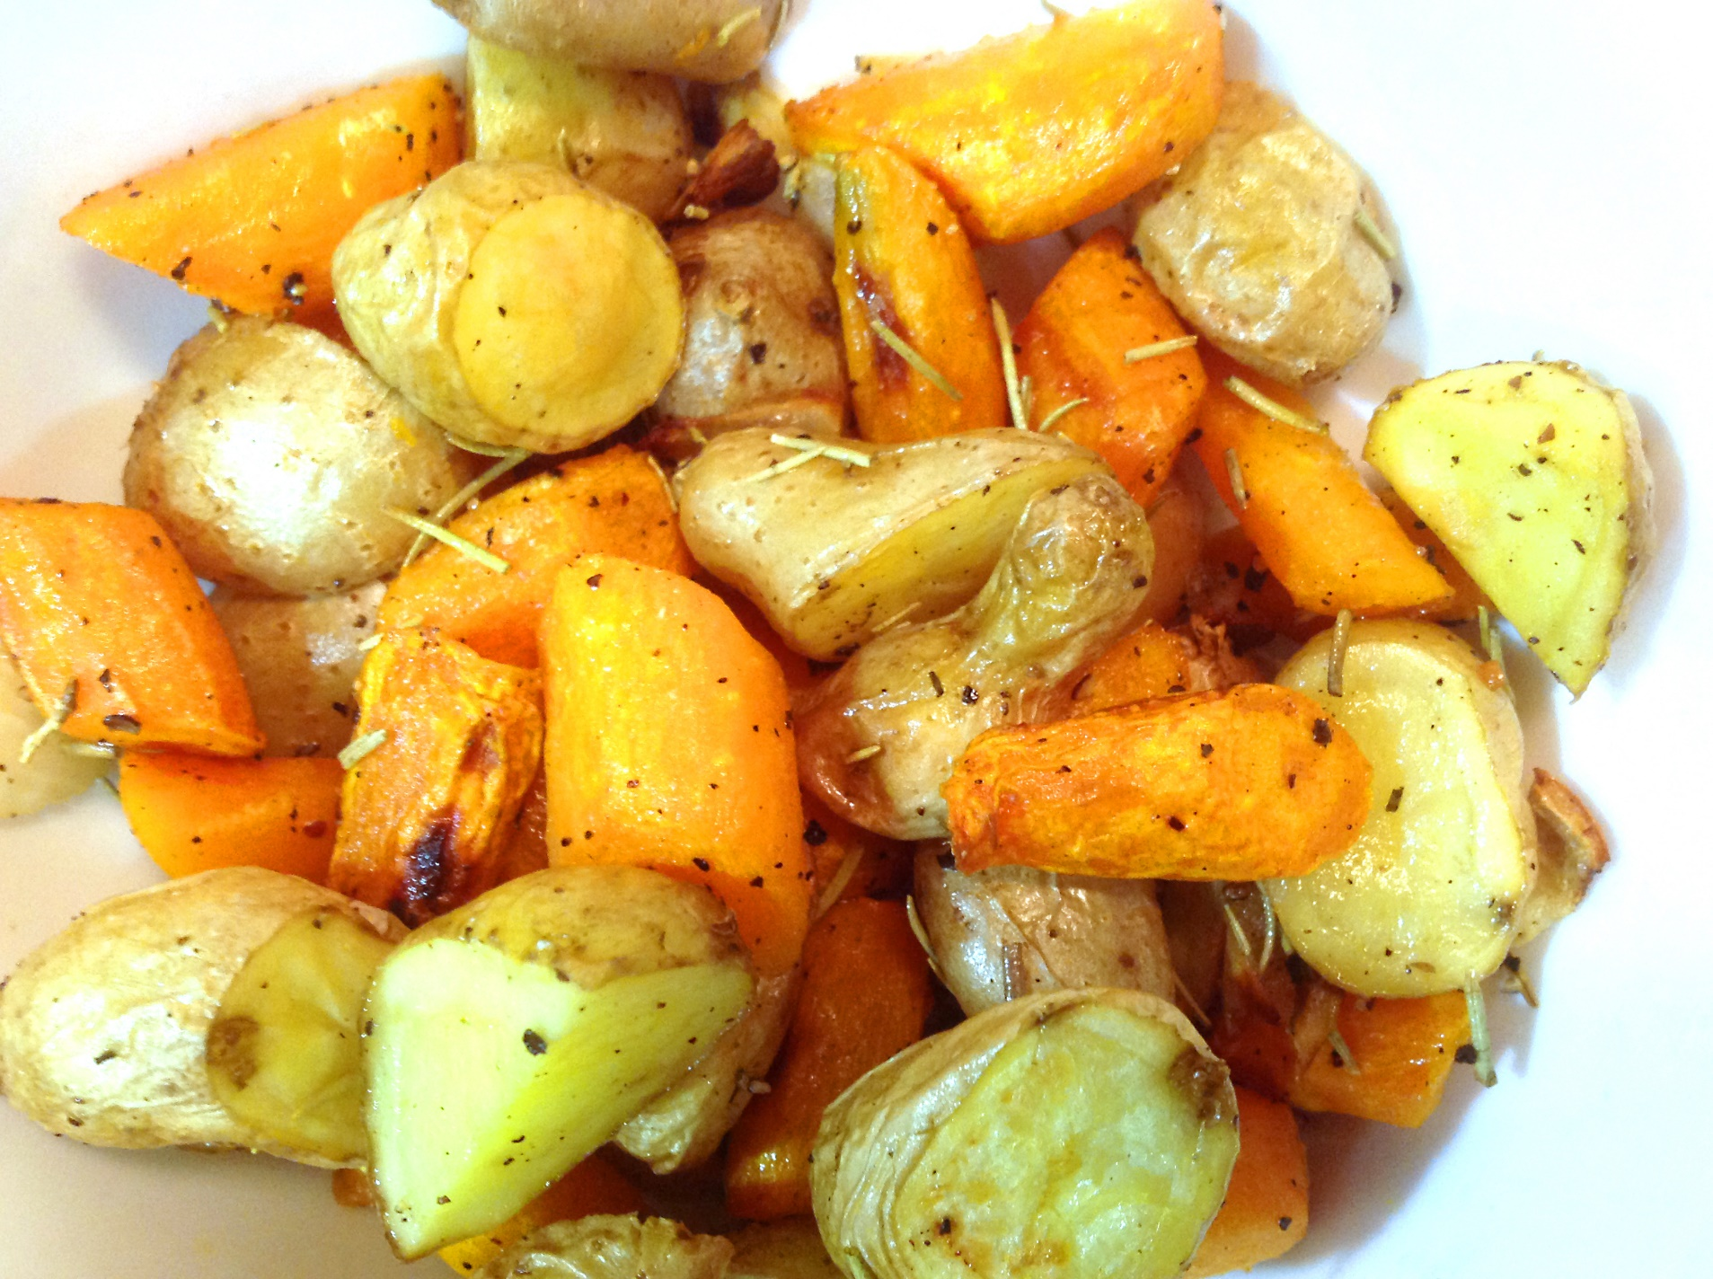
Roasted
Root
Vegetables
Photo credit: Alice Henneman
Notes:
Roasting root vegetables adds a delightful sweet taste and is a delicious way to use up those last few vegetables lingering in your refrigerator or on your counter top. Cut vegetables into chunks similar in size so they will finish roasting at the same time.

Slide 74
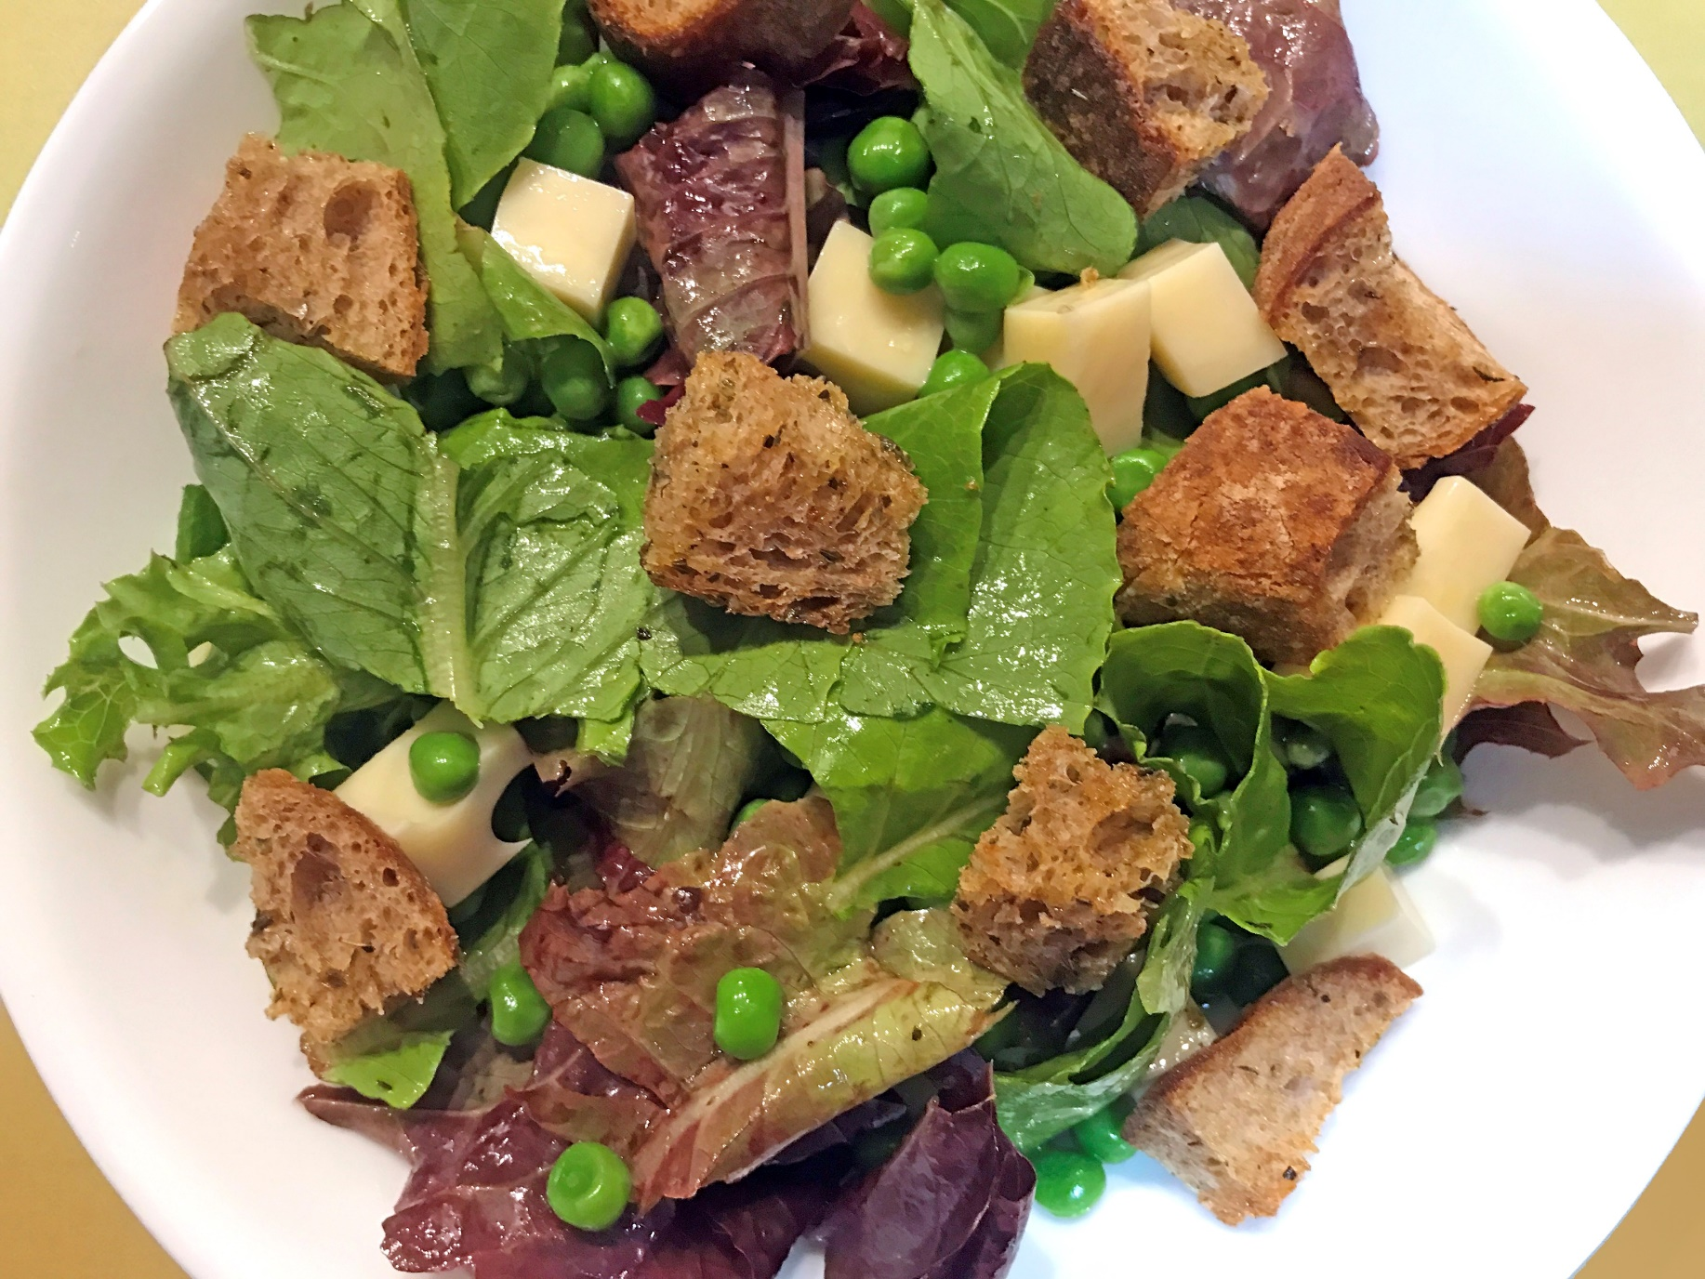
Homemade
Whole
Grain
Croutons
Photo credit: Alice Henneman
Notes:
Making your own croutons is a tasty way to use bread that has dried out slightly. You’ll save money, too! Homemade croutons also are a terrific way to enjoy those last few slices of a special bread from the Farmers’ Market.

Slide 75
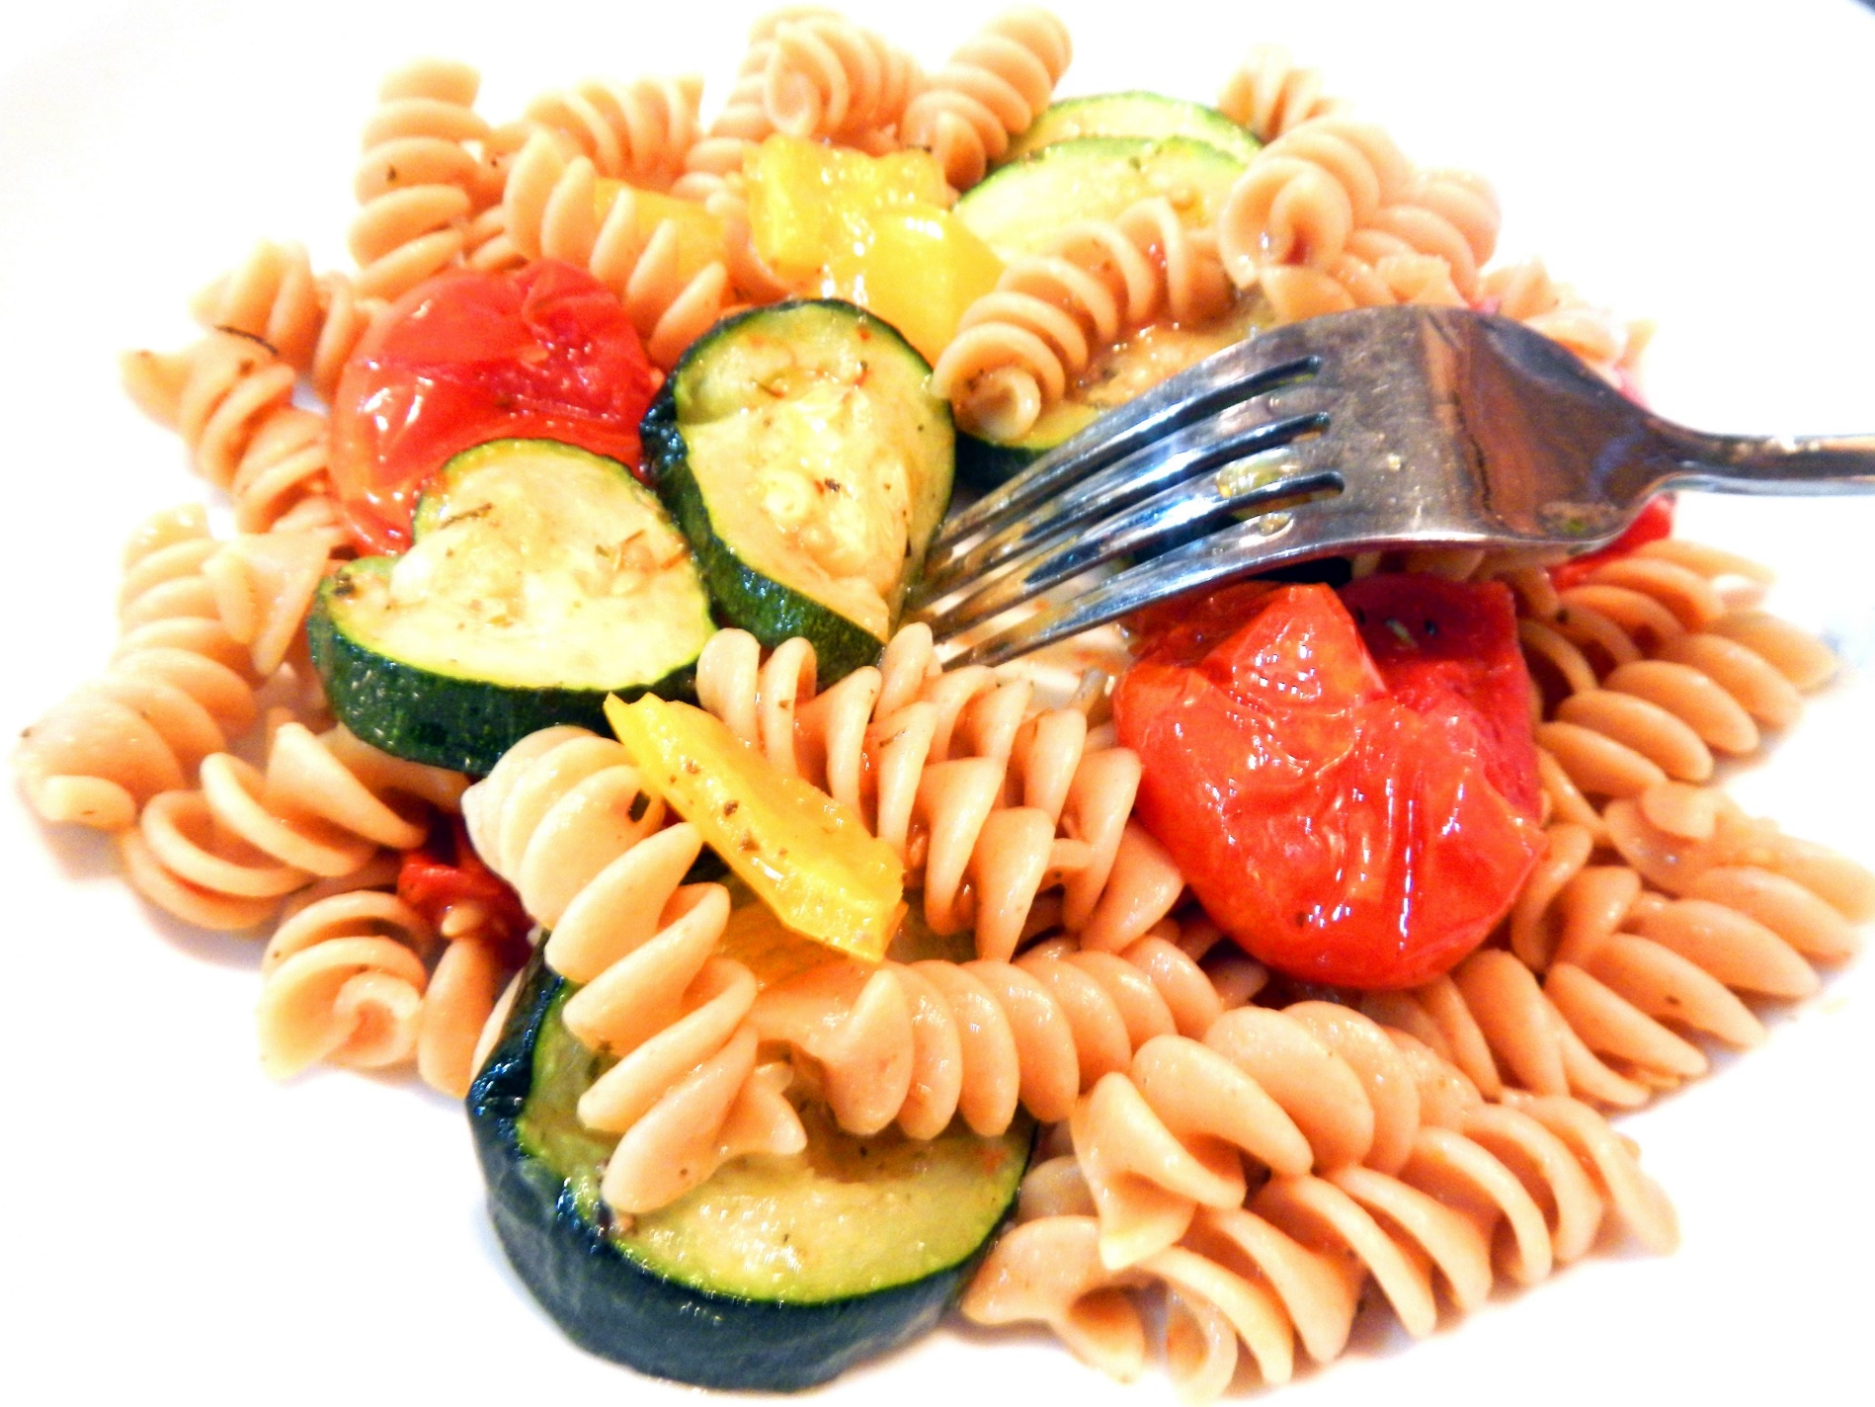
Roasted
Vegetable
Pasta
Photo credit: Alice Henneman
Notes:
Try this recipe if you have some of these vegetables in your kitchen that you need to use up: Cherry tomatoes, any color of bell peppers, zucchini, eggplant or asparagus.

Slide 76
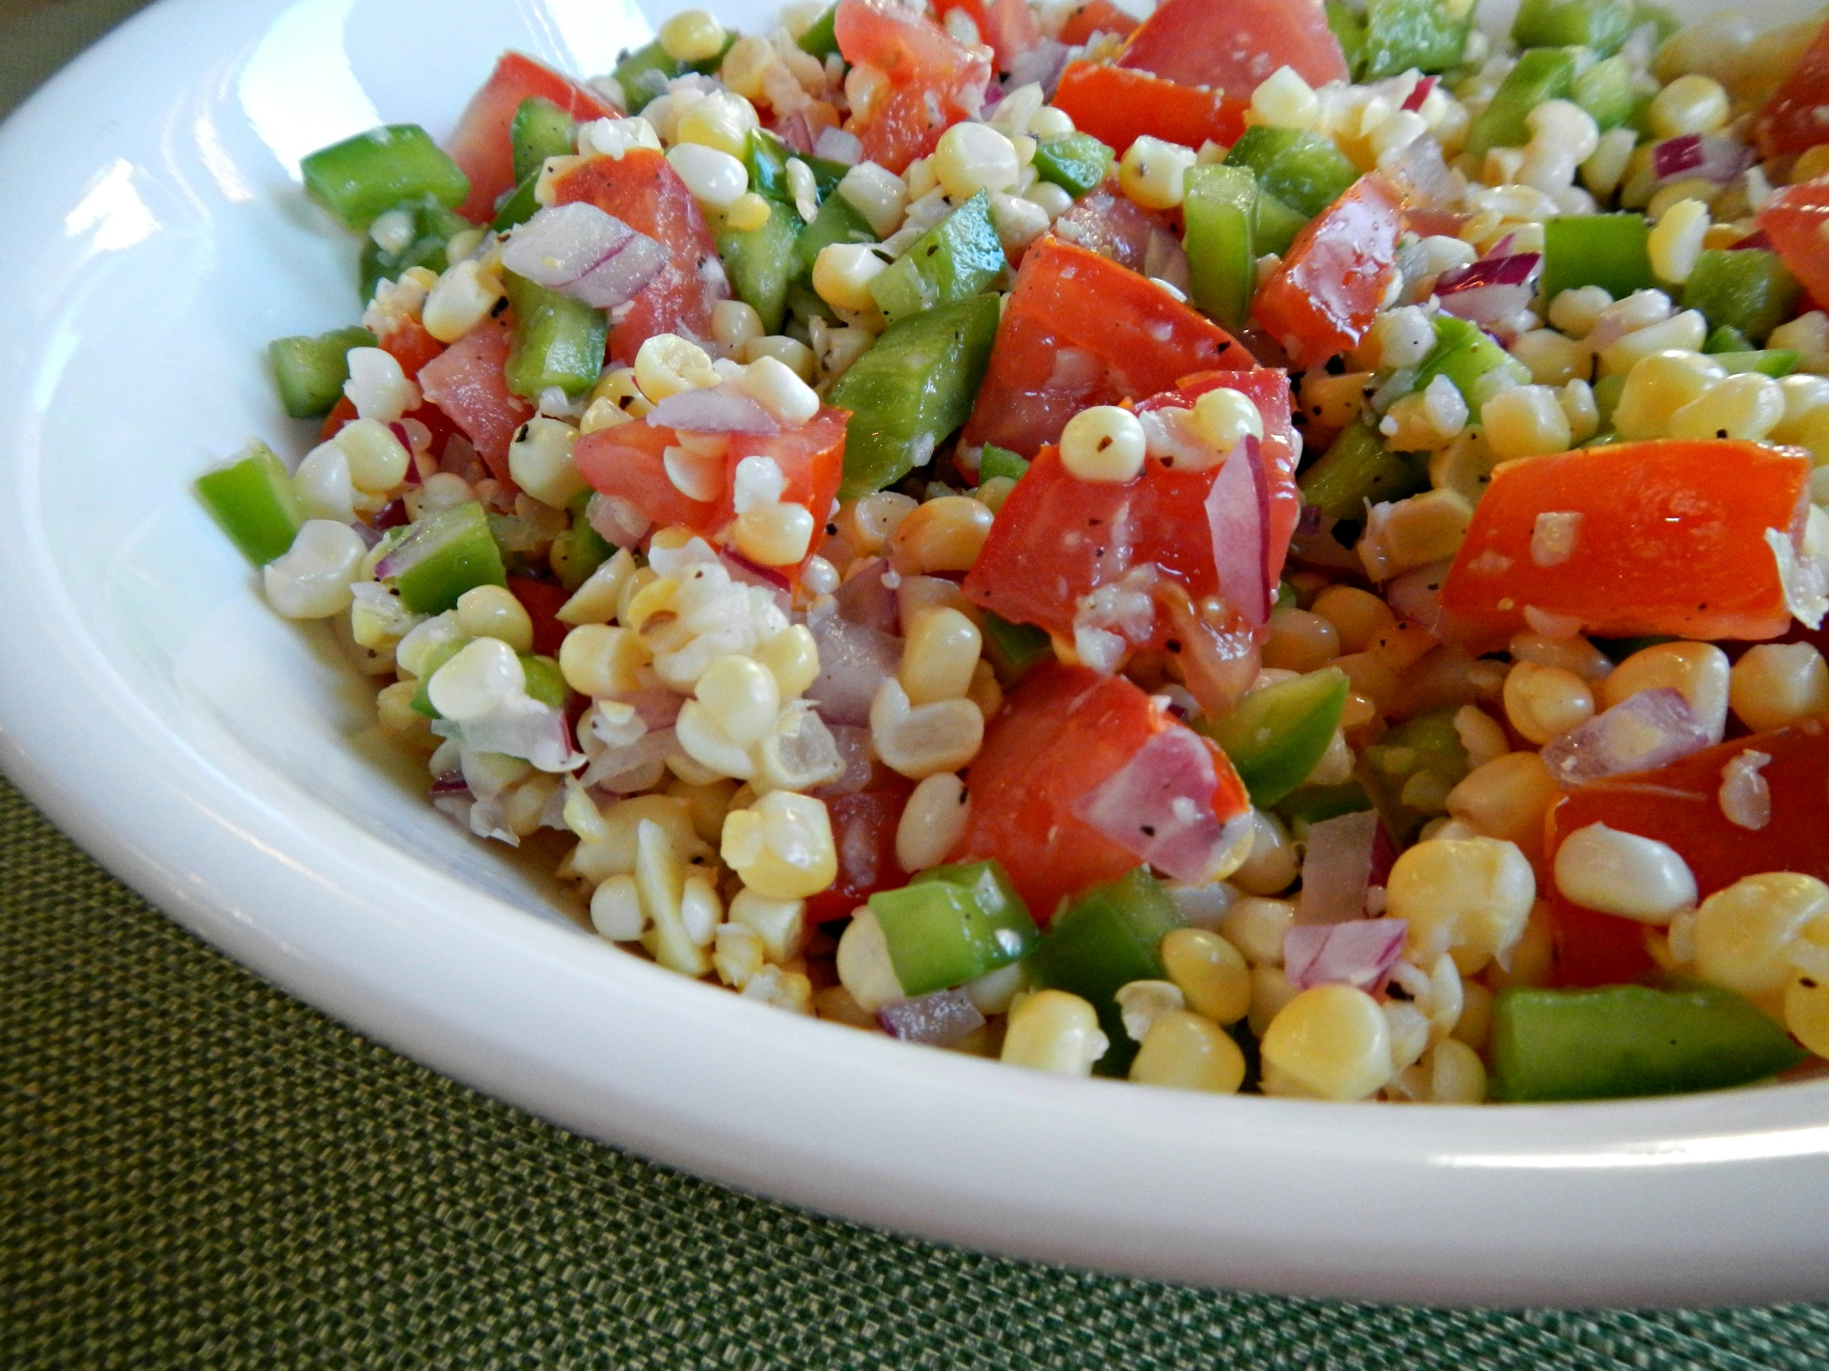
Clean the
Fridge
Chopped
Salad
Photo credit: Alice Henneman
Notes:
A chopped salad is known for containing small pieces of fresh produce, usually vegetables. You’re limited only by your imagination. Possibilities include onions, bell peppers, carrots, tomatoes, celery, lettuce, spinach, cabbage, zucchini, cauliflower, broccoli, kale, peas, radishes, cucumbers, cooked corn cut from the cob and zucchini. Chopped salads are a delicious dish for cleaning out your refrigerator. A chopped salad is easier to eat from a bowl with sides.

Slide 77
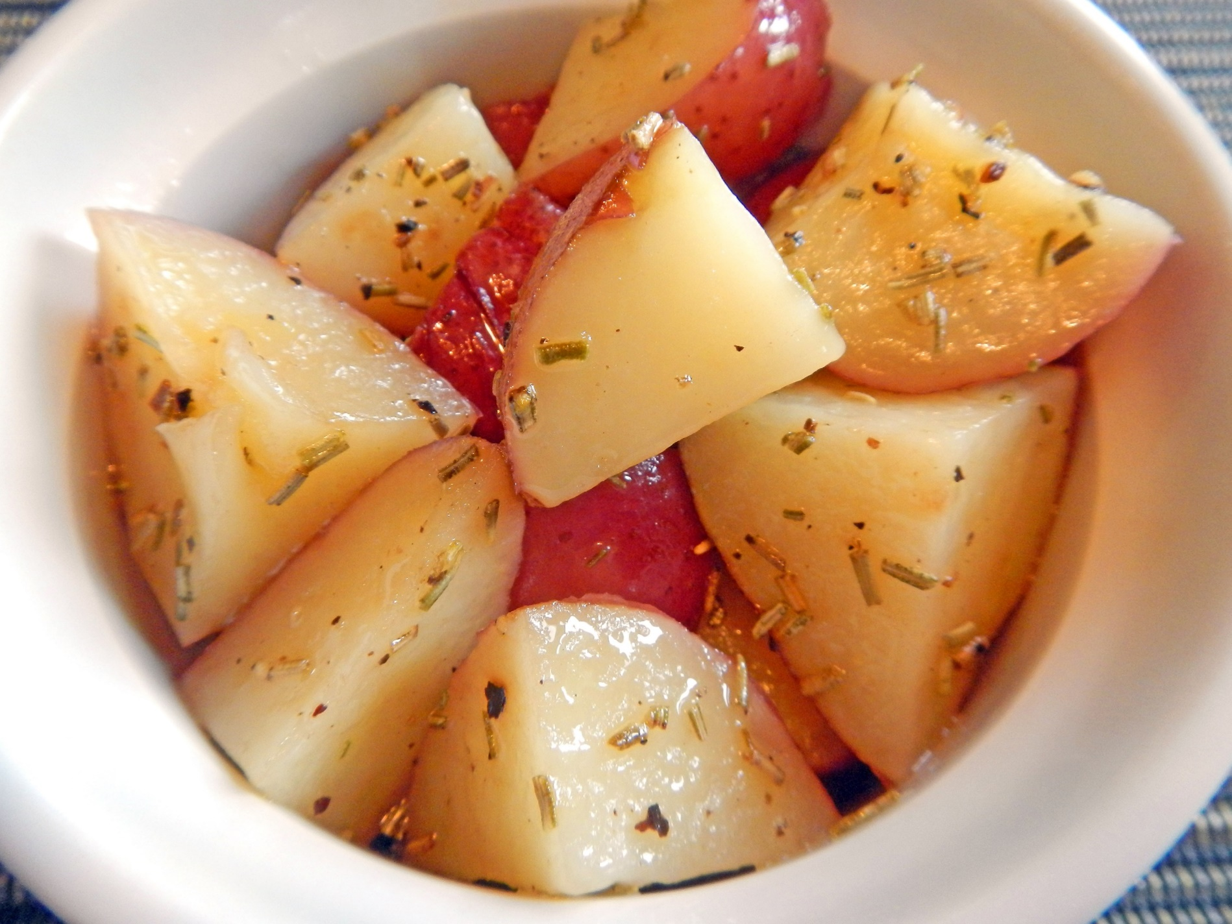
Tasty
Microwave
Potato
Chunks
Photo credit: Alice Henneman
Notes:
Try this quick potato dish that can be made in your microwave.

Slide 78
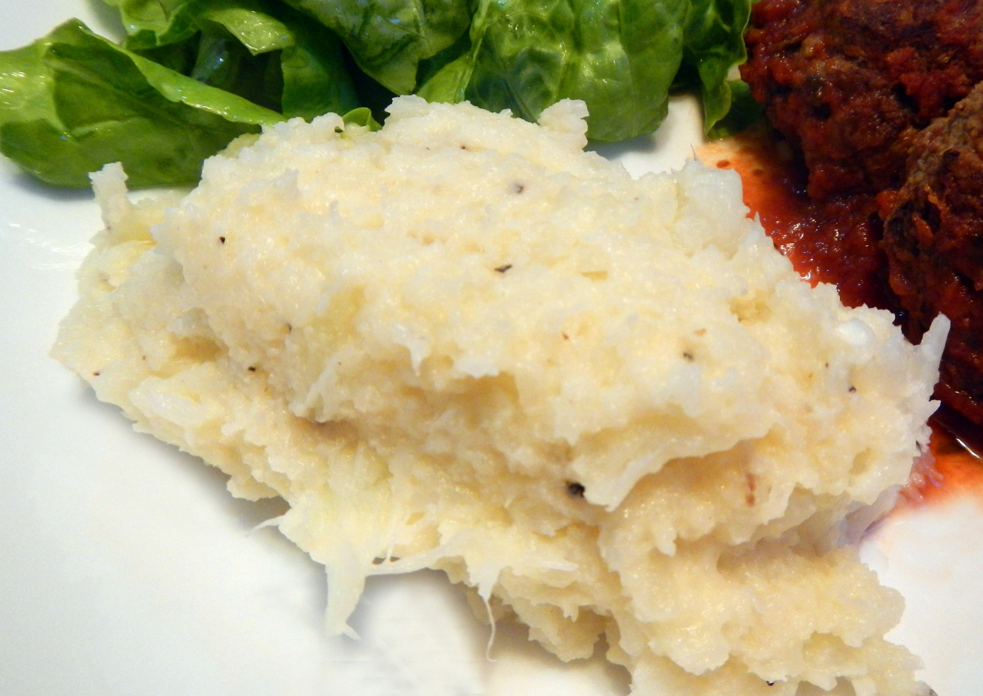
Mashed
Cauliflower
Photo credit: Alice Henneman
Notes:
While the first half of a cauliflower often is eaten soon, sometimes the last half remains until it finally gets tossed. Try making mashed cauliflower to give a whole new personality to the other half of the cauliflower.

Slide 79
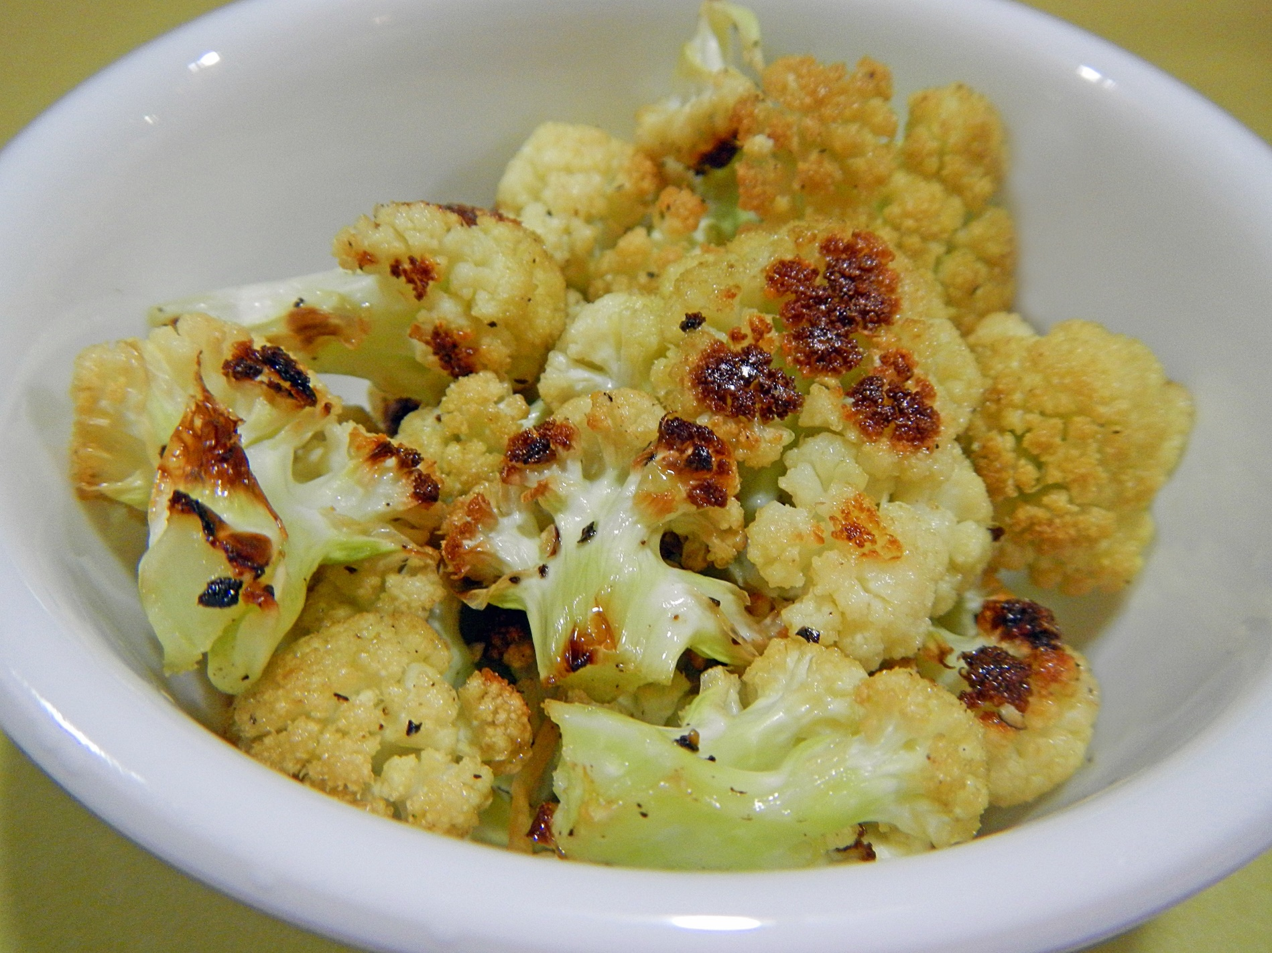
Roasted
Cauliflower
Photo credit: Alice Henneman
Notes:
As well as adding flavor to cauliflower, roasting also reduces the volume slightly. You may be surprised by how much you and family members eat when you roast cauliflower.

Slide 80
French
Toast
Photo credit: Alice Henneman
Notes:
Transform bread that is starting to dry out into tasty French toast.

Slide 81
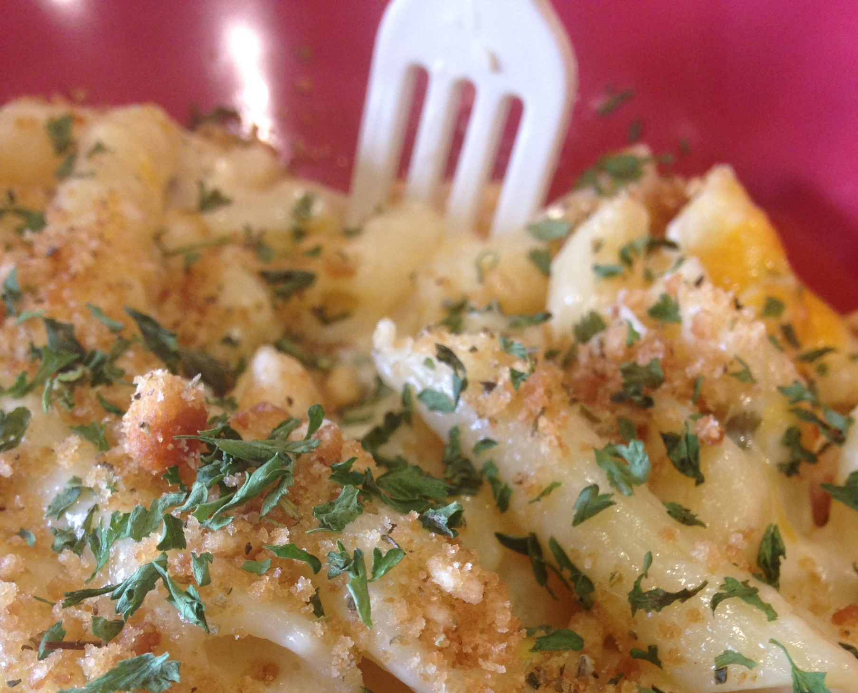
Bread
Crumb
Casserole
Topping
Photo credit: Pixabay.com
Notes:
Use this bread crumb topping on any casserole that is baked without a lid. Make it with just three ingredients: toasted bread, extra-virgin olive oil and Italian seasoning.

Slide 82
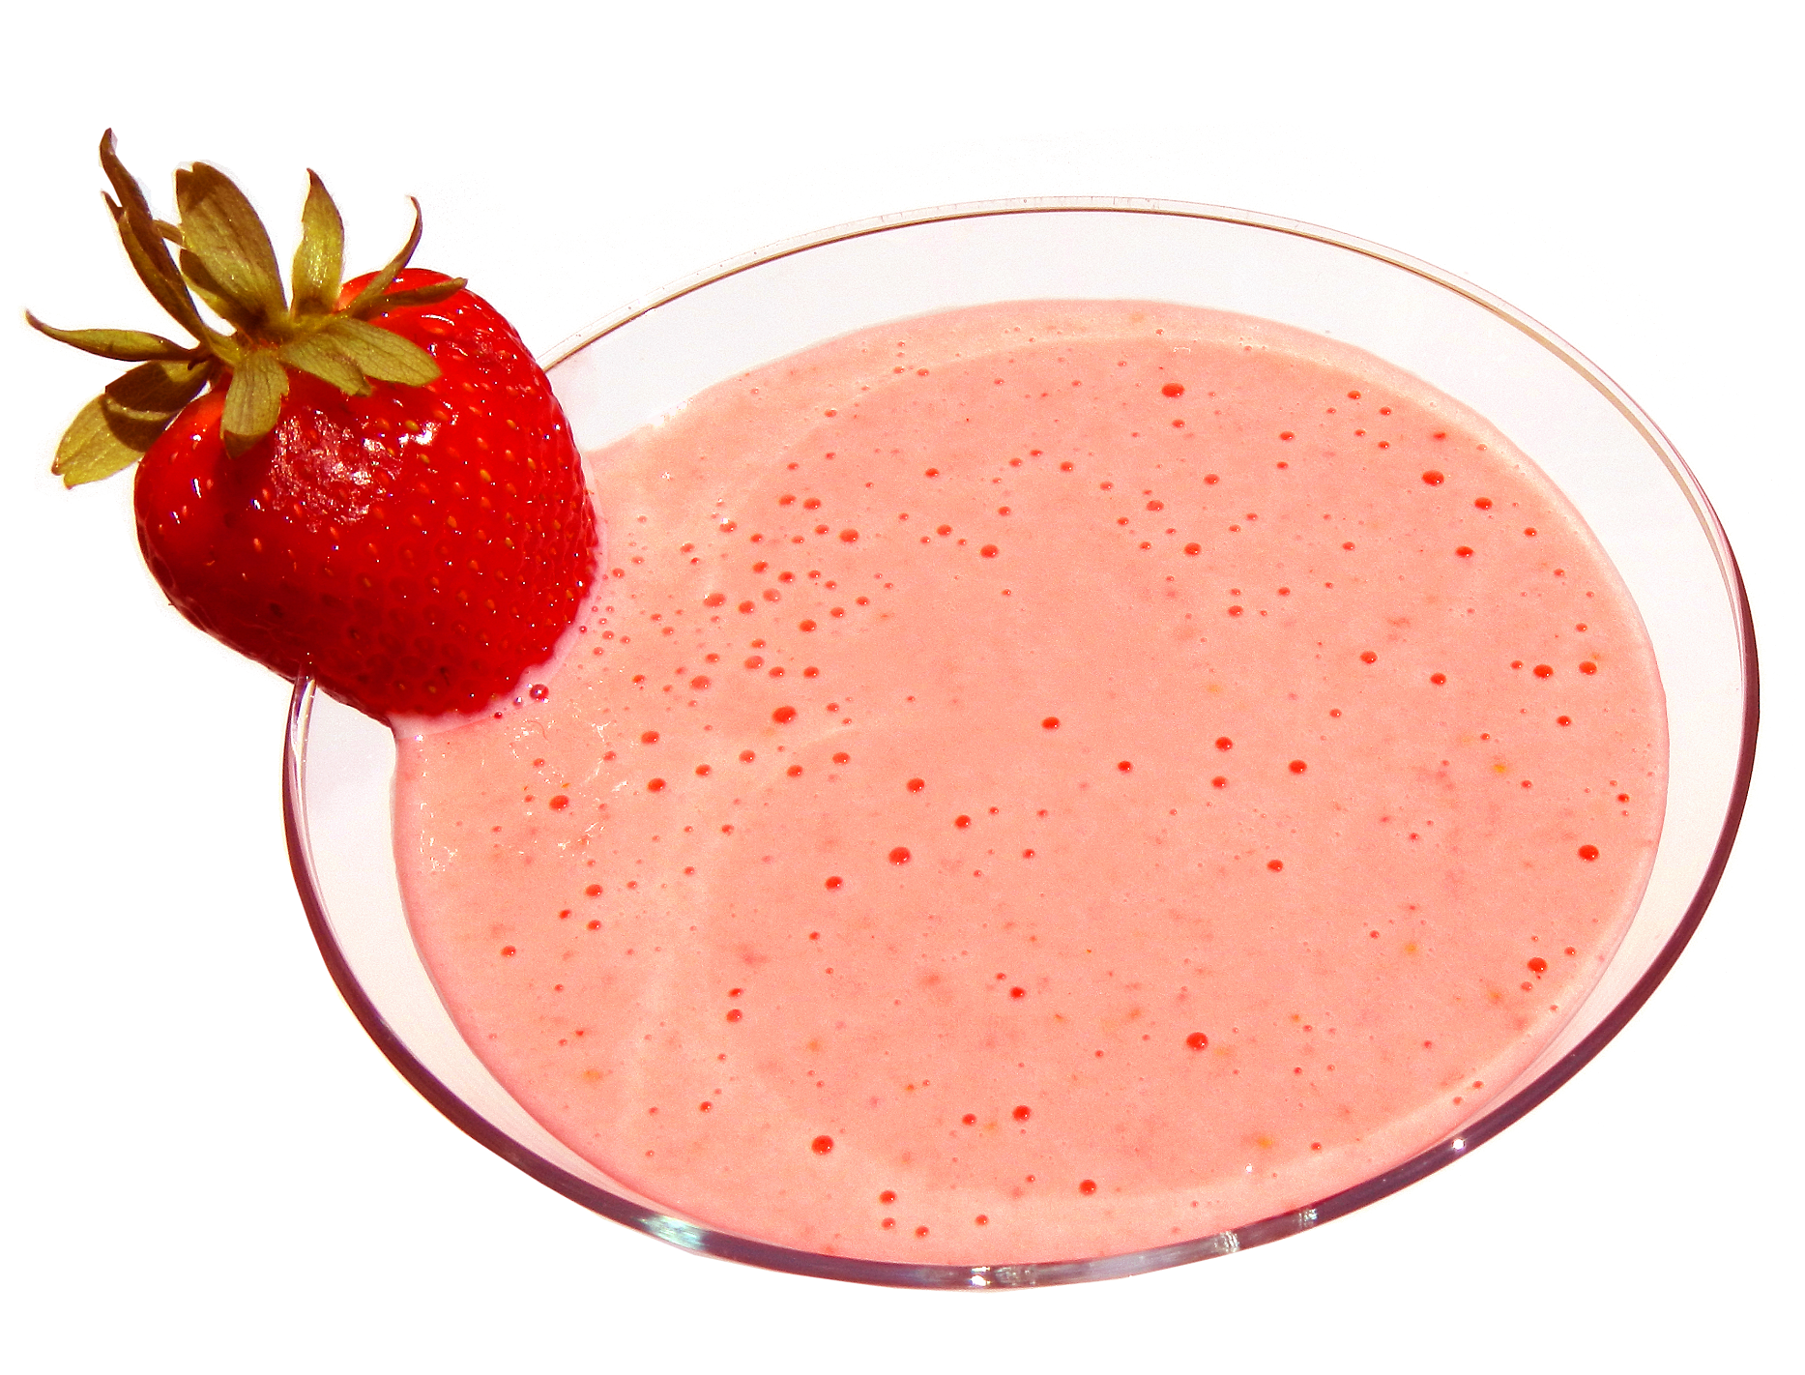
It’s the
Berries
Yogurt
Smoothie
Photo credit: Alice Henneman
Notes:
If you purchased a large carton of yogurt to save money, but it is becoming a permanent fixture in your refrigerator, try this quick smoothie recipe.

Slide 83
Smoothie
recipes also
make great
ice pops!
Photo credit: Alice Henneman
Notes:
As an alternative to smoothies, pour the smoothie recipe into molds and make ice pops!

Slide 84
Turkey Mashed Potato Soup
Turkey Salsa Soup
Photo credit: Alice Henneman
Notes:
Give new life to turkey leftovers with these turkey soup recipes. They start with the same basic ingredients of 4 cups of low sodium chicken broth and 2 cups of chopped, cooked turkey.

Slide 85
Fiesta Rice Skillet Dinner
Photo credit: MidwestDairy.com
Notes:
Cheese adds nutrition and flavor to recipes, and when combined with whole grains and vegetables, can help kids and adults eat more of these foods. Spice up your weekly dinner plans with this quick and easy, cheesy dish using turkey, rice and corn. Packing a decent dose of fiber, iron and calcium, this dinner is sure to become a family favorite all year round.

Slide 86
MORE WAYS TO PREVENT WASTED FOOD

Slide 87
More ways to PREVENT wasted food include:
Reducing the size of a recipe
Substituting a more common ingredient
Storing and preparing fruits and vegetables to prevent spoilage
Handling food safely so it doesn’t go bad
Interpreting food date codes correctly
Photo credit: Pixabay.com
Notes:
(Read slide)

Slide 88
Can you answer these 10 questions on preventing wasted food? Materials giving more information about these and other ways to prevent wasted food are in the “Kitchen Helpers” section of the related handout at: http://bit.ly/recipes4leftovers
How many will you get right?
Photo credit: Pixabay.com
Notes:
(Read slide)

Slide 89
1. How many teaspoons are there in one half of a tablespoon?
1 1/4
1 1/2
2
Photo credit: Alice Henneman
Notes:
(Read slide)

Slide 90
1. How many teaspoons are there in one half of a tablespoon?
1 1/4
1 1/2
2
Photo credit: Alice Henneman
Notes:
Many recipes can be cut in half or thirds. Check the “Reducing the Size of Recipes” page in the related handout for more information on how to make a smaller amount of recipes.

Slide 91
2. How much garlic powder will substitute for a small clove garlic?
1/2 teaspoon
1/4 teaspoon
1/8 teaspoon
Photo credit: Pixabay.com
Notes:
(Read slide)

Slide 92
2. How much garlic powder will substitute for a small clove garlic?
1/2 teaspoon
1/4 teaspoon
1/8 teaspoon
Photo credit: Pixabay.com
Notes:
Refer to “Ingredient Substitutions” in the related handout for more substitutions.

Slide 93
You (and your friends!) may be sorry if you got this substitution wrong!
Photo credit: Pixabay.com
Notes:
(Read slide)

Slide 94
3. Should you wash fruits and vegetables before refrigerating them?
Yes
No
Photo credit: Pixabay.com
Notes:
(Read slide)

Slide 95
3. Should you wash fruits and vegetables before refrigerating them?
Yes
No
Photo credit: Pixabay.com
Notes:
Wash produce before you use it, NOT when you bring it home! Wash hands before working with produce. Fresh produce has a natural protective coating that helps keep in moisture and freshness. Washing produce before storage causes it to spoil faster. Remember those berries that turned moldy after you washed and then stored them?
For more information about handling fruits and vegetables, Check “How to Store and Prepare Fresh Fruits and Vegetables to Prevent Food Waste” in the related handout for more information.

Slide 96
4. Which of these foods should be stored at room temperature?
Onion
Tomato
Pumpkin and winter squashes
All of them
Photo credit: www.pachd.com
Notes:
(read slide)

Slide 97
4. Which of these foods should be stored at room temperature?
Onion
Tomato
Pumpkin and winter squashes
All of them
Photo credit: www.pachd.com
Notes:
(read slide)

Slide 98
Store these foods at room temperature!
Onions
Tomatoes
Potatoes
(including sweet potatoes)
Bananas
Garlic
Pumpkins and Winter Squashes
Photo credit: www.pachd.com | Garlic: Pixabay.com
Notes:
Some foods that taste best stored at room temperature include: bananas, garlic, onions, potatoes, sweet potatoes, tomatoes and winter squashes. Store them in a clean, dry, well-ventilated place, away from direct sunlight and away from areas where meat is prepared.

Slide 99
Avoid leaving produce in a sealed plastic bag on your countertop
Photo credit: Alice Henneman
Notes:
Avoid leaving produce in a sealed plastic bag on your countertop. This slows ripening and may increase off-odors and decay from accumulation of carbon dioxide and depletion of oxygen inside the bag.

Slide 100
5. Which of these fruits will NOT ripen at room temperature?
Peach
Orange
Avocado
Photo credit: Pixabay.com
Notes:
(Read slide)

Slide 101
5. Which of these fruits will NOT ripen at room temperature?
Peach
Orange
Avocado
Photo credit: Pixabay.com

Slide 102
Ripen these fruits on the counter; then store them in the refrigerator!
Avocado
Peaches and
Nectarines
Kiwifruit
Photo credit: www.pachd.com
Pears
Plums
Notes:
Ripen these fruits on the counter, then store in the refrigerator.

Slide 103
Store fruits in a separate refrigerator crisper drawer from vegetables at a refrigerator temperature of 40⁰F or lower
Photo credit: Alice Henneman
Notes:
Fruits give off ethylene gas which can shorten the storage life of vegetables.
Some vegetables give off odors that can be absorbed by fruits and affect their quality.

Slide 104
If you don’t have access to commercial, food-grade, perforated bags for storing refrigerated fruits and vegetables, poke several small holes in a food-grade plastic bag
Photo credit: Alice Henneman
Notes:
Refrigerate fruits and vegetables in perforated plastic bags to help maintain moisture. This helps provide air flow and prevent growth of mold or bacteria. f you don’t have access to commercial, food-grade, perforated bags, poke several holes in a food-grade plastic bag.

Slide 105
6.How long will food keep safely in the freezer at 0ºF?
About a year
Indefinitely
Photo credit: USDA/FSIS
Notes:
(read slide)

Slide 106
6.How long will food keep safely in the freezer at 0ºF?
About a year
Indefinitely
Photo credit: USDA/FSIS
Notes:
(Read answer) Indefinitely!

Slide 107
Food stored constantly at 0⁰F will always be safe. Only the quality suffers with lengthy freezer storage.
Photo credit: “Frozen Food Caroline's Freezer 12-9-09_0011_1101209” by Steven Depolo is licensed under CC BY 2.0
Notes:
Food stored constantly at 0°F will always be safe. Only the quality suffers with lengthy freezer storage. Freezing keeps food safe by slowing the movement of molecules, causing microbes to enter a dormant stage. Freezing preserves food for extended periods because it prevents the growth of microorganisms that cause both food spoilage and foodborne illness.

Slide 108
7. How long should you store leftovers in the refrigerator?
3 - 4 days
Up to a week
2 weeks
Photo credit: “Leftovers” by Ginny is licensed under CC BY SA 2.0
Notes:
(Read slide)

Slide 109
7. How long should you store leftovers in the refrigerator?
3 - 4 days
Up to a week
2 weeks
Photo credit: “Leftovers” by Ginny is licensed under CC BY SA 2.0
Notes:
• Use cooked leftovers within 3 - 4 days. Discard any food left out at room temperature for more than 2 hours-1 hour if the temperature was above 90°F (32.2 ºC).
• Place food into shallow containers and refrigerate for rapid cooling.

Slide 110
8. Is it SAFE to eat food from rusted or dented cans?
Yes
No
Sometimes
Photo credit: Alice Henneman
Notes:
(Read slide)

Slide 111
8. Is it SAFE to eat food from rusted or dented cans?
Yes
No
Sometimes
Photo credit: Alice Henneman
Notes:
Discard heavily rusted cans. Cans that are heavily rusted can have tiny holes in them, allowing bacteria to enter. Surface rust that you can remove by rubbing with your finger or a paper towel is not serious. You can keep these canned foods. If you open the cans and there is any rust inside, do not eat the food. Rust (oxidized iron) is not safe to eat.
If a can containing food has a small dent, but is otherwise in good shape, the food should be safe to eat. Discard deeply dented cans. A deep dent is one that you can lay your finger into. Deep dents often have sharp points. A sharp dent on either the top or side seam can damage the seam and allow bacteria to enter the can. Discard any can with a deep dent on any seam.
Source: USDA/FSIS. Shelf-Stable Food Safety. Accessed 2/19/2017 at http://bit.ly/2lk1UvO

Slide 112
9. Is a food immediately UNSAFE after a “best if used by” date?
Yes
No
Photo credit: Alice Henneman
Notes:
A "Best if Used By (or Before)" date is recommended for best flavor or quality. It is not a purchase or safety date.

Slide 113
9. Is a food immediately UNSAFE after a “best if used by” date?
Yes
No
Photo credit: Alice Henneman
Notes:
A "Best if Used By (or Before)" date is recommended for best flavor or quality. It is not a purchase or safety date.

Slide 114
Over 90% (9 out of 10) of Americans may toss food too soon
Photo credit: Alice Henneman
Photo credit: Alice Henneman
Photo credit: Pixabay.com
Notes:
(Read slide)

Slide 115
New voluntary date labels
Manufacturers have until July 2018 to make the change
2 standard phrases
“BEST If Used By” describes quality where the food may not taste or perform as expected but is still safe to use
“USE by” applies to the few products that are highly perishable and/or have a food safety concern over time
Lead by Food Marketing Institute and Grocery Manufacturers Association
Information source: Grocery Manufacturers Association at http://bit.ly/2lxTVtk | Image: Created by Alice Henneman
Notes:
In a new industry-wide effort to reduce consumer confusion about product date labels, grocery manufacturers and retailers have joined together to adopt standard wording on packaging about the quality and safety of products. The new voluntary initiative streamlines the myriad date labels on consumer products packaging down to just two standard phrases.
“BEST If Used By” describes product quality, where the product may not taste or perform as expected but is safe to use or consume. “USE By” applies to the few products that are highly perishable and/or have a food safety concern over time; these products should be consumed by the date listed on the package – and disposed of after that date.
The new initiative for common phrasing is led by the Food Marketing Institute (FMI) and the Grocery Manufacturers Association (GMA), the two major trade associations for retailers and consumer products manufacturing.
Manufacturers have until July 2018 to make the change. As these standards are voluntary, there is no guarantee that every company will adopt them. In some states, there may be labeling regulations that preempt the industry standards.
(Source: News Release, Grocery Manufacturers of America, 2/15/2017. Grocery Industry launches New Initiative to Reduce Consumer Confusion on Product Date Labels. Accessed 2/23/2017 at http://bit.ly/2moQea)
.

Slide 116
Some labels currently found on food products
Notes:
Currently, there are more than 10 different date labels on packages such as Sell By, Use By, Expires On, Best Before, Better if Used By or Best By.
This can result in confused consumers discarding a safe or usable product after the date on the package
These are some of the most common examples (read definitions on the slide)
Date labeling is voluntary except federal regulations require a "Use By" date on the product label of infant formula. Consumption by this date ensures the formula contains not less than the quantity of each nutrient as described on the label. Formula must maintain an acceptable quality to pass through an ordinary bottle nipple.
Except for infant formula, the usage date is selected by the manufacturer, packer or distributor of the product on the basis of product analysis throughout its shelf life, tests, or other information. It is also based on the conditions of handling, storage, preparation, and use printed on the label.

Slide 117
10. Which is these statements is FALSE about freezing milk?
Frozen milk is used most successfully in cooking
Frozen milk may become separated and the texture somewhat grainy when thawed
Freezing milk makes it unsafe to drink
Photo credit: Microsoft PowerPoint images
Notes:
(Read slide)

Slide 118
10. Which is these statements is FALSE about freezing milk?
Frozen milk is used most successfully in cooking
Frozen milk may become separated and the texture somewhat grainy when thawed
Freezing milk makes it unsafe to drink
Photo credit: Microsoft PowerPoint images
Notes:
While milk can be frozen; it may separate, or be slightly grainy when thawed. Frozen milk works best for cooking, but you may find it's still okay for drinking. If you are thinking about freezing milk for drinking, you might try freezing a small amount first to see how you like it before freezing a larger batch.
Freeze milk in plastic freezer containers or special freezer-proof glass jars. Leave some extra space at the top since milk expands during freezing. If packaged in a wide-mouth container, leave 1/2-inch head space for pints and 1-inch for quarts. If packaged in a narrow-mouth container (such as jars), leave 1 1/2-inch head space for either pints or quarts.
Frozen milk will maintain best quality in the freezer for about 3 months; but will remain safe after that if stored at 0 degrees F. Thaw milk in the refrigerator. Stir well before using. Plan to drink within two or three days.
For more information about freezing milk and freezing cheese, see “How to Freeze Milk and Cheese” in the related handout.

Slide 119
Concluding with one of the most frequently repeated quotes about leftovers …
Notes:
I’ll end what is probably the most frequently repeated quote about leftovers …

Slide 120
“The most remarkable thing about my mother is that for thirty years she served the family nothing but leftovers. The original meal has never been found.” ― Calvin Trillin
Photo credit: Pixabay.com
Notes:
(Read slide)

Slide 121
Photo credit: Pixabay.com
Notes:
Thank you!

Slide 122
Questions?
Notes:
Questions?

Slide 123
Extension is a Division of the Institute of Agriculture and Natural Resources at the University of Nebraska–Lincoln cooperating with the Counties and the United States Department of Agriculture. University of Nebraska–Lincoln Extension educational programs abide with the nondiscrimination policies of the University of Nebraska–Lincoln and the United States Department of Agriculture.
Reference to commercial products or trade names is made with the understanding that no discrimination is intended of those not mentioned and no endorsement by University of Nebraska—Lincoln Extension is implied for those mentioned.

